Slide 1

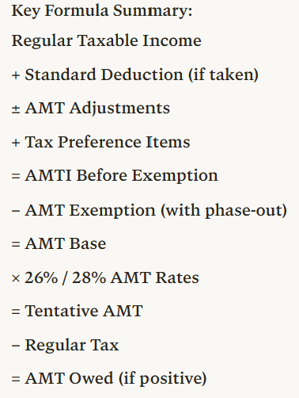
Step | Description | Operation | Notes
1 | Regular taxable income (TI) | Starting point | From Form 1040
2 | Plus: Standard deduction if taken | + | Add back if claimed
3 | Plus/minus: AMT adjustment items | ± adjustments | SALT, depreciation, ISO, etc.
4 | Plus: Tax preference items | + | Private activity bonds, etc.
5 | = AMTI before exemption | Subtotal | Alternative Minimum Taxable Income
6 | Minus: AMT exemption amount | − | Subject to phase-out
 | - MFJ: $140,200 (2026) |  | Phase-out starts at $1,000,000
 | - Single/HOH: $90,100 (2026) |  | Phase-out starts at $500,000
 | - Phase-out rate: 50% |  | Lose $0.50 per $1 over threshold
7 | = AMT base (AMTI after exemption) | Subtotal | Amount subject to AMT rates
8 | Multiplied by AMT tax rates | × 26% or 28% | Two-bracket system
 | - 26% on first $244,500 (MFJ) / $122,250 (MFS)
 | - 28% on amounts above these thresholds
9 | = Tentative AMT before credits | Subtotal | Preliminary AMT liability
10 | Minus: Allowable credits | − | Foreign tax credit, etc.
11 | = Tentative AMT | Subtotal | Final AMT calculation
12 | Less: Regular tax liability | − | From regular tax calculation
13 | = AMT owed (pay if positive) | FINAL | Additional tax beyond regular tax
📹 Videos AICPA MCQs & Sims 🤖 Farhat AI Assistant🎙 Podcast Lessons 📊 CPA, CMA, EA Exam 💼Accounting & Finance Courses 🙌 Support by Farhat Team
🌐 farhatlectures.com | ⭐ Start Your Free Trial

Slide 2
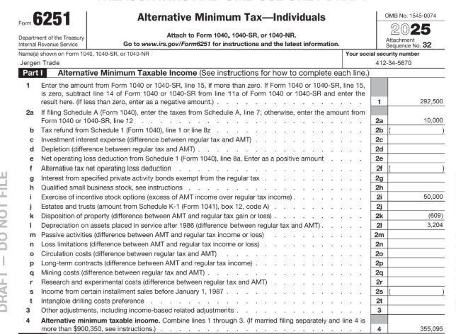
210,225
40,000
50,000
(646)
4,448
25,000
329,027
📹 Videos AICPA MCQs & Sims 🤖 Farhat AI Assistant🎙 Podcast Lessons 📊 CPA, CMA, EA Exam 💼Accounting & Finance Courses 🙌 Support by Farhat Team
🌐 farhatlectures.com | ⭐ Start Your Free Trial

Slide 3
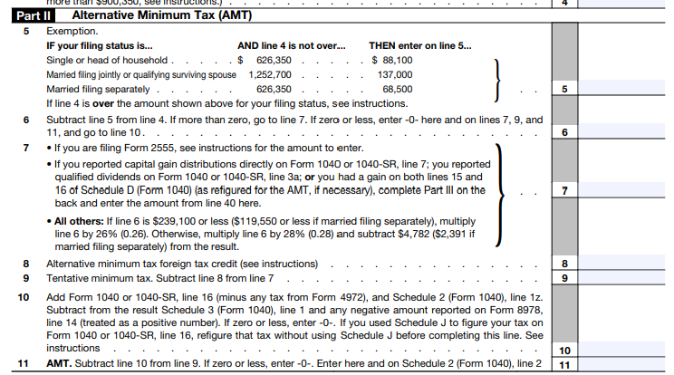
📹 Videos AICPA MCQs & Sims 🤖 Farhat AI Assistant🎙 Podcast Lessons 📊 CPA, CMA, EA Exam 💼Accounting & Finance Courses 🙌 Support by Farhat Team
🌐 farhatlectures.com | ⭐ Start Your Free Trial

Slide 4
For 2026: The individual AMT exemption
AMT Exemption
Exemption amount subject to change:
❑Single/HOH: $90,100 --- Phaseout starts at $500,000
❑MFJ: $140,200 --- Phaseout starts at $1,000,000
❑MFS: $70,100 --- Phaseout starts at $500,000
Phase-out – exemption is reduced by 50% of AMTI in excess of income limits
Homer and Marge have AMTI of $1,100,000 MFJ.
The initial exemption is $140,200
The exemption is reduced to $90,200
($140,200 – 0.50[$1,100,000 – $1,000,000])
📹 Videos AICPA MCQs & Sims 🤖 Farhat AI Assistant🎙 Podcast Lessons 📊 CPA, CMA, EA Exam 💼Accounting & Finance Courses 🙌 Support by Farhat Team
🌐 farhatlectures.com | ⭐ Start Your Free Trial

Slide 5
AMT Exemptions
AMT base = 1,100,000 − 90,200 = 1,009,800
Apply 26% / 28% AMT rates (MFJ 2026)
26% applies to first 244,500 of AMT base.
  244,500 × 26% = 63,570
28% applies to the rest: 1,009,800 − 244,500 = 765,300
  765,300 × 28% = 214,986
3. Tentative minimum tax and AMT owed
Tentative minimum tax = 63,570 + 214,986 = 278,556
Assuming “no credit” the AMT tax is:
AMT tax before tax credits allowed for AMT = 278,556
📹 Videos AICPA MCQs & Sims 🤖 Farhat AI Assistant🎙 Podcast Lessons 📊 CPA, CMA, EA Exam 💼Accounting & Finance Courses 🙌 Support by Farhat Team
🌐 farhatlectures.com | ⭐ Start Your Free Trial

Slide 6
Tax Credit Allowed for AMT
Common personal credits still usable while in AMT (subject to overall TMT limit):
  Child Tax Credit / Additional Child Tax Credit
  Education credits (American Opportunity, Lifetime Learning)
  Adoption credit
  Saver’s credit
  Residential/energy‑efficient home credits
  Foreign tax credit and other general business credits passed through from K‑1s
📹 Videos AICPA MCQs & Sims 🤖 Farhat AI Assistant🎙 Podcast Lessons 📊 CPA, CMA, EA Exam 💼Accounting & Finance Courses 🙌 Support by Farhat Team
🌐 farhatlectures.com | ⭐ Start Your Free Trial

Slide 7

MCQ from farhatlecturs.com
After the AMT exemption is applied, the remaining amount is called:
A. Alternative Minimum Taxable Income
B. AMT Base
C. Tentative Minimum Tax
D. Regular Tax Liability
A. Incorrect. AMTI is calculated before subtracting the exemption.
B. Correct. After subtracting the AMT exemption from AMTI, the result is called the AMT base.
C. Incorrect. Tentative minimum tax is computed after applying the AMT rates.
D. Incorrect. Regular tax liability is calculated separately under the normal tax system.
📹 Videos AICPA MCQs & Sims 🤖 Farhat AI Assistant🎙 Podcast Lessons 📊 CPA, CMA, EA Exam 💼Accounting & Finance Courses 🙌 Support by Farhat Team
🌐 farhatlectures.com | ⭐ Start Your Free Trial

