Slide 1


What Is a Restricted
Stock Award?
A Restricted Stock Award (RSA) is a form of equity compensation in which an employer grants actual shares of company stock to an employee, subject to vesting conditions.
Although the employee receives the shares on the grant date, the stock is subject to restrictions—typically a required service period or performance condition.
The employee cannot sell or transfer the shares until those restrictions lapse.
📹 Videos AICPA MCQs & Sims 🤖 Farhat AI Assistant🎙 Podcast Lessons 📊 CPA, CMA, EA Exam 💼Accounting & Finance Courses 🙌 Support by Farhat Team
🌐 farhatlectures.com | ⭐ Start Your Free Trial

Slide 2

Key Characteristics of
Restricted Stock Awards
Employee receives actual shares, not options.
Shares are subject to a substantial risk of forfeiture until vesting.
Income is recognized at vesting, not at grant.
Basis equals the fair market value (FMV) on the vesting date.
Capital gain or loss arises upon later sale of the shares.
RSUs
  Simpler structure.
  No election allowed.
  No ownership until vesting.
Stock Options (NSOs/ISOs)
  Provide the right to purchase stock.
  Value depends on stock price exceeding exercise price.
  More complex tax consequences, especially for ISOs.
📹 Videos AICPA MCQs & Sims 🤖 Farhat AI Assistant🎙 Podcast Lessons 📊 CPA, CMA, EA Exam 💼Accounting & Finance Courses 🙌 Support by Farhat Team
🌐 farhatlectures.com | ⭐ Start Your Free Trial

Slide 3
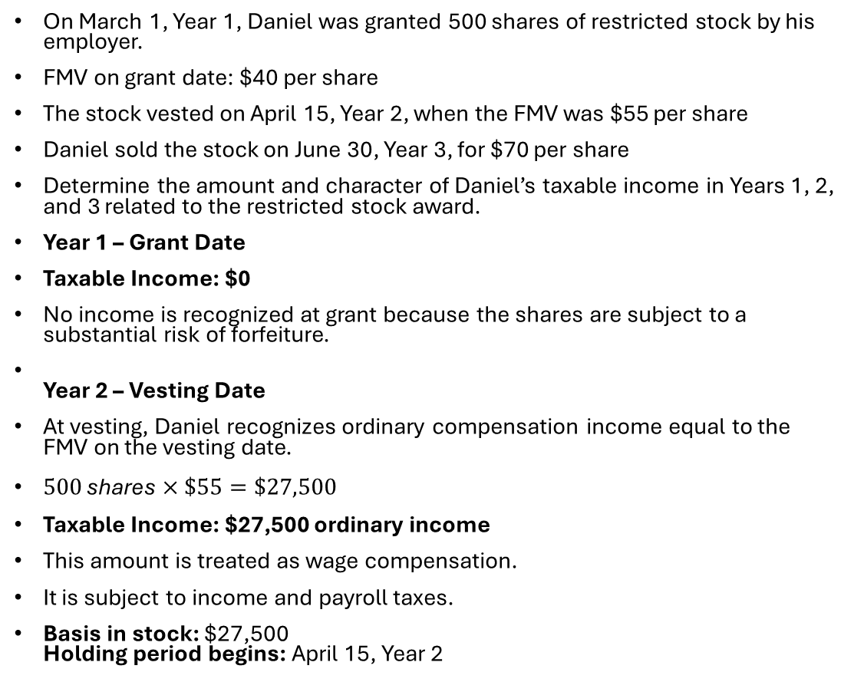
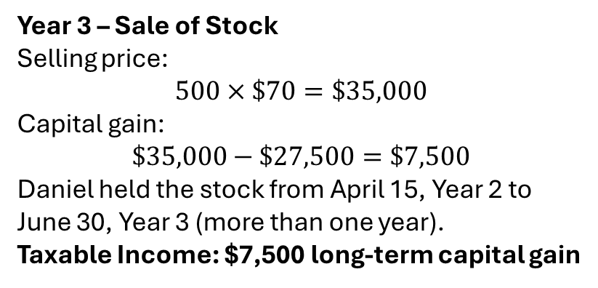
Example Restricted Stock Award
On March 1, Year 1, Daniel was granted 500 shares of restricted stock by his employer.
FMV on grant date: $40 per share
The stock vested on April 15, Year 2, when the FMV was $55 per share
Daniel sold the stock on June 30, Year 3, for $70 per share
Determine the amount and character of Daniel’s taxable income in Years 1, 2, and 3 related to the restricted stock award.
Year 1 – Grant Date
Taxable Income: $0
No income is recognized at grant because the shares are subject to a substantial risk of forfeiture.
Year 2 – Vesting Date
At vesting, Daniel recognizes ordinary compensation income equal to the FMV on the vesting date.
$500 \text{shares}×\$55=\$27,500$
Taxable Income: $27,500 ordinary income
This amount is treated as wage compensation.
It is subject to income and payroll taxes.
Basis in stock: $27,500
Holding period begins: April 15, Year 2
Year 3 – Sale of Stock
Selling price:
$$500×\$70=\$35,000$$
Capital gain:
$$\$35,000−\$27,500=\$7,500$$
Daniel held the stock from April 15, Year 2 to June 30, Year 3 (more than one year).
Taxable Income: $7,500 long-term capital gain
📹 Videos AICPA MCQs & Sims 🤖 Farhat AI Assistant🎙 Podcast Lessons 📊 CPA, CMA, EA Exam 💼Accounting & Finance Courses 🙌 Support by Farhat Team
🌐 farhatlectures.com | ⭐ Start Your Free Trial

Slide 4
Summary (Simulation)
Year | Event | Income Recognized | Character
Year 1 | Grant | $0 | —
Year 2 | Vesting | $27,500 | Ordinary income
Year 3 | Sale | $7,500 | Long-term capital gain
📹 Videos AICPA MCQs & Sims 🤖 Farhat AI Assistant🎙 Podcast Lessons 📊 CPA, CMA, EA Exam 💼Accounting & Finance Courses 🙌 Support by Farhat Team
🌐 farhatlectures.com | ⭐ Start Your Free Trial

Slide 5

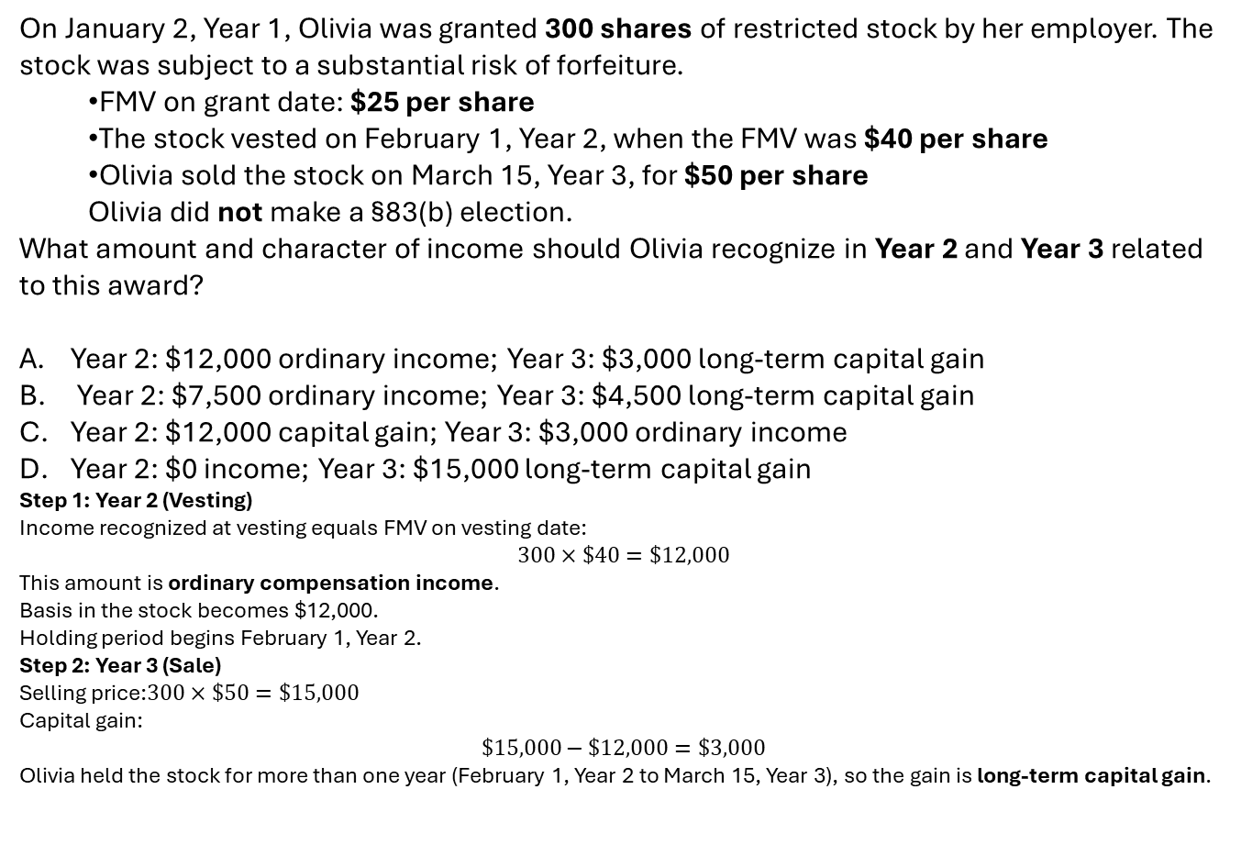
MCQ from Farhatlectures.com
On January 2, Year 1, Olivia was granted 300 shares of restricted stock by her employer. The stock was subject to a substantial risk of forfeiture.
  FMV on grant date: $25 per share
  The stock vested on February 1, Year 2, when the FMV was $40 per share
  Olivia sold the stock on March 15, Year 3, for $50 per share
  Olivia did not make a §83(b) election.
What amount and character of income should Olivia recognize in Year 2 and Year 3 related to this award?
Year 2: $12,000 ordinary income; Year 3: $3,000 long-term capital gain
Year 2: $7,500 ordinary income; Year 3: $4,500 long-term capital gain
Year 2: $12,000 capital gain; Year 3: $3,000 ordinary income
Year 2: $0 income; Year 3: $15,000 long-term capital gain
Step 1: Year 2 (Vesting)
Income recognized at vesting equals FMV on vesting date:
$$300×\$40=\$12,000$$
This amount is ordinary compensation income.
Basis in the stock becomes $12,000.
Holding period begins February 1, Year 2.
Step 2: Year 3 (Sale)
Selling price:$300×\$50=\$15,000$
Capital gain:
$$\$15,000−\$12,000=\$3,000$$
Olivia held the stock for more than one year (February 1, Year 2 to March 15, Year 3), so the gain is long-term capital gain.
📹 Videos AICPA MCQs & Sims 🤖 Farhat AI Assistant🎙 Podcast Lessons 📊 CPA, CMA, EA Exam 💼Accounting & Finance Courses 🙌 Support by Farhat Team
🌐 farhatlectures.com | ⭐ Start Your Free Trial

