Slide 1


Quality Control Framework for Issuer Engagements
In contrast to AICPA standards (private; non-issuers)
Purpose of PCAOB Quality Control Standards
Quality control (QC) standards issued for audits of public companies establish a structured system that audit firms must follow to ensure consistent audit quality.
These standards require firms to:
  Design and maintain a system of quality control
Ensure compliance with:
  Professional auditing standards
  The firm’s internal policies and procedures
Apply quality procedures consistently across:
  Multiple offices
  Different engagement teams
Why This Matters
Audit firms often operate in multiple locations with many partners and staff. Without a formal quality control system:
  Audit approaches may vary
  Errors may go undetected
  Investor confidence may decline
A strong QC framework ensures that every audit engagement meets the same high standard, regardless of who performs the work.
📹 Videos AICPA MCQs & Sims 🤖 Farhat AI Assistant🎙 Podcast Lessons 📊 CPA, CMA, EA Exam 💼Accounting & Finance Courses 🙌 Support by Farhat Team
🌐 farhatlectures.com | ⭐ Start Your Free Trial

Slide 2
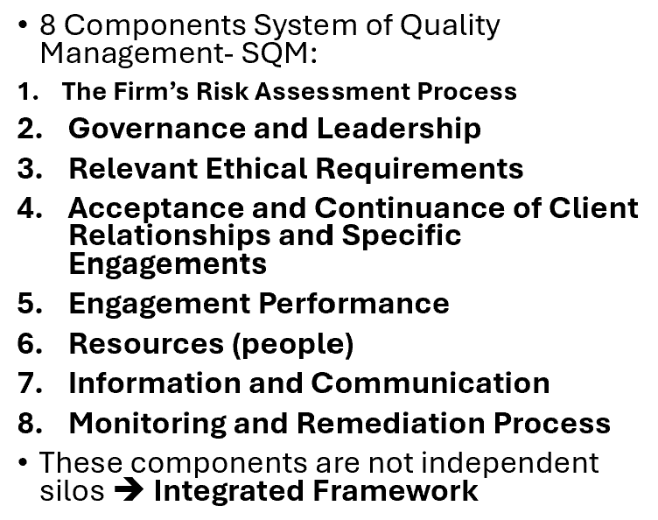
Five Elements of a Firm’s
Quality Control System
Independence, Integrity, and Objectivity
Personnel Management
Acceptance and Continuance of Clients and Engagements
Engagement Performance
Monitoring
📹 Videos AICPA MCQs & Sims 🤖 Farhat AI Assistant🎙 Podcast Lessons 📊 CPA, CMA, EA Exam 💼Accounting & Finance Courses 🙌 Support by Farhat Team
🌐 farhatlectures.com | ⭐ Start Your Free Trial

Slide 3

Independence, Integrity, and Objectivity (1 of 5)
1. Independence
Independence means the auditor must be free from financial or personal relationships that could impair impartial judgment.
There are two dimensions:
  Independence in fact – The auditor is truly unbiased.
  Independence in appearance – A reasonable third party would perceive the auditor as unbiased.
2. Integrity (hold your ground!)
  Integrity requires straightforwardness and honesty in professional work.
  An auditor must not knowingly misrepresent facts or subordinate professional judgment to others.
3. Objectivity
  Objectivity requires neutrality.
  Decisions must be based on evidence, not on pressure from clients or personal benefit.
These requirements apply to everyone involved in the engagement, including partners, managers, and staff.
📹 Videos AICPA MCQs & Sims 🤖 Farhat AI Assistant🎙 Podcast Lessons 📊 CPA, CMA, EA Exam 💼Accounting & Finance Courses 🙌 Support by Farhat Team
🌐 farhatlectures.com | ⭐ Start Your Free Trial

Slide 4

Example
Assume an audit manager assigned to audit XYZ Corporation owns stock in XYZ.
Because of this financial interest, the manager’s independence is impaired.
Even if the manager believes they can remain fair, independence in appearance is compromised.
Under firm policy, the manager must either dispose of the stock or be removed from the engagement.
If the firm fails to enforce such policies, the credibility of the audit opinion could be questioned.
📹 Videos AICPA MCQs & Sims 🤖 Farhat AI Assistant🎙 Podcast Lessons 📊 CPA, CMA, EA Exam 💼Accounting & Finance Courses 🙌 Support by Farhat Team
🌐 farhatlectures.com | ⭐ Start Your Free Trial

Slide 5

Personnel Management (2 oF 5)
Purpose of Personnel Management in Quality Control
Personnel management ensures that:
  Firm personnel have the competence and proficiency required.
  Supervision levels are appropriate for each engagement.
  Individuals are assigned responsibilities that match their experience.
This element of quality control focuses on placing the right people in the right roles.
Core Requirements
  The firm must ensure that:
  Employees hired possess appropriate education, skills, and ethical traits.
  Engagements are staffed with individuals who have the necessary technical knowledge.
  Ongoing professional education is maintained.
  Promotions and advancement are based on demonstrated competence.
📹 Videos AICPA MCQs & Sims 🤖 Farhat AI Assistant🎙 Podcast Lessons 📊 CPA, CMA, EA Exam 💼Accounting & Finance Courses 🙌 Support by Farhat Team
🌐 farhatlectures.com | ⭐ Start Your Free Trial

Slide 6
Example
Assume a firm accepts a complex audit engagement involving cryptocurrency transactions.
  Hot wallet versus cold wallet
If the firm assigns staff with no knowledge of digital assets:
  Errors may go undetected.
  Risk assessment may be inadequate.
  Audit quality declines.
Proper personnel management would require assigning team members trained in digital asset accounting and supervision by someone experienced in this area.
📹 Videos AICPA MCQs & Sims 🤖 Farhat AI Assistant🎙 Podcast Lessons 📊 CPA, CMA, EA Exam 💼Accounting & Finance Courses 🙌 Support by Farhat Team
🌐 farhatlectures.com | ⭐ Start Your Free Trial

Slide 7

Competence and Professional
Development
Hiring and Training Expectations
Quality control policies must ensure that:
  Personnel meet general and industry-specific professional education requirements.
  Technical training is sufficient for assigned responsibilities.
  Advancement occurs only when qualifications are demonstrated.
This includes both:
  Initial qualifications (degree, CPA eligibility, ethics training)
  Continuing professional education (CPE)
Advancement and Responsibility
  Personnel selected for promotion must:
  Possess appropriate technical expertise.
  Demonstrate sound professional judgment.
  Be capable of supervising others effectively.
For example:
A senior associate should not be promoted to manager unless they can independently evaluate internal controls and supervise engagement staff.
📹 Videos AICPA MCQs & Sims 🤖 Farhat AI Assistant🎙 Podcast Lessons 📊 CPA, CMA, EA Exam 💼Accounting & Finance Courses 🙌 Support by Farhat Team
🌐 farhatlectures.com | ⭐ Start Your Free Trial

Slide 8

Ensuring Engagement-Level
Competence
Reasonable Assurance Through Policies
The firm must establish policies that provide reasonable assurance that engagement teams:
  Understand the firm’s system of quality control.
  Follow ethical requirements under the professional code of conduct.
  Understand applicable accounting, auditing, and attestation standards.
  Understand the client’s industry.
  Apply sound professional judgment.
Example
Assume an audit firm accepts a healthcare client.
If engagement personnel:
  Do not understand healthcare reimbursement rules
  Are unfamiliar with revenue recognition complexities in the industry gross versus net)
    Then risk increases significantly.
Proper personnel management would ensure that at least one team member has industry expertise and that others receive appropriate training.
📹 Videos AICPA MCQs & Sims 🤖 Farhat AI Assistant🎙 Podcast Lessons 📊 CPA, CMA, EA Exam 💼Accounting & Finance Courses 🙌 Support by Farhat Team
🌐 farhatlectures.com | ⭐ Start Your Free Trial

Slide 9

Acceptance and Continuance of Clients and Engagements (3 of 5)
Purpose Within the Quality Control System (gate keeping!)
Before accepting a new client — or continuing with an existing one — an audit firm must evaluate whether the relationship is appropriate.
Policies and procedures must provide reasonable assurance that the firm:
  Accepts only engagements it can perform competently.
  Evaluates the integrity of management.
  Considers whether ethical requirements can be maintained.
  Assesses risks associated with providing the service.
  This process protects the firm from associating with high-risk or unethical clients.
Key Objectives
The objective is to minimize the risk of:
  Associating with clients lacking integrity.
  Accepting engagements beyond the firm’s technical expertise.
  Facing legal or reputational damage due to poor client selection.
Firms must evaluate both:
  Client risk (association with client)
  Engagement risk (risk associated with performing a specific engagement for a client.
📹 Videos AICPA MCQs & Sims 🤖 Farhat AI Assistant🎙 Podcast Lessons 📊 CPA, CMA, EA Exam 💼Accounting & Finance Courses 🙌 Support by Farhat Team
🌐 farhatlectures.com | ⭐ Start Your Free Trial

Slide 10
Evaluating Risk and Establishing Clear Understanding
Risk Considerations Before Acceptance
The firm must consider:
  Whether it has personnel with sufficient technical expertise.
  Whether independence can be maintained.
  Whether management demonstrates honesty and cooperation.
  Whether engagement risks are manageable.
Firms should also reassess these factors annually for continuing clients.
Establishing an Understanding with the Client
Once a client is accepted, the firm must clearly define:
  Nature of the services (audit, review, attestation).
  Scope of work to be performed.
  Limitations of the engagement.
  Responsibilities of management and the auditor.
This understanding is typically documented in an engagement letter.
📹 Videos AICPA MCQs & Sims 🤖 Farhat AI Assistant🎙 Podcast Lessons 📊 CPA, CMA, EA Exam 💼Accounting & Finance Courses 🙌 Support by Farhat Team
🌐 farhatlectures.com | ⭐ Start Your Free Trial

Slide 11
Example
Assume a firm is approached by a startup company with rapid growth and weak internal controls.
During preliminary discussions, the firm discovers:
  Management refuses to provide full financial records.
  There are ongoing regulatory investigations.
Even if the engagement is financially attractive, the firm should decline the client because integrity concerns and elevated risk threaten audit quality.
📹 Videos AICPA MCQs & Sims 🤖 Farhat AI Assistant🎙 Podcast Lessons 📊 CPA, CMA, EA Exam 💼Accounting & Finance Courses 🙌 Support by Farhat Team
🌐 farhatlectures.com | ⭐ Start Your Free Trial

Slide 12
Example
Suppose a firm continues auditing a manufacturing company year after year.
If, during the current year:
The company enters a new high-risk foreign market,
Management changes significantly,
Fraud allegations arise,
The firm must reassess whether continuation is appropriate.
📹 Videos AICPA MCQs & Sims 🤖 Farhat AI Assistant🎙 Podcast Lessons 📊 CPA, CMA, EA Exam 💼Accounting & Finance Courses 🙌 Support by Farhat Team
🌐 farhatlectures.com | ⭐ Start Your Free Trial

Slide 13
Five Elements of a Firm’s
Quality Control System
Independence, Integrity, and Objectivity
Personnel Management
Acceptance and Continuance of Clients and Engagements
Engagement Performance
Monitoring
📹 Videos AICPA MCQs & Sims 🤖 Farhat AI Assistant🎙 Podcast Lessons 📊 CPA, CMA, EA Exam 💼Accounting & Finance Courses 🙌 Support by Farhat Team
🌐 farhatlectures.com | ⭐ Start Your Free Trial

Slide 14

MCQ from farhatlectures.com
An audit firm is engaged to audit Delta Manufacturing, a public company. During the engagement, a senior associate assigned to the audit discloses that her spouse recently purchased a small amount of Delta’s publicly traded stock. The senior associate does not participate in financial reporting decisions and believes the investment will not affect her judgment.
What is the most appropriate action under the firm’s quality control policies?
(a) Allow the senior associate to remain on the engagement because she is not in a decision-making role.
(b) Require the spouse to sell the stock within 90 days while the senior continues working.
(c) Remove the senior associate from the engagement or eliminate the financial interest immediately.
(d) Disclose the financial interest in the audit report and proceed with the engagement.
Choice (c) is correct because financial interests held by immediate family members impair independence in fact and in appearance. The firm must either eliminate the financial interest immediately or remove the individual from the engagement to maintain compliance with independence requirements.
Choice (a) is incorrect because independence applies to all covered members of the engagement team, regardless of decision-making authority.
Choice (b) is incorrect because delayed corrective action does not cure an existing impairment during the period of the financial interest.
Choice (d) is incorrect because disclosure does not eliminate an independence impairment in an audit engagement.
📹 Videos AICPA MCQs & Sims 🤖 Farhat AI Assistant🎙 Podcast Lessons 📊 CPA, CMA, EA Exam 💼Accounting & Finance Courses 🙌 Support by Farhat Team
🌐 farhatlectures.com | ⭐ Start Your Free Trial

