Slide 1

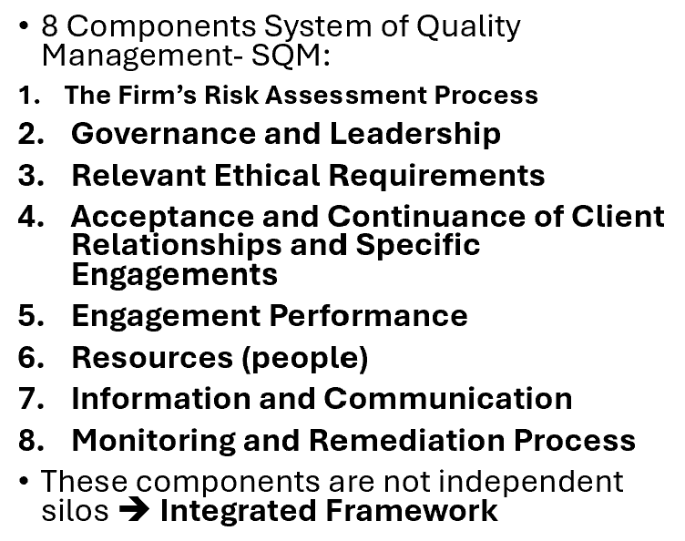
Findings and Deficiencies
The Feedback Engine of the System of Quality Management
Where This Topic Fits Within SQM?
A system of quality management is designed to:
  Establish quality objectives
  Identify and assess quality risks
  Implement responses to those risks
  Monitor (8) whether the system is working
    Monitoring activities generate findings and deficiencies.
      Findings and deficiencies represent the feedback loop that keeps the system effective.
      0 finding/error ➔ broken monitoring system
      Monitoring is to make the system better
An audit firm sets a quality objective:
All engagement files must contain sufficient documentation of revenue testing.
During monitoring, reviewers notice that several files are missing documentation of cutoff testing.
  The missing documentation = finding
  If it reflects a breakdown in policy or supervision = deficiency
📹 Videos AICPA MCQs & Sims 🤖 Farhat AI Assistant🎙 Podcast Lessons 📊 CPA, CMA, EA Exam 💼Accounting & Finance Courses 🙌 Support by Farhat Team
🌐 farhatlectures.com | ⭐ Start Your Free Trial

Slide 2

Findings vs. Deficiencies
Understanding the Difference
A finding is an observation identified (check engine light) through:
  Monitoring activities
  Engagement inspections
  External inspections
  Other relevant quality sources
Not every finding automatically represents a deficiency.
Determining Whether a Deficiency Exists
Professional judgment is required to evaluate whether a finding indicates that:
  A quality objective has not been achieved, or
  A response to a quality risk is ineffective.
Safety net did not catch the error.
📹 Videos AICPA MCQs & Sims 🤖 Farhat AI Assistant🎙 Podcast Lessons 📊 CPA, CMA, EA Exam 💼Accounting & Finance Courses 🙌 Support by Farhat Team
🌐 farhatlectures.com | ⭐ Start Your Free Trial

Slide 3

Example
A firm has a policy requiring engagement partners to review significant estimates.
Monitoring discovers that in three engagements, the partner review was rushed and undocumented.
  The observation = finding
  The pattern suggests review procedures are not functioning properly = possible deficiency
If ignored, this could lead to audit failure in complex areas like goodwill impairment.
📹 Videos AICPA MCQs & Sims 🤖 Farhat AI Assistant🎙 Podcast Lessons 📊 CPA, CMA, EA Exam 💼Accounting & Finance Courses 🙌 Support by Farhat Team
🌐 farhatlectures.com | ⭐ Start Your Free Trial

Slide 4

Connection to Continuous
Improvement
Findings and deficiencies:
  Drive root cause analysis
    Remediation must address the underlying problem, not just the symptom.
  How serious the deficiency is
  Whether it is isolated or widespread
  Its effect on the overall system of quality management
Deficiencies must be assessed both (Severity and Pervasiveness ):
  Individually, and
  In combination with other identified deficiencies.
Should lead to remediation
  Influence updates to quality objectives and risk responses
  Strengthen the system over time
  This is how SQM becomes dynamic and responsive rather than checklist-driven.
📹 Videos AICPA MCQs & Sims 🤖 Farhat AI Assistant🎙 Podcast Lessons 📊 CPA, CMA, EA Exam 💼Accounting & Finance Courses 🙌 Support by Farhat Team
🌐 farhatlectures.com | ⭐ Start Your Free Trial

Slide 5

Evaluating (assessing) the Significance of Findings (how bad?)
When evaluating findings, firms should consider:
  Frequency of occurrence
  Number of affected engagements
  Magnitude of the issue
  Nature and seriousness of the matter
  Impact on professional standards compliance
Relative Importance
Findings must be evaluated in relation to:
  Quality objectives
  Identified quality risks
  Established responses
One engagement out of 50 missed a required checklist → Likely minor.
Eight engagements failed to test internal controls properly → Potential systemic deficiency.
A recurring issue across multiple audits suggests a breakdown in the quality management system.
CPA exam focus: Look for patterns and systemic indicators.
📹 Videos AICPA MCQs & Sims 🤖 Farhat AI Assistant🎙 Podcast Lessons 📊 CPA, CMA, EA Exam 💼Accounting & Finance Courses 🙌 Support by Farhat Team
🌐 farhatlectures.com | ⭐ Start Your Free Trial

Slide 6
Example
Monitoring reveals poor audit documentation.
Possible root causes:
  Staff not trained properly
  Time pressure from unrealistic budgets
  Weak supervision
  Firm culture prioritizing speed over quality
If the firm simply tells staff to “be more careful,” the problem will recur.
If the firm revises workload policies and enhances supervision, it addresses the root cause.
📹 Videos AICPA MCQs & Sims 🤖 Farhat AI Assistant🎙 Podcast Lessons 📊 CPA, CMA, EA Exam 💼Accounting & Finance Courses 🙌 Support by Farhat Team
🌐 farhatlectures.com | ⭐ Start Your Free Trial

Slide 7

Remedial Actions and
System-Level Responses
The firm must design and implement corrective actions (remedials) that:
  Address the root cause
  Prevent recurrence
  Align with quality objectives
Remedial actions may include:
  Revising policies and procedures
  Enhancing supervision or training
  Updating quality risk assessments
  Establishing new or modified quality objectives
System-Wide Perspective
A deficiency related to a single engagement may signal a broader weakness that affects the entire quality management system.
📹 Videos AICPA MCQs & Sims 🤖 Farhat AI Assistant🎙 Podcast Lessons 📊 CPA, CMA, EA Exam 💼Accounting & Finance Courses 🙌 Support by Farhat Team
🌐 farhatlectures.com | ⭐ Start Your Free Trial

Slide 8
Example
If audit teams repeatedly fail to properly test revenue:
Possible remediation:
  Mandatory revenue recognition workshop
  Revised engagement review checklist
  Additional partner involvement for high-risk clients
A deficiency in one engagement might reveal a system-wide weakness
📹 Videos AICPA MCQs & Sims 🤖 Farhat AI Assistant🎙 Podcast Lessons 📊 CPA, CMA, EA Exam 💼Accounting & Finance Courses 🙌 Support by Farhat Team
🌐 farhatlectures.com | ⭐ Start Your Free Trial

Slide 9

Responsibility and Compliance
After Identifying Deficiencies
Individuals responsible for monitoring must ensure that:
  Responses are appropriate to the severity of the deficiency
  Remedial actions are implemented effectively
  Follow-up procedures confirm resolution
Engagement-Specific Deficiencies
  If a deficiency relates to a specific engagement:
    Immediate corrective action must be taken
    The firm must also evaluate whether broader system changes are required
  Compliance with professional standards and regulatory requirements must be maintained
📹 Videos AICPA MCQs & Sims 🤖 Farhat AI Assistant🎙 Podcast Lessons 📊 CPA, CMA, EA Exam 💼Accounting & Finance Courses 🙌 Support by Farhat Team
🌐 farhatlectures.com | ⭐ Start Your Free Trial

Slide 10
Example
If one engagement incorrectly issued an opinion due to insufficient evidence:
The firm must:
  Correct the engagement issue immediately.
  Evaluate whether other engagements had similar problems.
  Assess whether supervision or training failed system-wide.
CPA exam insight: Always think beyond the single engagement.
📹 Videos AICPA MCQs & Sims 🤖 Farhat AI Assistant🎙 Podcast Lessons 📊 CPA, CMA, EA Exam 💼Accounting & Finance Courses 🙌 Support by Farhat Team
🌐 farhatlectures.com | ⭐ Start Your Free Trial

Slide 11

MCQ from farhatlectures.com
A CPA firm’s monitoring process identifies that, in one engagement file, the engagement team failed to cross-reference one supporting document to the working paper index. All required audit procedures were properly performed and documented.
Which of the following best describes this situation?
(a) A deficiency because documentation standards were not achieved
(b) A finding that does not necessarily represent a deficiency
(c) A significant deficiency requiring immediate system-wide remediation
(d) A quality risk that must automatically trigger a revision of quality objectives
Choice (b) is correct because a finding is an observation identified during monitoring. A minor documentation cross-referencing issue does not necessarily indicate that a quality objective was not achieved or that a risk response failed. Professional judgment is required before concluding a deficiency exists.
Choice (a) is incorrect because not every minor documentation issue constitutes a deficiency affecting quality objectives.
Choice (c) is incorrect because a single minor issue does not automatically represent a significant or systemic weakness.
Choice (d) is incorrect because quality objectives are revised only when broader system weaknesses are identified, not for isolated minor findings.
📹 Videos AICPA MCQs & Sims 🤖 Farhat AI Assistant🎙 Podcast Lessons 📊 CPA, CMA, EA Exam 💼Accounting & Finance Courses 🙌 Support by Farhat Team
🌐 farhatlectures.com | ⭐ Start Your Free Trial

