Slide 1

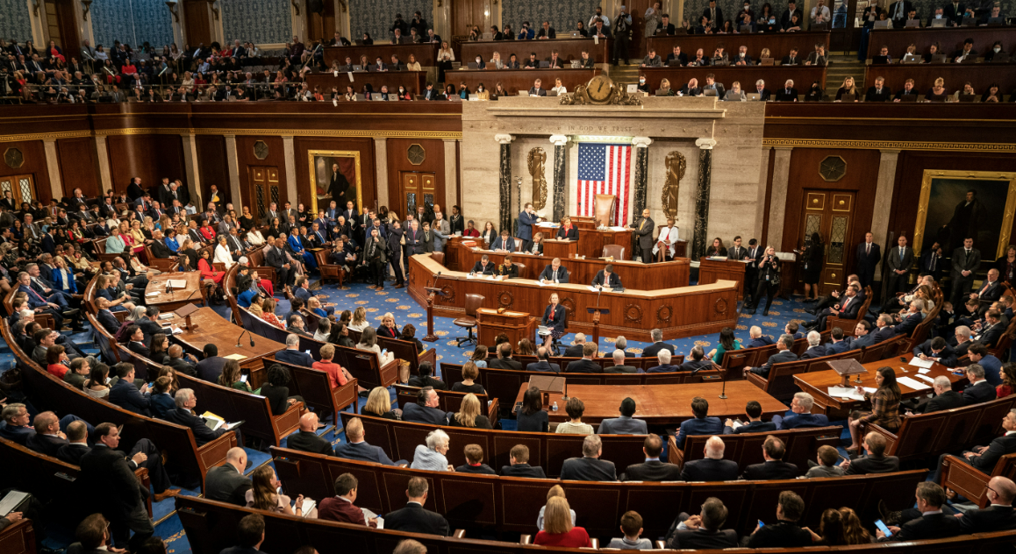

QBI Deduction Limitations
Section 199A
Please see prior 2 recordings:
QBI, MTI, and TI.
1) MTI = taxable income before the QBI deduction, less net capital gain (including qualified dividends).
Starting point: the lesser of
  20% of qualified business income
  20% of modified taxable income
Additional limitations
2). Higher Income: W-2 wages and qualified property
Specified Service Trade or Business (SSTB or SSB) rules
📹 Videos AICPA MCQs & Sims 🤖 Farhat AI Assistant🎙 Podcast Lessons 📊 CPA, CMA, EA Exam 💼Accounting & Finance Courses 🙌 Support by Farhat Team
🌐 farhatlectures.com | ⭐ Start Your Free Trial
Notes:
NARRATION
This lecture uses tax year 2026 rules under section 199A. The One Big Beautiful Bill Act made the deduction permanent and, for years beginning after December 31, 2025, widened the phase-in ranges and added a minimum deduction. Permanence means there is no scheduled expiration, not that Congress cannot change the law.
For our examples, there is one positive-QBI business, no QBI loss carryforward, no REIT/PTP component, and no agricultural cooperative adjustment. QBI and taxable income are already determined after all applicable related deductions. The ordinary starting point is the lesser of 20% of QBI or 20% of modified taxable income, followed by the applicable business limitations.
TEACHING REMINDERS
Say "20% of modified taxable income," not the full MTI amount. In this lecture, MTI means taxable income before the QBI deduction less net capital gain for section 199A purposes. That includes qualified dividends. Do not subtract all ordinary dividends or net short-term gains. Use taxable income before the deduction, without removing net capital gain, when testing the income thresholds.
The new 2026 minimum is the greater of the ordinary section 199A deduction or $400 for a taxpayer with at least $1,000 of aggregate QBI from active qualified trades or businesses. Active means material participation under section 469(h). Material participation is a condition of this minimum, not a general requirement for the ordinary QBI deduction. The minimum is an exception to the ordinary caps. The $400 and $1,000 amounts are indexed after 2026. It does not rescue income excluded from QBI, such as a fully phased-out SSTB.
SOURCES
Public Law 119-21, section 70105: https://www.govinfo.gov/content/pkg/PLAW-119publ21/html/PLAW-119publ21.htm
IRS QBI overview: https://www.irs.gov/newsroom/qualified-business-income-deduction
IRS Form 8995-A instructions, taxable income/net capital gain framework: https://www.irs.gov/instructions/i8995a

Slide 2

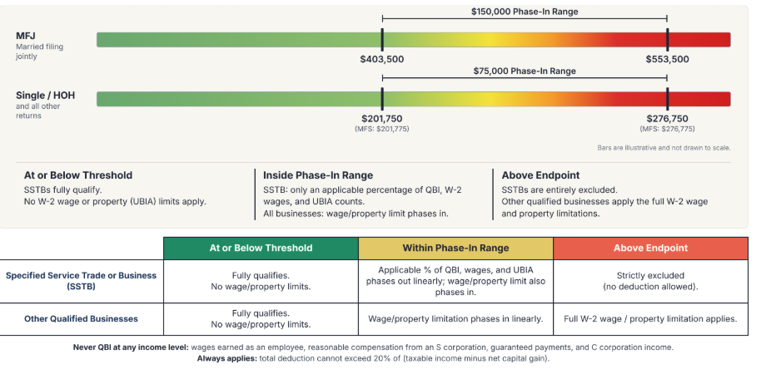
Income Limitations for 2026
📹 Videos AICPA MCQs & Sims 🤖 Farhat AI Assistant🎙 Podcast Lessons 📊 CPA, CMA, EA Exam 💼Accounting & Finance Courses 🙌 Support by Farhat Team
🌐 farhatlectures.com | ⭐ Start Your Free Trial
Notes:
NARRATION
Use the official 2026 thresholds. Single and most other returns: $201,750 to $276,750. Married filing jointly: $403,500 to $553,500. Married filing separately has a distinct $25 difference: $201,775 to $276,775. The widths are $75,000 for other returns and $150,000 for joint returns. The underlying threshold is inflation adjusted. The width does not automatically grow each year under current law.
At or below the threshold, the wage/property and SSTB limitations do not apply. The overall taxable-income limit still applies, subject to the active-business minimum. Above the threshold but below the upper endpoint, limitations phase in. At the upper endpoint the applicable percentage for an SSTB reaches zero, while the wage/property limit is fully effective for a non-SSTB. Say "upper endpoint" when describing full exclusion, not simply "threshold." An SSTB owner can still have a deduction from another eligible business or REIT income.
SSTB CLASSIFICATION
SSTB means specified service trade or business. Listed fields include health, law, accounting, actuarial science, performing arts, consulting, athletics, financial services, brokerage, investing/investment management, trading and dealing in specified assets. Engineering and architecture are excluded from the listed fields.
Owner effort, personal initiative, or dependence on the owner's skills is not a general SSTB test. The reputation-or-skill provision addresses endorsement income, licensing an individual's identity, and paid appearances. A YouTube channel's classification depends on the actual services and income streams. Do not say that all YouTubers are SSTBs, or classify an educational channel without examining its activities. An endorsement or paid media appearance may fall within an SSTB category. Mixed-business and de minimis rules may require further analysis.
SOURCES
IRS Rev. Proc. 2025-32, section 4.26: https://www.irs.gov/irb/2025-45_IRB
Treas. Reg. 1.199A-5(a), (b)(2)(xiv), and (c): https://www.ecfr.gov/current/title-26/section-1.199A-5
Public Law 119-21, section 70105(a): https://www.govinfo.gov/content/pkg/PLAW-119publ21/html/PLAW-119publ21.htm

Slide 3
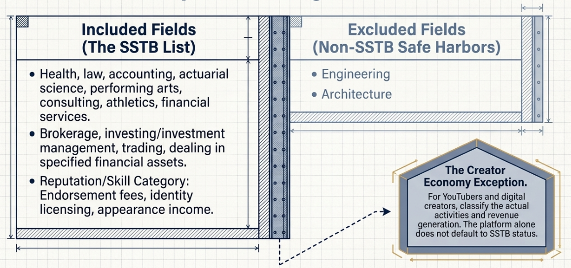
Specified Service Trades or Businesses
📹 Videos AICPA MCQs & Sims 🤖 Farhat AI Assistant🎙 Podcast Lessons 📊 CPA, CMA, EA Exam 💼Accounting & Finance Courses 🙌 Support by Farhat Team
🌐 farhatlectures.com | ⭐ Start Your Free Trial
Notes:
Apply the detailed definitions and exclusions in Regulation 1.199A-5(b)(2). The list is categorical, rather than a broad test of owner skill or effort. Creator income may involve performing arts, consulting, endorsements or other categories. Training and educational courses alone do not constitute consulting. Real-estate and insurance brokerage are excluded from the brokerage-services definition. Engineering and architecture are excluded as such, but a business’s other activities still require analysis. The reputation/skill category has the narrow meanings stated here.
Sources (checked October 11, 2026):
https://www.law.cornell.edu/cfr/text/26/1.199A-5#b
https://www.irs.gov/instructions/i8995a
Branding and retained images: supplied Farhat Lectures presentation.

Slide 4
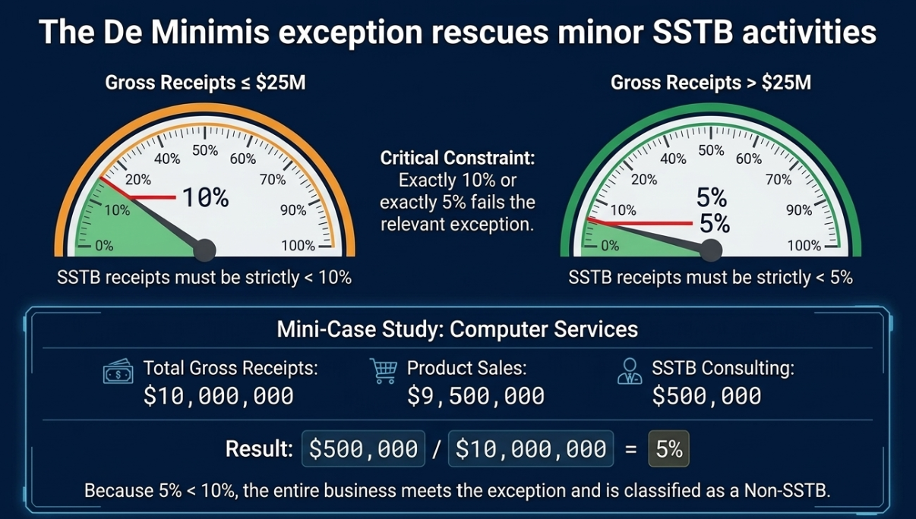
📹 Videos AICPA MCQs & Sims 🤖 Farhat AI Assistant🎙 Podcast Lessons 📊 CPA, CMA, EA Exam 💼Accounting & Finance Courses 🙌 Support by Farhat Team
🌐 farhatlectures.com | ⭐ Start Your Free Trial
Notes:
IRS try to b fair.
Some services coul be SSB and others are non SSB.

Slide 5
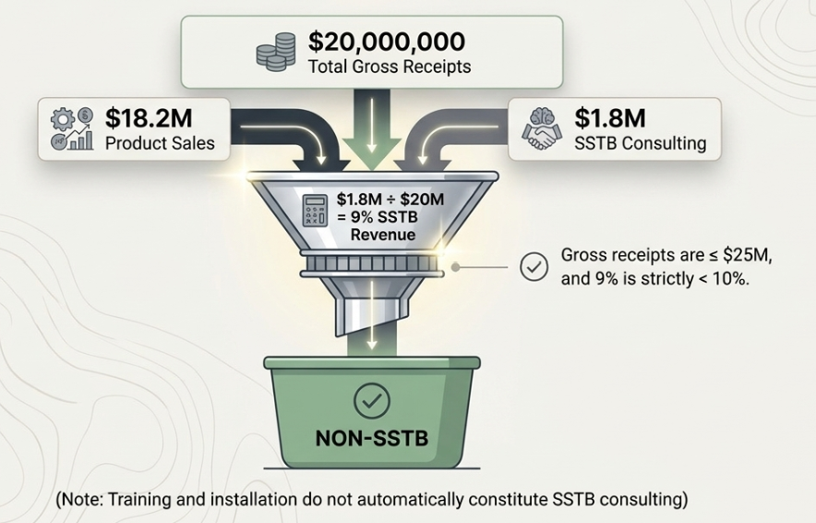
Example: TechPro LLC
📹 Videos AICPA MCQs & Sims 🤖 Farhat AI Assistant🎙 Podcast Lessons 📊 CPA, CMA, EA Exam 💼Accounting & Finance Courses 🙌 Support by Farhat Team
🌐 farhatlectures.com | ⭐ Start Your Free Trial
Notes:
Assume the $500,000 consists entirely of professional advice and counsel under Regulation 1.199A-5(b)(2)(vii), billed separately from product sales. The consulting definition excludes training and educational courses. Installation services are not automatically consulting. Advice embedded in or ancillary to an otherwise non-SSTB sale may be excluded when there is no separate payment. Other deduction conditions still apply.
Sources (checked October 11, 2026):
https://www.law.cornell.edu/cfr/text/26/1.199A-5#b_2_vii
https://www.law.cornell.edu/cfr/text/26/1.199A-5#c
Branding and retained images: supplied Farhat Lectures presentation.

Slide 6
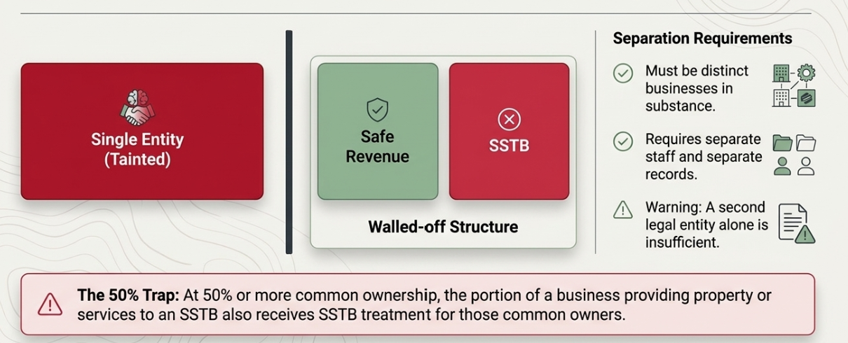
The Contagion Effect
📹 Videos AICPA MCQs & Sims 🤖 Farhat AI Assistant🎙 Podcast Lessons 📊 CPA, CMA, EA Exam 💼Accounting & Finance Courses 🙌 Support by Farhat Team
🌐 farhatlectures.com | ⭐ Start Your Free Trial
Notes:
Apply the de minimis rule to the actual Section 162 trade or business. Do not automatically combine every activity of an entity into one business. Below the owner’s threshold the SSTB exclusion does not apply. Within the range the applicable percentage applies. At or above the upper endpoint no SSTB amounts enter the QBI calculation. Other qualified businesses or REIT/PTP items may still support a deduction.
Sources (checked October 11, 2026):
https://www.law.cornell.edu/cfr/text/26/1.199A-5#c
https://www.law.cornell.edu/cfr/text/26/1.199A-1#d
Branding and retained images: supplied Farhat Lectures presentation.

Slide 7
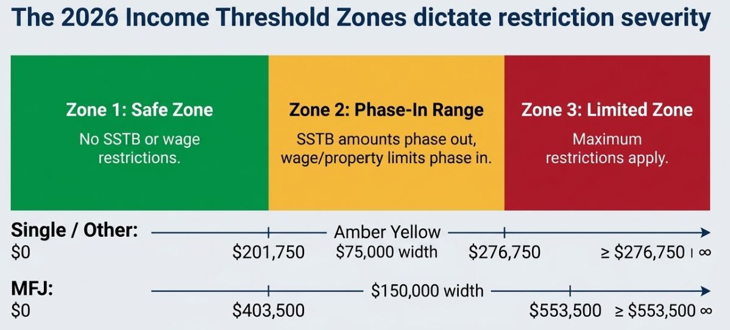
📹 Videos AICPA MCQs & Sims 🤖 Farhat AI Assistant🎙 Podcast Lessons 📊 CPA, CMA, EA Exam 💼Accounting & Finance Courses 🙌 Support by Farhat Team
🌐 farhatlectures.com | ⭐ Start Your Free Trial
Notes:
Regulation 1.199A-5(c)(1), Example 2, shows separate veterinary and dog-food businesses within one entity. Separate books, employees and operational substance support the distinction. No separate corporation is automatically necessary or sufficient. The common-ownership rule includes applicable direct and indirect ownership under Sections 267(b) or 707(b). It reaches the portion providing property or services to the commonly owned SSTB. Forming a C corporation does not create a Section 199A deduction.
Sources (checked October 11, 2026):
https://www.law.cornell.edu/cfr/text/26/1.199A-5#c
https://www.irs.gov/newsroom/qualified-business-income-deduction
Branding and retained images: supplied Farhat Lectures presentation.

Slide 8
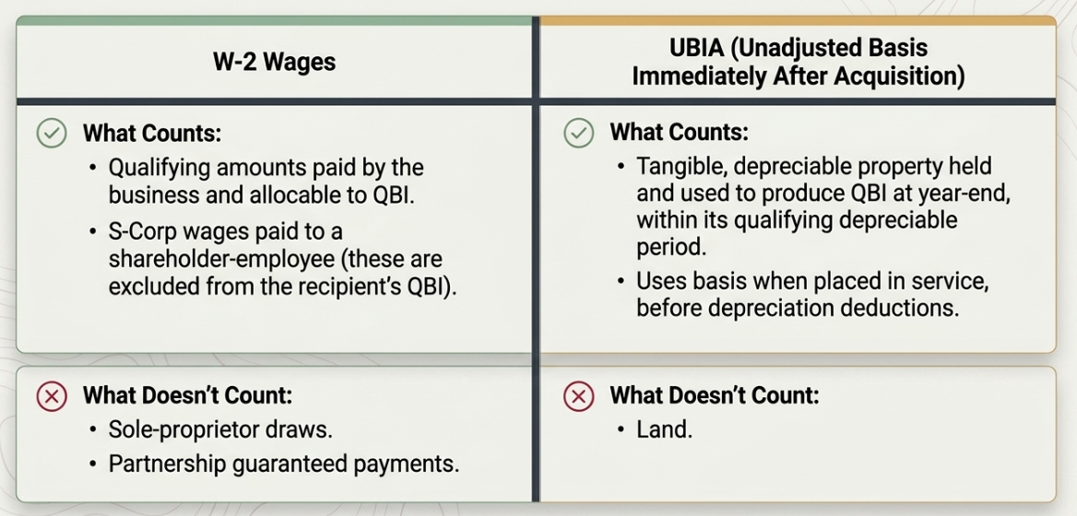
The Limitation Weights
📹 Videos AICPA MCQs & Sims 🤖 Farhat AI Assistant🎙 Podcast Lessons 📊 CPA, CMA, EA Exam 💼Accounting & Finance Courses 🙌 Support by Farhat Team
🌐 farhatlectures.com | ⭐ Start Your Free Trial
Notes:
Regulation 1.199A-5(c)(1), Example 2, shows separate veterinary and dog-food businesses within one entity. Separate books, employees and operational substance support the distinction. No separate corporation is automatically necessary or sufficient. The common-ownership rule includes applicable direct and indirect ownership under Sections 267(b) or 707(b). It reaches the portion providing property or services to the commonly owned SSTB. Forming a C corporation does not create a Section 199A deduction.
Sources (checked October 11, 2026):
https://www.law.cornell.edu/cfr/text/26/1.199A-5#c
https://www.irs.gov/newsroom/qualified-business-income-deduction
Branding and retained images: supplied Farhat Lectures presentation.

Slide 9
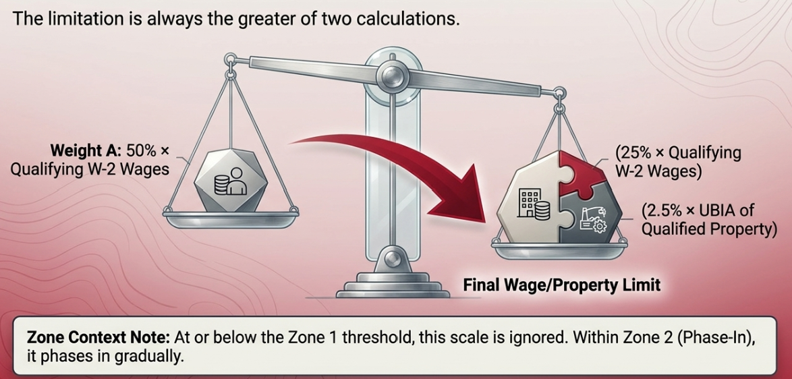
The Limitation Weights
📹 Videos AICPA MCQs & Sims 🤖 Farhat AI Assistant🎙 Podcast Lessons 📊 CPA, CMA, EA Exam 💼Accounting & Finance Courses 🙌 Support by Farhat Team
🌐 farhatlectures.com | ⭐ Start Your Free Trial
Notes:
Regulation 1.199A-5(c)(1), Example 2, shows separate veterinary and dog-food businesses within one entity. Separate books, employees and operational substance support the distinction. No separate corporation is automatically necessary or sufficient. The common-ownership rule includes applicable direct and indirect ownership under Sections 267(b) or 707(b). It reaches the portion providing property or services to the commonly owned SSTB. Forming a C corporation does not create a Section 199A deduction.
Sources (checked October 11, 2026):
https://www.law.cornell.edu/cfr/text/26/1.199A-5#c
https://www.irs.gov/newsroom/qualified-business-income-deduction
Branding and retained images: supplied Farhat Lectures presentation.

Slide 10
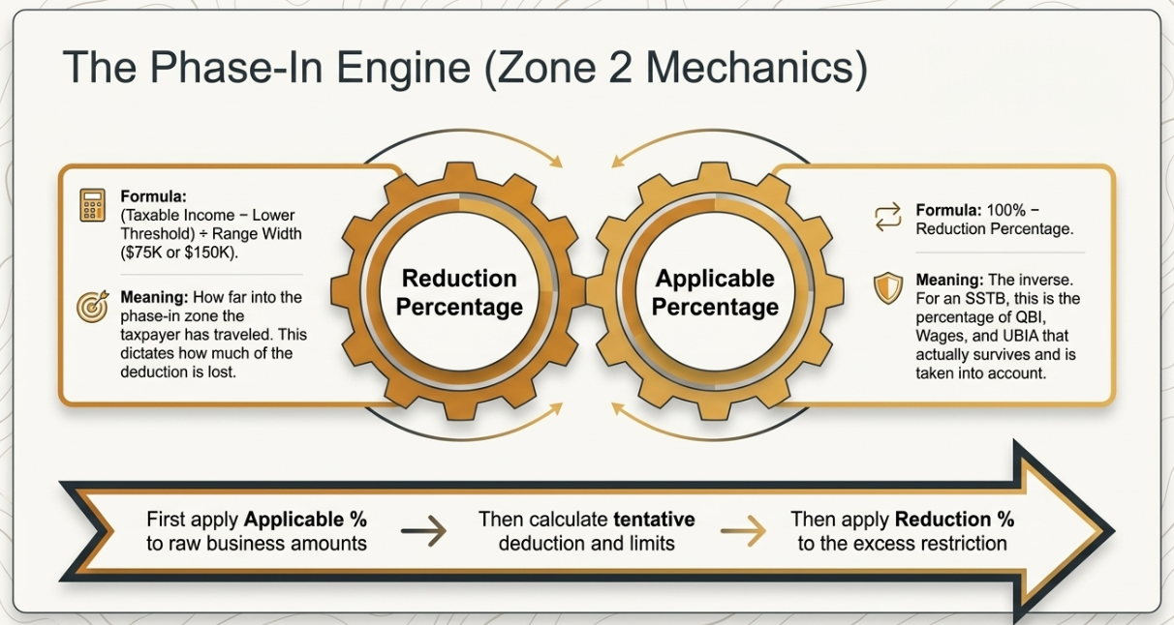
📹 Videos AICPA MCQs & Sims 🤖 Farhat AI Assistant🎙 Podcast Lessons 📊 CPA, CMA, EA Exam 💼Accounting & Finance Courses 🙌 Support by Farhat Team
🌐 farhatlectures.com | ⭐ Start Your Free Trial
Notes:
Regulation 1.199A-5(c)(1), Example 2, shows separate veterinary and dog-food businesses within one entity. Separate books, employees and operational substance support the distinction. No separate corporation is automatically necessary or sufficient. The common-ownership rule includes applicable direct and indirect ownership under Sections 267(b) or 707(b). It reaches the portion providing property or services to the commonly owned SSTB. Forming a C corporation does not create a Section 199A deduction.
Sources (checked October 11, 2026):
https://www.law.cornell.edu/cfr/text/26/1.199A-5#c
https://www.irs.gov/newsroom/qualified-business-income-deduction
Branding and retained images: supplied Farhat Lectures presentation.

Slide 11
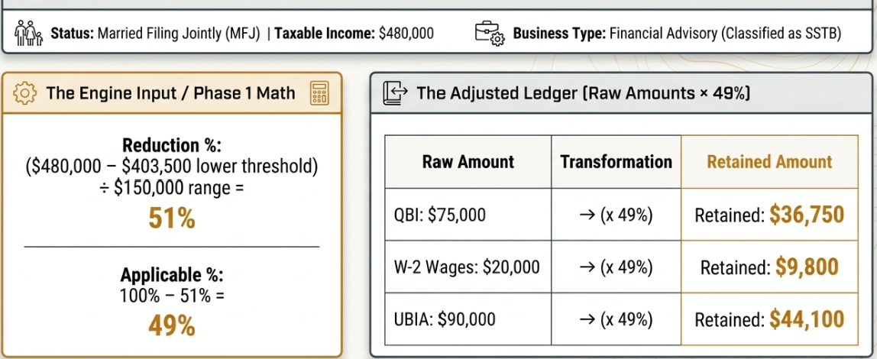
📹 Videos AICPA MCQs & Sims 🤖 Farhat AI Assistant🎙 Podcast Lessons 📊 CPA, CMA, EA Exam 💼Accounting & Finance Courses 🙌 Support by Farhat Team
🌐 farhatlectures.com | ⭐ Start Your Free Trial
Notes:
Regulation 1.199A-5(c)(1), Example 2, shows separate veterinary and dog-food businesses within one entity. Separate books, employees and operational substance support the distinction. No separate corporation is automatically necessary or sufficient. The common-ownership rule includes applicable direct and indirect ownership under Sections 267(b) or 707(b). It reaches the portion providing property or services to the commonly owned SSTB. Forming a C corporation does not create a Section 199A deduction.
Sources (checked October 11, 2026):
https://www.law.cornell.edu/cfr/text/26/1.199A-5#c
https://www.irs.gov/newsroom/qualified-business-income-deduction
Branding and retained images: supplied Farhat Lectures presentation.

Slide 12
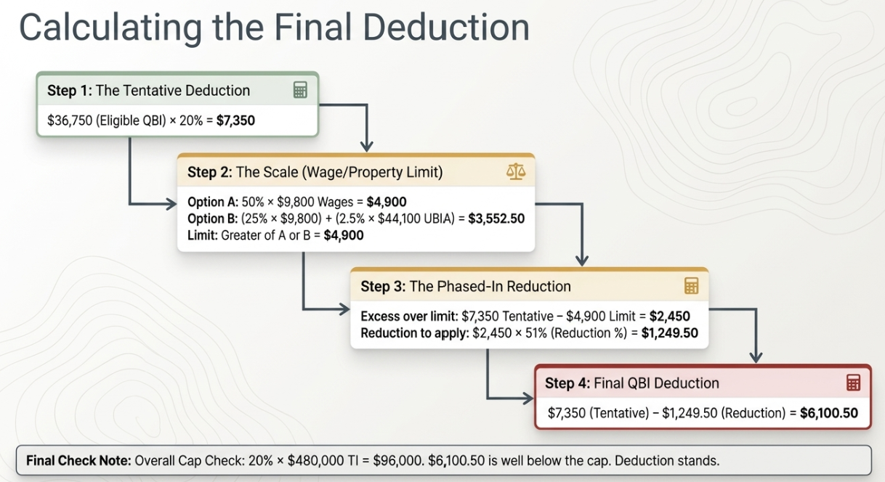
📹 Videos AICPA MCQs & Sims 🤖 Farhat AI Assistant🎙 Podcast Lessons 📊 CPA, CMA, EA Exam 💼Accounting & Finance Courses 🙌 Support by Farhat Team
🌐 farhatlectures.com | ⭐ Start Your Free Trial
Notes:
Regulation 1.199A-5(c)(1), Example 2, shows separate veterinary and dog-food businesses within one entity. Separate books, employees and operational substance support the distinction. No separate corporation is automatically necessary or sufficient. The common-ownership rule includes applicable direct and indirect ownership under Sections 267(b) or 707(b). It reaches the portion providing property or services to the commonly owned SSTB. Forming a C corporation does not create a Section 199A deduction.
Sources (checked October 11, 2026):
https://www.law.cornell.edu/cfr/text/26/1.199A-5#c
https://www.irs.gov/newsroom/qualified-business-income-deduction
Branding and retained images: supplied Farhat Lectures presentation.

