Slide 1

Alternative Business/Support Services Options
Shared Services
Outsourcing
Offshoring
For more, visit:
www.farhatlectures.com

Slide 2

Shared Services
Let's say a large company with multiple business units (consulting, software development, renewable energy etc.). Each unit has its own finance and accounting functions.
Instead of having each business unit manage their own finance and accounting operations separately, the company creates a centralized finance and accounting unit that will provide services to all business units.
  This unit will be responsible for processing payments, managing accounts receivable and accounts payable, conducting audits, and providing financial reports to each business unit.
  This unit may also provide financial analysis and support to help each business unit make strategic decisions.
  Purpose/benefit: reduce duplication of effort, streamline processes, and improve efficiency.
  This can lead to cost savings, as the company no longer needs to duplicate finance and accounting staff and resources across each business unit.
  ALSO, the centralized unit can benefit from economies of scale, enabling the company to negotiate better prices and terms with vendors and suppliers.
For more, visit:
www.farhatlectures.com

Slide 3
Disadvantages of Shared Services
Resistance to change:
  Implementing a shared services model may face resistance from employees who are accustomed to working in a decentralized environment.
  This can lead to delays and increased implementation costs.
Communication and coordination challenges:
  Sharing services across different departments and business units can pose communication and coordination challenges, which can lead to confusion and delays.
Loss of autonomy:
  Implementing a shared services model may require departments to relinquish some control over their operations, which can be perceived as a loss of autonomy.
Risk of service disruption:
  A shared services model can be vulnerable to service disruptions if the central service team experiences technical issues or staffing shortages. This can have a ripple effect on the entire organization.
For more, visit:
www.farhatlectures.com

Slide 4
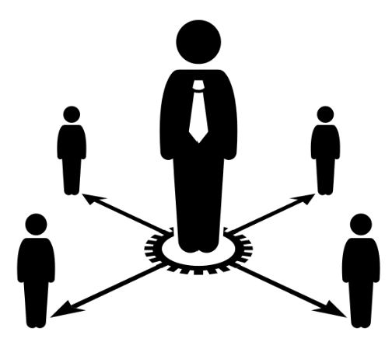
Outsourcing
Let's say a software development company needs to develop a new mobile application, but doesn't have the in-house expertise or resources to do so.
  The company decides to outsource the mobile app development to a third-party vendor that specializes in mobile app development.
Outsourcing is a business practice in which an organization contracts with an external company or individual to perform certain business functions or services that were previously performed in-house.
By outsourcing the mobile app development, the software development company can benefit from specialized expertise and resources without having to invest in building a new team or acquiring new tools and technologies.
  This can result in cost savings, increased efficiency, and faster time-to-market for the new mobile app.
For more, visit:
www.farhatlectures.com

Slide 5
Disadvantages of Outsourcing
Loss of control:
  Outsourcing can result in a loss of control over business processes and operations, which can be challenging for some organizations to manage.
Communication and coordination challenges:
  Especially when working with vendors located in different time zones or with different cultural norms.
  need to establish clear communication channels, provide detailed project requirements and timelines, and regularly monitor the vendor's performance to ensure that the project is delivered on time, on budget, and to the desired quality standards.
Quality concerns:
  Outsourcing can result in quality concerns, especially if the vendor does not have the same level of commitment to quality and customer satisfaction as the organization.
Security risks:
  Outsourcing can increase security risks, as sensitive data and intellectual property may be shared with external vendors who may not have the same level of security controls in place.
For more, visit:
www.farhatlectures.com

Slide 6

Offshoring
Let's say a company based in the United States needs to produce a large number of clothing items at a low cost.
The company decides to offshores its manufacturing operations to a factory in Bangladesh, where labor costs are lower than in the United States.
Offshoring is a business practice in which an organization relocates its business processes or services to a foreign country to take advantage of lower labor costs, tax incentives, or other favorable economic conditions.
  The term "offshoring" specifically refers to the relocation of business processes or services to a foreign country, whereas outsourcing can refer to the relocation of business processes or services to either a foreign or domestic third-party vendor.
For more, visit:
www.farhatlectures.com

Slide 7
Benefits of Offshoring
Offshoring can involve a wide range of business functions, such as manufacturing, customer service, IT support, and more.
  The practice is often associated with developing countries, where labor costs and other business expenses are lower than in developed countries.
Offshoring can provide several benefits to organizations, including cost savings, access to new markets and talent pools, and increased scalability.
For more, visit:
www.farhatlectures.com

Slide 8
Disadvantages of Offshoring
Language and cultural barriers:
  Offshoring can involve working with vendors or partners in foreign countries, which can create language and cultural barriers that can be challenging to overcome.
  These barriers can lead to miscommunications, misunderstandings, and other issues that can impact productivity and quality.
Quality control issues:
  Offshoring can create quality control issues, especially if the offshore vendor does not have the same quality control standards or processes as the organization.
  This can lead to product defects, delays, and other issues that can impact customer satisfaction.
Ethical concerns:
  Offshoring can raise ethical concerns related to labor practices and working conditions in the offshore country.
  Organizations may face criticism or backlash if it is discovered that they are working with vendors that engage in unethical or illegal labor practices.
Security risks:
  Offshoring can create security risks related to the sharing of sensitive data or intellectual property with vendors in foreign countries.
  The organization may need to take extra precautions to protect its data and intellectual property from theft or misuse.
Potential negative impact on domestic job market:
  Offshoring can lead to job losses in the organization's home country, which can have a negative impact on the local economy and job market.
For more, visit:
www.farhatlectures.com

