Slide 1
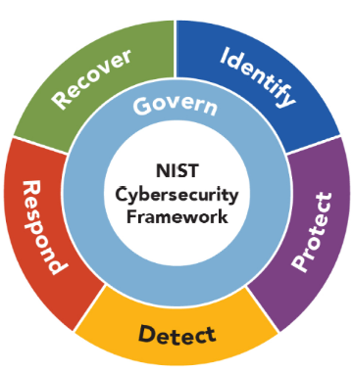

NIST Cybersecurity Framework: 4 Tiers
Core Functions:
Govern
    Categories (6)
Identify
    Categories (3)
Protect
    Categories (5)
Detect
    Categories (2)
Respond
    Categories (4)
Recover
    Categories (2)
Profile
Target Profile
Current Profile
Gap Analysis
4 Tiers
Partial
Risk Informed
Repeatable
Adaptive
Lectures + MCQs @ farhatlectures.com ➔ Free Trial

Slide 2
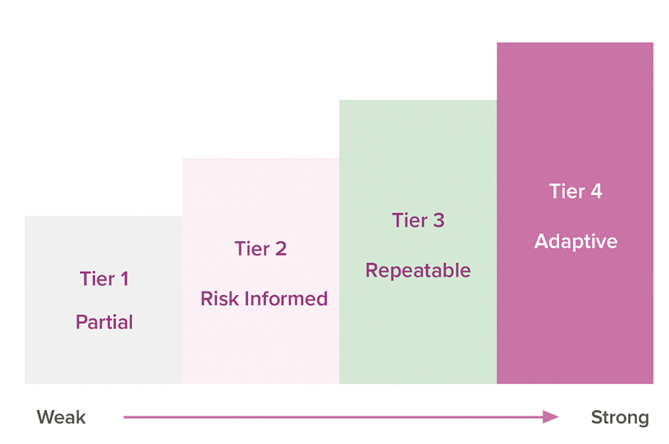
NIST: 4 Tiers
Lectures + MCQs @ farhatlectures.com ➔ Free Trial

Slide 3
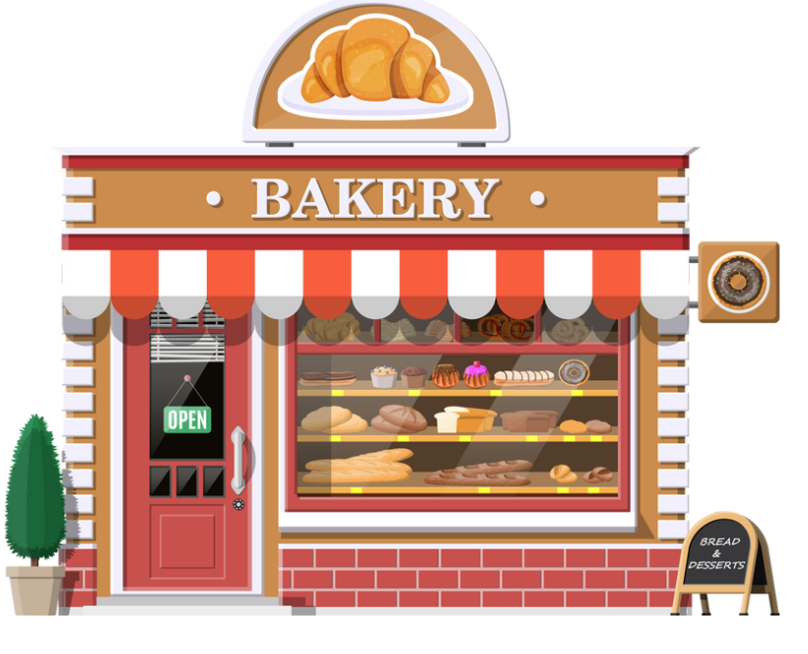
Sweet Treats Bakery
Sweet Treats Bakery began as a family-owned bakery dedicated to crafting high-quality, homemade baked goods.
From its humble beginnings, it quickly grew into a local favorite.
Over the years, Sweet Treats expanded across the state and eventually nationwide, now operating multiple locations with about 3,000 employees. To meet customer needs, the bakery has also developed a convenient online ordering system for catering and special events.
Lectures + MCQs @ farhatlectures.com ➔ Free Trial

Slide 4
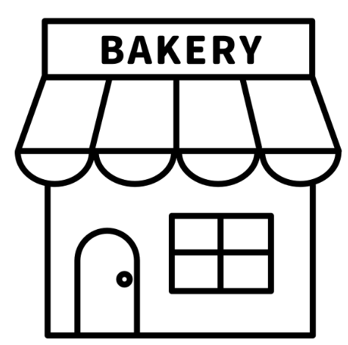
Tier 1: Partial (Ad-Hoc and Reactive)
At Tier 1, Sweet Treats Bakery’s cybersecurity efforts are minimal and reactive.
There are no systematic or formalized measures in place. Cybersecurity is considered a secondary concern, addressed only when immediate problems arise.
Scenario at Tier 1:
No dedicated IT or cybersecurity personnel.
Employees use computers for processing orders but rely solely on basic antivirus programs.
Online orders and payment transactions are processed without regular cybersecurity checks.
Risk management and incident response are ad hoc, typically responding only after a problem occurs.
Lectures + MCQs @ farhatlectures.com ➔ Free Trial

Slide 5
Tier 1: Partial (Ad-Hoc and Reactive)
Impact:
Sweet Treats Bakery experiences a simple malware attack through an employee clicking on a malicious email link.
This disrupts order processing for several days because there's no immediate response plan.
The bakery loses customer trust and sales during this downtime.
Lectures + MCQs @ farhatlectures.com ➔ Free Trial

Slide 6

Tier 2: Risk-Informed
At Tier 2, Sweet Treats Bakery recognizes the importance of cybersecurity risks and implements basic risk management processes.
While aware of cybersecurity risks, the bakery’s approach remains fragmented and inconsistently applied.
Scenario at Tier 2:
The bakery hires part-time IT support to help install updated antivirus software and firewalls.
Employees receive occasional cybersecurity awareness training.
Processes for data backups are in place but not consistently followed.
Some communication about cybersecurity risks occurs across different store locations but lacks coordination.
Lectures + MCQs @ farhatlectures.com ➔ Free Trial

Slide 7
Tier 2: Risk-Informed
Impact :
Another phishing attack targets employees, but because of occasional cybersecurity training, most employees avoid clicking harmful links.
However, one store still faces a ransomware infection due to inconsistent software updates and backups.
The incident causes disruption at one location but is contained without affecting all bakery locations.
Lectures + MCQs @ farhatlectures.com ➔ Free Trial

Slide 8

Tier 3: Repeatable
At Tier 3, Sweet Treats Bakery formalizes cybersecurity risk management processes.
The bakery ensures consistent application of cybersecurity measures a
cross all locations, regularly assesses risk, and actively promotes cybersecurity awareness among staff.
Scenario at Tier 3:
Dedicated IT service provider contracted to oversee cybersecurity.
Regular training sessions and phishing simulations conducted for employees.
Clear incident response plans and regular data backups systematically performed.
Consistent cybersecurity practices are documented and followed at all bakery locations.
Lectures + MCQs @ farhatlectures.com ➔ Free Trial

Slide 9
Tier 3: Repeatable
Impact:
Sweet Treats Bakery faces another cyberattack attempt targeting customer payment data.
Because of documented protocols, employees quickly identify suspicious activity and alert IT immediately.
The incident is swiftly resolved without any compromise of customer data, maintaining customer confidence and business continuity.
Lectures + MCQs @ farhatlectures.com ➔ Free Trial

Slide 10
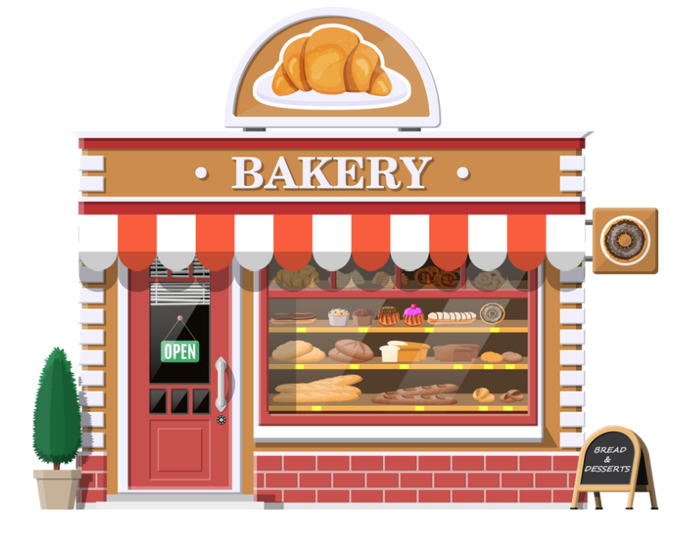
Tier 4: Adaptive
At Tier 4, Sweet Treats Bakery adopts a proactive, advanced cybersecurity posture.
The bakery continuously improves cybersecurity practices by learning from previous experiences, leveraging real-time threat intelligence, and collaborating with external cybersecurity partners.
Scenario at Tier 4:
Bakery integrates advanced threat detection tools, monitoring transactions and communications continuously.
Predictive analysis used to identify potential threats before they occur.
Regularly collaborates with cybersecurity industry groups and local commerce associations, sharing best practices and threat intelligence.
Strong cybersecurity culture fostered by leadership, extending down to every employee.
Lectures + MCQs @ farhatlectures.com ➔ Free Trial

Slide 11
Tier 4: Adaptive
Impact
Through advanced monitoring and predictive analytics, Sweet Treats Bakery identifies unusual access patterns on their online ordering platform.
Their proactive approach ensures the threat is addressed immediately, and security enhancements are implemented rapidly, preventing any customer data exposure.
Their proactive cybersecurity practices become a competitive advantage, enhancing their brand reputation for reliability and trustworthiness.
Lectures + MCQs @ farhatlectures.com ➔ Free Trial

Slide 12
MCQ from farhatlectures.com
After repeated malware incidents, Sweet Treats Bakery’s IT consultant installs basic firewalls, conducts occasional backups, and provides infrequent employee training. However, patching and backups are inconsistent. Which cybersecurity maturity Tier level best fits their current practices?
(a) Tier 1 - Partial
(b) Tier 2 - Risk-Informed
(c) Tier 3 - Repeatable
(d) Tier 4 - Adaptive
Correct Explanation: Choice (b) is correct because the bakery recognizes risks and implements basic cybersecurity measures, although inconsistently.
Incorrect Explanations:
(a) Tier 1 is incorrect because there's now some structured awareness, beyond purely reactive actions.
(c) Tier 3 is incorrect because the bakery’s processes lack consistency and comprehensive documentation.
(d) Tier 4 is incorrect because proactive and adaptive strategies are entirely absent.
Lectures + MCQs @ farhatlectures.com ➔ Free Trial

