Slide 1


What Is a Common-Size Financial Statement?
A common-size financial statement is a standardized version of a financial statement in which each line item is expressed as a percentage of a base figure.
This method facilitates comparison by eliminating the effects of size and scale.
There are two main types:
  Common-Size Income Statement: Each item is expressed as a percentage of net sales.
  Common-Size Balance Sheet: Each item is expressed as a percentage of total assets.
Purpose, how, example and business implication.
Lectures + MCQs @ farhatlectures.com ➔ Free Trial

Slide 2
Purpose of a Common-Size Financial Statement
1. Comparative Analysis
Enables comparison across companies of different sizes by standardizing data.
Facilitates analysis over multiple periods (trend analysis) to evaluate changes in financial structure or performance.
  A small retail chain compares its income statement to that of a national competitor.
  By using common-size percentages, it discovers that its COGS is 65% of sales, while the competitor’s is 58%, highlighting potential inefficiencies in purchasing or pricing.
2. Vertical Analysis
Provides insight into the relative weight of each account.
Helps assess how resources are allocated (e.g., how much of total assets are in cash or inventory).
  An analyst reviewing a manufacturer’s balance sheet sees that 30% of total assets are tied up in inventory.
  This signals excessive inventory holding and may prompt management to review inventory turnover or adopt just-in-time practices.
Lectures + MCQs @ farhatlectures.com ➔ Free Trial

Slide 3
Purpose of a Common-Size Financial Statement
3. Efficiency and Cost Control
Allows analysts to identify high or growing expense items (e.g., rising SG&A as a percentage of sales).
Highlights areas of operational inefficiency or cost savings.
  A CFO notices that Selling, General, and Administrative (SG&A) expenses increased from 12% to 18% of sales over two years.
  This triggers an internal audit to assess whether marketing or administrative costs have become excessive.
4. Strategic Decision-Making
Management can use it to benchmark performance against competitors or industry averages.
Investors and creditors use it to assess profitability, solvency, and financial stability.
  An investor compares two tech firms. One has R&D expenses at 20% of sales, while the other has only 5%.
  This signals that the first firm is more focused on innovation, influencing the investor's decision to invest in long-term growth potential.
5. Improved Communication
Makes financial information easier to understand for stakeholders with varying levels of financial literacy.
  A startup presents its common-size financials to potential investors. By showing each expense category as a percentage of sales, it clearly communicates where funds are going—making it easier for non-accountants to evaluate the business model.
Lectures + MCQs @ farhatlectures.com ➔ Free Trial

Slide 4
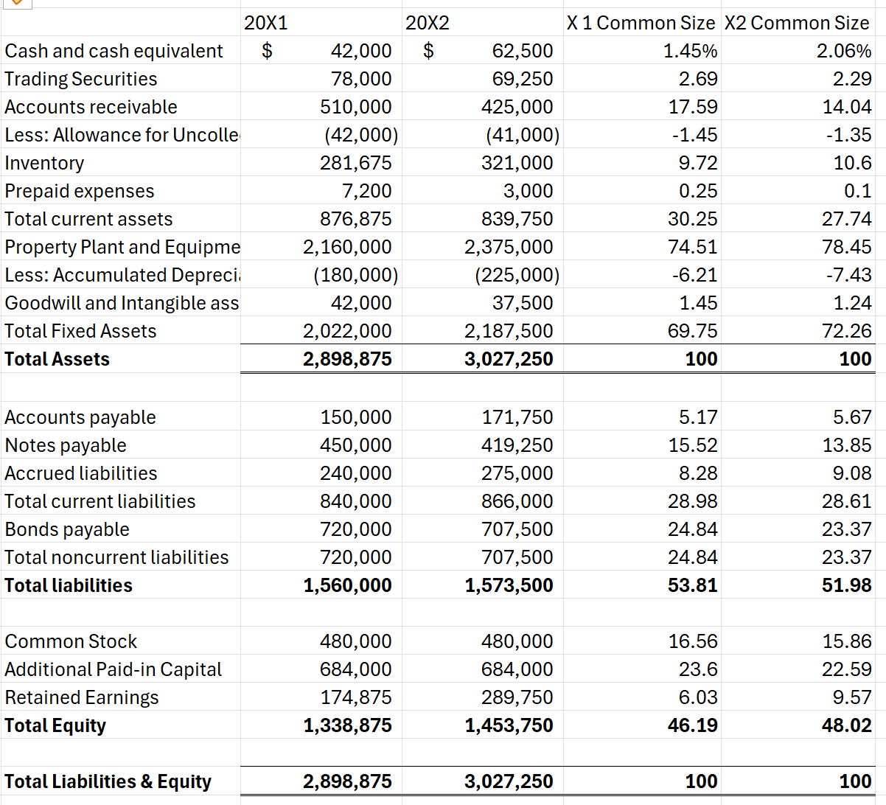
Balance Sheet: Common Size
1. Increase in Cash and Cash Equivalents (1.45% → 2.06%)
Insight: The company has significantly increased its cash reserves relative to total assets.
Business Implication:
Stronger liquidity position, enhancing the company’s ability to meet short-term obligations.
Greater financial flexibility for potential investment
2. Decline in Accounts Receivable (17.59% → 14.04%)
Insight: Accounts receivable now form a smaller proportion of total assets.
Business Implication:
Possibly indicates more efficient collection processes or tighter credit policies.
Reduced risk of bad debts and improved working capital cycle.
Alternatively, may signal a drop in credit sales, which could affect revenue if not offset elsewhere.
s, acquisitions, or economic downturns.
May reflect improved cash flow management or a conservative approach to cash allocation.
Lectures + MCQs @ farhatlectures.com ➔ Free Trial

Slide 5
Balance Sheet: Common Size
3. Increase in Inventory (9.72% → 10.60%)
Insight: Inventory as a percentage of total assets has increased.
Business Implication:
Could suggest stockpiling in anticipation of demand or supply chain disruptions.
May lead to higher carrying costs and potential inventory obsolescence if sales do not follow.
Should be monitored in conjunction with sales trends and inventory turnover ratios.
4. Growth in Fixed Assets (69.77% → 72.29%)
Insight: Fixed assets now constitute a greater portion of the total asset base.
Business Implication:
Indicates capital investments, likely in property, plant, or equipment.
Suggests strategic expansion or upgrade of operations.
Needs to be assessed alongside return on assets (ROA) to ensure investments are generating adequate returns.
Lectures + MCQs @ farhatlectures.com ➔ Free Trial

Slide 6
Balance Sheet: Common Size
Stability in Total Liabilities (~53.8% → 52.0%)
Insight: Slight decline in liabilities relative to assets.
Business Implication:
Shows slight deleveraging or increase in equity funding.
Lower financial risk and improved solvency, which may enhance creditworthiness.
Reduces interest burden, potentially increasing net income.
Increase in Retained Earnings (6.03% → 9.57%)
Insight: Retained earnings grew significantly as a percentage of total assets.
Business Implication:
Indicates the company is reinvesting profits rather than distributing dividends.
Reflects profitable operations and a commitment to growth.
Increases equity base, which can support future financing needs internally.
Lectures + MCQs @ farhatlectures.com ➔ Free Trial

Slide 7
Balance Sheet: Common Size
Improvement in Total Equity (46.22% → 48.04%)
Insight: Equity now represents a larger share of the financing mix.
Business Implication:
Strengthens the company’s capital structure.
Reduces reliance on debt, lowering financial risk.
Enhances the company’s ability to attract investors and obtain favorable loan terms.
Overall Business Assessment:
The company shows signs of improved financial health, better liquidity, and a strategic reinvestment approach. While capital investment is rising and inventory levels should be watched, the balance sheet reflects a stable and strengthening financial position with prudent asset and liability management.
Lectures + MCQs @ farhatlectures.com ➔ Free Trial

Slide 8
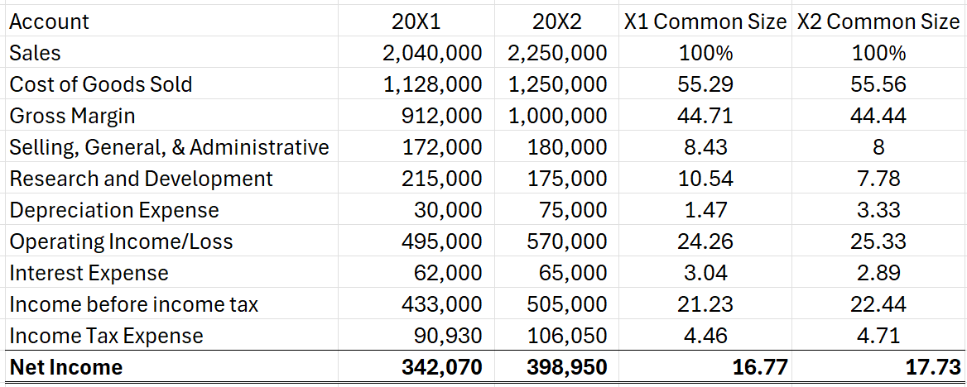
Income Statement: Common Size
Stable Gross Margin (44.71% → 44.44%)
Insight: Gross margin slightly declined despite higher sales.
Business Implication:
Indicates that the cost of goods sold increased marginally faster than sales.
May reflect rising input costs or less favorable pricing power.
Management should monitor margins to maintain profitability.
Decrease in R&D Expenses (10.54% → 7.78%)
Insight: Research and development costs declined as a percentage of sales.
Business Implication:
Could suggest a shift in strategy from innovation to cost control.
May raise concerns about long-term growth if underinvestment in innovation continues.
Needs contextual review (e.g., project lifecycle or strategic focus).
Lectures + MCQs @ farhatlectures.com ➔ Free Trial

Slide 9
Income Statement: Common Size
Increase in Depreciation Expense (1.47% → 3.33%)
Insight: Depreciation expense rose significantly relative to sales.
Business Implication:
Reflects capital investments made in prior periods (e.g., equipment, facilities).
Signals expansion or upgrading of productive capacity.
May improve efficiency or reduce costs in the long term.
Improved Operating Income (24.26% → 25.33%)
Insight: Operating income grew both in absolute and relative terms.
Business Implication:
Indicates better operating efficiency and cost control.
Suggests that the company is managing its expenses well relative to revenue growth.
Positive sign for investors and creditors.
Lectures + MCQs @ farhatlectures.com ➔ Free Trial

Slide 10
Income Statement: Common Size
Steady Interest Expense (3.04% → 2.89%)
Insight: Interest expense remained relatively stable as a percentage of sales.
Business Implication:
Implies stable debt levels or favorable borrowing terms.
Consistent with the earlier balance sheet trend of reduced liabilities.
Supports sustainable financial structure.
Increase in Net Income (16.76% → 17.73%)
Insight: Net income as a percentage of sales increased, improving overall profitability.
Business Implication:
Indicates efficient expense management and strong revenue growth.
Enhances retained earnings and return on equity.
May increase investor confidence and potential for dividend distribution.
Lectures + MCQs @ farhatlectures.com ➔ Free Trial

Slide 11
Income Statement: Common Size
Overall Financial Picture:
Farhat Co. demonstrated strong revenue growth and improved net profitability, driven by operational efficiencies and stable financial leverage.
However, the decline in R&D spending might raise strategic concerns about long-term innovation unless well-justified.
Lectures + MCQs @ farhatlectures.com ➔ Free Trial

Slide 12
MCQ from Farhatlectures.com
A company’s common-size income statement shows that its SG&A expenses increased from 8% to 12% of sales, while its gross margin remained unchanged. What should management infer from this trend?
a. Rising production costs are eroding profitability
b. Operating efficiency has improved
c. Overhead expenses are rising faster than revenue
d. The company’s interest obligations have increased
Lectures + MCQs @ farhatlectures.com ➔ Free Trial

