Slide 1
Intro
Prerequisite
Annuities?
PV of single payment

Slide 2


Present Value of Annuity: Practical Application
Loan Payments
  Purpose: Determine the present value of future loan payments to understand the amount borrowed (loan principal).
Bonds (any investment) Valuation
  Purpose: Calculate the present value of future interest payments and principal repayment to determine a bond's price.
Retirement Planning
  Purpose: Determine how much you need to invest today to achieve a fixed income during retirement.
Lectures + MCQs @ farhatlectures.com ➔ Free Trial

Slide 3
How to Calculate Present Value for Multiple Cash Flows
Starting with a simple example
Imagine you need $1,000 in one year and $2,000 in two years. The interest rate is 9%. How much do you need to set aside today to meet these obligations?
Discount each cash flow to the present:
  Year 1: Divide $1,000 by ( 1.09^1 ) → $917.43
  Year 2: Divide $2,000 by ( 1.09^2 ) → $1,683.36
Add the present values:
  $917.43 + $1,683.36 = $2,600.79
This total is what you'd invest today at a 9% interest rate to meet both payments on time.
Lectures + MCQs @ farhatlectures.com ➔ Free Trial

Slide 4
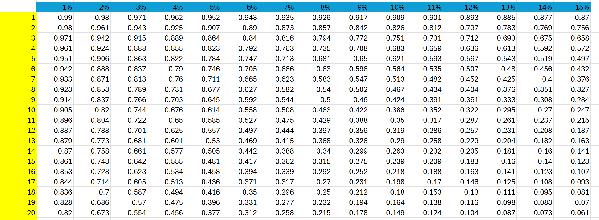
A Five-Year Investment Example
Let’s say you’re considering an investment that pays $1,000 at the end of each year for five years, with an annual return of 6%. You want to know: "What’s this investment worth today?"
Calculate the PV of each $1,000:
  Year 1: ( 1,000 / 1.06^1 = 943.40 ) (PV of 1$ factor: .9433)
  Year 2: ( 1,000 / 1.06^2 = 890.00 ) (PV of 1$ factor: .89)
  Year 3: ( 1,000 / 1.06^3 = 839.62 ) (PV of 1$ factor: .84)
  Year 4: ( 1,000 / 1.06^4 = 792.09 ) (PV of 1$ factor: .792)
  Year 5: ( 1,000 / 1.06^5 = 747.26 ) ( PV of 1$ factor: .747)
Add them up:
  Total PV = ( 943.40 + 890.00 + 839.62 + 792.09 + 747.26 ) = $4,212.37. (PV ordinary An= 4.2123)
By investing $4,212.37 today, you can earn 6% annually and withdraw $1,000 each year for 5 years.
Lectures + MCQs @ farhatlectures.com ➔ Free Trial

Slide 5
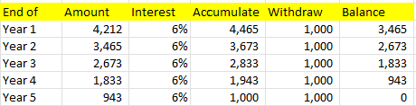
Prove it!
Let’s say you’re considering an investment that pays $1,000 at the end of each year for five years, with an annual return of 6%. You want to know: "What’s this investment worth today?"
Lectures + MCQs @ farhatlectures.com ➔ Free Trial

Slide 6
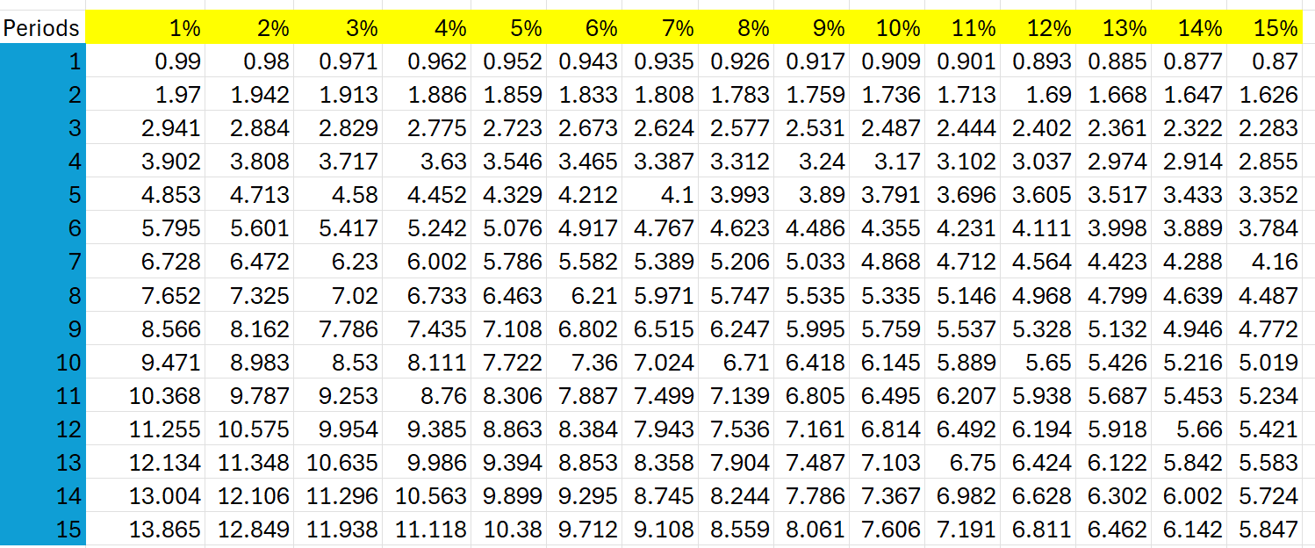
Present Value of Ordinary Annuity Table
1,000 x 4.212 = 4,212 rounding
Lectures + MCQs @ farhatlectures.com ➔ Free Trial

Slide 7
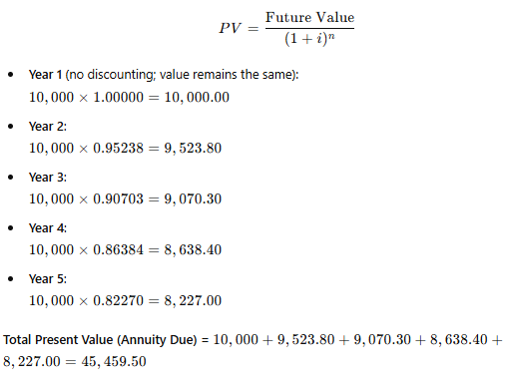
Present Value of an Annuity Due
How much should you pay for an investment that promises to pay you $10,000 annually for 5 years at a 5% interest rate, with payments made at the beginning of each period?
List of Payments (Annuity Due):
$10,000 at the start of Year 1
$10,000 at the start of Year 2
$10,000 at the start of Year 3
$10,000 at the start of Year 4
$10,000 at the start of Year 5
Add up the factors: 4.546
Lectures + MCQs @ farhatlectures.com ➔ Free Trial

Slide 8
Annuity Due Formula
For an annuity due, the present value formula adjusts to account for the earlier timing of payments:
PV Due​=PV Ordinary​ ×(1+i)
From tables or formula, the Present Value of an Ordinary Annuity Factor (PVIF) for 5 years at 5% is 4.3295.
Multiply this factor by 1+0.05 to adjust for an annuity due:
PVIF Due​=4.3295 ×1.05= 4.5460
Multiply the payment (PMT) by the adjusted factor:
PV Due​=10,000×4.5460=45,460.00
Lectures + MCQs @ farhatlectures.com ➔ Free Trial

Slide 9
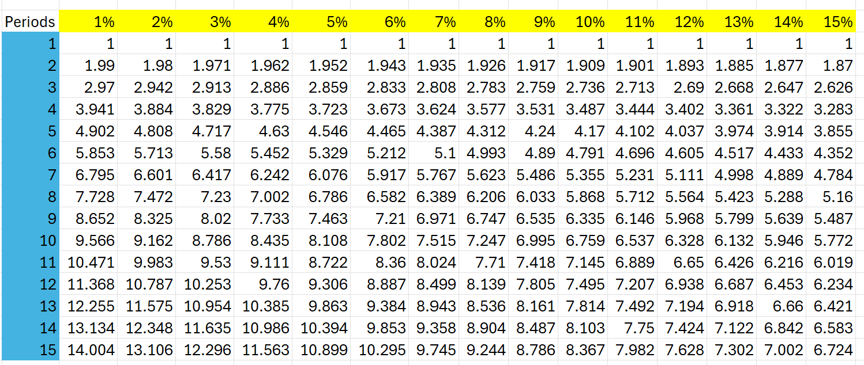
Present Value of Annuity Due Table
10,000 x 4.546 = 34,460
Lectures + MCQs @ farhatlectures.com ➔ Free Trial

Slide 10
Find the Interest Rate
Assume you own 528.77 on your Visa Card. The lender offer you 12 equal monthly payments if $50 to payoff the balance. What interest rate is the lender charging you?
PV annuity = payment x PVF oa
528.77 = 50 x PVF oa
PVF oa = 528.77/50 = 10.5753
2% monthly rate
Lectures + MCQs @ farhatlectures.com ➔ Free Trial

Slide 11
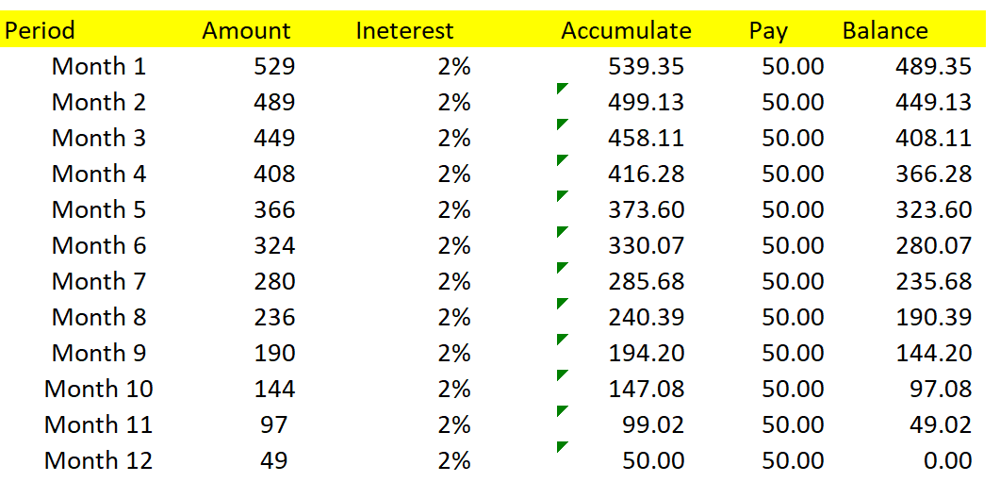
Prove it!
Assume you own 528.77 on your Visa Card. The lender offer you 12 equal monthly payments if $50 to payoff the balance. What interest rate is the lender charging you?
PV annuity = payment x PVF oa
528.77 = 50 x PVF oa
PVF oa = 528.77/50 = 10.5753
2% monthly rate
Lectures + MCQs @ farhatlectures.com ➔ Free Trial

Slide 12
Calculating the Payment
Marge and Homer have saved 36,000 to finance Lisa’s 4-year of education in a local bank earning 4%,. What amount can Lisa withdraw every 6-month during her 4 college years?
PV OA = Payment x (PVF oa)
36,000 = payment x (7.3255)
Payment = 36,000/7.3255
4,914.35 approx.
Lectures + MCQs @ farhatlectures.com ➔ Free Trial

Slide 13
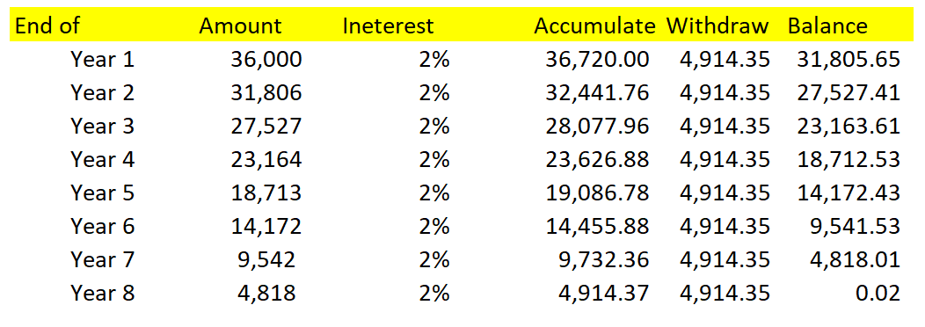
Calculation the Payments
Marge and Homer have saved 36,000 to finance Lisa’s 4-year of education in a local bank earning 4%,. What amount can Lisa withdraw every 6-month during her 4 college years?
PV OA = Payment (PVF oa)
36,000 = payment (7.3255)
Payment = 36,000/7.3255
4,914.35 approx.
Lectures + MCQs @ farhatlectures.com ➔ Free Trial

Slide 14

Tips for Success
Use a timeline: Drawing out the years and payments helps to keep things organized.
Double-check the discount rate: Ensure you're applying the correct interest or return rate.
Understand the problem: Are payments at the start or end of each period? That distinction changes everything.
Lectures + MCQs @ farhatlectures.com ➔ Free Trial

Slide 15
MCQ from Farhatlectures.com
Which of the following best describes the present value of an ordinary annuity?
a. The value of equal payments received at the beginning of each period.
b. The value of equal payments received at the end of each period, discounted to today.
c. The future value of equal payments compounded at the end of each period.
d. The total sum of all payments received without considering the time value of money.
Correct Answer: b
Explanation:
  Choice b is correct because the present value of an ordinary annuity discounts a series of equal payments received at the end of each period back to today's value.
  Choice a is incorrect because this describes an annuity due, not an ordinary annuity.
  Choice c is incorrect because it describes future value, not present value.
  Choice d is incorrect because it ignores the time value of money, which is fundamental to present value calculations.
Lectures + MCQs @ farhatlectures.com ➔ Free Trial

Slide 16
Deferred Annuity
Imagine an investment promises to pay $5,000 at the end of years 4, 5, and 6, with a return of 11%. What’s the PV of this investment today?
Discount each $5,000 to the present:
  Year 4: ( 5,000 / 1.11^4 = 3,293.65 )
  Year 5: ( 5,000 / 1.11^5 = 2,967.12 )
  Year 6: ( 5,000 / 1.11^6 = 2,673.50 )
Add them up:
  Total PV = ( 3,293.65 + 2,967.12 + 2,673.50 ) = $8,934.27
If someone offers you this investment for less than $8,934.27, it may be worth considering. If it's priced higher, it might not be the best deal.

