Slide 1
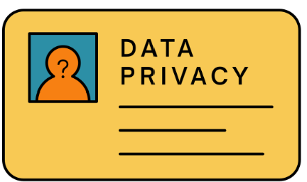

NIST Privacy Framework
NIST Cybersecurity Framework
Privacy has become an increasingly critical concern for organizations of all sizes.
The NIST Privacy Framework provides a comprehensive approach to managing privacy risks (customer data) effectively.
  Not prescriptive: Any industry can use
Its structure parallels the well-known NIST Cybersecurity Framework (not surprising), offering organizations a familiar way to address privacy challenges alongside cybersecurity needs.
  The Core
  Profiles
  Tiers
Lectures + MCQs @ farhatlectures.com ➔ Free Trial

Slide 2

The Core: Privacy Outcomes and Functions
The Core of the Privacy Framework defines high-level privacy outcomes, offering a structured way to determine what privacy means for your organization.
These outcomes are categorized into five functions.
  Identify
  Govern
  Control
  Communicate
  Protect
These functions: breaking down into categories and subcategories.
Lectures + MCQs @ farhatlectures.com ➔ Free Trial

Slide 3
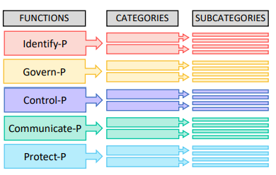
Functions, Categories and Subcategories
The core elements work together as follows:
Functions: Represent high-level privacy activities, such as managing data processing, making risk decisions, engaging with individuals, and fostering continuous improvement.
  For example, a company might use the "Identify" Function to map the personal data it collects and processes.
  Functions are performed concurrently to adapt to evolving privacy risks.
Categories: Subdivide Functions into related privacy outcomes based on programmatic needs.
  For instance, within the "Identify" Function, a Category might focus on understanding the organization’s data processing ecosystem.
Subcategories: Further break down Categories into specific technical or management outcomes.
  For example, a Subcategory under data mapping might involve documenting data flows between systems to identify potential privacy risks.
Lectures + MCQs @ farhatlectures.com ➔ Free Trial

Slide 4

Identify Function
Identify: Recognize privacy risks and the data elements requiring protection.
Example: A retail company maps its customer data flow to identify where sensitive information, like credit card details, is stored and processed.
This includes tracking data collection points (e.g., online purchases, in-store transactions), storage locations, and data sharing with vendors.
By visualizing this flow, they identify vulnerabilities such as unencrypted storage and lack of vendor agreements, addressing these by encrypting data and formalizing vendor contracts.
Lectures + MCQs @ farhatlectures.com ➔ Free Trial

Slide 5
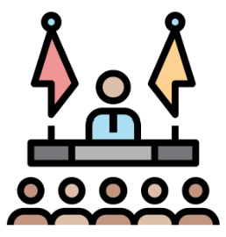
Govern Function
The "Govern" function focuses on defining, implementing, and maintaining organizational structures, roles, and processes to ensure effective privacy management.
It involves creating clear policies and assigning accountability to ensure compliance with privacy regulations and internal standards.
  A healthcare provider establishes governance policies to comply with HIPAA regulations.
  These policies include assigning a Chief Privacy Officer (CPO) responsible for overseeing privacy practices, implementing staff training programs on handling patient data, and conducting regular audits to ensure compliance.
Lectures + MCQs @ farhatlectures.com ➔ Free Trial

Slide 6
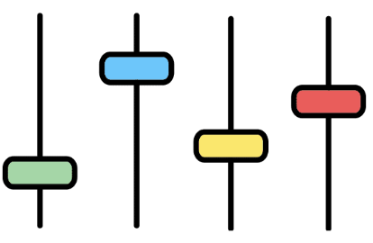
Control Function
Control: Implement measures to manage the use, sharing, and deletion of data.
The "Control" function focuses on establishing safeguards to regulate how data is accessed, shared, modified, and deleted.
These measures ensure that personal information is handled securely and in alignment with privacy requirements.
  A hospital utilizes encryption to protect patient records.
    It ensures that data is encrypted both at rest and in transit, reducing the risk of unauthorized access during file transfers or system breaches.
Lectures + MCQs @ farhatlectures.com ➔ Free Trial

Slide 7
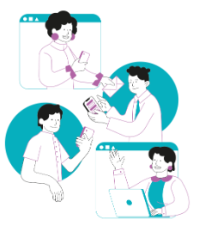
Communicate Function
Communicate: Share privacy-related information with stakeholders transparently.
The "Communicate" function emphasizes the importance of informing all relevant stakeholders—customers, employees, and regulators—about privacy policies, practices, and any potential risks in an open and understandable manner.
  Effective communication builds trust and ensures compliance with transparency requirements.
A healthcare provider creates detailed but user-friendly privacy brochures for patients.
  These brochures explain how their health data will be used, stored, and shared, with specific examples of scenarios such as billing, treatment coordination, or research.
Lectures + MCQs @ farhatlectures.com ➔ Free Trial

Slide 8

Protect Function
The "Protect" function ensures that personal data is secure against unauthorized access, modification, or destruction.
  This function emphasizes proactive measures to prevent data breaches and maintain the integrity of sensitive information.
A financial institution encrypts sensitive transaction data both at rest and in transit.
  They also implement multi-factor authentication (MFA) to add an extra layer of security, ensuring that only authorized personnel can access critical systems.
Lectures + MCQs @ farhatlectures.com ➔ Free Trial

Slide 9
Profiles (same as Cybersecurity)
Aligning Privacy with Organizational Goals
A privacy profile allows organizations to map their privacy practices to their operational needs and objectives.
Like the Cybersecurity Framework, privacy profiles have two key components:
Current Profile: A snapshot of the organization’s existing privacy posture.
Target Profile: The desired state of privacy practices based on risk tolerance and business goals.
By comparing these profiles through a gap analysis, organizations can identify areas needing improvement.
Example: A retail company may find it has robust data protection policies (Protect) but lacks adequate communication strategies (Communicate) for notifying customers about data usage.
  These insights drive prioritized action plans, such as introducing automated notifications and privacy training for staff.
Organizations often document profiles in spreadsheets, diagrams, or other visual tools to align privacy practices with legal, regulatory, and business requirements.
Lectures + MCQs @ farhatlectures.com ➔ Free Trial

Slide 10

The 4 Tiers
The Tiers in the Privacy Framework describe varying levels of privacy risk management sophistication.
Unlike traditional maturity models, these tiers are not hierarchical but are designed to help organizations choose the most appropriate level for their needs. The four tiers are:
Tier 1: Partial
Tier 2: Risk-Informed
Tier 3: Repeatable
Tier 4: Adaptive
Lectures + MCQs @ farhatlectures.com ➔ Free Trial

Slide 11

Tier 1: Partial
Level: Novice
Characteristics:
  Minimal or ad hoc privacy processes.
  Basic understanding of privacy risks.
  Reactive rather than proactive approach.
Example: A small startup with no dedicated privacy policies or resources relies on ad hoc responses to customer privacy concerns.
Lectures + MCQs @ farhatlectures.com ➔ Free Trial

Slide 12
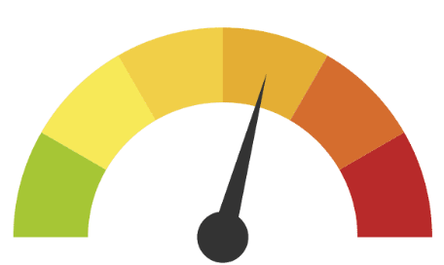
Tier 2: Risk-Informed
Level: Intermediate
Characteristics:
  General understanding of privacy risks.
  Inconsistent application of privacy controls.
  Limited stakeholder engagement.
Example: A mid-sized business with privacy policies for customer data but no standardized processes for employee data privacy.
Lectures + MCQs @ farhatlectures.com ➔ Free Trial

Slide 13
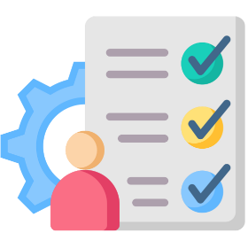
Tier 3: Repeatable
Level: Proficient
Characteristics:
  Documented privacy policies.
  Consistent application of controls.
  Engagement with internal and external stakeholders.
Example: A multinational corporation with standardized privacy practices, such as annual privacy audits and training programs for all employees.
Lectures + MCQs @ farhatlectures.com ➔ Free Trial

Slide 14

Tier 4: Adaptive
Level: Expert
Characteristics:
  Continuous monitoring and real-time adjustments.
  Integration of advanced tools like AI for privacy management.
  Active collaboration with industry peers.
Example: A tech company leveraging AI-driven tools to ensure compliance with global privacy regulations and leading industry initiatives to set privacy standards.
Lectures + MCQs @ farhatlectures.com ➔ Free Trial

Slide 15

Why Tiers Matter
Selecting an appropriate tier helps organizations align their privacy efforts with their risk tolerance and operational needs. For instance:
Tier 1: Focus on building foundational privacy policies and awareness.
Tier 2: Standardize processes across departments.
Tier 3: Strengthen risk management and integrate privacy into organizational workflows.
Tier 4: Invest in cutting-edge tools and collaborate with external partners.
Unlike traditional maturity models, the goal isn’t necessarily to reach Tier 4 but to choose the tier that best meets the organization’s needs and regulatory requirements.
Lectures + MCQs @ farhatlectures.com ➔ Free Trial

Slide 16
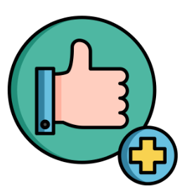
Benefits of Using the Privacy Framework
Common Language: Facilitates clear communication across departments and with external partners.
  Example: A supply chain manager and IT officer can use standardized terms to address privacy risks collaboratively.
Compliance Alignment: Helps align practices with regulatory requirements.
  Example: A financial firm maps its privacy practices to GDPR and CCPA using the Core and Profiles.
Risk Management: Identifies and mitigates privacy risks effectively.
  Example: An e-commerce company addresses risks related to data breaches by enhancing encryption protocols.
Cost Efficiency: Prioritizes resources for maximum impact.
  Example: A nonprofit optimizes limited resources by focusing on high-priority privacy gaps identified in their profile.
Continuous Improvement: Tracks progress and strengthens privacy programs over time.
  Example: A government agency uses iterative assessments to enhance citizen data protection.
Lectures + MCQs @ farhatlectures.com ➔ Free Trial

Slide 17
MCQ from Farhatlectures.com
A healthcare provider wants to establish a formal privacy program. Which function of the NIST Privacy Framework should it prioritize first?
a) Protect
b) Communicate
c) Identify
d) Control
Choice a is incorrect because "Protect" deals with safeguarding data, which requires identifying data risks first.
Choice b is incorrect because "Communicate" focuses on transparency, which is built on understanding risks and governance.
Choice c is correct because "Identify" involves understanding privacy risks and mapping data flows, which are foundational steps for a privacy program.
Choice d is incorrect because "Control" addresses managing privacy risks, which comes after risks are identified and governance is established.
Lectures + MCQs @ farhatlectures.com ➔ Free Trial

