Slide 1

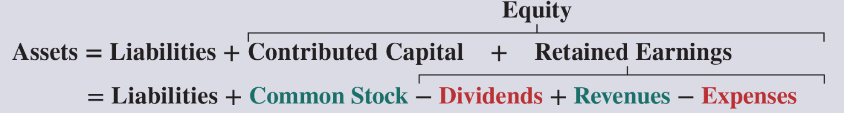

Equity
Equity represents the ownership interest in a company, essentially what the owners or shareholders would claim after all liabilities are paid off.
  Net worth, net assets, residual value.
It’s the residual interest in the assets of the company and can be broken down into several key components:
  revenues
  expenses
  common stock, and
  dividends
Each of these elements plays a crucial role in shaping the equity of a business.
Lectures + MCQs @ farhatlectures.com ➔ Free Trial

Slide 2

Revenues
Definition: Revenues are the income generated from the sale of goods or services.
  It represents the total amount of money earned by the business from its core activities.
Role in Equity: Revenues increase equity as they represent the inflow of resources resulting from business operations.
Higher revenues indicate a successful business, leading to growth in retained earnings and overall equity.
Lectures + MCQs @ farhatlectures.com ➔ Free Trial

Slide 3

Expenses
Definition: Expenses are the costs incurred in the process of earning revenues.
  These include costs like salaries, rent, utilities, and materials.
Role in Equity: Expenses decrease equity because they represent the outflow of resources used to generate revenues.
Effective management of expenses is crucial for maintaining profitability and healthy equity levels.
Lectures + MCQs @ farhatlectures.com ➔ Free Trial

Slide 4
Dividends
Definition: Dividends are distributions of a portion of the company's earnings to its shareholders.
  They are usually paid out in cash or additional shares of stock.
Role in Equity: Dividends decrease equity as they are payments made to shareholders from the company’s retained earnings.
While paying dividends can attract investors and provide a return on their investment, it also reduces the amount of retained earnings that can be reinvested into the business.
Lectures + MCQs @ farhatlectures.com ➔ Free Trial

Slide 5
Common Stock
Definition: Common stock represents the shares of ownership in a corporation.
  When a company issues common stock, it sells ownership stakes to investors in exchange for capital.
Role in Equity: The funds raised from issuing common stock contribute directly to equity.
This capital can be used to finance operations, invest in new projects, and grow the business.
Common stockholders typically have voting rights and may receive dividends.
Lectures + MCQs @ farhatlectures.com ➔ Free Trial

Slide 6
MCQ from Farhatlectures.com
A retail company issues common stock worth $20,000. How does this transaction affect the company’s balance sheet?
a) Increase in assets and increase in equity
b) Increase in liabilities and decrease in equity
c) Increase in assets and decrease in liabilities
d) Decrease in assets and increase in equity
Answer: a) Increase in assets and increase in equity
Explanation:
Choice a is correct because issuing common stock increases cash (assets) and equity.
Choice b is incorrect because it does not involve liabilities or a decrease in equity.
Choice c is incorrect because it misrepresents the transaction affecting liabilities.
Choice d is incorrect because it incorrectly shows a decrease in assets.
Lectures + MCQs @ farhatlectures.com ➔ Free Trial

