Slide 1
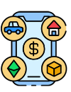

Assets
They are resources that a business owns or controls with the expectation that these resources will provide future economic benefits.
Assets are diverse in nature and can range from physical items to intangible rights and claims.
Assets are essential components of a company's financial health and operational capacity.
Assets are listed on the balance sheet (TBD)
Lectures + MCQs @ farhatlectures.com ➔ Free Trial

Slide 2

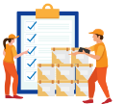
Current Assets
Current Assets: These are assets that are expected to be converted into cash or used up within one year or one operating cycle, whichever is longer. Examples include:
Cash: The most liquid asset, readily available for use in operations or investment.
Accounts Receivable: Money owed to the company by customers who have purchased goods or services on credit.
Inventory: Goods available for sale to customers.
Supplies: Items used in the normal course of business operations.
Lectures + MCQs @ farhatlectures.com ➔ Free Trial

Slide 3
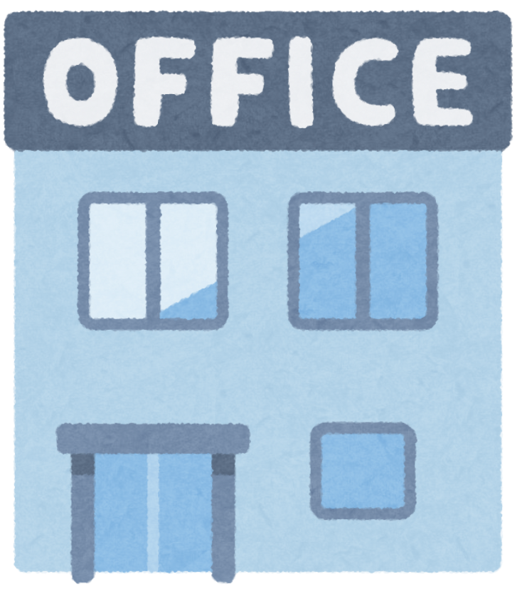
Non-Current Assets (long Term)
These are long-term investments and resources that are not expected to be converted into cash within a year. Examples include:
Property, Plant, and Equipment (PPE): Tangible assets such as land, buildings, machinery, and equipment used in production or operations.
Long-Term Investments: Investments in stocks, bonds, or other assets intended to be held for more than one year.
Lectures + MCQs @ farhatlectures.com ➔ Free Trial

Slide 4
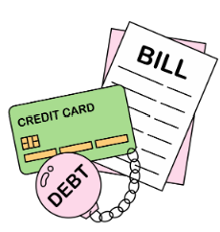
Liabilities (debt)
Liabilities represent a company's obligations to external parties.
These obligations arise from past transactions or events and will require the company to provide assets, products, or services in the future.
In essence, liabilities are creditors' claims on a company's assets and reflect the financial responsibilities the company must fulfill.
Lectures + MCQs @ farhatlectures.com ➔ Free Trial

Slide 5

Current Liabilities
Current Liabilities: These are obligations that the company expects to settle within one year or one operating cycle, whichever is longer. Examples include:
  Accounts Payable: Amounts owed to suppliers for goods or services purchased on credit. This is a common liability for businesses that operate on a credit basis.
  Wages Payable: Salaries and wages owed to employees for work performed.
  Taxes Payable: Taxes owed to governmental authorities, such as income tax, sales tax, and property tax.
  Short-Term Loans Payable: Loans that need to be repaid within a year.
Lectures + MCQs @ farhatlectures.com ➔ Free Trial

Slide 6

Non-Current Liabilities (long Term)
Non-Current Liabilities: These are obligations that are due beyond one year. Examples include:
Long-Term Loans and Notes Payable: Loans from banks or other financial institutions that have repayment terms extending beyond one year.
Bonds Payable: Debt securities issued by the company to raise capital, typically with repayment terms of more than one year.
Lectures + MCQs @ farhatlectures.com ➔ Free Trial

Slide 7

Importance of Managing Liabilities
Effective management of liabilities is crucial for maintaining a company's financial health and stability.
Proper handling of liabilities ensures that the company can meet its obligations as they come due, avoiding default and maintaining good credit standing.
  Cash Flow Management: Ensuring that the company has sufficient cash or liquid assets to meet its short-term liabilities.
  Debt Management: Balancing the use of debt to finance operations and growth while maintaining a manageable level of debt relative to equity.
  Compliance: Adhering to legal and regulatory requirements related to taxes, wages, and other obligations to avoid penalties and legal issues.
Lectures + MCQs @ farhatlectures.com ➔ Free Trial

Slide 8
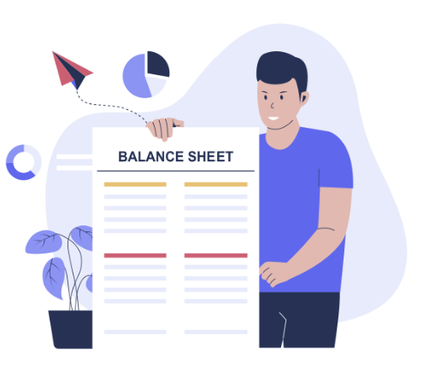
Liabilities on the Balance Sheet
Liabilities are recorded on the balance sheet and are classified into current and non-current categories.
This classification helps stakeholders understand the timing and nature of the company's obligations.
The balance sheet equation, Assets = Liabilities + Equity, reflects the fundamental relationship between a company's resources, its obligations, and the residual interest of its owners.
Lectures + MCQs @ farhatlectures.com ➔ Free Trial

Slide 9
MCQ from Farhatlectures.com
A software company provides services on credit worth $10,000. How will this transaction be recorded?
a) Increase in cash and increase in equity
b) Increase in accounts receivable and increase in equity
c) Increase in accounts payable and increase in liabilities
d) Increase in cash and decrease in accounts receivable
Answer: b) Increase in accounts receivable and increase in equity
Explanation:
Choice b is correct because the service on credit increases accounts receivable (an asset) and increases revenue, thereby increasing equity.
Choice a is incorrect because it incorrectly states an increase in cash, not accounts receivable.
Choice c is incorrect because it misrepresents the transaction involving accounts payable and liabilities.
Choice d is incorrect because it incorrectly associates cash with accounts receivable, which is not applicable in this context.
Lectures + MCQs @ farhatlectures.com ➔ Free Trial

