Slide 1


Estimated Tax Payments For C Corporation.
Tax Strategy Tool
Corporations make estimated tax payments (unlike employees) to comply:
  with tax laws,
  avoid penalties for underpayment,
  manage cash flow throughout the year, and
  implement effective tax planning strategies.
These payments help ensure financial and regulatory compliance and smooth financial operations.
Effective corporate tax planning involves strategies aimed at reducing the overall tax burden a corporation faces and at the same time, ensuring compliance to avoid penalties associated with underpayment of taxes.
Lectures + MCQs @ farhatlectures.com ➔ Free Trial

Slide 2

Dates
The tax return deadline for most C corporations is 3.5 months post their fiscal year end.
Corporation can apply for an automatic 6-month filing extension with the IRS, which extends the filing deadline but not the payment due date.
  Thus, C corporations must still estimate and pay any owed taxes by the original due date when requesting an extension.
For a corporation on a calendar year basis, the original tax return deadline is April 15 of the following year, and the deadline with an extension is October 15 of the following year.
  Should these dates fall on a weekend or federal holiday, the deadline shifts to the subsequent business day.
Lectures + MCQs @ farhatlectures.com ➔ Free Trial

Slide 3
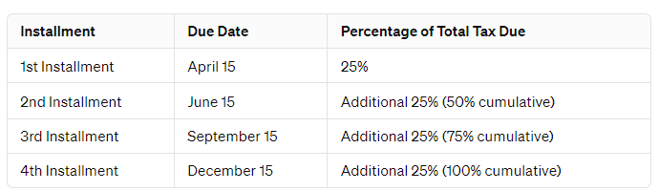
C Corporation Estimated Tax Payments
Corporations, with a few exceptions for those with very small tax liabilities (under $500), are required to make payments towards their estimated tax liability on a quarterly basis.
Lectures + MCQs @ farhatlectures.com ➔ Free Trial

Slide 4
Estimated Tax payments
The calculation of this "annual required payment" can be based on one of three criteria, chosen to minimize the payment amount:
Current Year's Tax Liability: The corporation can opt to pay 100% of the estimated tax liability for the current year.
  This method involves estimating the total tax for the current year and making quarterly payments that sum up to this estimate.
  For corporations with steady income, estimated tax payments are often based on the current year's estimated tax liability, divided equally over four quarterly installments.
Prior Year's Tax Liability: This option allows the corporation to base its quarterly payments on 100% of the tax liability reported on the previous year's tax return. However, there are restrictions:
  This method can only be used for the first quarter's payment by "large corporations," defined as those with over $1 million in taxable income in any of the three preceding years.
  It cannot be used at all if the corporation had no tax liability (NOL) in the previous year.
Annualized Income Method (TBD)
Lectures + MCQs @ farhatlectures.com ➔ Free Trial

Slide 5
Example
XYZ Corp, calendar year C corporation, is basing its estimated tax installment payments.
Taxable Income from Previous Year: $600,000
Taxable Income for Current Year (Projected): $900,000
With a federal tax rate of 21% for the current year, we can calculate the estimated tax payments under both scenarios as follows:
Federal Tax Rate: 21%
Estimated Tax Liability Based on Previous Year's Income:
  $600,000×21%=$126,000/4 = 31,500
Estimated Tax Liability Based on Current Year's Projected Income:
  $900,000×21%=$189,000/4 = 47,250
From a tax planning perspective, XYZ could choose to make estimated payments of $31,500 per installment to avoid any underpayment penalties, based on its previous year's income.
However, if XYZ's projections for the current year's taxable income are accurate, it would owe an additional tax payment of $63,000 ($189,000 - $126,000) at the year's end. Such a large tax payment could disrupt operations if not adequately planned for, potentially necessitating the sale of assets or securing a loan to cover the tax obligation.
Lectures + MCQs @ farhatlectures.com ➔ Free Trial

