Slide 1


Service Commitments
Prior session: System!
The evaluation of a service organization's system of internal controls using the trust services criteria (SOC 2) is to assess whether the controls in place effectively support the achievement of the organization's business goals.
These goals typically involve meeting service commitments to clients regarding the systems that deliver the services, as well as the necessary system requirements to fulfill those commitments.
Service Commitments: These are the promises or guarantees that a service organization makes to its clients regarding the performance and reliability of the services provided.
Lectures + MCQs @ farhatlectures.com ➔ Free Trial

Slide 2


Service Commitments
Service commitments are essential in defining the expectations and standards for the services an organization provides.
Service commitments could be relevant across different sectors and systems:
Data Backup and Recovery Protocols:
  Commitment to perform regular data backups to prevent data loss.
  Clear guidelines on the frequency of backups, the types of data backed up, and the procedures for data recovery in the event of data corruption or loss.
Service Level Agreements (SLAs):
  Defined performance metrics such as uptime guarantees (e.g., 99.9% availability) and response times for customer service inquiries.
  Penalties for failing to meet these metrics, providing accountability and reassurance to clients.
Lectures + MCQs @ farhatlectures.com ➔ Free Trial

Slide 3


Service Commitments
3. Quality Assurance Standards:
  Standards for testing and validation of software or system components to ensure they meet quality requirements before deployment.
  Commitments to continuous improvement and regular updates to maintain and enhance system quality.
4. User Access Controls:
  Specific policies regarding who can access certain levels of the system or data, including role-based access controls.
  Procedures for reviewing and updating access permissions to ensure they remain appropriate as roles or business needs change.
Lectures + MCQs @ farhatlectures.com ➔ Free Trial

Slide 4

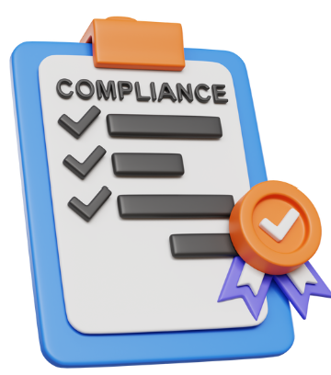
Service Commitments
5. Incident Response and Management:
  Commitments to address and resolve system failures or security breaches within a stipulated timeframe.
  Protocols for notifying affected customers and stakeholders in the event of a security breach, including steps taken to mitigate damages.
6. Compliance with Regulatory Requirements:
  Assurances that all system operations comply with applicable laws and regulations, such as GDPR for data protection or HIPAA for healthcare information.
  Regular audits and updates to systems and procedures to maintain compliance as regulations change.
7. Sustainability and Environmental Impact:
  Commitments to minimize the environmental impact of operations, such as using energy-efficient data centers or offsetting carbon emissions.
  Policies for sustainable sourcing and waste management in physical operations.
Lectures + MCQs @ farhatlectures.com ➔ Free Trial

Slide 5

Management Responsibilities
The management of a service organization has several critical responsibilities related to their service commitments and system requirements.
Primarily, they are responsible for ensuring these commitments and requirements are met effectively.
Moreover, they are tasked with clearly documenting these principal system requirements and service commitments in the system description.
This documentation is crucial as it helps users of SOC 2 reports understand how the organization's controls are designed, operate, and how both management and the service auditor assess these controls for their design and operational effectiveness in a Type 2 SOC 2 report.
Lectures + MCQs @ farhatlectures.com ➔ Free Trial

Slide 6
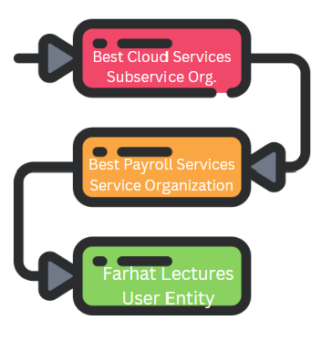
User Entity & Service Commitments
Service commitments can vary based on the specific needs of different user entities.
Thus, not all service commitments need to be disclosed to every user entity.
Instead, management should focus on disclosing those commitments that address the common needs of a broader audience of SOC 2 report users.
This selective disclosure ensures that the information provided is relevant and useful without overwhelming the users with unnecessary details.
This approach helps in maintaining clarity and relevance in the information provided to stakeholders and auditors, aiding them in their evaluation of the service organization's compliance and operational integrity.
Lectures + MCQs @ farhatlectures.com ➔ Free Trial

Slide 7

Disclosures
When evaluating the adequacy of the disclosures in a SOC 2 report, the service auditor must assess whether the information presented is sufficiently detailed and relevant for the report's users.
Detail and Clarity of Service Commitments: The auditor should verify if the service commitments and system requirements are described in enough detail.
  This detail is crucial for users to understand the connections between the implemented controls, the service commitments, and the system requirements.
  Users should be able to see how controls support the service's objectives and comply with the specified requirements.
Relevance and Summarization of Service Commitments: The description should effectively summarize the principal service commitments, especially those that are common among the report's users.
  This is particularly important when the SOC 2 report is intended for a broad audience. The summarization helps users quickly grasp which aspects of the service are relevant and assured through the described controls.
Lectures + MCQs @ farhatlectures.com ➔ Free Trial

Slide 8
Disclosures
Descriptive and Comprehensive Control Information: Beyond stating which controls have been implemented, the description should provide enough detail about each control to help users, such as user entities and business partners, understand how these controls impact their interactions with the service organization.
  Detailed descriptions help users assess the reliability of the service organization in terms of operational practices and risk management.
In essence, the auditor's role involves ensuring that the SOC 2 report's disclosures are thorough, relevant, and comprehensible, enabling users to make informed decisions about their reliance on the service organization’s controls and services.
Lectures + MCQs @ farhatlectures.com ➔ Free Trial

Slide 9
Example
MediTech Solutions Inc. is a provider of electronic health record (EHR) systems that allows healthcare providers to manage patient data securely.
Hospital Network HealthGroup partners with MediTech because of the company's robust security measures and its compliance with the trust services criterion of Security.
To ensure these critical elements are maintained, HealthGroup stipulates the following service requirements in its service-level agreement with MediTech:
  MediTech will implement multifactor authentication for all users accessing the EHR system to enhance security measures and ensure that only authorized personnel can access patient data.
  MediTech will conduct regular security audits every six months to identify and rectify potential vulnerabilities within the system, thereby maintaining the integrity and security of the data.
  MediTech will provide real-time data encryption for all stored and transmitted patient information to protect the privacy and security of patient data against unauthorized access or breaches.
These stipulations are designed to protect patient data and ensure compliance with regulatory requirements, mirroring the focus on specific trust services criteria.
Lectures + MCQs @ farhatlectures.com ➔ Free Trial

Slide 10
MCQ from Farhatlectures.com
Which of the following is NOT a typical service commitment in a service-level agreement for a payment processing system?
a) Transaction processing within 24 hours
b) Compliance with international data security standards
c) Revenue sharing between the service provider and client
d) Providing transaction records to customers upon request
Correct Answer: c) Revenue sharing between the service provider and client
Explanation:
Choice a is incorrect because it is a typical service commitment related to the timeliness of processing.
Choice b is incorrect as it relates to compliance with security standards, commonly included in service commitments.
Choice c is correct because revenue sharing is generally a contractual financial arrangement, not a typical service commitment relating to the quality or scope of service.
Choice d is incorrect because providing transaction records upon request is a common service commitment that enhances transparency and trust.
Lectures + MCQs @ farhatlectures.com ➔ Free Trial

