Slide 1
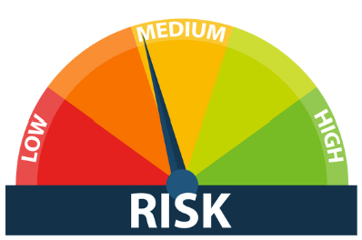

Understanding the Client as Part of the Risk Assessment: System
In a SOC 2 engagement, assessing risk is crucial as these reports provide assurance about the controls at a service organization concerning security, availability, processing integrity, confidentiality, or privacy of systems handling user data.
The system under review includes various components that help the organization meet its defined business objectives.
These components are categorized into:
    infrastructure,
    software,
    people,
    data, and
    procedures.
Each of these categories is critical to the functionality and security of the system and plays a specific role in maintaining the SOC 2 standards of Trust Security Criteria.
Lectures + MCQs @ farhatlectures.com ➔ Free Trial

Slide 2
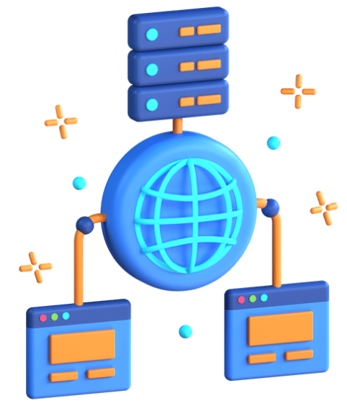
Infrastructure
Infrastructure includes all physical and virtual resources that support the operations of a service organization.
Cloud Infrastructure: Virtual servers hosted off-site, providing scalability and flexibility for handling varying levels of demand.
Networking Hardware: Routers, switches, and firewalls that manage data traffic and secure data flows across the organization.
Data Centers: Facilities that house critical servers and computer systems with high levels of security measures such as biometric access controls.
Physical Security Systems: Surveillance cameras and alarm systems that enhance the physical security of the infrastructure.
Lectures + MCQs @ farhatlectures.com ➔ Free Trial

Slide 3
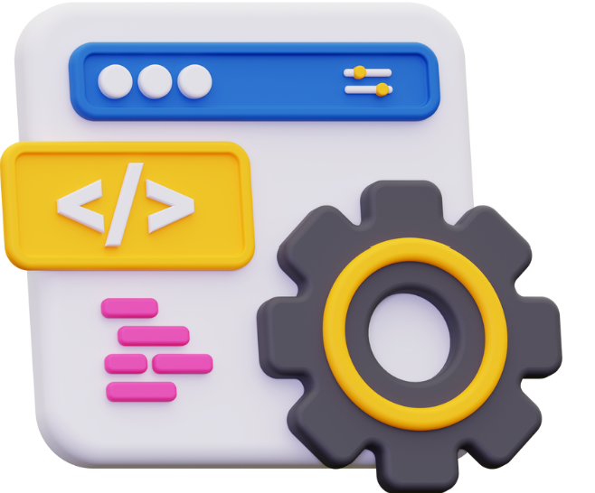
Software
Software is essential for the operation and management of IT systems, encompassing:
Enterprise Resource Planning (ERP) Systems: Integrates core business processes such as procurement, sales, and finance.
Customer Relationship Management (CRM) Software: Manages interactions with clients and customers, storing data on customer activities and preferences.
Security Software: Includes anti-virus programs, encryption tools, and intrusion detection systems to protect the organization's data and operations.
Development Tools: Used by developers to create, test, and maintain software applications vital for the organization’s operations.
Lectures + MCQs @ farhatlectures.com ➔ Free Trial

Slide 4

People
People are the human resources who operate, manage, and use the system, and include:
IT Security Team: Focuses on implementing and maintaining security measures to protect data and manage cybersecurity threats.
Operations Staff: Ensures smooth day-to-day operations and addresses any issues that arise within the IT infrastructure.
Customer Support Team: Provides assistance to users of the system, ensuring customer satisfaction and support.
Compliance Officers: Ensure that the organization adheres to laws, regulations, and standards relevant to its industry.
Lectures + MCQs @ farhatlectures.com ➔ Free Trial

Slide 5

Data
Data involves all information processed and stored within the system, including:
Transactional Data: Records of all business transactions that occur, which are essential for financial reporting and analysis.
Personal Data of Customers: Includes sensitive information that must be protected under privacy laws and regulations.
Operational Data: Used for the analysis and optimization of business processes.
Audit Logs: Tracks and records who performed what actions within the system, crucial for security and compliance audits.
Lectures + MCQs @ farhatlectures.com ➔ Free Trial

Slide 6
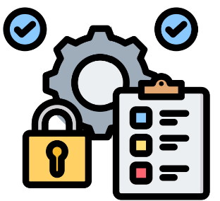
Procedures
Procedures are the operational and business processes related to services and products, such as:
Change Management Processes: Govern how changes to the IT environment are managed and documented to minimize the impact on service quality.
Quality Assurance Testing: Procedures to ensure that new software or updates meet the required standards before they are deployed.
Disaster Recovery Plans: Steps that the organization follows to recover from a catastrophic event, ensuring business continuity.
Data Backup Procedures: Regularly scheduled backups to prevent data loss and provide data recovery options in case of system failure.
Lectures + MCQs @ farhatlectures.com ➔ Free Trial
Lectures + MCQs @ farhatlectures.com ➔ Free Trial

Slide 7
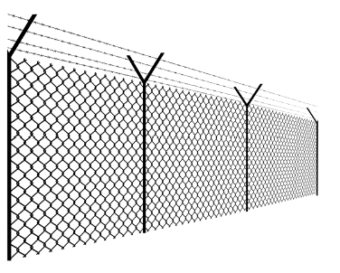
Importance Clear Boundaries
In a SOC 2 engagement, understanding and defining system boundaries is crucial because it specifies what parts of the organization’s setup are being evaluated.
These boundaries involve the infrastructure, software, people, procedures, and data that are integral to the service
Clear system boundaries help:
  stakeholders, including clients, regulatory bodies, and management, understand the scope of the audit.
    This transparency ensures that all parties are aware of the areas being assessed and the controls in place.
  help in managing expectations and in demonstrating compliance with specific criteria relevant to the organization’s service commitments and objectives
Lectures + MCQs @ farhatlectures.com ➔ Free Trial

Slide 8

Human Resource Management System (HRMS)
The boundaries of a system dedicated to human resource management include all components involved in employee-related processes, from recruitment and onboarding to payroll, benefits, performance management, and offboarding.
  Recruitment and Onboarding: Tools for tracking applicants and integrating new hires.
  Payroll Processing: Systems for managing salaries and deductions.
  Benefits Administration: Software for handling employee benefits like health insurance and retirement plans.
  Performance Management: Applications for evaluating and providing feedback on employee performance.
  Employee Data Management: Databases for storing sensitive employee information.
  Employee Offboarding: Procedures for securely managing employee exits.
Purpose: Establishing these boundaries ensures that all HR processes are secure, compliant, and efficient, protecting sensitive employee data and supporting effective HR management. Clear boundaries
Lectures + MCQs @ farhatlectures.com ➔ Free Trial

Slide 9
Information Security Management System (ISMS)
The boundaries for an ISMS encompass all components critical to maintaining the confidentiality, integrity, and availability of an organization's information assets. This includes:
  Network Security: Tools and technologies that protect network infrastructure, including firewalls, intrusion detection systems, and secure VPNs.
  Data Encryption: Technologies used to encrypt data both at rest and in transit to prevent unauthorized access.
  Access Control: Systems that manage user access rights and authentication to ensure that only authorized personnel can access sensitive information.
  Threat Management: Tools for identifying, analyzing, and mitigating potential security threats in real-time.
  Compliance Monitoring: Procedures and technologies to ensure ongoing compliance with relevant data protection regulations and standards.
  Employee Training: Programs that educate employees on security policies, potential risks, and safe practices to minimize human error in data handling.
Purpose: Establishing clear boundaries in an ISMS helps ensure that all aspects of information security are thoroughly managed and protected against breaches and other security incidents. Related boundaries/integrated system
Lectures + MCQs @ farhatlectures.com ➔ Free Trial

Slide 10

Expanding Boundaries Depending on Operational Needs
The boundaries of each system are not fixed and can be adapted based on operational requirements and strategic goals of the organization. For example:
E-commerce Platform: For an e-commerce company, the SOC 2 scope might extend to include systems that handle customer transactions, data analytics tools for customer behavior, inventory management systems, and the cybersecurity measures protecting these systems.
Telecommunication Services: A telecom operator might define boundaries that include network infrastructure, customer data management, service delivery platforms, and emergency response systems.
Lectures + MCQs @ farhatlectures.com ➔ Free Trial

Slide 11
MCQ from Farhatlectures.com
What is the main reason for defining clear system boundaries in a SOC 2 engagement?
A) To determine the financial stability of the service organization
B) To ensure all critical components are included in the assessment
C) To facilitate the external audit of the organization
D) To comply with international trade regulations
Correct Answer: B) To ensure all critical components are included in the assessment
Explanation:
Choice B is correct because defining clear system boundaries ensures that all relevant components are assessed for compliance with SOC 2 criteria.
Choice A is incorrect because the financial stability of the organization is not the focus of SOC 2 engagements.
Choice C is incorrect although external audits benefit from clear boundaries, this is not the primary reason for defining them.
Choice D is incorrect because SOC 2 engagements are not directly concerned with international trade regulations.
Lectures + MCQs @ farhatlectures.com ➔ Free Trial

