Slide 1


Objectives and Responsibilities of Service Auditor
The objectives of a service auditor in SOC engagements (1, 2 or 3) revolve around providing reasonable assurance on certain aspects of the service organization's systems and controls, based on established criteria.
Fair Presentation: The auditor aims to verify that the description provided by management accurately represents the service organization’s system as it was designed and implemented, either throughout a specified period (Type 2) or as of a specific date (Type 1).
  This objective ensures that the information provided by management truly reflects the actual systems in place, helping stakeholders trust the accuracy of the description
Lectures + MCQs @ farhatlectures.com ➔ Free Trial

Slide 2
Objective of Service Auditor
2. Design of Controls: The auditor assesses whether the controls related to the objectives outlined in management’s description were suitably designed during the specified period (Type 2) or as of a particular date (Type 1).
  : Evaluating the design of the controls ensures that they are capable of meeting the specified objectives if they operate as intended.
Lectures + MCQs @ farhatlectures.com ➔ Free Trial

Slide 3
Objective of Service Auditor
3. Operation of Controls: If it's included in the engagement's scope, the auditor evaluates whether the controls operated effectively throughout the specified period.
This is to ensure they provided reasonable assurance that the objectives stated in management’s description were met.
  This checks the effectiveness of the controls in practice, not just in theory, verifying that they function as designed during the audit period.
Lectures + MCQs @ farhatlectures.com ➔ Free Trial

Slide 4

Objective of Service Auditor: Reporting
Based on the findings from the audit, the auditor reports whether the organization's system and controls were presented fairly, designed suitably, and operated effectively in line with the audit objectives.
  This culminates the audit process, where the auditor communicates the results to stakeholders, providing them with an assessment of the service organization’s control environment as per the audit criteria.
Lectures + MCQs @ farhatlectures.com ➔ Free Trial

Slide 5

Responsibilities of Service Auditor
The responsibilities of a service auditor during the planning phase of any System and Organization Controls (SOC) engagement include several critical steps:
  Engagement suitability
  Engagement Terms
  Responsibility of the Service auditor
Lectures + MCQs @ farhatlectures.com ➔ Free Trial

Slide 6
Responsibilities of Service Auditor
Determining Engagement Suitability: The auditor decides whether to accept a new engagement or continue with an ongoing one based on factors like risk, the organization's integrity, and the auditor’s capacity and expertise.
  This step is about ensuring that the auditor is the right fit for the job and that the engagement aligns with professional standards and ethical guidelines.
Lectures + MCQs @ farhatlectures.com ➔ Free Trial

Slide 7

Responsibilities of Service Auditor: Engagement Terms
2. Agreement on Terms: The auditor and the client agree on the terms of the engagement, which define the scope, objectives, and expectations from both sides to ensure clarity and mutual understanding.
  Setting clear terms helps prevent misunderstandings and ensures that both parties are aware of their roles and responsibilities
Lectures + MCQs @ farhatlectures.com ➔ Free Trial

Slide 8
Engagement Terms
Responsibilities of the Service Auditor and the Responsible Party: The service auditor's responsibilities are to conduct the audit and report findings.
The responsible party, typically the management of the service organization, must ensure the accurate presentation of the system and controls, and provide a representation letter confirming the completeness and accuracy of the information provided.
  Establishing these responsibilities ensures accountability and clarifies what is expected from each party, reducing the risk of misunderstandings.

Slide 9
Engagement Terms
Identification of the Criteria: This involves defining the benchmarks or standards against which the system or controls will be assessed.
These criteria are used to measure, evaluate, or disclose the information concerning the subject matter of the audit.
  This is essential for ensuring that the audit has a clear benchmark for evaluation, providing a structured approach to assessing the organization's controls.
Conduct According to Attestation Standards: The agreement should acknowledge that the audit will be performed in accordance with the attestation standards set by the American Institute of Certified Public Accountants (AICPA).
It should also recognize the inherent limitations of an engagement, acknowledging that while the audit aims to provide reasonable assurance, it does not guarantee absolute assurance.
  Agreeing to follow AICPA standards ensures the audit adheres to professional and ethical guidelines, enhancing the reliability and credibility of the audit.
Lectures + MCQs @ farhatlectures.com ➔ Free Trial

Slide 10
Engagement Terms
Management's Written Assertion: The auditor should request that management provide a written assertion.
This assertion is a formal statement by management affirming the fairness and accuracy of the presentation of the system and the effectiveness of the controls.
  This requirement emphasizes management's involvement and their commitment to the accuracy and completeness of the information being audited. It forms a part of the evidential matter necessary for the audit.
Lectures + MCQs @ farhatlectures.com ➔ Free Trial

Slide 11

Responsibilities of Service Auditor
3. Understanding of the Assertion: The auditor must reach an agreement with management on providing a written assertion.
This assertion should state that the management’s description of the system is fairly presented and that the design and, if applicable, operation of the controls are suitable for achieving the specified objectives.
  The agreement on a written assertion is crucial for holding management accountable for their representation of the system and controls.
Lectures + MCQs @ farhatlectures.com ➔ Free Trial

Slide 12
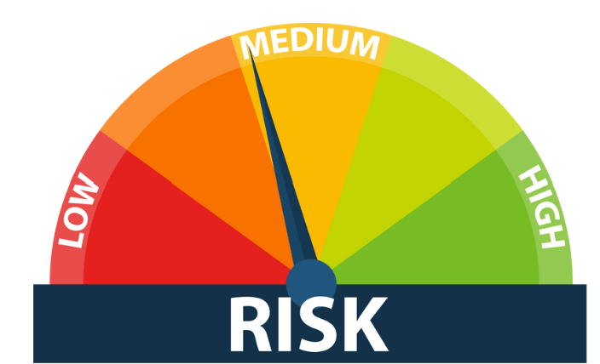
Planning for SOC 1
Risk Assessment (SOC 1): This is specific to financial reporting and is essential to identifying areas where financial information could be misstated.
Understanding the System and Criteria (SOC 1):
  This thorough understanding is critical to ensuring the audit is effectively tailored to the specific context and requirements of the organization.
Lectures + MCQs @ farhatlectures.com ➔ Free Trial

Slide 13

Planning SOC 2 and 3
During the planning of SOC 2 and SOC 3 engagements, the service auditor has specific responsibilities that help ensure a thorough and effective audit:
  Establishing an Engagement Strategy: The auditor sets the scope, timing, and direction of the audit, outlining the engagement plan.
  This includes considerations of materiality and identifying potential risks of material misstatement for SOC 2.
    This step is crucial as it lays the groundwork for the entire audit process.
    It involves making key decisions on how the audit will be conducted, what areas will be covered, and when various aspects of the audit will be performed.
    This strategy is essential for organizing and directing the audit efficiently and effectively.
Lectures + MCQs @ farhatlectures.com ➔ Free Trial

Slide 14
Planning SOC 2 and 3
Performing Risk Assessment Procedures: For SOC 2 specifically, the auditor conducts risk assessments to understand the service organization’s system.
The auditor evaluates how the system controls were designed, implemented, and operated to verify they meet the service organization’s commitments and requirements based on the Trust Services Criteria.
  By understanding the design, implementation, and operation of the system’s controls, the auditor can identify areas where there might be weaknesses or gaps.
  This detailed risk assessment helps in focusing the audit efforts on areas that are most crucial for ensuring the reliability and security of the service organization’s operations as per the Trust Services Criteria.
  This is a critical step in ensuring that the auditor can provide a reasonable assurance about the organization's controls and their effectiveness in meeting the specified objectives.
Lectures + MCQs @ farhatlectures.com ➔ Free Trial

Slide 15
MCQ from Farhatlectures.com
A service organization is planning to undergo a SOC 2 engagement. Which of the following would be the primary focus of the auditor’s risk assessment procedures?
a) The organization's financial reporting accuracy.
b) The effectiveness of internal controls over financial reporting.
c) How the organization’s system controls meet the service commitments based on Trust Services Criteria.
d) The organization's compliance with international financial reporting standards.
Correct Answer: c) How the organization’s system controls meet the service commitments based on Trust Services Criteria.
Choice a is incorrect because financial reporting accuracy is more relevant to a SOC 1 engagement.
Choice b is incorrect as it pertains specifically to SOC 1, which focuses on internal controls over financial reporting.
Choice c is correct because SOC 2 engagements evaluate the effectiveness of controls related to security, availability, processing integrity, confidentiality, or privacy, as stipulated by the Trust Services Criteria.
Choice d is incorrect because SOC engagements do not primarily focus on international financial reporting standards.
Lectures + MCQs @ farhatlectures.com ➔ Free Trial

