Slide 1


COSO Integrated Framework + TSC
5 Components:
  Control Environment (5 principles + points of focus)
  Risk Assessment (4 Principles + points of focus)
  Control Activities (3 principles + points of focus) + supplemental Criteria
  Information and Communication (3 principles + points of focus)
  Monitoring (2 Principles + points of focus)
Total of 17 Principles
Additional categories
  Availability (A Series)
  Privacy (P series)
  Confidentiality (C Series)
  Processing Integrity (PI Series)
Lectures + MCQs @ farhatlectures.com ➔ Free Trial

Slide 2
Additional Categories
The trust services criteria are guidelines used to evaluate the security and reliability of information systems.
These criteria are divided into two main parts:
Common Criteria: These are criteria that apply to all five categories of trust services.
They are general rules or standards that every category must meet, regardless of their specific functions.
Additional Specific Criteria: These are criteria that are specific to each of the following four categories:
  Availability: Ensures that information and systems are accessible to authorized users when needed. A series
  Processing Integrity: Ensures that system processing is complete, accurate, timely, and authorized. PI Series
  Confidentiality: Protects information that should not be disclosed to unauthorized individuals. C Series
  Privacy: Ensures the personal information of users is collected, used, disclosed, and disposed of properly and securely. P series
Lectures + MCQs @ farhatlectures.com ➔ Free Trial

Slide 3

Availability: A1.1: Managing Processing Capacity
The entity must actively manage and monitor how much capacity its systems are using and have a plan to increase capacity when needed to meet its goals.
Example: A streaming service tracks the number of viewers during live events and adds more servers automatically to handle spikes in viewership to prevent buffering and downtime.
Lectures + MCQs @ farhatlectures.com ➔ Free Trial

Slide 4
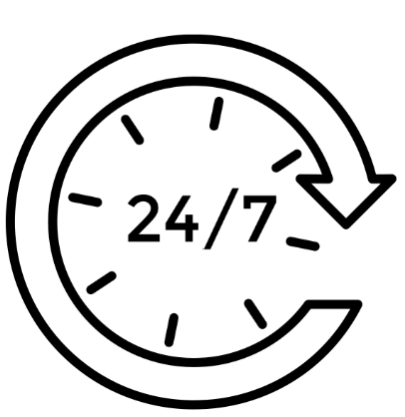
Availability: A1.2 Ensuring System Availability
The entity must identify potential environmental threats to its systems (like natural disasters or power outages), set up measures to detect and guard against these threats, and have a clear plan for responding to them.
This includes performing regular data backups, storing data offsite, and having alternative systems ready to take over if needed.
Example: A bank has sensors and alarms to detect flooding in its data center.
In case of water detection, the system triggers an alert, automatically switches operations to another data center in a different location, and initiates data recovery from backed-up storage.
Lectures + MCQs @ farhatlectures.com ➔ Free Trial

Slide 5

Availability: A1.3 Testing Recovery Plans
The entity must regularly test its recovery procedures to ensure they work effectively and can meet the organization's needs during an actual emergency.
Example: A hospital conducts quarterly disaster recovery drills, simulating a scenario where critical systems fail.
The test involves restoring clinical systems from backups to ensure that patient services can continue smoothly even during a system outage.
Lectures + MCQs @ farhatlectures.com ➔ Free Trial

Slide 6

Processing Integrity :
PI1.1: Managing Quality Information
The additional criteria for processing integrity focus on ensuring that all aspects of an entity's operations involving data processing are handled correctly and efficiently.
This helps in delivering products or services that meet specific objectives in terms of quality and reliability. :
PI1.1 Managing Quality Information
The entity ensures that it obtains, uses, and shares accurate and relevant information needed to achieve its processing goals, which support the quality of its products and services.
Example: A software company gathers feedback from users regularly and uses this information to update its development priorities, ensuring that upgrades align with user needs and expectations.
Lectures + MCQs @ farhatlectures.com ➔ Free Trial

Slide 7

Processing Integrity
PI1.2: Controls Over System Inputs
The entity sets up rules and procedures to control the information entering its systems, ensuring this data helps produce outputs (products, services, reports) that fulfill the entity's goals.
Example: An online retailer has automated checks to verify the accuracy of product pricing and stock levels entered into its database, ensuring customers receive correct information and the inventory is managed properly.
Lectures + MCQs @ farhatlectures.com ➔ Free Trial

Slide 8
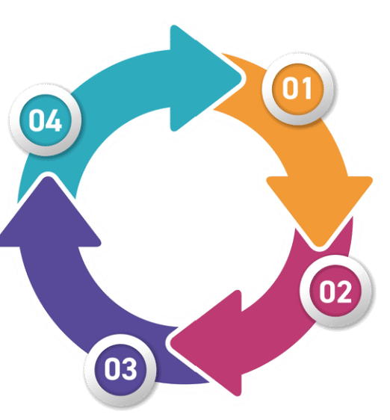
Processing Integrity
PI1.3: Controls Over System Processing
The entity has rules and procedures in place to manage how data is processed within its systems, guaranteeing the resulting products, services, and reports meet the set objectives.
Example: A financial institution uses software that double-checks calculations for loan eligibility and terms, ensuring all offers meet regulatory standards and internal criteria.
Lectures + MCQs @ farhatlectures.com ➔ Free Trial

Slide 9
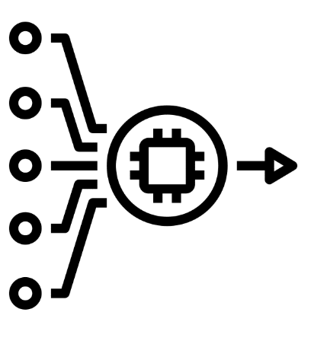
Processing Integrity
PI1.4: Delivery of Outputs
The entity ensures that the final outputs—whether products, services, or reports—are delivered accurately, completely, and on time.
Example: A manufacturing company has systems that automatically check and record the quality of finished products before they are shipped to customers, ensuring every item meets company standards.
Lectures + MCQs @ farhatlectures.com ➔ Free Trial

Slide 10
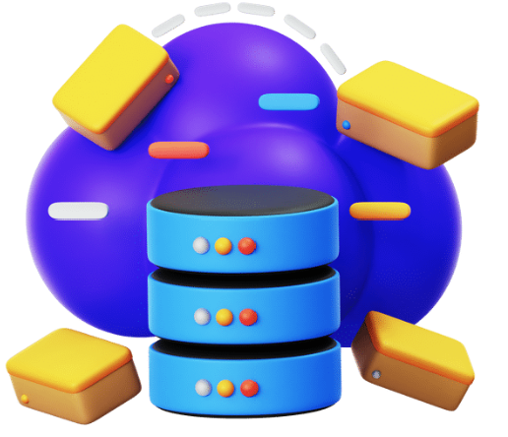
Processing Integrity
PI1.5: Storage of Data
The entity has policies to store all incoming data, data in process, and final outputs in a manner that maintains their accuracy, completeness, and timeliness, aligning with specified system requirements.
Example: A hospital uses a digital system that securely stores patient records, ensuring they are updated in real-time as new medical information becomes available and are accessible when needed for treatment.
Lectures + MCQs @ farhatlectures.com ➔ Free Trial

Slide 11

Confidentiality
C1.1: Identification and Maintenance of Confidential Information
The additional criteria for confidentiality focus on the proper handling of confidential information within an entity to ensure that such information remains secure and is used appropriately.
C1.1: Identification and Maintenance of Confidential Information
The entity must accurately identify what information is confidential and have systems and processes in place to maintain the confidentiality of this information, aligning with the entity's objectives.
Example: A law firm classifies client communication and case details as confidential.
It uses encrypted communication channels and restricts access to these documents to authorized personnel only, ensuring that sensitive information is not exposed to unauthorized individual.
Lectures + MCQs @ farhatlectures.com ➔ Free Trial

Slide 12

Confidentiality
C1.2: Disposal of Confidential Information
The entity must have procedures to safely dispose of confidential information in a manner that continues to protect its confidentiality, meeting the organization's objectives.
Example: A healthcare provider uses a secure shredding service to dispose of outdated patient records and uses certified software for securely deleting electronic records, ensuring that no sensitive information can be retrieved after disposal.
Lectures + MCQs @ farhatlectures.com ➔ Free Trial

Slide 13

Privacy
The additional criteria for privacy involve a series of guidelines aimed at safeguarding personal data throughout its lifecycle.
These guidelines ensure that data is collected and used ethically, with transparency and respect for individual privacy rights.
P1.0: Notice and Communication of Objectives Related to Privacy
  The entity informs individuals about how and why their personal data will be used, ensuring transparency in its privacy practices.
P2.0: Choice and Consent
  Individuals are given choices regarding the collection and use of their personal data, and their consent is obtained before their data is processed.
P3.0: Collection
  Personal data is collected only for specific, clear, and legitimate purposes, and the collection is done in a lawful and fair manner.
P4.0: Use, Retention, and Disposal
  Personal data is used only for the purposes specified at the time of collection, retained only as long as necessary, and disposed of securely to protect privacy.
Lectures + MCQs @ farhatlectures.com ➔ Free Trial

Slide 14
Privacy
P5.0: Access
  Individuals have the right to access their personal data and correct it if necessary, ensuring data accuracy and completeness.
P6.0: Disclosure and Notification
  The entity clearly discloses to third parties how personal data is handled and notifies individuals about who their data might be shared with.
P7.0: Quality
  The entity ensures that personal data is accurate, complete, and up-to-date, appropriate for the purposes for which it is used.
P8.0: Monitoring and Enforcement
  Practices for handling personal data are regularly monitored and enforced to ensure compliance with privacy policies and regulations.
Lectures + MCQs @ farhatlectures.com ➔ Free Trial

Slide 15
MCQ from Farhatlectures.com
A rapidly growing online retailer is evaluating its current IT infrastructure to ensure it can handle increasing traffic during peak shopping seasons.
What should the retailer primarily focus on to enhance system availability in line with Trust Services Criteria for Availability?
Encrypting customer data.
Monitoring and evaluating processing capacity.
Redesigning the website interface.
Increasing the marketing budget.
Correct Answer: b) Monitoring and evaluating processing capacity.
Explanation:
  Choice b is correct because it addresses A1.1, which focuses on managing capacity to meet demands and support system availability.
  Choice a is incorrect because encryption relates more to confidentiality and security rather than availability.
  Choice c is incorrect because while a redesigned interface might improve user experience, it does not directly impact the processing capacity or system availability.
  Choice d is incorrect because the marketing budget does not influence the technical aspects of system availability.
Lectures + MCQs @ farhatlectures.com ➔ Free Trial

