Slide 1


Attestation Engagements
An attestation engagement is a service where auditors evaluate the reliability of a third party’s statements (assertions) about subjects (subject matter) such as financial statements, compliance or controls using a particular benchmark or criteria.
The auditor then issues a report providing an opinion or conclusion, with varying levels of assurance based on the type of engagement.
This process helps lend credibility to the audited information, aiding stakeholders in decision-making.
Lectures + MCQs @ farhatlectures.com ➔ Free Trial

Slide 2
SOC 2 Attestation Angagement
A SOC 2 attestation engagement is a specific type of audit designed to evaluate and report on controls at a service organization relevant to the security, availability, processing integrity, confidentiality, and privacy of a system.
  Trust Services Criteria (TSC)
This type of audit is guided (benchmark) by the American Institute of Certified Public Accountants (AICPA) standards and specifically addresses the needs of service organizations that store, process, or transmit information on behalf of their clients.
Lectures + MCQs @ farhatlectures.com ➔ Free Trial

Slide 3
SOC 2 Engagement
In a SOC 2 engagement, management assert that:
  The controls (relevant to trust service criteria) were appropriately designed (description) and implemented to meet the organization’s service commitments and system requirements.
  Benchmark: These controls are based on the Trust Services Criteria (specific criteria) relevant to the chosen trust services categories, such as security or availability.
In a SOC 2 engagement,
the service auditor, on the other hand, reviews management's description and the controls to:
  Assess and express an opinion on the accuracy and completeness of management's description of the system.
  Evaluate the suitability of the control design to meet the specified objectives according Trust Services Criteria (specific criteria).
Lectures + MCQs @ farhatlectures.com ➔ Free Trial

Slide 4

SOC 2 Report (Type 1 and 2)
A SOC 2 Type 1 report evaluates whether the controls were suitably designed to achieve the specified objectives at a specific point in time.
A SOC 2 Type 2 report goes further by asserting that these controls not only were suitably designed but also operated effectively over a period.
Lectures + MCQs @ farhatlectures.com ➔ Free Trial

Slide 5
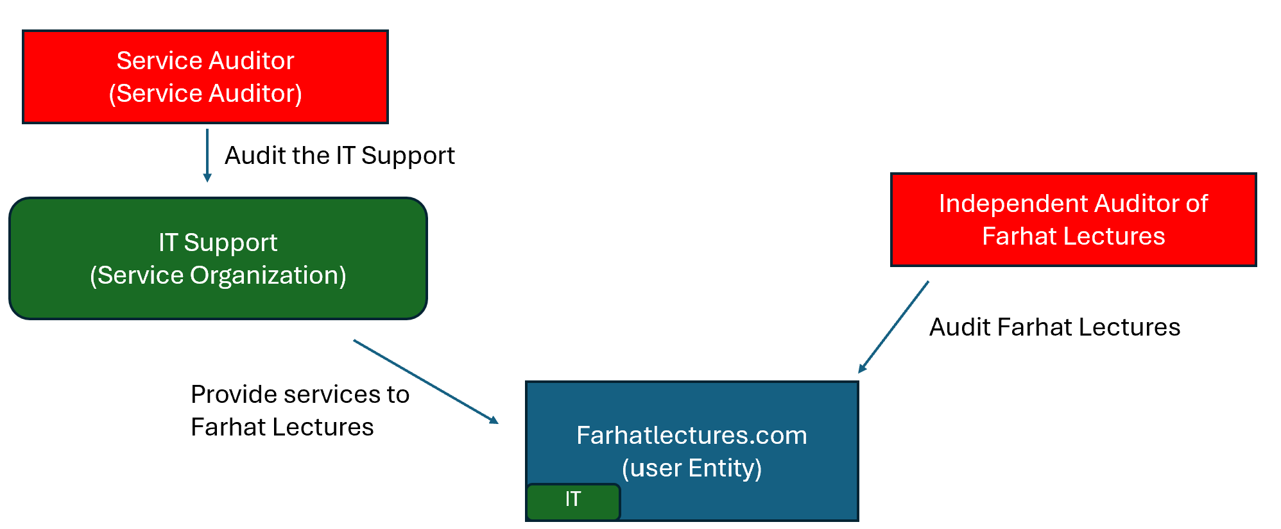
Service Organization
Subject Matter
(IT Controls)
Criteria
(TSC and COSO Framework
Assertions
Auditor
Subject Matter
(IT Controls)
Criteria
(TSC and COSO)
Report
Lectures + MCQs @ farhatlectures.com ➔ Free Trial

