Slide 1
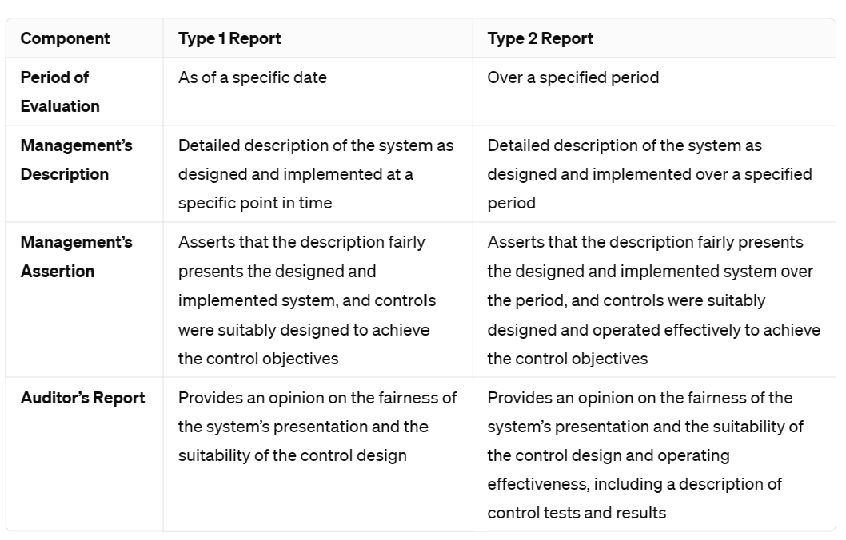

Trust Services Criteria (TSC)
Lectures + MCQs @ farhatlectures.com ➔ Free Trial

Slide 2
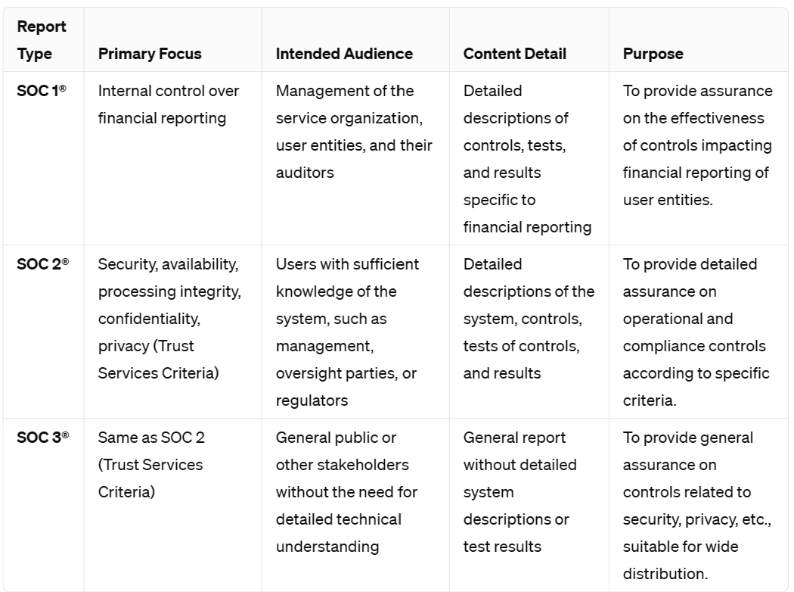
Trust Services Criteria (TSC)
Lectures + MCQs @ farhatlectures.com ➔ Free Trial

Slide 3

Purpose of Trust Services Criteria (TSC)
The TSC provide a standardized framework that practitioners use to assess whether the controls in place are adequate and effective in protecting the aspects of information systems that are critical to the reliability and security of those systems.
  Measurement tool. Think of GAAP
This is crucial for organizations that need to demonstrate the robustness of their control environments to stakeholders, clients, and regulatory bodies.
Lectures + MCQs @ farhatlectures.com ➔ Free Trial

Slide 4

Trust Services Criteria (TSC)
TSC established by the AICPA's Assurance Services Executive Committee (ASEC) are designed to guide entities in creating and implementing controls that mitigate inherent risks to their internal systems.
These risks, if not properly managed, could hinder the entity's ability to meet its objectives.
The TSC outline specific outcomes that an entity's controls should achieve to ensure they effectively support the entity's goals.
In the context of SOC 2® and SOC 3® engagements, these criteria are particularly relevant.
These engagements focus on evaluating and reporting on the controls surrounding the security, availability, processing integrity, confidentiality, and privacy of an entity's information and systems.
  Practitioners can base their reports on one or more of these five trust services categories, depending on the scope of the audit.
Lectures + MCQs @ farhatlectures.com ➔ Free Trial

Slide 5
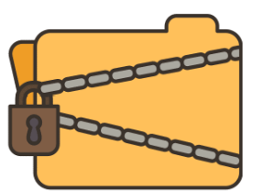
Trust Services Criteria: Confidentiality
1.Confidentiality: This criterion ensures that information deemed confidential is protected according to the organization's objectives.
  Confidential information could include trade secrets, intellectual property, or business strategies that are crucial for maintaining competitive advantage.
  Example: A law firm uses encrypted data storage and restricts access to sensitive client documents to ensure that only authorized personnel can view them, thereby meeting its confidentiality objectives.
Lectures + MCQs @ farhatlectures.com ➔ Free Trial

Slide 6

Trust Services Criteria: Availability
Availability: This focuses on ensuring that information and systems are accessible and usable for operation as needed to meet the organization's objectives.
  This includes maintaining hardware, performing necessary upgrades, and defending against denial-of-service attacks.
  Example: An e-commerce website implements redundant server and network architectures to ensure that their online store remains operational during high traffic events like Black Friday sales.
Lectures + MCQs @ farhatlectures.com ➔ Free Trial

Slide 7

Trust Services Criteria: Processing Integrity
This criterion ensures that system processing is complete, valid, accurate, timely, and authorized, supporting the entity’s objectives efficiently without errors or omissions.
  Example: A bank's transaction processing system is designed to ensure that all transactions are automatically logged, reviewed for accuracy, and processed on the same day they are made to maintain financial integrity.
Lectures + MCQs @ farhatlectures.com ➔ Free Trial

Slide 8
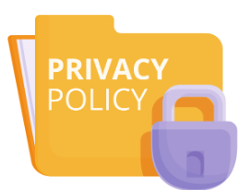
Trust Services Criteria: Privacy
Privacy: This involves the proper handling of personal information throughout its lifecycle, including how it is collected, used, retained, disclosed, and disposed of, in alignment with the entity’s objectives and privacy policies.
  Example: A healthcare provider uses secure systems to manage patient records, ensuring that personal health information is accessible only to authorized medical personnel and is deleted securely when no longer needed.
Lectures + MCQs @ farhatlectures.com ➔ Free Trial

Slide 9

Trust Services Criteria: Security
This category covers the protection of information and systems from unauthorized access, disclosure, and damage.
  This is crucial for maintaining the trustworthiness and reliability of systems and data.
  Example: A technology company uses multi-factor authentication, firewalls, and intrusion detection systems to prevent unauthorized access to its network and to protect its systems and data from cyber threats.
Lectures + MCQs @ farhatlectures.com ➔ Free Trial

Slide 10
TSC (Security)
The security category is typically a central focus in most trust services engagements because both organizations and their external stakeholders (such as customers and business partners) heavily rely on technology.
This reliance brings increased concerns about cybersecurity risks and their potential impact on operational processes.
Given the critical importance of safeguarding data and systems, security controls are usually prioritized in evaluations of system controls.
However, there are rare instances where the security category might not be explicitly addressed in a trust services engagement.
This could occur if the specific scope of the engagement is focused on other aspects such as availability, processing integrity, confidentiality, or privacy, depending on the particular needs and risk profile of the organization.
  In such cases, while security may not be the main focus, it is generally still considered to some extent, given its foundational role in protecting information systems.
Lectures + MCQs @ farhatlectures.com ➔ Free Trial

Slide 11

SOC Cybersecurity
The Trust Services Criteria offer a flexible framework that can be applied to a variety of different audits or evaluations.
This flexibility allows practitioners to tailor their reports to specific subject matters depending on the needs of the entity.
One key application of these criteria is in a SOC for Cybersecurity engagement.
In such an engagement, a practitioner evaluates the effectiveness of an entity's cybersecurity risk management program.
  The goal is to determine whether the controls in place effectively support the entity's cybersecurity objectives.
Lectures + MCQs @ farhatlectures.com ➔ Free Trial

Slide 12
SOC Cybersecurity
To do this, the practitioner uses relevant Trust Services Criteria, particularly those focused on:
  security,
  availability, and
  confidentiality.
These criteria serve as the basis for assessing how well the entity protects its systems and information from unauthorized access, ensures system and data availability for operation and use, and maintains the confidentiality of sensitive information.
Lectures + MCQs @ farhatlectures.com ➔ Free Trial

Slide 13
Example
For example, a practitioner might evaluate a financial institution's cybersecurity program by reviewing its:
  firewall and intrusion detection systems (security),
  its data backup and disaster recovery processes (availability), and
  its data encryption practices (confidentiality).
This comprehensive evaluation helps ensure that the institution's cybersecurity measures align with its overall objectives and adequately protect its stakeholders.
Lectures + MCQs @ farhatlectures.com ➔ Free Trial

Slide 14
MCQ from Farhatlectures.com
In a SOC for Cybersecurity engagement, which Trust Services Criteria might be most relevant?
Security and availability
Confidentiality and privacy
Processing integrity and economic efficiency
Compliance with international trade laws and financial reporting
Correct Answer: a) Security and availability
Explanation:
  Choice a is correct because security and availability are central to evaluating the effectiveness of cybersecurity controls.
  Choice b is incorrect because while important, confidentiality and privacy are not as central to cybersecurity controls as security and availability.
  Choice c is incorrect as processing integrity pertains to data accuracy and completeness, and economic efficiency is not a Trust Services Criterion.
  Choice d is incorrect because compliance with trade laws and financial reporting are not central to cybersecurity engagements.
Lectures + MCQs @ farhatlectures.com ➔ Free Trial

