Slide 1
Area I – Information Systems and Data Management (35–45%)
Information systems
1. IT infrastructure
Summarize the role and responsibilities of cloud service providers

Slide 2
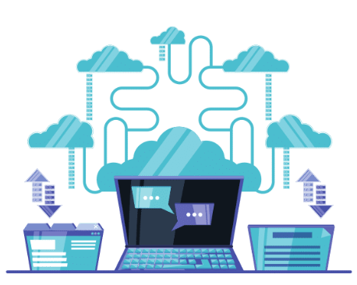

Cloud Service Providers: Role and Responsibilities
Cloud service providers (CSPs) are companies that offer a range of services related to computing, storage, networking, analytics, and applications on the internet (in the cloud).
  Amazon Web Services (AWS), Microsoft Azure, Google Cloud Platform (GCP), IBM Cloud, Oracle Cloud, Alibaba Cloud
Customers can access these resources on a pay-as-you-go basis, typically eliminating the need to own and maintain physical hardware.
  Responsibilities of Cloud Service Providers
Lectures + MCQs @ farhatlectures.com ➔ Free Trial

Slide 3
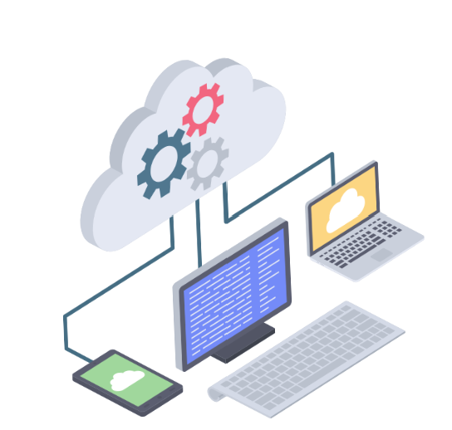
Responsibilities of Cloud Service Providers
Cloud service Providers are responsible for the following:
  Infrastructure Maintenance
  Data Security
  Service Availability
  Backup and Recovery
  Customer Support and Issue Resolution
  Compliance and Legal Obligations
  Innovation and Updates
Lectures + MCQs @ farhatlectures.com ➔ Free Trial

Slide 4
Infrastructure Maintenance
1. Hardware Maintenance:
  Regular Inspections: Conducting routine inspections of servers, storage devices, networking equipment, and other hardware components to identify and rectify any anomalies or wear and tear.
  Hardware Upgrades and Replacement: Updating hardware components periodically to ensure optimal performance and replacing faulty or outdated hardware to prevent failures.
2. Software Maintenance:
  Patch Management: Regularly updating software, operating systems, and applications with the latest patches to address vulnerabilities and bugs.
  Software Upgrades: Implementing new software versions to leverage advanced features and improvements.
  Configuration Management: Managing and optimizing software configurations to ensure stability and performance.
3. Network Maintenance:
  Monitoring: Continuously observing network performance and traffic to identify and resolve issues promptly.
  Optimization: Regularly refining network configurations and topologies to ensure optimal performance and reliability.
  Security: Implementing and maintaining firewalls, intrusion detection/prevention systems, and other security measures to safeguard network infrastructure.
Lectures + MCQs @ farhatlectures.com ➔ Free Trial

Slide 5

Data Security
Data security is one of the core responsibilities of cloud service providers. It involves the protection of data, applications, and infrastructures from unauthorized access, attacks, and data breaches.
Implementation and Management:
  Encryption: CSPs encrypt data at rest and in transit, employing advanced cryptographic techniques to protect sensitive information.
  Access Control: Providers implement stringent access controls, ensuring that only authorized individuals can access sensitive resources and data.
  Firewalls and Intrusion Detection Systems: These are used to monitor and block malicious traffic and potential threats.
  Security Compliance: Providers adhere to various industry standards and regulations like GDPR, HIPAA, and ISO 27001 to ensure data protection and privacy.
  Regular Audits: Security audits are conducted regularly to identify and mitigate vulnerabilities.
Lectures + MCQs @ farhatlectures.com ➔ Free Trial

Slide 6

Service Availability
Service availability is crucial for maintaining the continuity of services provided by the CSPs.
It’s typically governed by Service Level Agreements (SLAs) which outline the expected level of service availability, usually expressed as a percentage (e.g., 99.9%).
Implementation and Management:
  Redundancy: Multiple servers, data centers, and network paths are used to ensure continuous service availability, even if one component fails.
  Load Balancing: Distributing incoming network traffic across multiple servers to ensure no single server is overwhelmed.
  Monitoring: Continuous monitoring of services and infrastructure to detect and resolve issues promptly.
  Incident Response: Having predefined procedures for responding to incidents, minimizing downtime.
  Disaster Recovery Planning: Creating and implementing plans to recover services quickly in the event of a disaster.
Lectures + MCQs @ farhatlectures.com ➔ Free Trial

Slide 7

Backup and Recovery
Backup and recovery are essential for safeguarding data against loss, deletion, corruption, or a security incident. It helps in restoring data to its original state in case of any adversities.
Implementation and Management:
  Regular Backups: Performing regular backups of data, applications, and configurations.
  Offsite Storage: Storing backup data in a geographically separate location from the primary data center to protect against local disasters.
  Data Retention Policies: Implementing policies governing how long backup data is retained, depending on regulatory requirements and business needs.
  Testing: Regularly testing backup and recovery processes to ensure data can be restored accurately and promptly.
  User-Driven Backups and Recovery: Providing options for users to initiate backups and recover data as needed, offering more flexibility and control.
Lectures + MCQs @ farhatlectures.com ➔ Free Trial

Slide 8

Customer Support and Issue Resolution
Support Services: Providing assistance to customers experiencing issues with the services and resolving their queries.
Incident Management: Addressing and resolving incidents affecting service availability or performance promptly.
Cost Management: Offering transparent pricing and helping customers to manage and optimize their costs.
Lectures + MCQs @ farhatlectures.com ➔ Free Trial

Slide 9

Compliance and Legal Obligations
Compliance and Legal Obligations: Adhering to relevant laws, regulations, and industry standards related to data protection and privacy.
Compliance Audits: Ensuring the infrastructure adheres to legal and regulatory standards related to data protection, privacy, and other industry-specific requirements (HIPPA, GDRP).
Legal Liaisons: Keeping abreast with the changing legal landscape and aligning infrastructure maintenance strategies accordingly.
Lectures + MCQs @ farhatlectures.com ➔ Free Trial

Slide 10

Innovation and Updates
Regularly updating services and introducing new features and technologies to meet evolving customer needs.
1. Research and Development:
  Investment: Cloud service providers allocate substantial resources for R&D to create innovative solutions and stay ahead of the competition.
  Emerging Technologies: The R&D teams explore emerging technologies such as quantum computing, edge computing, and AI to develop new services and improve existing ones.
2. Service Improvement and Optimization:
  Feature Development: New features are developed and introduced to meet evolving customer needs and demands.
  User Experience: Innovations are aimed at improving the user interface and overall user experience.
Lectures + MCQs @ farhatlectures.com ➔ Free Trial

Slide 11
Innovation and Updates
Sustainability Innovations:
  Green Computing: The development and adoption of energy-efficient technologies and practices to reduce environmental impact.
  Renewable Energy: Implementing and promoting the use of renewable energy sources to power data centers and other infrastructures.
User-Centric Innovations:
  Customization: Developing new ways for users to customize services according to their specific needs.
  Accessibility: Innovating to make services more accessible to people with disabilities, ensuring inclusivity.
Lectures + MCQs @ farhatlectures.com ➔ Free Trial

Slide 12
MCQ from Farhat Lectures
An e-commerce company is assessing its data recovery options with a cloud service provider.
Question: What is crucial for safeguarding data against loss and enabling restoration of data to its original state?
a) Data Encryption
b) Load Balancing
c) Regular Backups
d) Network Optimization
Correct: Regular Backups are pivotal for safeguarding data and enabling restoration.
Incorrect:
  Data Encryption: It's crucial for protecting data from unauthorized access, not for restoration.
  Load Balancing: It is used for distributing network or application traffic across several servers.
  Network Optimization: It involves refining network configurations and topologies for optimal performance.
Lectures + MCQs @ farhatlectures.com ➔ Free Trial

