Slide 1
Area I – Information Systems and Data Management
  A. Information System:
  IT Infrastructure
  Explain the purpose and recognize examples of key components of IT architecture (e.g., operating systems, servers, network infrastructure, end-user devices.

Slide 2
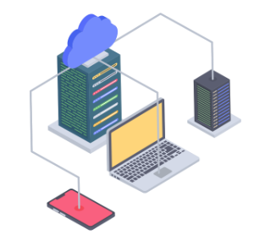

Purpose of IT Architecture Components
IT Architecture is crucial for organizing and utilizing technology resources to meet the business objectives and needs of an organization.
Some key components of IT Architecture and their purposes:
  Operating System
  Servers
  Network Infrastructure
  End-User Devices
  Storage
  Middleware
  Software Applications
  Data Architecture
Lectures + MCQs @ farhatlectures.com ➔ Free Trial

Slide 3
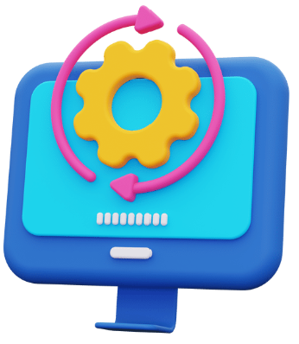
Operating Systems (1 of 8)
System software that manages computer hardware, software resources, and provides various services for computer programs. Brain!
It acts as an intermediary between users and the computer hardware. Chaos!
Purpose:
  Manage Hardware Resources:
    Controls and manages hardware such as CPU, memory, storage devices, and input/output devices.
    Allocates resources and ensures the efficient execution of tasks.
  Provide Services to Software Applications:
    Offers services and libraries that are required for the development and execution of software applications.
    Handles errors and manages interactions between software and hardware.
  Enable User Interactions:
    Offers a user interface, either graphical or command-line, allowing users to interact with the computer.
    Manages user input and output, translating user actions into machine-level instructions.
Lectures + MCQs @ farhatlectures.com ➔ Free Trial

Slide 4
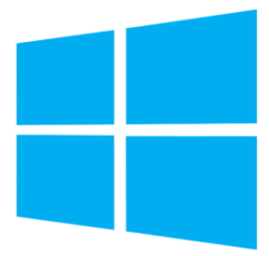

Types of Operating Systems
Desktop Operating Systems:
  Examples: Windows, MacOS, Linux.
  Usage: Primarily used on personal computers, laptops, and workstations.
Mobile Operating Systems:
  Examples: iOS, Android.
  Usage: Developed for mobile devices like smartphones and tablets.
Server Operating Systems:
  Examples: Windows Server, Ubuntu Server.
  Usage: Designed to run on servers and provide services to networked computers.
Embedded Operating Systems:
  Examples: FreeRTOS, Embedded Linux.
  Usage: Tailored for embedded systems like appliances, industrial machines, and automobiles.
Real-Time Operating Systems (RTOS):
  Examples: QNX, VxWorks.
  Usage: Used where timely and deterministic responses are critical, such as in robotics, aircraft navigation, and medical devices.
Lectures + MCQs @ farhatlectures.com ➔ Free Trial

Slide 5
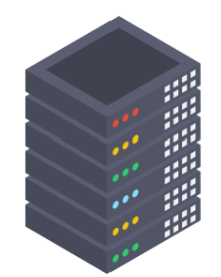
Servers (2 of 8)
A server is a software application or a hardware device designed to perform a specific task, or a set of tasks, and respond to requests across a computer network.
Purpose:
  Host and Manage Applications, Services, and Databases:
    Stores, processes, and manages access to information, applications, and services.
    Acts as a centralized location where services are hosted and data is stored and retrieved.
  Serve Client Requests and Manage Network Resources:
    Handles requests from clients and serves responses, allowing multiple clients to interact with the same application or database.
    Manages network resources and allocates them to different clients as required.
Lectures + MCQs @ farhatlectures.com ➔ Free Trial

Slide 6
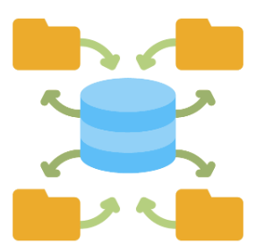
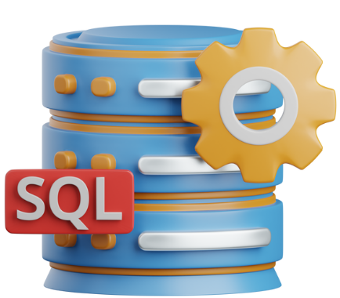
Types of Servers
Web Servers:
  Purpose: Host and serve web pages to users.
  Examples: Apache HTTP Server, Nginx, Microsoft Internet Information Services (IIS).
Database Servers:
  Purpose: Provide database services and respond to database queries from client machines.
  Examples: MySQL, Microsoft SQL Server, Oracle Database.
Application Servers:
  Purpose: Host and run specific software applications.
  Examples: Apache Tomcat, JBoss, IBM WebSphere.
File Servers:
  Purpose: Manage and provide access to files within an internal network.
  Examples: Windows File Server, Samba Server.
Lectures + MCQs @ farhatlectures.com ➔ Free Trial

Slide 7
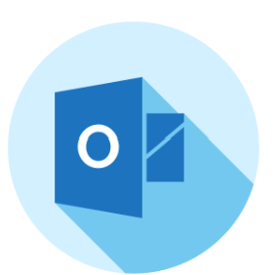
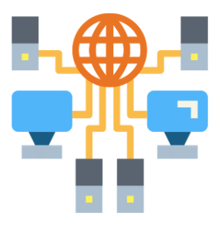
Types of Servers
5.Mail Servers:
  Purpose: Manage and transfer emails over a network.
  Examples: Microsoft Exchange Server, Postfix, Sendmail.
6.DNS Servers:
  Purpose: Resolve domain names to IP addresses.
  Examples: BIND, Microsoft DNS, Unbound.
7.Proxy Servers:
  Purpose: Act as intermediaries between end-users and the websites they visit, providing security, anonymity, and content filtering.
  Examples: Squid, Nginx, Apache Traffic Server.
Lectures + MCQs @ farhatlectures.com ➔ Free Trial

Slide 8
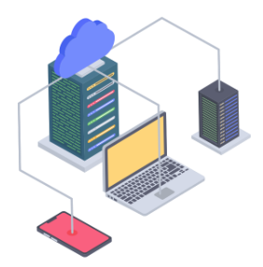
Network Infrastructure (3 of 8)
Refers to the hardware and software resources of an entire network that enable network connectivity, communication, operations, and management of an enterprise network.
Purpose:
Provide Connectivity and Communication:
  Enable the interconnection of computers and other devices to share resources and information.
  Facilitate communication between users, systems, applications and extenal network/internet
Ensure Data Integrity, Availability, and Security:
  Protect data from unauthorized access and data corruption throughout its lifecycle.
  Ensure that network services are available when needed.
Lectures + MCQs @ farhatlectures.com ➔ Free Trial

Slide 9
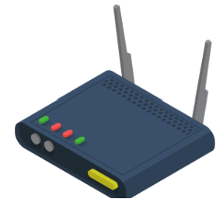
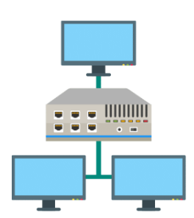

Components and Examples
Routers:
  Purpose: Direct packets between networks and connect different network segments.
  Examples: Cisco Routers, Juniper Routers.
Switches:
  Purpose: Connect devices within a network segment and use MAC addresses to forward data to the correct destination.
  Examples: Cisco Switches, Netgear Switches.
Firewalls:
  Purpose: Protect networks from unauthorized access and cyber threats by controlling incoming and outgoing network traffic.
  Examples: Palo Alto Networks Firewalls, Fortinet FortiGate.
Access Points:
  Purpose: Provide wireless connectivity to a wired network.
  Examples: Aruba Access Points, Cisco Aironet.
Lectures + MCQs @ farhatlectures.com ➔ Free Trial

Slide 10
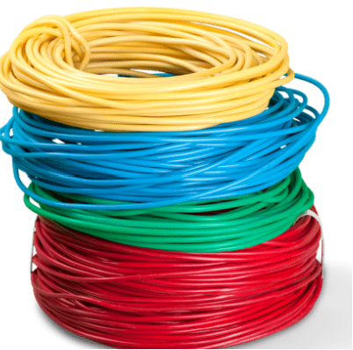
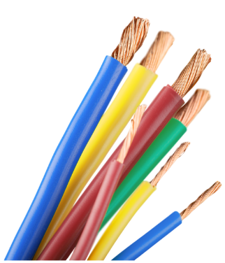
Components and Examples
5. Cabling and Connectors:
  Purpose: Facilitate the connection of different network devices and the transmission of data.
  Examples: Ethernet cables, Fiber optic cables, RJ45 connectors.
6. Network Interface Cards (NICs):
  Purpose: Provide the interface for computers and other devices to connect to a network.
  Examples: Intel Ethernet Adapter, TP-Link Ethernet Adapter.
7. Load Balancers:
  Purpose: Distribute incoming network traffic across multiple servers to ensure no single server is overwhelmed.
  Examples: F5 BIG-IP, Citrix ADC.
8. Proxy Servers:
  Purpose: Act as an intermediary for requests from clients seeking resources from other servers.
  Examples: NGINX, Squid Proxy.
9.DNS Servers:
  Purpose: Translate domain names to IP addresses.
  Examples: BIND, Microsoft DNS.
Lectures + MCQs @ farhatlectures.com ➔ Free Trial

Slide 11
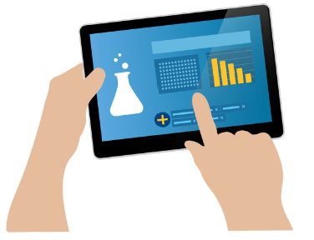
End-User Devices (4 of 8)
End-user devices refer to the computing devices used by end-users to interact with the organization’s IT environment.
Purpose:
Enable User Access and Interaction:
  Provide users with access (interface) to applications, services, and network resources.
  Serve as the user interface for interaction with IT systems, allowing users to create, modify, and consume content.
Enhance Mobility and Flexibility:
  Enable users to perform tasks and access resources from different locations, facilitating remote work and mobile access.
Lectures + MCQs @ farhatlectures.com ➔ Free Trial

Slide 12

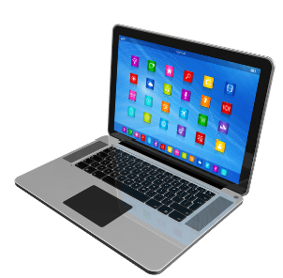
Examples and Types
Desktop Computers:
  Purpose: Used for a wide range of tasks from document editing to software development, primarily in a stationary environment.
  Examples: iMac, Dell OptiPlex, HP EliteDesk.
Laptops:
  Purpose: Portable computers that offer mobility and are suitable for a wide range of tasks.
  Examples: MacBook Pro, Lenovo ThinkPad, Dell XPS.
Tablets:
  Purpose: Highly portable devices suitable for content consumption, note-taking, and other lightweight tasks.
  Examples: iPad, Samsung Galaxy Tab, Microsoft Surface Pro.
Lectures + MCQs @ farhatlectures.com ➔ Free Trial

Slide 13


Examples and Types
4.Smartphones:
  Purpose: Handheld devices offering a range of functionalities including voice communication, internet access, and a variety of apps.
  Examples: iPhone, Samsung Galaxy, Google Pixel.
5.Thin Clients:
  Purpose: Lightweight computers that depend primarily on the central server for processing activities, used in centralized computing environments.
  Examples: Dell Wyse, HP t630.
6.Wearables:
  Purpose: Devices worn on the body that offer functionalities like fitness tracking and health monitoring.
  Examples: Apple Watch, Fitbit, Garmin Vivosmart.
Lectures + MCQs @ farhatlectures.com ➔ Free Trial

Slide 14
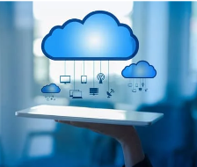
Cloud Computing (5 of 8)
Cloud computing is a technology that allows users to access computing resources (like servers, storage, databases, networking, software, analytics) over the internet (the cloud) instead of relying on owning and maintaining physical hardware.
Purpose:
Resource Utilization and Elasticity:
  Allows organizations to use resources as needed and scale up or down based on demand, thus avoiding upfront costs and reducing waste.
Accessibility and Flexibility:
  Provides access to resources and services from anywhere with an internet connection, offering flexibility and facilitating remote work and collaboration.
Data Management and Analytics:
  Offers powerful tools for storing, processing, and analyzing large volumes of data.
Lectures + MCQs @ farhatlectures.com ➔ Free Trial

Slide 15
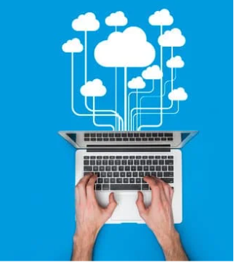
Service Models
Infrastructure as a Service (IaaS):
  Purpose: Provides virtualized computing resources over the internet.
  Examples: Amazon EC2, Microsoft Azure Virtual Machines, Google Compute Engine.
Platform as a Service (PaaS):
  Purpose: Offers a platform allowing customers to develop, run, and manage applications without dealing with the infrastructure.
  Examples: Heroku, Microsoft Azure App Services, Google App Engine.
Software as a Service (SaaS):
  Purpose: Delivers software applications over the internet, eliminating the need to install and run applications on individual computers.
  Examples: Google Workspace, Microsoft 365, Salesforce.
Function as a Service (FaaS):
  Purpose: Provides a platform for building and running event-driven functions in the cloud, enabling developers to execute and scale individual functions without provisioning servers.
  Examples: AWS Lambda, Azure Functions, Google Cloud Functions.
Lectures + MCQs @ farhatlectures.com ➔ Free Trial

Slide 16
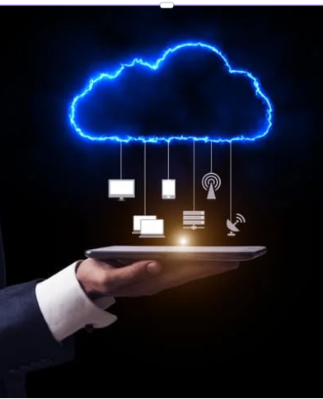
Deployment Models
Public Cloud:
  Owned and operated by third-party cloud service providers and available to the public.
  Examples: Amazon Web Services (AWS), Microsoft Azure, Google Cloud Platform.
Private Cloud:
  Exclusively used by a single organization and can be located on-premises or hosted by third-party providers.
  Examples: VMware Cloud, OpenStack.
Hybrid Cloud:
  Combines public and private clouds, allowing data and applications to be shared between them, providing greater flexibility and optimization of existing infrastructures.
  Examples: AWS Outposts, Azure Arc.
Lectures + MCQs @ farhatlectures.com ➔ Free Trial

Slide 17
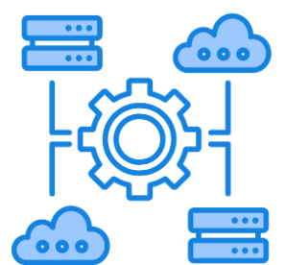
Middleware (6 of 8)
Middleware is a type of software that acts as a bridge between the operating system and the applications running on it, or between different applications.
Facilitate Communication:
  Middleware allows different software components to communicate and interact, enabling the integration of different and potentially heterogeneous systems.
Enhance Functionality:
  It provides a set of common services and capabilities to applications outside of what’s offered by the operating system, enabling developers to focus on the specific purpose of their application without having to deal with the details of the network, database, or input/output.
Enable Interoperability:
  Middleware standardizes the way different systems and applications interact, allowing them to work together seamlessly, even if they are built on different platforms or written in different programming languages.
Lectures + MCQs @ farhatlectures.com ➔ Free Trial

Slide 18
Examples and Types
Message Oriented Middleware (MOM):
  Purpose: Supports the exchange of general-purpose messages in a distributed application setup.
  Examples: IBM MQ, Apache Kafka, RabbitMQ.
Object Request Brokers (ORBs):
  Purpose: Enable objects to send requests and receive responses, even across different systems.
  Examples: CORBA, RMI.
Database Middleware:
  Purpose: Provides applications with a consistent interface to communicate with different types of databases.
  Examples: ODBC, JDBC.
Remote Procedure Call (RPC) Middleware:
  Purpose: Enables procedures to execute in another address space, commonly on another physical computer.
  Examples: gRPC, XML-RPC.
Lectures + MCQs @ farhatlectures.com ➔ Free Trial

Slide 19
Examples and Types
5. Web Middleware:
  Purpose: Facilitates the development of web applications, handling requests and responses between the user and the server.
  Examples: ASP.NET, Express.js, Django.
6. Content Management Middleware:
  Purpose: Manages and organizes digital content for websites or applications.
  Examples: WordPress, Drupal, Joomla!
7. Identity Middleware:
  Purpose: Manages and authenticates user identities, granting permissions and securing access.
  Examples: OAuth, OpenID Connect, SAML.
Lectures + MCQs @ farhatlectures.com ➔ Free Trial

Slide 20
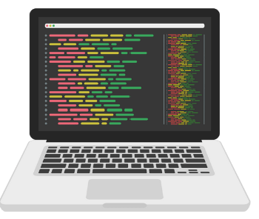
Software Applications (7 of 8)
A software application is a program or a group of programs designed to perform specific tasks for the end-user or another application. It sits atop system software and operating systems and utilizes these foundational technologies to execute its functionality.
Purpose:
Task Execution:
  Applications enable users to perform specific tasks, ranging from simple text editing to complex data analysis, game playing, and more.
Data Manipulation and Analysis:
  They allow users to input, manipulate, and analyze data to generate information, insights, and results.
Automation:
  Software applications can automate repetitive tasks, streamlining processes and improving productivity and accuracy.
Interaction:
  They provide interfaces for users to interact with, and manage data and perform operations.
Lectures + MCQs @ farhatlectures.com ➔ Free Trial

Slide 21
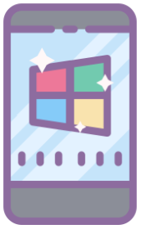

Examples and Types
1.Productivity Software:
  Purpose: Assist users in producing information.
  Examples: Microsoft Office Suite, Google Workspace, Adobe Creative Cloud.
2. Web Browsers:
  Purpose: Allow users to access, retrieve, and view information on the internet.
  Examples: Google Chrome, Mozilla Firefox, Microsoft Edge.
3. Media Players:
  Purpose: Play multimedia files, such as audio and video.
  Examples: VLC Media Player, Windows Media Player, Spotify.
4. Games:
  Purpose: Provide entertainment through interactive multimedia content.
  Examples: Fortnite, Minecraft, Among Us.
Lectures + MCQs @ farhatlectures.com ➔ Free Trial

Slide 22


Examples and Types
5.Development Tools:
  Purpose: Assist developers in creating, debugging, and maintaining other applications and services.
  Examples: Visual Studio, Eclipse, PyCharm.
6. Communication Software:
  Purpose: Enable users to communicate and collaborate through various means such as text, voice, and video.
  Examples: Zoom, Microsoft Teams, Slack.
7. Database Software:
  Purpose: Manage and structure data.
  Examples: MySQL, Oracle Database, Microsoft SQL Server.
Lectures + MCQs @ farhatlectures.com ➔ Free Trial

Slide 23
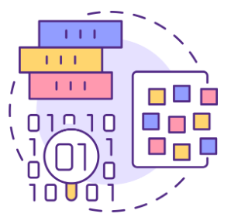
Data Architecture
Refers to the policies, rules, standards, and models that govern the type, nature, and storage of data within an organization's ecosystem.
It is a subset of IT architecture focusing on the way an organization's data is stored, managed, processed, and utilized.
Purpose:
Organizational Alignment:
  Data Architecture ensures that data management and policies are aligned with organizational objectives and strategies.
Data Quality and Consistency:
  By establishing standards and policies, it maintains the quality, integrity, and consistency of data across the organization.
Optimizing Data Flow:
  It optimizes the flow of data through the system and ensures the effective integration and communication of data between disparate systems.
Scalability and Performance:
  Data Architecture allows organizations to scale their data management efficiently, ensuring optimal performance even as data volume grows.
Data Security and Compliance:
  By defining rules and policies, it helps in securing data and ensuring compliance with relevant laws and regulations.
Lectures + MCQs @ farhatlectures.com ➔ Free Trial

Slide 24
Components of Data Architecture
1. Data Models:
  Represent the organizational data, detailing how data is stored, accessed, and managed.
2. Data Warehouses:
  Central repositories of integrated data from one or more disparate sources, used for reporting and data analysis.
3. Databases:
  Structured collections of data that can be easily accessed, managed, and updated.
  Examples: MySQL, Oracle, Microsoft SQL Server.
4
Lectures + MCQs @ farhatlectures.com ➔ Free Trial

Slide 25
Components of Data Architecture
4. ETL Processes:
  Extract, Transform, Load processes are used for copying data from one or more sources into a destination system.
5. Big Data Technologies:
  Handle the processing and analysis of large datasets that are too complex for traditional databases.
  Examples: Apache Hadoop, Apache Spark.
6. Data Lakes:
  Storage repositories that can hold vast amounts of raw data in its native format until it is needed.
Lectures + MCQs @ farhatlectures.com ➔ Free Trial

Slide 26
MCQ from Farhat Lectures
A new startup company specializing in app development is setting up its IT infrastructure. The company needs to decide on an operating system to use for its servers.
Which of the following operating systems is typically used for servers in a business environment?
a) Windows Server
b) Android
c) iOS
d) Chrome OS
Explanation: Windows Server is designed specifically for server environments and is widely used in business settings due to its robustness, security, and scalability.
Incorrect Answers:
b) Android : Android is an operating system designed for mobile devices, not servers.
c) iOS iOS is an operating system designed for Apple's mobile devices, not servers.
d) Chrome OS: Chrome OS is designed for lightweight, internet-dependent computing, typically on Chromebooks, and is not suitable for server environments.
Lectures + MCQs @ farhatlectures.com ➔ Free Trial

