Slide 1
Explain how the COSO frameworks address cloud computing governance

Slide 2
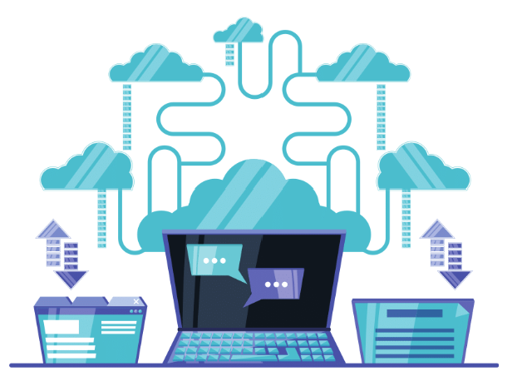

Committee of Sponsoring Organizations of the Treadway Commission (COSO) and Cloud Computing Governance
COSO has established frameworks for:
  Internal control
  Enterprise risk management
  Fraud deterrence
Connect the COSO framework as a foundational structure for managing the governance and control environment to cloud computing environments.
Lectures + MCQs @ farhatlectures.com ➔ Free Trial

Slide 3

Internal Control - Integrated Framework
The Internal Control framework is often leveraged to build governance around cloud computing services.
The five components:
  Control Environment
  Risk Assessment
  Control Activities,
  Information and Communication and
  Monitoring Activities
Lectures + MCQs @ farhatlectures.com ➔ Free Trial

Slide 4

Control Environment
Establishes a set of standards, processes, and structures for carrying out internal control across the organization.
In the context of cloud computing, it mandates the formation of cloud governance policies, procedures, and structures to control the cloud environment effectively.
  Establishes a Cloud Governance Committee (“specific”), consisting of IT, legal, compliance, and business representatives, to oversee the implementation and management of cloud services.
  This committee develops and enforces policies and procedures for the use of cloud services, ensuring alignment with organizational objectives and compliance with applicable laws and regulations.
Lectures + MCQs @ farhatlectures.com ➔ Free Trial

Slide 5

Risk Assessment
A crucial step to evaluate risks associated with cloud computing:
  Data breaches
  loss of data, and
  service interruptions.
This component helps organizations to assess and prioritize risks related to the use of cloud services.
Example: Before adopting a cloud service, the organization conducts a comprehensive risk assessment to identify potential risks, such as data breaches, data loss, and service downtime.
The organization then prioritizes these risks based on their likelihood and impact, determining which risks need to be mitigated, transferred, accepted, or avoided.
Lectures + MCQs @ farhatlectures.com ➔ Free Trial

Slide 6

Control Activities
These are the actions taken to help mitigate the identified risks.
For cloud computing, these could include implementing security measures like encryption, multi-factor authentication, and regular audits.
Example: To mitigate the risk of unauthorized access to cloud services, the organization implements multi-factor authentication (MFA) and strict access controls, ensuring only authorized personnel can access sensitive data stored in the cloud.
Regular audits and reviews of access logs are conducted to monitor for any suspicious activities.
Lectures + MCQs @ farhatlectures.com ➔ Free Trial

Slide 7

Information and Communication
Ensures that relevant and reliable information is disseminated properly within the organization.
In cloud computing, this could mean proper communication of cloud policies, changes, and incidents to relevant stakeholders.
Example: The organization develops clear and concise communication channels and procedures to ensure that all relevant stakeholders are aware of the policies, procedures, and changes related to cloud services.
For instance, any updates or incidents related to cloud services are promptly communicated to the relevant departments via email alerts or dashboard notifications.
Lectures + MCQs @ farhatlectures.com ➔ Free Trial

Slide 8

Monitoring Activities
Regular evaluations are conducted to ascertain whether the controls and processes are working as intended.
For cloud services, continuous monitoring of security and compliance is essential.
Example: The organization deploys automated monitoring tools to continuously monitor the security and performance of cloud services.
These tools alert the IT team in real-time to any security breaches or performance issues, allowing for immediate response and remediation.
Lectures + MCQs @ farhatlectures.com ➔ Free Trial

Slide 9

Enterprise Risk Management (ERM) Framework
The ERM framework emphasizes a risk-based approach.
When applied to cloud computing governance, it helps in aligning strategy, performance, and risk management.
  Governance and Culture: This component focuses on organizational governance and culture which directly impacts cloud computing governance by defining roles, responsibilities, and establishing a risk-aware culture.
  Strategy and Objective-Setting: In the context of cloud computing, this involves setting clear objectives and strategies for the use of cloud services, in alignment with the organization’s risk tolerance and appetite.
  Performance: Measures and monitors the performance of cloud computing services against the set objectives and risk management expectations. KPIs and KRIs
  Review and Revision: This involves a regular review and revision of cloud computing governance policies and controls to ensure their effectiveness and relevance.
Lectures + MCQs @ farhatlectures.com ➔ Free Trial

Slide 10

Enterprise Risk Management (ERM) Application
  Via ERM should establishe
    Key Risk Indicators (KRIs) and
    Key Performance Indicators (KPIs)
  to measure and monitor the performance and risk of cloud services regularly.
  By defining clear KPIs and KRIs, organizations can effectively measure, monitor, and manage their cloud computing services' performance and associated risks.
  Establishing relevant thresholds and objectives for each indicator provides a basis for actionable insights and informed decision-making.
  Best to look at specific examples
Lectures + MCQs @ farhatlectures.com ➔ Free Trial

Slide 11
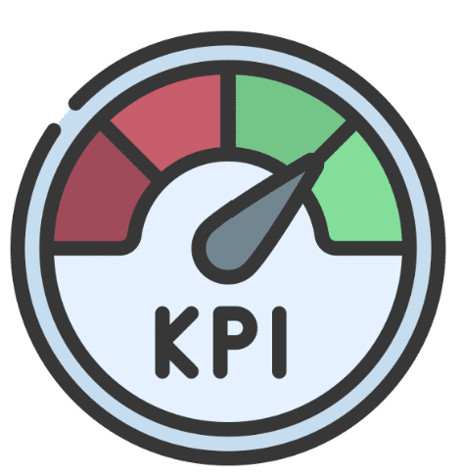
Key Performance Indicators (KPIs)
Service Availability:
  Specific KPI: Percentage of uptime of a cloud service.
  Objective: To ensure the cloud service is available, aiming for a target like 99.9% availability.
Response Time:
  Specific KPI: Average response time of a cloud service.
  Objective: To ensure that the cloud service responds within an acceptable time frame, e.g., below 300 milliseconds.
Resource Utilization:
  Specific KPI: Percentage of CPU, memory, and storage utilization.
  Objective: To manage resource consumption efficiently and avoid overprovisioning, for example, keeping CPU utilization below 70%.
Lectures + MCQs @ farhatlectures.com ➔ Free Trial

Slide 12

Key Risk Indicators (KRIs)
Security Incidents:
  Specific KRI: Number of security incidents detected per month.
  Objective: To monitor the security of cloud services, with a threshold of zero incidents.
Data Breaches:
  Specific KRI: Number of unauthorized data access incidents.
  Objective: To identify and prevent any unauthorized access to confidential information, with an aim of zero breaches.
Compliance Violations:
  Specific KRI: Number of compliance violations identified in audits.
  Objective: To ensure adherence to regulatory and organizational policies, maintaining compliance with zero violations.
Lectures + MCQs @ farhatlectures.com ➔ Free Trial

Slide 13

Fraud Deterrence
COSO frameworks also have a focus on fraud deterrence.
In the context of cloud computing, this includes implementing controls and policies to detect and prevent fraudulent activities related to cloud services, like unauthorized access and data theft.
Fraud deterrence involves a set of proactive steps and measures taken to prevent fraud before it occurs within an organization or system
Lectures + MCQs @ farhatlectures.com ➔ Free Trial

Slide 14

Example of Fraud Detection
Anomaly Detection System:
  Implementation: The company implements a machine-learning-based anomaly detection system in its cloud environment that monitors user behaviors and system interactions, flagging any abnormal behavior or transactions that don’t align with regular patterns.
  Objective: Detecting fraudulent activities in real-time, allowing immediate action to prevent any potential damage or loss.
Access Control and Monitoring:
  Implementation: Strict access controls are enforced, ensuring that only authorized personnel have access to sensitive data. Every access and modification are logged meticulously for review.
  Objective: Preventing unauthorized access and modifications, and having a clear trail of interactions with the data for accountability and investigations.
Multi-Factor Authentication (MFA):
  Implementation: The company enforces MFA for all users accessing the cloud services, requiring at least two forms of identification before granting access.
  Objective: Adding an extra layer of security to protect against unauthorized access, even if passwords are compromised.
Lectures + MCQs @ farhatlectures.com ➔ Free Trial

Slide 15
MCQ from Farhat Lectures
A healthcare provider is ensuring adherence to regulatory and organizational policies in its cloud environment.
Question: What specific KPI should the healthcare provider monitor to ensure compliance with applicable regulations?
  a) Service Availability
  b) Resource Utilization
  c) Cost Management
  d) Compliance Violation
a) Service Availability: Measures the uptime of a service.
b) Resource Utilization: Measures how efficiently resources are being used.
c) Cost Management: Focuses on managing expenditures related to cloud services.
d) Compliance Violations (Correct): Directly measures adherence to applicable laws and regulations, ensuring compliance.
Lectures + MCQs @ farhatlectures.com ➔ Free Trial

