Slide 1

Example (CPA simulation): Tax Planning
Emily Parker, age 40, who is single and a senior manager at a multinational corporation.
Her salary for the current year is $200,000. She has total itemized deductions of $18,000. Emily's withholdings for the current year are $45,000.
The amount of tax reported on her Form 1040 in the previous year was $42,000.
Emily is planning to sell some shares of stock she bought as an investment two years ago.
The anticipated taxable gain on the sale of the stock is $25,000. She is concerned about potentially having to pay estimated tax payments or facing a penalty for underpayment of tax due to this additional income.
What recommendation(s) would you give?
Lectures + MCQs @ farhatlectures.com ➔ Free Trial
Lectures + MCQs @ farhatlectures.com ➔ Free Trial

Slide 2
Recommended Actions
Sell the Investment Stock: Selling the investment stock is beneficial as it qualifies for long-term capital gain tax treatment since it was held for more than a year.
Increase Charitable Contribution: Donating a portion of the sales proceeds, say $7,000 (simulate other figures), to charity can provide a larger itemized deduction, thereby reducing taxable income.
IRA Contribution: Contributing to an IRA (up to the maximum limit of $6,000 for 2023) can further decrease her taxable income.
Lectures + MCQs @ farhatlectures.com ➔ Free Trial

Slide 3
Before Charitable Contribution and IRA Contribution
Income: $200,000
AGI: $200,000
Standard Deduction: Not utilized
Itemized Deductions: $18,000
Ordinary Taxable Income: $182,000 ($200,000 - $18,000)
Long-Term Capital Gain from Stock Sale: $25,000
Ordinary Income Tax: Calculated based on 2023 tax rates
Preferential Tax on LTCG: $3,750 (15% of $25,000)
Total Income Tax: next slide
Lectures + MCQs @ farhatlectures.com ➔ Free Trial

Slide 4
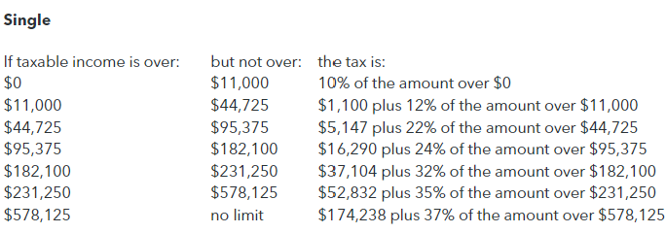
16,290 + 24% x (182,000 – 95,375) =
16,290 + 20,790 = 37,080 + 3,750 =
40,830
Lectures + MCQs @ farhatlectures.com ➔ Free Trial

Slide 5
After Charitable Contribution and IRA Contribution
Additional Charitable Contribution: -$7,000
IRA Contribution: -$6,000
Adjusted AGI: $187,000 ($200,000 - $6,000)
Total Itemized Deductions: $25,000 ($18,000 + $7,000)
Taxable Income: $162,000 ($187,000 - $25,000)
Ordinary Income Tax: Calculated based on 2023 tax rates
Preferential Tax on LTCG: $3,750
Total Income Tax After Actions: (To be calculated)
Lectures + MCQs @ farhatlectures.com ➔ Free Trial

Slide 6
16,290 + 24% x (162,000 -95,375) =
16,290 + 15,990 = 32,280 + 3,750 = 36,030
40,830 – 36,030 = 4,800 reduction in tax bill
Lectures + MCQs @ farhatlectures.com ➔ Free Trial

Slide 7
Estimated Tax Payments and Underpayment Penalties
Emily should ensure her withholdings cover at least 110% of the prior year's tax ($42,000 × 110% = $46,200) or 90% of the current year's tax to avoid underpayment penalties.
Withholding Comparison:
  Prior Year Tax Paid: $42,000 × 110% = $46,200
  Current Year Tax Due: (32,280 + 3,750) × 90%
  Her withholdings are $45,000.
  If the calculated tax due exceeds her withholdings, she may need to make an estimated tax payment to avoid penalties.

Slide 8
Summary
In this scenario, Emily aims to manage her tax liability effectively by selling her investment stock, which she held for more than a year, thus qualifying for lower long-term capital gains tax rates.
By increasing her charitable contributions and making an IRA contribution, she can further reduce her taxable income.
Her overall tax liability will depend on the adjusted gross income after these actions and the applicable tax rates for her income bracket.
It's crucial for Emily to compare her withholdings with the estimated tax liability to ensure she's not underpaying and thus avoid potential penalties. This approach demonstrates strategic tax planning, utilizing available investment and retirement savings options to optimize her tax position.
Lectures + MCQs @ farhatlectures.com ➔ Free Trial

