Slide 1


Review of Itemized vs. Standard Deduction
The standard deduction is a fixed dollar amount that reduces the income on which you are taxed.
Itemized deductions are specific expenses allowed by the IRS that taxpayers can deduct from their taxable income
Choosing between itemized and standard deductions depends on which option provides the greater tax benefit.
Lectures + MCQs @ farhatlectures.com ➔ Free Trial

Slide 2
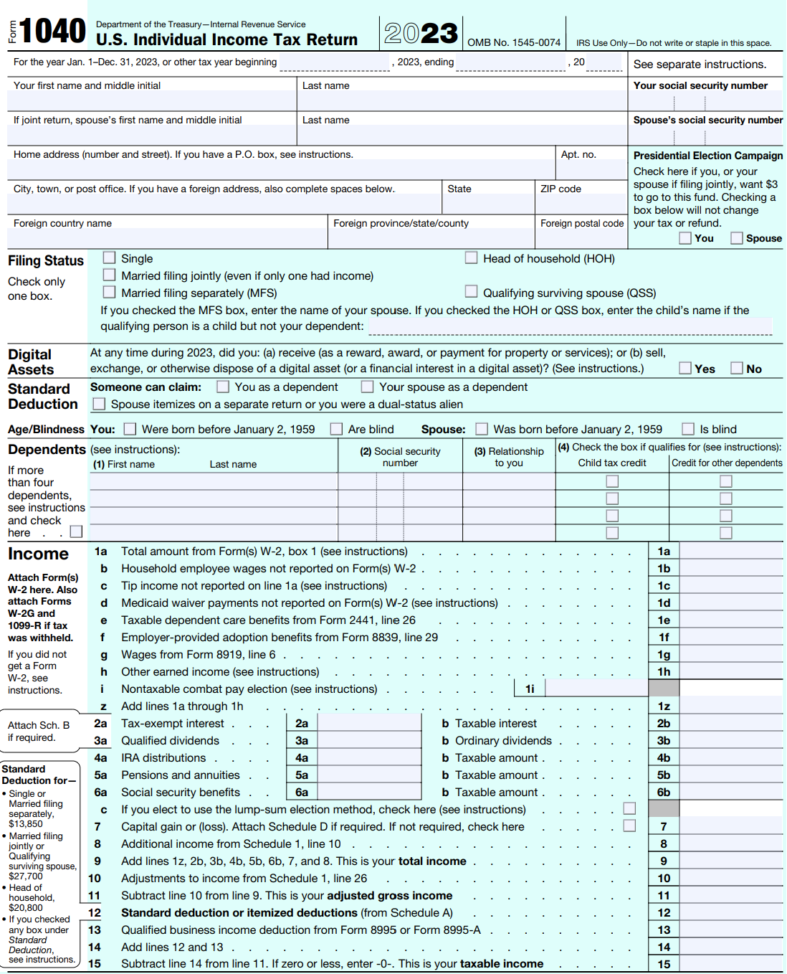
Lectures + MCQs @ farhatlectures.com ➔ Free Trial

Slide 3
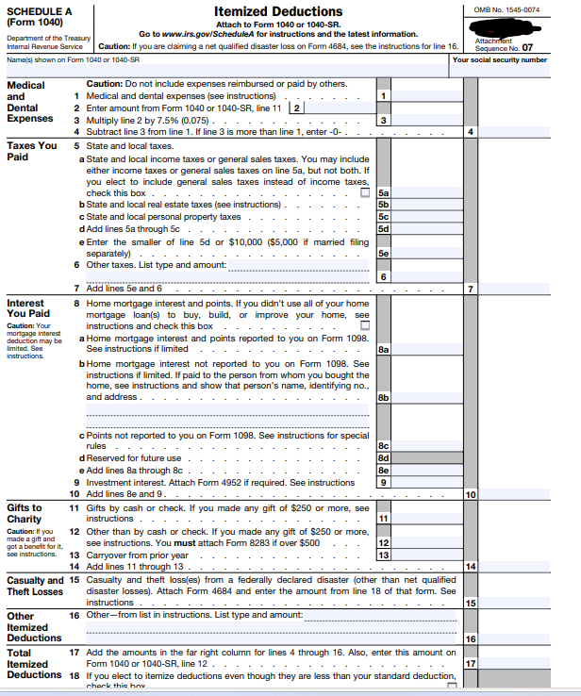
Lectures + MCQs @ farhatlectures.com ➔ Free Trial

Slide 4
List of Itemized Deductions
Itemized deductions offer an alternative to the standard deduction, and taxpayers typically choose this option when the sum of their allowable deductions exceeds the standard deduction amount. Key categories of itemized deductions include:
  Medical Expenses: Deductions for medical expenses are allowed to the extent that they exceed 7.5% of the taxpayer's Adjusted Gross Income (AGI).
  State and Local Taxes (SALT): Includes state and local income, sales, and property taxes, but the total deduction is capped at $10,000.
  Interest Expenses: This includes deductions for interest on home mortgages and investment interest.
  Charitable Contributions: Donations made to qualified charities are deductible.
  Casualty and Theft Losses: Deductions are permitted for losses due to casualty or theft, but only in the event of a federal disaster. These losses are deductible to the extent that each loss exceeds $100, and the aggregate of these losses surpasses 10% of the taxpayer's AGI.
Lectures + MCQs @ farhatlectures.com ➔ Free Trial

Slide 5
Example
Wages: John - $40,000, Judy - $60,000
Unreimbursed Medical Expenses: John - $8,000, Judy - $1,000
State Income Taxes: John - $2,000, Judy - $5,000
State Property Taxes: John - $3,000, Judy - $3,000
Home Mortgage Interest: $7,500 (combined)
Casualty Loss in Federally Declared Disaster Area: $14,000 (after $100 floor deduction)
Standard Deduction:
MFJ: $27,700
Calculation for MFJ:
Standard Deduction: Their taxable income with the standard deduction is $72,300 ($100,000 wages - $27,700 standard deduction).
Itemized Deductions:
  Medical Expenses: $9,000 - 7.5% of AGI ($7,500) = $1,500.
  SALT Limit: $10,000 (combined state income and property taxes).
  Home Mortgage Interest: $7,500.
  Casualty Loss: $14,000 - 10% of AGI ($10,000) = $4,000.
  Total Itemized Deductions: $1,500 + $10,000 + $7,500 + $4,000 = $23,000.
Taxable Income with Itemized Deductions: $100,000 - $23,000 = $77,000.
Lectures + MCQs @ farhatlectures.com ➔ Free Trial

