Slide 1


Payment Card Industry Data Security Standard (PCI DSS)
The Payment Card Industry Data Security Standard (PCI DSS) is a set of security standards and guidelines designed to ensure the secure handling of payment card information. Why?
These standards were created to protect sensitive data, such as credit card numbers and cardholder information, from being compromised by cybercriminals.
PCI DSS is not a law, but it is a requirement imposed by the major credit card companies, including Visa, MasterCard, American Express, Discover, and JCB, as a condition for merchants and service providers that process credit card transactions.
GDRP issue!
Lectures + MCQs @ farhatlectures.com ➔ Free Trial

Slide 2

PCI DSS: 6 Goals and 12 Requirements
The Payment Card Industry Data Security Standard (PCI DSS) has six overarching goals, each of which is supported by a set of 12 specific requirements.
These requirements are designed to help organizations secure payment card data and protect against data breaches.
Here are the six goals and examples of the 12 requirements associated with each goal.
Lectures + MCQs @ farhatlectures.com ➔ Free Trial

Slide 3

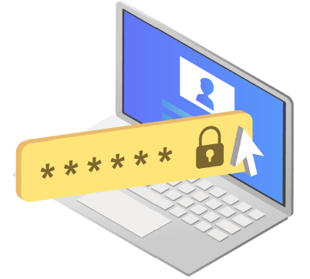
Goal 1: Build and Maintain a Secure Network and Systems
Requirement 1: Install and maintain a firewall configuration to protect cardholder data:
This goal aims to establish strong network defenses. Organizations should have a well-designed network architecture that includes firewalls to control the flow of traffic between their internal networks and the external internet.
  Firewalls should be configured to permit only necessary traffic while blocking unauthorized access.
Requirement 2: Do not use vendor-supplied defaults for system passwords and other security parameters:
Using default settings, passwords, and configurations provided by vendors can create vulnerabilities.
  To meet this requirement, organizations must change default passwords, use strong authentication mechanisms, and customize security parameters to enhance system security.
Lectures + MCQs @ farhatlectures.com ➔ Free Trial

Slide 4
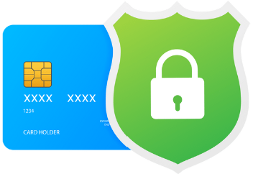

Goal 2: Protect Cardholder Data
Requirement 3: Protect stored cardholder data: This goal focuses on safeguarding sensitive cardholder data when it's at rest.
  It requires organizations to use strong encryption and cryptographic techniques to protect data in storage, such as credit card numbers, by rendering it unreadable if unauthorized access occurs.
Requirement 4: Encrypt transmission of cardholder data across open, public networks:
When cardholder data is transmitted over open networks, like the internet, it must be encrypted to prevent interception by attackers.
  Secure communication protocols, like TLS, should be used to encrypt data during transmission.
Lectures + MCQs @ farhatlectures.com ➔ Free Trial

Slide 5


Goal 3: Maintain a Vulnerability Management Program
Requirement 5: Protect all systems against malware and regularly update antivirus software or programs:
This goal addresses the need to defend against malware and other malicious software.
  Organizations should deploy antivirus solutions, regularly update them, and conduct scans to detect and remove malware.
Requirement 6: Develop and maintain secure systems and applications:
To minimize vulnerabilities, organizations must design, develop, and maintain their systems and applications securely.
  This involves applying security patches, implementing secure coding practices, and conducting regular security assessments.
Lectures + MCQs @ farhatlectures.com ➔ Free Trial

Slide 6

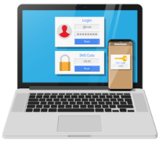
Goal 4: Implement Strong Access Control Measures
Requirement 7: Restrict access to cardholder data by business need-to-know:
Access to cardholder data should be limited to individuals who require it for their job roles.
  Role-based access control, authentication, and authorization mechanisms are used to enforce this requirement.
Requirement 8: Identify and authenticate access to system components:
This goal emphasizes the importance of identifying and verifying users before granting access to systems.
  Multi-factor authentication (MFA) is often required to enhance security.
Lectures + MCQs @ farhatlectures.com ➔ Free Trial

Slide 7


Goal 5: Regularly Monitor and Test Networks
Requirement 9: Restrict physical access to cardholder data:
Physical access to systems and data storage should be restricted.
  Measures like locks, card readers, and surveillance cameras may be used to secure physical access points.
Requirement 10: Track and monitor all access to network resources and cardholder data:
This goal involves implementing comprehensive logging and monitoring systems.
  Organizations need to track and analyze access to detect suspicious activities, investigate security incidents, and generate audit trails.
Lectures + MCQs @ farhatlectures.com ➔ Free Trial

Slide 8


Goal 6: Maintain an Information Security Policy
Requirement 11: Regularly test security systems and processes:
Organizations must periodically test their security measures through activities like penetration testing and vulnerability scanning.
  This helps identify weaknesses that need to be addressed.
Requirement 12: Maintain a policy that addresses information security for all personnel:
This goal requires organizations to establish and communicate an information security policy to all employees and contractors.
  This policy should outline their responsibilities, best practices, and security awareness training.
Lectures + MCQs @ farhatlectures.com ➔ Free Trial

Slide 9
MCQ From Farhat Lectures
Scenario: A retail company is setting up its online store to accept credit card payments. What is the primary goal of the PCI DSS requirement that involves installing and maintaining a firewall configuration?
To encrypt credit card data during transmission.
To protect stored cardholder data.
To conduct regular vulnerability assessments.
To implement strong access controls.
Explanation: Correct Choice: B) To protect stored cardholder data.
The primary goal of the PCI DSS requirement involving the installation and maintenance of a firewall configuration is to protect stored cardholder data.
Incorrect Choices: A) To encrypt credit card data during transmission.
Encryption during transmission is important but not the primary goal of this requirement.
C) To conduct regular vulnerability assessments.
Vulnerability assessments are part of other PCI DSS requirements.
D) To implement strong access controls.
Strong access controls are important but are not the primary goal of this specific requirement.
Lectures + MCQs @ farhatlectures.com ➔ Free Trial

