Slide 1


Imputed Interest on Below-Market-Rate-Loan
When a taxpayer lends money at an interest rate lower than the market rate, it's considered a below-market-rate loan.
In such cases, the IRS has specific rules regarding how this affects both the lender and the borrower for tax purposes.
For the Lender (the person giving the loan): The lender must report 'foregone interest' as interest income on their tax return.
  This means that even though they're not actually receiving this interest (because the loan's interest rate is below the market rate), they must still report it as if they had received it.
For the Borrower (the person receiving the loan): The borrower might be able to deduct this foregone interest from their taxes.
  However, this is only possible if the interest would have been deductible if it had been paid.
  This deduction doesn't apply if the loan is for personal purposes, in which case the foregone interest is considered personal interest and is not deductible.
Lectures + MCQs @ farhatlectures.com ➔ Free Trial

Slide 2

What is Foregone Interest?
To calculate the foregone interest, first, you need to know the 'Applicable Federal Rate' (AFR) published by the IRS. This rate varies and is updated regularly.
Then, compare the interest that would have been payable at the AFR with the interest that is actually being paid on the loan.
The difference between these two amounts is the foregone interest.
In simpler terms, the IRS treats it as if the lender is receiving the market rate of interest (as per AFR) and then either gifting back or not charging the excess to the borrower.
Lectures + MCQs @ farhatlectures.com ➔ Free Trial

Slide 3
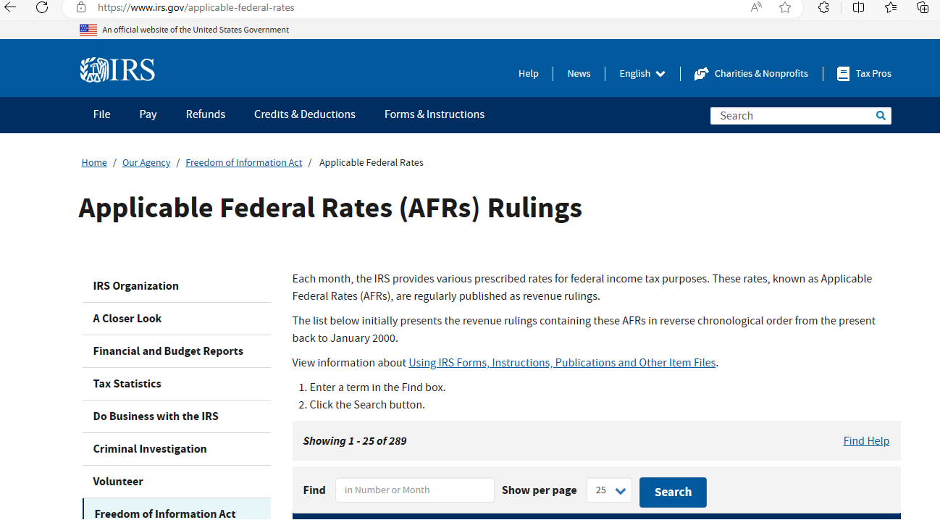
Lectures + MCQs @ farhatlectures.com ➔ Free Trial

Slide 4
Types of Loan Subject to Imputed Interest Rules
The IRS has specific rules for imputed interest, which apply to below-market loans in certain situations. These rules require the lender to report interest income even if no interest is charged.
Gift Loans: These are loans between individuals, such as friends and family members. When no or low interest is charged, the IRS may consider the foregone interest as a gift, and it may have tax implications. Exceptions.
Compensation-Related Loans: This category includes loans between employers and employees or between independent contractors and their clients. If an employer provides a low-interest or interest-free loan to an employee, it could be seen as a form of compensation.
Corporation-Shareholder Loans: These are loans between a corporation and its shareholders. If a shareholder receives a below-market loan from the corporation, the IRS might view the foregone interest as a benefit to the shareholder. exceptions
Tax-Avoidance Loans: This refers to any below-market loan where avoiding federal tax is a primary purpose of the interest arrangement. The IRS closely scrutinizes these loans to prevent tax evasion.
Loans to Qualified Continuing Care Facilities: This includes loans made to qualified continuing care facilities under a continuing care contract. It applies if the lender, or the lender's spouse, is 65 years or older by the end of the year. These loans often involve arrangements for long-term care.
In each of these cases, the IRS imputes interest on the loan – that is, it treats the loan as if it had interest at the market rate, even if it doesn’t.
This imputed interest is then treated as income for the lender and potentially as a gift, compensation, or another type of benefit for the borrower, with various tax implications.
Lectures + MCQs @ farhatlectures.com ➔ Free Trial

Slide 5

Example
Alex is in need of financial assistance and approaches their friend Jordan for a loan. Jordan agrees to lend $15,000 to Alex at an annual interest rate of 2%.
The applicable federal rate (AFR) at this time is 4%.
Required: We need to calculate the imputed interest income that Jordan must report for this below-market-rate loan to Alex.
Minimum Interest Required by the AFR:
  The AFR is 4%. So, the minimum interest required for a $15,000 loan is $600 ($15,000 × 4%).
Interest Payable Under the Loan:
  The actual interest rate agreed upon is 2%. Hence, the interest payable on the loan is $300 ($15,000 × 2%).
Imputed Interest Income:
  The imputed interest income is the difference between the minimum interest required by the AFR and the actual interest payable under the loan.
  Therefore, Jordan's imputed interest income is $300 ($600 - $300).
In this scenario, Jordan must report $300 as imputed interest income on their tax return, even though they are only receiving $300 in actual interest from Alex.
This is because the IRS treats it as if Jordan is receiving interest at the 4% AFR and then either gifting back or not charging the additional $300 to Alex.
Lectures + MCQs @ farhatlectures.com ➔ Free Trial

Slide 6

Loans less than 10,000
For small loans (De Minimis Rule) of up to $10,000, the IRS allows a simplification where the lender doesn't have to calculate or report imputed interest income, as long as certain conditions are met. This makes it easier for individuals to provide small, informal loans without worrying about complex tax implications.
Gift Loans Between Individuals: If an individual lends $10,000 or less to another individual, the imputed interest rules do not apply, provided the borrowed funds are not used to purchase income-producing assets.
For example, if a parent lends their child $9,000 to help with general expenses or to buy a car, this loan would not be subject to imputed interest rules.
However, if the child uses the money to invest in stocks or buy rental property, the exception wouldn't apply.
Compensation-Related and Corporate-Shareholder Loans: In the case of loans that are related to employment (like those between an employer and employee) or loans between a corporation and its shareholder, the imputed interest rules also do not apply to loans of $10,000 or less, as long as avoiding federal tax is not the main reason for the interest arrangement.
This means that small, low-interest or interest-free loans in a professional context may not trigger the need to report imputed interest, assuming tax avoidance isn’t the primary goal of the loan.
Lectures + MCQs @ farhatlectures.com ➔ Free Trial

Slide 7
Exceptions other than the De Minimis Rule
In addition to the "de minimis" exceptions for small loans, there are also general exceptions to the imputed interest rules for certain below-market loans when their impact on the federal tax liability of the borrower or lender is not significant. These exceptions include:
Government-Subsidized Loans: This category includes loans like student loans that are subsidized or backed by the government. Since these loans often have lower interest rates as part of educational or social support programs, they are exempt from the imputed interest rules.
Business-Related Loans to the Public: Loans that a lender offers to the general public as part of their normal business operations are also exempt. Examples include no-interest financing deals for products like automobiles or zero-interest periods offered by credit card companies. These are considered standard business practices and are not subject to imputed interest rules.
Employee Relocation Loans: When an employer provides a loan to an employee specifically to assist with work-related relocation expenses, this loan is exempt. This facilitates companies in helping employees with moving costs without additional tax burdens.
Certain International Loans: Loans made to or from a foreign person can be exempt, depending on the specific circumstances and tax implications involved.
Gift Loans to Charitable Organizations: If a loan is made to a Section 501(c)(3) charitable organization and the total outstanding amount of all loans between the borrower and lender is no more than $250,000 throughout the year, this loan is not subject to imputed interest rules. This encourages individuals to provide financial support to charitable organizations without facing complicated tax implications.
In essence, these exceptions recognize situations where applying imputed interest rules would either be against public policy interests (like discouraging educational loans or charitable lending) or unnecessary due to the nature of the transaction (like standard business practices or employee relocation assistance).
Lectures + MCQs @ farhatlectures.com ➔ Free Trial

Slide 8
Gift Loans of 100,000 or <
For gift loans between individuals where the total outstanding loans between the lender and borrower are $100,000 or less, there are special rules regarding the calculation of foregone interest for tax purposes:
Limitation Based on Borrower's Net Investment Income: The amount of foregone interest that the lender must report as income (and that the borrower might be able to deduct) is limited to the borrower's net investment income for the year.
Special Rule for Low Net Investment Income: If the borrower's net investment income is $1,000 or less, the foregone interest is considered to be zero.
  In this case, the lender does not have to report any foregone interest as income, and the borrower has nothing to deduct. This rule simplifies tax matters for small-scale or informal loans where the borrower's investment income is minimal.
Exception for Tax-Avoidance Purpose: The above limitations do not apply if one of the main purposes of the loan's interest arrangement is the avoidance of federal tax.
  If tax avoidance is a key factor, then the usual rules for imputed interest apply, regardless of the borrower's net investment income.
This structure aims to reduce the tax reporting burden for smaller, personal loans between individuals, particularly when the loans are not significantly impacting the borrower's investment income or being used for tax avoidance purposes.
Lectures + MCQs @ farhatlectures.com ➔ Free Trial

Slide 9
MCQ from Farhatlectures.com
In the context of gift loans of $100,000 or less, when is the foregone interest treated as zero?
a) When the borrower's net investment income exceeds $1,000.
b) When the borrower's net investment income is exactly $1,000.
c) When the borrower's net investment income is $1,000 or less.
d) Regardless of the borrower's net investment income.
Correct Answer: c) When the borrower's net investment income is $1,000 or less. Explanation: For gift loans of $100,000 or less, the foregone interest is treated as zero if the borrower's net investment income is $1,000 or less. Option a is incorrect because if the net investment income exceeds $1,000, the foregone interest is not treated as zero. Option b is partially correct, but it does not include cases where the income is less than $1,000. Option d is incorrect as the borrower's net investment income level is a deciding factor.
Lectures + MCQs @ farhatlectures.com ➔ Free Trial

