Slide 1


Flat File
Data redundancy
Waste of time and space
Complex
Hard to retrieve data
For more lectures and MCQs: farhatlectures.com

Slide 2
Employee
First Name
Last Name
Address*
Email
Telephone
Tax ID
Pay rate
Other
Customer
First Name
Last Name
Address*
Email
Telephone
Tax ID
Other
Employee ID
Customer ID
Order
Customer
Product 1
Product 2
Order Date
Employee
Other
Order ID
Customer ID
Product ID
Product ID
Product 2
Product Description
Quantity on hand
Supplier
Other
Employee ID
Product 1
Product Description
Quantity on hand
Supplier
Other
Product ID
Product ID
For more lectures and MCQs: farhatlectures.com

Slide 3
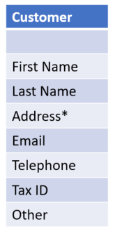
Primary Key
Definition: A primary key is a column in a table that uniquely identifies each row of the table. There can be only one primary key in a table.
Uniqueness: Values in the primary key column(s) must be unique for each row. Two rows cannot have the same primary key value.
Purpose: The main purpose is to uniquely identify each record in the table.
Physical Implications: the primary key is used as an indexing mechanism, which speeds up the retrieval of rows based on their primary key values.
Customer ID
For more lectures and MCQs: farhatlectures.com

Slide 4
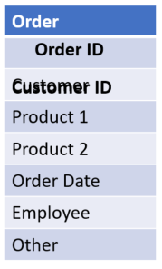
Foreign Key
Definition: A foreign key is a column in one table that refers to the primary key in another table. It's used to establish a link between the data in two tables and ensure referential integrity.
Matching Primary Key: For any value in the foreign key column, there should be a matching value in the primary key column of the table it refers to. However, the reverse need not be true; not every primary key value must have a corresponding foreign key value.
Purpose: The main purpose is to ensure referential integrity and establish a relationship between tables. It ensures that the records in one table have corresponding records in another table.
For more lectures and MCQs: farhatlectures.com

Slide 5
Benefits of Relational Database
Scalability: As data grows, relational databases can scale more effectively than flat files.
Complex Queries: SQL allows for complex querying, joining data from different tables, filtering, and aggregating, which can be cumbersome or slow with flat files.
Data Integrity: Relational databases can enforce data types, uniqueness constraints, and referential integrity, ensuring data stays consistent and accurate.
Data Relationships: Relational databases allow for the representation and querying of data relationships, which flat files don't natively support.
Redundancy Reduction: With normalized database design, the same data isn't stored multiple times, reducing redundancy and saving space.
Other
For more lectures and MCQs: farhatlectures.com

