Slide 1

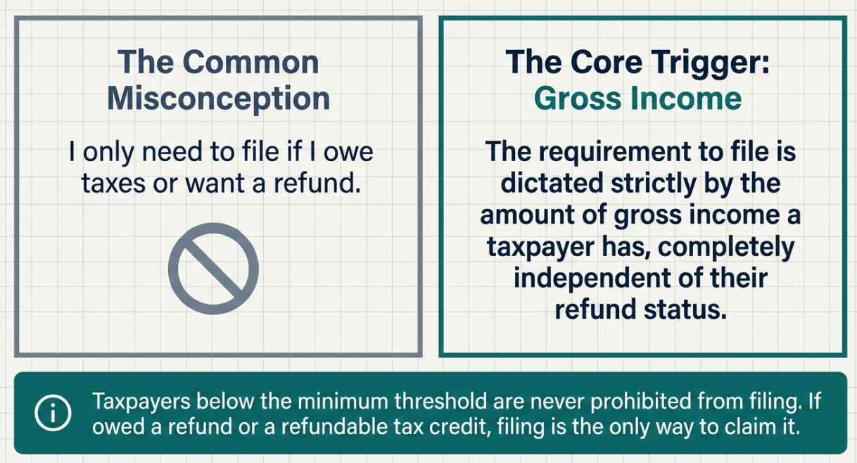
Who Must File income Tax return?
📹 Videos AICPA MCQs & Sims 🤖 Farhat AI Assistant🎙 Podcast Lessons 📊 CPA, CMA, EA Exam 💼Accounting & Finance Courses 🙌 Support by Farhat Team
🌐 farhatlectures.com | ⭐ Start Your Free Trial
Notes:
The Core Filing Trigger: Gross Income
The legal filing requirement is based on gross income, not on whether the taxpayer owes tax or expects a refund.
Key Point
A taxpayer may be required to file even if no tax is ultimately due.
A taxpayer may not be legally required to file, but filing may still be financially wise.
A taxpayer should consider filing if:
Federal income tax was withheld
The taxpayer qualifies for a refundable credit
The taxpayer may receive a refund
Example
A student earns $5,000 from a part-time job and has $300 withheld for federal income tax. The student may not be required to file, but filing is necessary to claim the $300 refund.

Slide 2
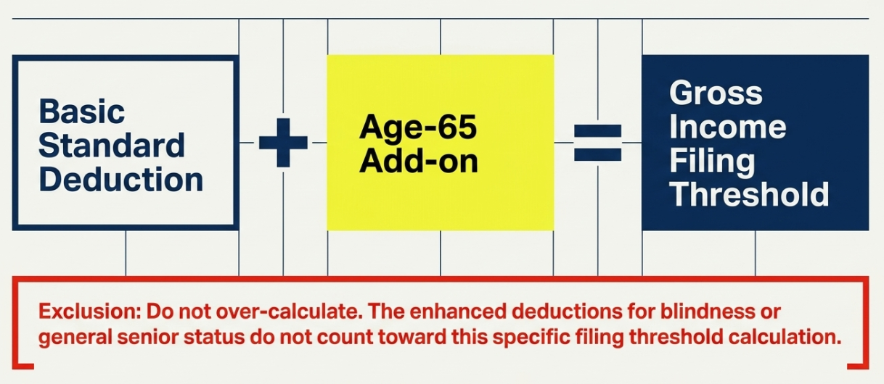
General Filing Threshold Formula
📹 Videos AICPA MCQs & Sims 🤖 Farhat AI Assistant🎙 Podcast Lessons 📊 CPA, CMA, EA Exam 💼Accounting & Finance Courses 🙌 Support by Farhat Team
🌐 farhatlectures.com | ⭐ Start Your Free Trial

Slide 3
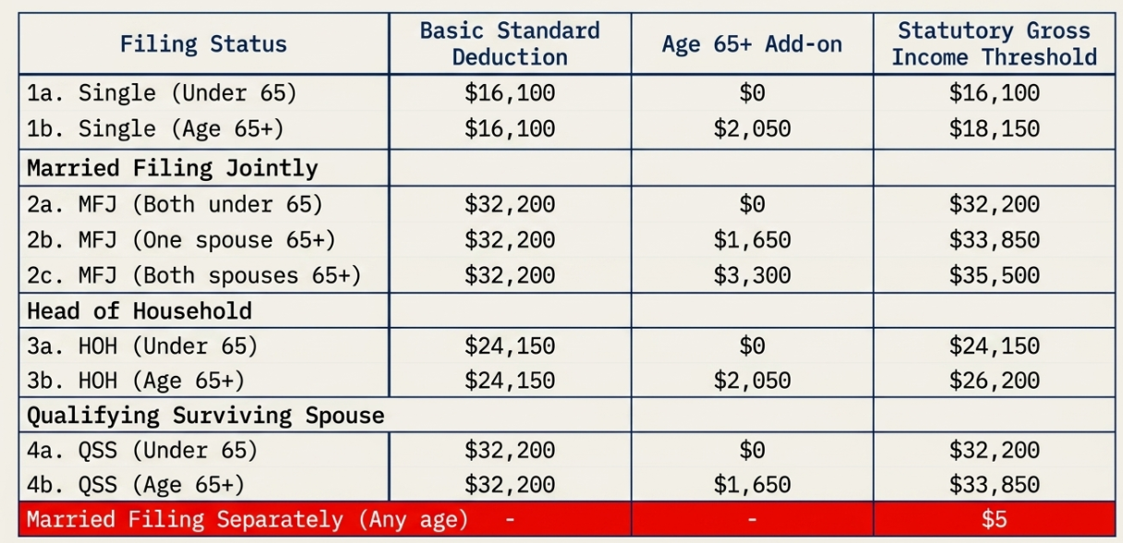
2026 Individual Gross-Income
Filing Thresholds
📹 Videos AICPA MCQs & Sims 🤖 Farhat AI Assistant🎙 Podcast Lessons 📊 CPA, CMA, EA Exam 💼Accounting & Finance Courses 🙌 Support by Farhat Team
🌐 farhatlectures.com | ⭐ Start Your Free Trial

Slide 4
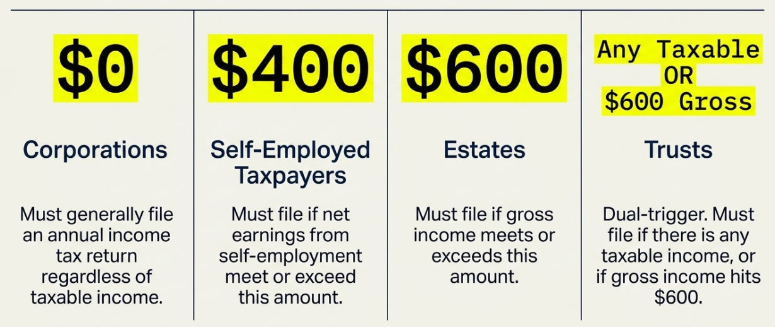
Non-Individual Entities
📹 Videos AICPA MCQs & Sims 🤖 Farhat AI Assistant🎙 Podcast Lessons 📊 CPA, CMA, EA Exam 💼Accounting & Finance Courses 🙌 Support by Farhat Team
🌐 farhatlectures.com | ⭐ Start Your Free Trial

Slide 5
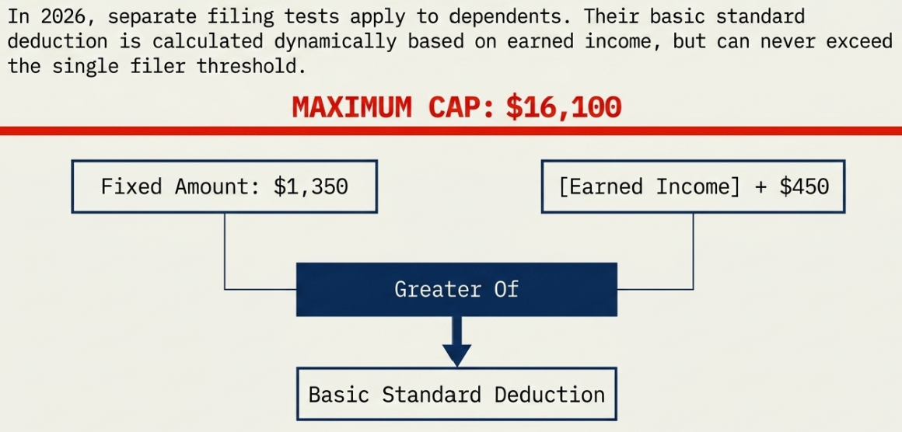
Dependent Filing Threshold:
Basic Rule
📹 Videos AICPA MCQs & Sims 🤖 Farhat AI Assistant🎙 Podcast Lessons 📊 CPA, CMA, EA Exam 💼Accounting & Finance Courses 🙌 Support by Farhat Team
🌐 farhatlectures.com | ⭐ Start Your Free Trial
Notes:
For dependents, the standard deduction is generally the greater of:
$1,350, or
Earned income + $450
But it cannot exceed the regular standard deduction for a single taxpayer.
Key Point
A dependent’s filing threshold moves depending on the mix of earned and unearned income.
Slide 12 —
Slide 13 — Dependent Example: Earned and Unearned Income
Example
Alex earns $3,000 from a summer job and also has $500 of interest income.
Threshold calculation:
Earned income + $450 = $3,450
Gross income = $3,000 + $500 = $3,500
Because $3,500 exceeds $3,450, Alex must file.
Analogy
The dependent rule is a moving tripwire. A small amount of unearned income can cause the taxpayer to cross the line.

Slide 6
Dependent Examples
Unearned Income Only
Alex is 16 and has no job.
His savings account earns $500 of interest.
Threshold calculation:
Earned income: $0
Earned income + $450 = $450
Greater of $1,350 or $450 = $1,350
Because Alex’s gross income is $500, he does not have to file.
Earned Income Only
Alex earns $3,000 from a summer job and has no interest income.
Threshold calculation:
Earned income: $3,000
Earned income + $450 = $3,450
Greater of $1,350 or $3,450 = $3,450
Because Alex’s gross income is $3,000, he does not have to file.
📹 Videos AICPA MCQs & Sims 🤖 Farhat AI Assistant🎙 Podcast Lessons 📊 CPA, CMA, EA Exam 💼Accounting & Finance Courses 🙌 Support by Farhat Team
🌐 farhatlectures.com | ⭐ Start Your Free Trial

Slide 7
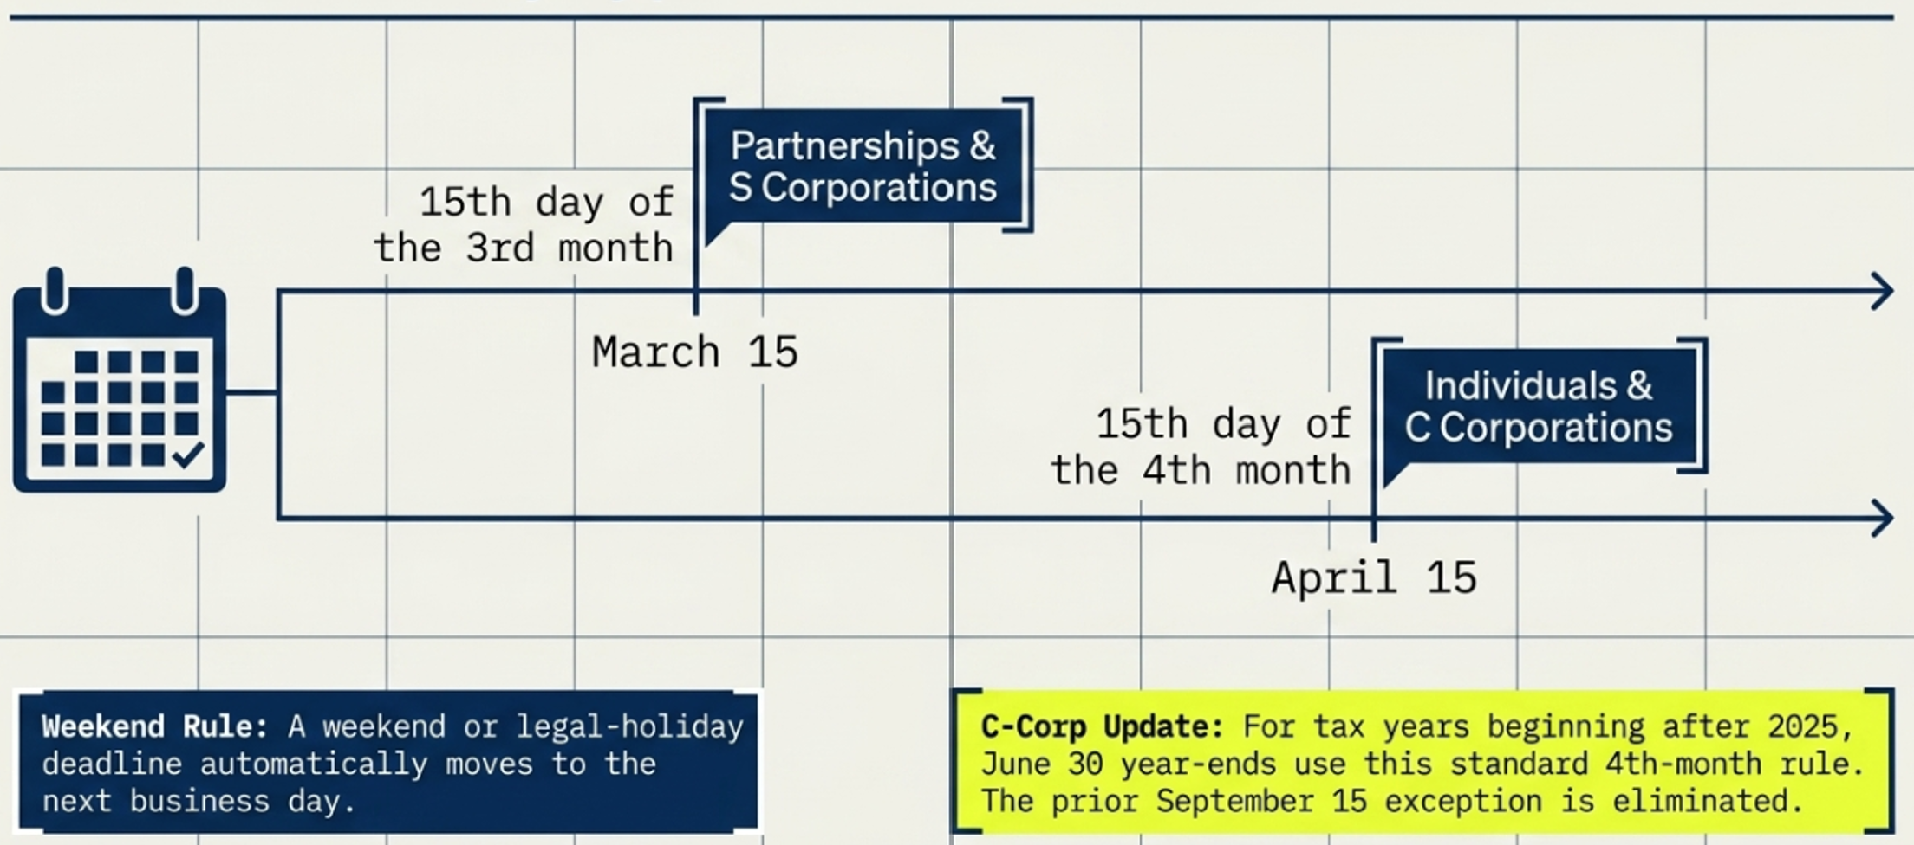
When to File?
📹 Videos AICPA MCQs & Sims 🤖 Farhat AI Assistant🎙 Podcast Lessons 📊 CPA, CMA, EA Exam 💼Accounting & Finance Courses 🙌 Support by Farhat Team
🌐 farhatlectures.com | ⭐ Start Your Free Trial

Slide 8
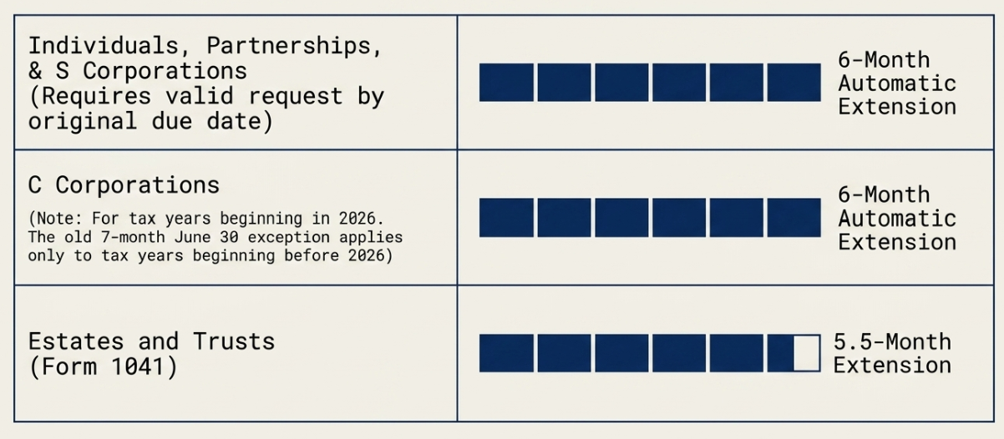
Extension
📹 Videos AICPA MCQs & Sims 🤖 Farhat AI Assistant🎙 Podcast Lessons 📊 CPA, CMA, EA Exam 💼Accounting & Finance Courses 🙌 Support by Farhat Team
🌐 farhatlectures.com | ⭐ Start Your Free Trial

Slide 9
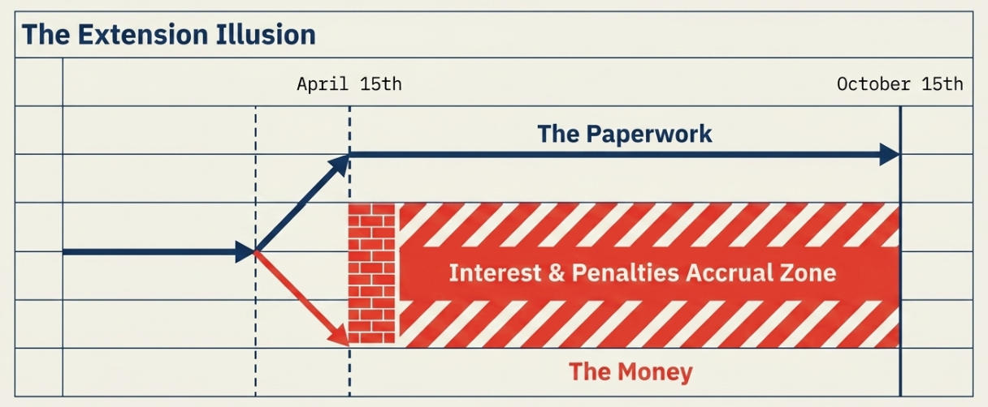
An Extension to File: Never an Extension To Pay
📹 Videos AICPA MCQs & Sims 🤖 Farhat AI Assistant🎙 Podcast Lessons 📊 CPA, CMA, EA Exam 💼Accounting & Finance Courses 🙌 Support by Farhat Team
🌐 farhatlectures.com | ⭐ Start Your Free Trial
Notes:
Slide 21 — Extensions: The Big Misconception
An extension gives more time to file the return.
It does not give more time to pay the tax.
Critical Rule
Taxes are still due by the original deadline.
Interest begins running from the original due date on unpaid tax.
Slide 22 — Extension Analogy
Filing an extension is like asking a professor for extra time to finish a research paper.
The professor may allow more time to submit the final paper, but still requires:
A strong outline
An estimated conclusion
Key supporting information
Similarly, the IRS gives more time to finish the paperwork, but still expects a good-faith estimate and payment of the tax due.

Slide 10
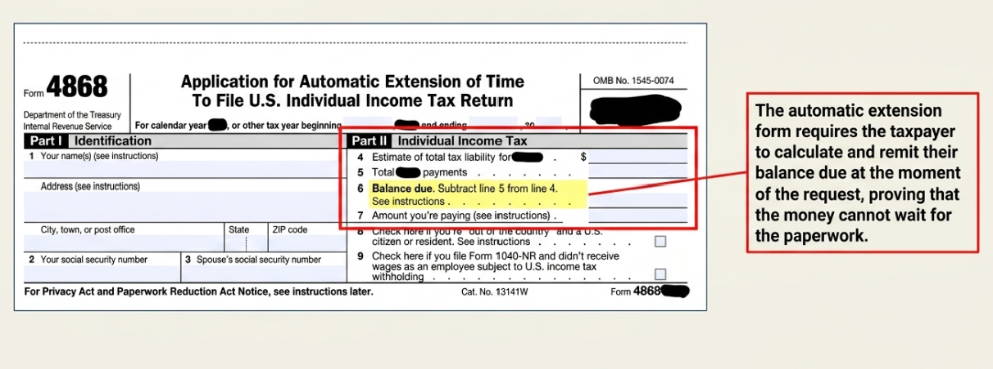
Form 4868
📹 Videos AICPA MCQs & Sims 🤖 Farhat AI Assistant🎙 Podcast Lessons 📊 CPA, CMA, EA Exam 💼Accounting & Finance Courses 🙌 Support by Farhat Team
🌐 farhatlectures.com | ⭐ Start Your Free Trial
Notes:
Slide 21 — Extensions: The Big Misconception
An extension gives more time to file the return.
It does not give more time to pay the tax.
Critical Rule
Taxes are still due by the original deadline.
Interest begins running from the original due date on unpaid tax.
Slide 22 — Extension Analogy
Filing an extension is like asking a professor for extra time to finish a research paper.
The professor may allow more time to submit the final paper, but still requires:
A strong outline
An estimated conclusion
Key supporting information
Similarly, the IRS gives more time to finish the paperwork, but still expects a good-faith estimate and payment of the tax due.

