Slide 1

Itemized Deductions: Schedule A
Itemized Deductions (from AGI) included a range of expenses, including non-trade business expenses (such as employee and investment expenses), as well as certain personal expenses that can be deducted.
These deductions are subject to individual limits and must collectively exceed the standard deduction. Less usage of schedule A?
Medical and dental expenses
Specific taxes
Interest paid on mortgages and investments
Charitable contributions
Miscellaneous expenses (employee and investment expenses)
Visit: farhatlectures.com for complete course: Lectures, MCQs, TF, & Notes

Slide 2
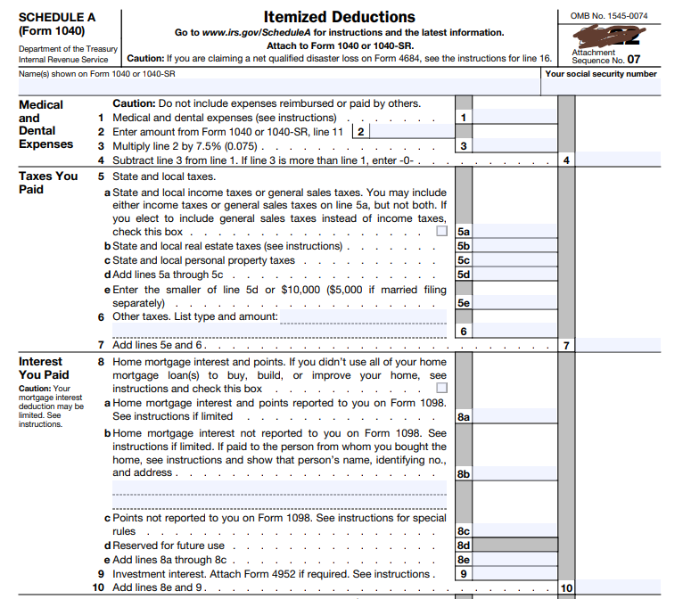
Visit: farhatlectures.com for complete course: Lectures, MCQs, TF, & Notes

Slide 3
Medical Expense Must Exceed 7.5% of AGI
Medical expenses are deductible to the extent unreimbursed medical expenses, in total, exceed 7.5% of AGI
  Emily, age 24, has AGI of $40,000 and medical expenses of $5,000 in 20X3
  Amy’s medical expense deduction = 2,000
    [$5,000 – ($40,000 × 7.5%)]
If Emily was reimbursed $3,000 from her insurance for the medical expenses incurred in 20X3, we need to adjust her medical expense deduction calculation:
  Adjusted qualifying medical expenses = $5,000 - $3,000 Adjusted qualifying medical expenses = $2,000. No deduction!
Qualified Medical Expenses
− Reimbursements
− 7.5% of AGI
= Deductible Medical Expense
Visit: farhatlectures.com for complete course: Lectures, MCQs, TF, & Notes

Slide 4
Which Medical Expenses are Deductible?
Deductible
Not Deductible
Doctor and dentist fees
Hospital and nursing home expenses
Prescription medications
Health insurance premiums (excluding premiums paid through pre-tax contributions)
Long-term care services and premiums
Medical equipment and supplies
Transportation costs for medical purposes (e.g., mileage, parking fees)
Home modifications for medical purposes
Physical therapy and rehabilitation expenses
Eye exams, glasses, and contact lenses
Hearing aids and batteries
Guide dogs and service animals (including their training and care)
Psychiatric and psychological treatments
Smoking cessation programs
Certain fertility treatments
Please note that this list is not exhaustive
Over-the-counter medications (unless prescribed by a doctor)
Health club or gym memberships
Cosmetic procedures (unless medically necessary)
Non-prescription vitamins or supplements
Elective surgeries or treatments (e.g., plastic surgery)
Funeral or burial expenses
Non-prescription weight-loss programs or products
Illegal medical treatments or drugs
Health-related expenses reimbursed by insurance or other sources
Medical expenses paid using pre-tax contributions (e.g., through a Health Savings Account or Flexible Spending Account)
Visit: farhatlectures.com for complete course: Lectures, MCQs, TF, & Notes

Slide 5

Example: Cosmetic Surgery
John, a 68-year-old individual, paid $15,000 to a plastic surgeon for a face-lift procedure with the sole purpose of enhancing his appearance.
Not medically necessary ➔the $15,000 expense does not qualify as a deductible medical expense.
Sarah experienced facial disfigurement due to a severe burn incident.
As a direct consequence of the accident, the cost of restorative cosmetic surgery undertaken by Sarah to reconstruct her damaged face would be eligible as a deductible medical expense.
Visit: farhatlectures.com for complete course: Lectures, MCQs, TF, & Notes

Slide 6

Nursing Home
If the primary purpose of residing in a nursing home or home for the aged is to receive medical care, the expenses associated with care, including meals and lodging, are deductible as medical expenses.
However, if the primary reason for residing in such a facility is personal, any costs related to medical or nursing care can still be claimed as deductible medical expenses.
  Nonetheless, the expenses for meals and lodging must be excluded from the deductible amount.
Visit: farhatlectures.com for complete course: Lectures, MCQs, TF, & Notes

Slide 7

Example
Olivia, who has a chronic heart ailment, required specialized medical and nursing care. In January, her family made the decision to admit Olivia to a nursing home that could adequately provide the necessary healthcare services.
Throughout the year, the total expenses incurred for Olivia's nursing home care amounted to $90,000.
  Among these expenses, $60,000 can be directly attributed to medical and nursing care.
Due to Olivia's substantial need for medical and nursing care, and the primary purpose of her placement in the facility being for healthcare reasons, the entire $90,000 spent on nursing home costs would be deductible.
Visit: farhatlectures.com for complete course: Lectures, MCQs, TF, & Notes

Slide 8

Tuition Expenses
Tuition expenses for a dependent attending a special school for individuals with mental or physical disabilities may be deductible as medical expenses.
To qualify, the primary reason for choosing the school must be its specialized resources for addressing the individual's impairments.
In such cases, both the tuition and the costs for meals and lodging can be claimed as deductible medical expenses.
Visit: farhatlectures.com for complete course: Lectures, MCQs, TF, & Notes

Slide 9
Example
Christopher's son, Ethan, attended public school until the seventh grade. However, due to Ethan's difficulties and academic struggles, he underwent an evaluation by a psychiatrist, who diagnosed him with attention deficit hyperactivity disorder (ADHD).
Based on the psychiatrist's recommendation, Christopher made the decision to enroll Ethan in a private school that specializes in providing individualized attention to students with learning disabilities, specifically focusing on ADHD.
The school offers a specialized curriculum developed by a team of educational and psychological professionals.
The expenses related to Ethan's attendance at the private school, along with the costs associated with any psychiatric care, are eligible as deductible medical expenses.
Visit: farhatlectures.com for complete course: Lectures, MCQs, TF, & Notes

Slide 10

Capital Expenditures
Capital expenditures
    Rule
      If dictated by medical necessity, then deductible
Must meet specific criteria:
  A physician must determine the medical necessity, and the patient should be the primary user.
  The costs incurred must also be reasonable.
  Examples of qualifying capital expenditures include dust elimination systems, elevators, and vans specially designed for wheelchair-bound individuals.
  Additional qualifying expenses may include swimming pools (if there is no access to a neighborhood pool) and non-permanent air conditioners (such as window units).
Visit: farhatlectures.com for complete course: Lectures, MCQs, TF, & Notes

Slide 11

Capital Expenditures
Both permanent improvements and their associated operating and maintenance costs may be eligible as medical expenses.
  deducted in the year they are incurred.
  No Depreciation ➔ the full amount taken in year of installment
The cost is deductible to the extent it exceeds the increase in value of the related property.
Appraisal costs related to capital improvements are not medical expenses.
Visit: farhatlectures.com for complete course: Lectures, MCQs, TF, & Notes

Slide 12
Example
James suffers from heart disease, and his doctor recommends the installation of an elevator in his home to avoid climbing stairs.
The cost of installing the elevator amounts to $12,000, while the increase in the residence's value is determined to be $5,000.
Consequently, $7,000 ($12,000 - $5,000) is considered a medical expense.
Ongoing utility expenses and maintenance costs for the elevator are also treated as medical expenses, as long as the medical necessity for the capital expenditure persists.
Visit: farhatlectures.com for complete course: Lectures, MCQs, TF, & Notes

Slide 13

Transportation expenses incurred for medical care
Deductible medical expenses, subject to the AGI floor.
Include:
  Fares for bus, taxi, train, or plane travel, charges for ambulance services, and out-of-pocket costs for using a personal vehicle or
  Alternatively, the taxpayer can utilize a mileage allowance (subject to change)
  Deductible transportation expenses also include parking fees, tolls, and costs for accompanying individuals like family members or nurses.
  However, the cost of meals during travel for medical care purposes is not deductible.
Visit: farhatlectures.com for complete course: Lectures, MCQs, TF, & Notes

Slide 14

Physically Handicapped Individuals
Certain capital expenditures made to facilitate independent living and productivity for physically handicapped individuals can qualify as medical expenses.
These include constructing ramps, widening hallways and doorways, installing support bars and railings, and adjusting electrical outlets and fixtures.
These expenditures are subject only to the AGI floor, with no increase in the home's value considered.
Visit: farhatlectures.com for complete course: Lectures, MCQs, TF, & Notes

Slide 15
Spouse and Dependent Medical Expense
When calculating the medical expense deduction, a taxpayer can include medical expenses for their spouse and any dependents.
  Joint return and gross income don’t apply
Christopher (age 22) is married and enrolled as a full-time student at a university.
Throughout the year, Christopher incurred medical expenses that were covered by his mother, Olivia.
Olivia provided over half of Christopher's financial support for the year.
Even if Christopher files a joint return with his wife, Olivia is eligible to claim the medical expenses she paid on his behalf.
Olivia would combine both her own medical expenses and those she paid for Christopher before applying the AGI floor.
Visit: farhatlectures.com for complete course: Lectures, MCQs, TF, & Notes

Slide 16
Divorced Individuals
In the case of divorced individuals with children, a specific rule applies to the noncustodial parent.
The noncustodial parent can claim medical expenses paid for the children, even if the children are not considered dependents of the noncustodial parent.
In Alex and Emily's divorce last year, Emily was granted custody of their child, Ethan.
Throughout the current year, Alex covers $3,000 in medical expenses for Ethan.
Despite Ethan being Emily's dependent, Alex has the ability to combine the $3,000 he paid for Ethan's medical bills with his own when calculating his medical expense deduction.
Visit: farhatlectures.com for complete course: Lectures, MCQs, TF, & Notes

Slide 17

Lodging While Away from Home for Medical Care
IF the following conditions are satisfied:
  The lodging is primarily for necessary medical care, provided by a licensed physician in a hospital or similar medical facility.
  Reasonable and not extravagant, and the travel does not involve significant personal pleasure.
  Lodging expenses is limited to $50 per night per person.
  This deduction applies not only to the patient but also to any accompanying individuals who must travel with the patient.
  Meal expenses are not deductible unless they are directly related to medical care and provided at a medical facility.
    If these meals qualify for a deduction, they are not subject to the 50 percent limit that applies to business meals.
Visit: farhatlectures.com for complete course: Lectures, MCQs, TF, & Notes

Slide 18

Medical Insurance Premiums
Medical insurance premiums are under a group plan or an individual plan included with other medical expenses
If an employer (ER) pays all or part of the taxpayer’s medical insurance premiums, the amount paid by the employer is not included in the employee’s gross income➔ no deductible by Employee (EE) ➔ deductible by ER
If a taxpayer is self-employed, insurance premiums paid for medical coverage (including spouse and dependent) are deductible as a business expense (for AGI).
  deduction is not allowed if the taxpayer (or taxpayer’s spouse) is eligible to participate in an employer-provided health plan.
Visit: farhatlectures.com for complete course: Lectures, MCQs, TF, & Notes

Slide 19
Year of Deduction
Medical expenses can only be deducted in the year they are paid, regardless of the taxpayer's accounting method.
Cash Basis.
No prepayment.
At the recommendation of his regular dentist, in December 20X3, Marcus seeks consultation from Dr. Johnson, a prosthodontist specializing in restorative dental work.
Dr. Johnson informs Marcus that the necessary restorative work will cost $15,000 and requires a 40% prepayment from all new patients.
Marcus pays $6,000 in December 20X3. The remaining balance of $9,000 is paid upon completion of the work in January 20X4.
In this scenario, Marcus can claim a medical expense deduction of $6,000 for 20X3 and $9,000 for 2024. The same deduction amount would apply even if Marcus prepaid the full $15,000 in 20X3.
Visit: farhatlectures.com for complete course: Lectures, MCQs, TF, & Notes

Slide 20

Reimbursements
Reimbursements for medical expenses received in the same year as they were paid simply reduce the amount eligible for the medical expense deduction.
Under the tax benefit rule, if a taxpayer receives an insurance reimbursement for medical expenses that were deducted in a prior year, they must include the reimbursement in their income up to the amount of the deductions that reduced their taxable income in the earlier year.
No itemize deductions in the year the expenses were paid ➔ do not include in income
Visit: farhatlectures.com for complete course: Lectures, MCQs, TF, & Notes

Slide 21
Example
Ethan, who had an AGI of $45,000 in 20X3. Ethan experienced an unfortunate car accident that resulted in $4,300 in hospital expenses and $1,700 in doctor bills. Additionally, Ethan incurred $600 in medical expenses for his dependent child. In 20x4, Ethan received a reimbursement of $950 from his insurance company for the medical expenses related to the car accident.
Medical expense deduction threshold = 7.5% × $45,000 Medical expense deduction threshold = $3,375
Total qualifying medical expenses = $4,300 + $1,700 + $600 Total qualifying medical expenses = $6,600
Deductible medical expenses = $6,600 - $3,375 Deductible medical expenses = $3,225
Visit: farhatlectures.com for complete course: Lectures, MCQs, TF, & Notes

