Slide 1
Who Must file a tax return and When?
Individuals:
Depends on three factors:
  Filing status (5 filing status)
  Income
  Age
  *Standard deduction + additional deductions
  *Blindness additional standard deduction DOES not apply in this determination
Self employed are required to file if net earnings exceed a certain amount (400)
If you are claimed by a dependent on another return. Greater of
  1,100 or
  Earned income plus 350 (not to exceed the single standard deduction)
Corporations:
  Regardless of the amount of taxable income they have, all corporations are required to file an annual tax return.
Estates and trusts:
  Estates and trusts must file annual income tax returns if their gross income is more than $600.
Student or CPA/EA Candidate?
www.farhatlectures.com

Slide 2
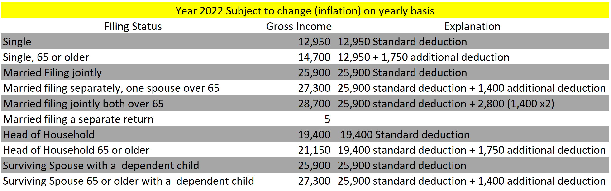
The requirement to file a tax return is based on the amount of gross income a taxpayer has, not on whether they are owed a refund.
A taxpayer is not prohibited from filing a tax return even if their gross income falls below the minimum threshold.
In fact, taxpayers who are owed a refund should file a tax return in order to receive the refund or claim a refundable tax credit, even if they are not otherwise required to file a tax return.
Student or CPA/EA Candidate?
www.farhatlectures.com

Slide 3
When do you have to file?
Individuals:
  Fifteenth day of the fourth month following year-end:
  April 15 for calendar-year individuals.
    (Due dates that fall on a Saturday, Sunday, or holiday are automatically extended to the next day that is not a Saturday, Sunday, or holiday.)
C corporations:
  fifteenth day of the fourth month following the corporation’s year-end.
  The exception is for tax returns for C corporations with a June 30 year-end, which are due on the fifteenth day of the third month (September 15).
Partnerships and S corporations (generally nontaxable corporations):
  fifteenth day of the third month following the entity’s year-end (March 15 for calendar-year partnerships or S corporations).
Student or CPA/EA Candidate?
www.farhatlectures.com

Slide 4

Student or CPA/EA Candidate?
www.farhatlectures.com

Slide 5
Extensions and Payments
Individuals, partnerships, and S corporations that are unable to file a tax return by the original due date can request a six-month extension to file by the same deadline.
  This extension is automatically granted by the IRS.
C corporations may also request an automatic six- or seven-month extension to file, depending on the corporation's year-end.
An extension to file a tax return only delays the deadline for filing, not for paying taxes.
If a taxpayer does not pay the full amount of taxes owed by the original due date of the tax return, the IRS will charge interest on the unpaid balance from the due date of the return until the taxes are paid.
Interest and penalties for not underpayment and nonfilers TBD
Student or CPA/EA Candidate?
www.farhatlectures.com

