Slide 1

US Cybersecurity Framework
The US Cybersecurity Framework, developed by the National Institute of Standards and Technology (NIST), is a voluntary set of guidelines that helps organizations manage and reduce cybersecurity risk.
The framework is designed to be flexible and adaptable, allowing organizations to tailor it to their unique needs and risk profiles.
The framework consists of five core functions, profile and 4 tiers which together form a comprehensive approach to cybersecurity.
4 Tiers
Profile
5 Core
Functions
1.Identify
2.Protect
3.Detect
4.Respond
5.Recover
Executive Order 13636
For more, visit
www.farhatlectures.com

Slide 2
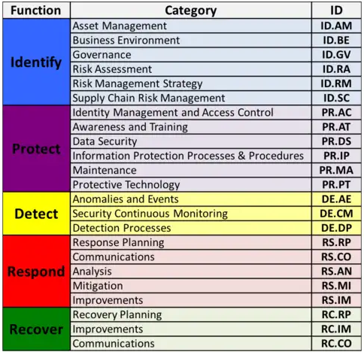
Big Picture
5 Core functions
23 Categories
108 Subcategories
Reference (many)
For more, visit
www.farhatlectures.com

Slide 3
NIST Cyber Security Framework
Identify
Protect
Detect
Respond
Recover
Asset Management
Identify Management &Access Control
Anomalies and Events
Response Planning
The purpose of the Recover function is to help organizations restore their capabilities and services after a cybersecurity incident, minimize the impact on business operations, and reduce the risk of future incidents.
Business Environment
Awareness & Training
Security Continuous Monitoring
Communication
Governance
Data Security
Analysis
Risk Assessment
Information Protection Processes & Procedures
Detection Processes
Mitigation
Risk Management
Improvements
Supply Chain Risk
Maintenance
Protective Technology
For more, visit
www.farhatlectures.com

Slide 4

NIST Cyber Security Framework
Recover
Recovery Planning (RC.RP):
Recovery Planning focuses on developing and implementing plans to recover from cybersecurity incidents.
1.1: RC.RP-1: Recovery plans are developed and maintained - This subcategory emphasizes the importance of having well-documented and up-to-date recovery plans in place to help organizations recover from cybersecurity incidents efficiently and effectively.
Recovery Planning
Improvements
Communication
For more, visit
www.farhatlectures.com

Slide 5

NIST Cyber Security Framework
Recover
Improvements (RC.IM):
Improvements involve incorporating lessons learned from past incidents and identifying opportunities to strengthen the organization's recovery capabilities.
2.1: RC.IM-1: Recovery plans are updated based on lessons learned - Organizations should analyze previous incidents, learn from them, and update their recovery plans accordingly to improve their response in future incidents.
2.2: RC.IM-2: Recovery strategies are improved - This subcategory focuses on enhancing recovery strategies by evaluating the effectiveness of existing approaches and identifying areas for improvement.
Recovery Planning
Improvements
Communication
For more, visit
www.farhatlectures.com

Slide 6

NIST Cyber Security Framework
Recover
Communications (RC.CO):
Communications focuses on coordinating with internal and external stakeholders during and after an incident to provide timely and accurate information. Who is responsibe?
3.1: RC.CO-1: Public relations are managed - Organizations should have a plan for managing public relations after a cybersecurity incident, which includes providing accurate information to the public, customers, partners, and other stakeholders.
3.2: RC.CO-2: Reputation (brand!) is managed after an incident - This subcategory emphasizes the importance of managing the organization's reputation by addressing the concerns of stakeholders, rebuilding trust, and demonstrating a commitment to preventing future incidents.
3.3: RC.CO-3: Recovery activities are communicated to internal and external stakeholders - Clear communication of recovery activities ensures that all parties involved are aware of the steps being taken to restore normal operations and maintain transparency.
Recovery Planning
Improvements
Communication
For more, visit
www.farhatlectures.com

Slide 7
US Cybersecurity Framework
The US Cybersecurity Framework, developed by the National Institute of Standards and Technology (NIST), is a voluntary set of guidelines that helps organizations manage and reduce cybersecurity risk.
The framework is designed to be flexible and adaptable, allowing organizations to tailor it to their unique needs and risk profiles.
The framework consists of five core functions, profile and 4 tiers which together form a comprehensive approach to cybersecurity.
4 Tiers
Profile
5 Core
Functions
1.Identify
2.Protect
3.Detect
4.Respond
5.Recover
Executive Order 13636
For more, visit
www.farhatlectures.com

