Slide 1
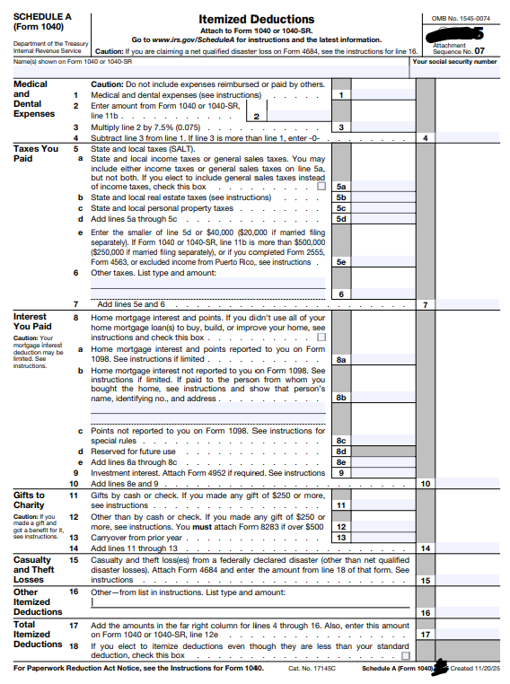

📹 Videos AICPA MCQs & Sims 🤖 Farhat AI Assistant🎙 Podcast Lessons 📊 CPA, CMA, EA Exam 💼Accounting & Finance Courses 🙌 Support by Farhat Team
🌐 farhatlectures.com | ⭐ Start Your Free Trial

Slide 2
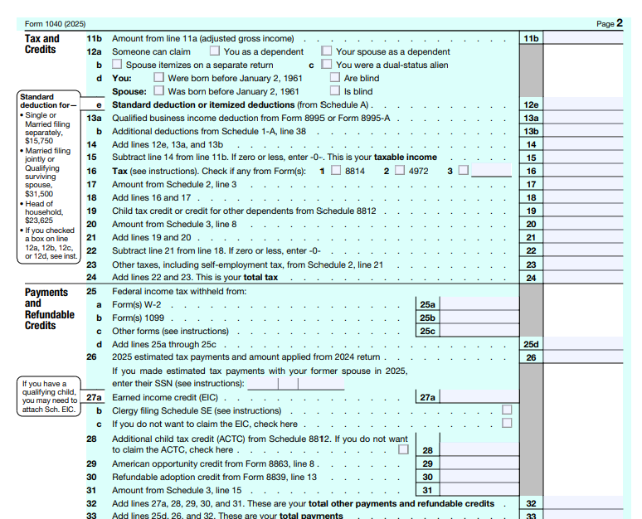

Slide 3

Itemized Deductions Schedule A
Itemized Deductions (from AGI) included a range of expenses, including non-trade business expenses (such as employee and investment expenses), as well as certain personal expenses that can be deducted.
These deductions are subject to individual limits and must collectively exceed the standard deduction before any tax benefit can be obtained.
  Medical and dental expenses
  Specific state and local Income Taxes (SALT)
  Interest paid on mortgages and investments
  Charitable contributions
  Miscellaneous expenses (employee and investment expenses)
  Casualty and Theft Loss
📹 Videos AICPA MCQs & Sims 🤖 Farhat AI Assistant🎙 Podcast Lessons 📊 CPA, CMA, EA Exam 💼Accounting & Finance Courses 🙌 Support by Farhat Team
🌐 farhatlectures.com | ⭐ Start Your Free Trial

Slide 4
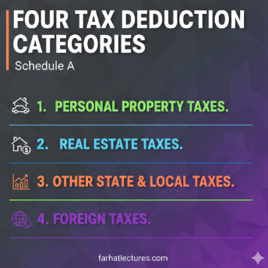
Deductible State and Local Taxes (SALT)
The key concept is avoiding multiple layers of taxation on the same income.
  Certain taxes reduce your ability to pay federal income taxes, so the tax law allows deductions to prevent double taxation on the same revenue base.
There are four major categories of deductible taxes on individual returns:
  Personal property taxes.
  Local real estate property taxes.
  Other state and local taxes.
  Foreign taxes.
📹 Videos AICPA MCQs & Sims 🤖 Farhat AI Assistant🎙 Podcast Lessons 📊 CPA, CMA, EA Exam 💼Accounting & Finance Courses 🙌 Support by Farhat Team
🌐 farhatlectures.com | ⭐ Start Your Free Trial

Slide 5

Deductible (When) State and
Local Taxes (SALT)
For cash method taxpayers, deductible taxes are generally deductible in the year paid.
For accrual method taxpayers, taxes are generally deductible in the year in which the taxes are accrued.
One important note is that federal taxes generally are not deductible on the federal tax return
📹 Videos AICPA MCQs & Sims 🤖 Farhat AI Assistant🎙 Podcast Lessons 📊 CPA, CMA, EA Exam 💼Accounting & Finance Courses 🙌 Support by Farhat Team
🌐 farhatlectures.com | ⭐ Start Your Free Trial

Slide 6

The SALT Deduction Cap
& Phase-Out
General Limit: Under the One Big Beautiful Bill Act (OBBBA), the total deduction for combined state and local taxes is capped at $40,000 ($20,000 for married filing separately).
Phase-Out Rules: For high-income earners, the $40,000 cap is reduced if Modified AGI exceeds $500,000 ($250,000 for MFS).
The Reduction Formula: The cap is reduced by 30% of the excess AGI over the threshold, but the cap cannot drop below $10,000 ($5,000 for MFS).
📹 Videos AICPA MCQs & Sims 🤖 Farhat AI Assistant🎙 Podcast Lessons 📊 CPA, CMA, EA Exam 💼Accounting & Finance Courses 🙌 Support by Farhat Team
🌐 farhatlectures.com | ⭐ Start Your Free Trial

Slide 7
Personal Property Taxes (1 of 4)
Personal property taxes are taxes imposed on movable property, not land or buildings
Common examples include:
  Automobiles
  Boats
  Business equipment
The deductibility of personal property taxes depends on how the property is used and how the tax is calculated
📹 Videos AICPA MCQs & Sims 🤖 Farhat AI Assistant🎙 Podcast Lessons 📊 CPA, CMA, EA Exam 💼Accounting & Finance Courses 🙌 Support by Farhat Team
🌐 farhatlectures.com | ⭐ Start Your Free Trial

Slide 8

3 Tests for Deductible
Personal Property Taxes
1) The tax must be levied on personal property
    not services or privileges
  Examples that meet this test:
    Annual tax on vehicles
    Annual tax on business equipment
2) The tax must be an ad valorem tax
  based on the value of the property
  The amount of tax increases or decreases as the property value changes
Examples:
  2% of a vehicle’s assessed value → deductible
  Flat fee per vehicle → not deductible
3) The tax must be imposed at least annually
  One-time charges or sporadic assessments do not qualify
  Most personal property taxes assessed by counties meet this requirement
If any one of these tests is not met, the tax is not deductible
📹 Videos AICPA MCQs & Sims 🤖 Farhat AI Assistant🎙 Podcast Lessons 📊 CPA, CMA, EA Exam 💼Accounting & Finance Courses 🙌 Support by Farhat Team
🌐 farhatlectures.com | ⭐ Start Your Free Trial

Slide 9

Real Property Taxes
Property taxes on real estate meet the same three deductibility tests as personal property taxes
Real property taxes are typically larger in dollar amount, which often leads to additional tax issues
Two common situations create complexity:
  Joint ownership of property
  Sale of property during the tax year
📹 Videos AICPA MCQs & Sims 🤖 Farhat AI Assistant🎙 Podcast Lessons 📊 CPA, CMA, EA Exam 💼Accounting & Finance Courses 🙌 Support by Farhat Team
🌐 farhatlectures.com | ⭐ Start Your Free Trial

Slide 10

Joint and Several Liability
Many properties are owned by more than one individual
The deductibility of real estate taxes depends on:
  State or local law
  Whether owners are jointly and severally liable for the tax
Who pays the tax is important, but legal liability is the controlling factor
Joint and several liability means:
  Each owner is legally responsible for the entire tax bill
  The taxing authority may collect the full amount from any one owner
If one owner pays the full tax:
  That owner may deduct the entire amount paid, even if ownership is less than 100%
📹 Videos AICPA MCQs & Sims 🤖 Farhat AI Assistant🎙 Podcast Lessons 📊 CPA, CMA, EA Exam 💼Accounting & Finance Courses 🙌 Support by Farhat Team
🌐 farhatlectures.com | ⭐ Start Your Free Trial

Slide 11
Joint and Several Liability Applies
Joint and Several Liability Applies
Two brothers jointly own real estate:
  Jacob owns 30%
  Rami owns 70%
Total real estate tax bill: $2,300
Jacob pays the entire tax
Because the state imposes joint and several liability:
  Jacob may deduct the entire $2,300 on Schedule
📹 Videos AICPA MCQs & Sims 🤖 Farhat AI Assistant🎙 Podcast Lessons 📊 CPA, CMA, EA Exam 💼Accounting & Finance Courses 🙌 Support by Farhat Team
🌐 farhatlectures.com | ⭐ Start Your Free Trial

Slide 12
No Joint and Several Liability
— Different Result
Some states do not impose joint and several liability
In these states:
  Each owner is only legally responsible for their ownership percentage
Paying more than your share does not increase your deduction
Same ownership percentages:
  Jacob: 30%
  Rami: 70%
Total tax bill: $2,300
Jacob pays the full amount
Because joint and several liability does not apply:
  Jacob’s deduction is limited to $690 ($2,300 × 30%)
📹 Videos AICPA MCQs & Sims 🤖 Farhat AI Assistant🎙 Podcast Lessons 📊 CPA, CMA, EA Exam 💼Accounting & Finance Courses 🙌 Support by Farhat Team
🌐 farhatlectures.com | ⭐ Start Your Free Trial

Slide 13
Deduction Rule for Jointly
Owned Property
Deductibility depends on legal liability, not payment alone
If joint and several liability exists:
  Deduct what you pay
If joint and several liability does not exist:
  Deduct only your proportionate share
Always check state or local law
📹 Videos AICPA MCQs & Sims 🤖 Farhat AI Assistant🎙 Podcast Lessons 📊 CPA, CMA, EA Exam 💼Accounting & Finance Courses 🙌 Support by Farhat Team
🌐 farhatlectures.com | ⭐ Start Your Free Trial

Slide 14

Property Taxes When Real
Estate Is Sold During the Year
When real property is sold during the year, real estate taxes are allocated between the buyer and the seller
Both parties may deduct a portion of the tax based on their period of ownership
Allocation is made using a daily proration method
Each party deducts only the tax attributable to the number of days the property was owned
The day of sale is excluded from the seller’s ownership period
Deductibility is based on economic responsibility, not on who pays the tax bill
📹 Videos AICPA MCQs & Sims 🤖 Farhat AI Assistant🎙 Podcast Lessons 📊 CPA, CMA, EA Exam 💼Accounting & Finance Courses 🙌 Support by Farhat Team
🌐 farhatlectures.com | ⭐ Start Your Free Trial

Slide 15
Example
Annual real estate tax: $3,300
Property sold on March 1
Seller’s ownership: 59 days
  Deduction: $3,300 × 59 ÷ 365 = $533
Buyer’s ownership: 306 days
  Deduction: $3,300 × 306 ÷ 365 = $2,767
Although the buyer pays the tax when due:
  The seller’s share is withheld at closing
Key takeaway: Each party deducts the portion of tax related to their ownership period, regardless of payment timing
📹 Videos AICPA MCQs & Sims 🤖 Farhat AI Assistant🎙 Podcast Lessons 📊 CPA, CMA, EA Exam 💼Accounting & Finance Courses 🙌 Support by Farhat Team
🌐 farhatlectures.com | ⭐ Start Your Free Trial

Slide 16
Real Estate Taxes (2 of 4)
Under the OBBBA of 2025, real estate property taxes remain deductible for federal income tax purposes
The deduction is subject to the aggregate SALT limitation of $40,000 for 2025
The schedule on which the deduction is taken depends on how the property is used:
  Personal-use real estate (e.g., principal residence):
    Deducted as an itemized deduction on Schedule A
  Rental real estate:
    Deducted on Schedule E in computing rental net income or loss
  Business real estate used by a sole proprietor:
    Deducted on Schedule C in computing net profit or loss
The same real estate tax may be deductible on different schedules depending on use, not ownership alone.
These taxes must be imposed for general public purposes, such as funding schools or public services.
📹 Videos AICPA MCQs & Sims 🤖 Farhat AI Assistant🎙 Podcast Lessons 📊 CPA, CMA, EA Exam 💼Accounting & Finance Courses 🙌 Support by Farhat Team
🌐 farhatlectures.com | ⭐ Start Your Free Trial

Slide 17

Taxes That Are Not Included in Real Property Taxes
Not all charges imposed by local governments qualify as deductible property taxes.
Special assessments for local improvements are not deductible.
Examples include assessments for:
  Streets
  Sidewalks
  Curbs
  Sewer or similar infrastructure improvements
These are considered capital-type improvements, not taxes for general government operations.
📹 Videos AICPA MCQs & Sims 🤖 Farhat AI Assistant🎙 Podcast Lessons 📊 CPA, CMA, EA Exam 💼Accounting & Finance Courses 🙌 Support by Farhat Team
🌐 farhatlectures.com | ⭐ Start Your Free Trial

Slide 18
Escrow Accounts and
Deductible Amount
Many mortgage payments include:
  Mortgage principal and interest
  Real estate property taxes collected through an escrow account
Monthly escrow deposits are not deductible when paid to the mortgage company
The deductible amount is the actual property tax paid to the local taxing authority
The mortgage lender reports the amount paid on a year-end statement (typically Form 1098)
Example:
Monthly mortgage payment: $1,500
  $1,250 for principal and interest
  $250 deposited into escrow for property taxes
Actual property tax paid from escrow in November 2025: $2,800
Deductible amount on Schedule A for 2025: $2,800, provided total SALT deductions do not exceed $40,000
📹 Videos AICPA MCQs & Sims 🤖 Farhat AI Assistant🎙 Podcast Lessons 📊 CPA, CMA, EA Exam 💼Accounting & Finance Courses 🙌 Support by Farhat Team
🌐 farhatlectures.com | ⭐ Start Your Free Trial

Slide 19


Slide 20
State and Local Income
Taxes (3 of 4)
State and local income taxes are among the largest itemized deductions for many taxpayers
Taxpayers may deduct:
  State income taxes withheld from wages
  State income taxes paid with estimated tax payments
  State income taxes paid with a prior-year return
The deduction is allowed only if the taxpayer itemizes
The deduction is subject to the aggregate SALT limitation
  $40,000 for tax year 2025 under the OBBBA
Example:
  A taxpayer who itemizes may deduct the actual amount of state income taxes paid during the year, provided the total SALT deduction does not exceed the annual limit
📹 Videos AICPA MCQs & Sims 🤖 Farhat AI Assistant🎙 Podcast Lessons 📊 CPA, CMA, EA Exam 💼Accounting & Finance Courses 🙌 Support by Farhat Team
🌐 farhatlectures.com | ⭐ Start Your Free Trial

Slide 22

State Tax Refunds and the Tax
Benefit Rule
If a taxpayer receives a state income tax refund after deducting state taxes in a prior year:
  The refund may be taxable in the year received
This treatment is governed by the tax benefit rule
The tax benefit rule states:
  A refund is taxable only to the extent the earlier deduction reduced federal taxable income
Example:
  A taxpayer deducted $4,700 of state income taxes in 20X5
  In 20X6, the taxpayer receives an $800 state tax refund
  Only the portion that produced a federal tax benefit is taxable
  If the full $4,700 deduction reduced taxable income, the $800 refund is included in income in 20X6
State tax refunds are reported as taxable refunds on Schedule 1 of Form 1040
📹 Videos AICPA MCQs & Sims 🤖 Farhat AI Assistant🎙 Podcast Lessons 📊 CPA, CMA, EA Exam 💼Accounting & Finance Courses 🙌 Support by Farhat Team
🌐 farhatlectures.com | ⭐ Start Your Free Trial

Slide 23

Choosing Between State Income Taxes and Sales Taxes
Taxpayers who itemize may deduct either:
  State and local income taxes, or
  State and local general sales taxes
Both options are subject to the aggregate SALT limitation
  $40,000 for tax year 2025 under the OBBBA
Taxpayers cannot deduct both
In general:
  Taxpayers in income-tax states benefit more from the income tax deduction
  Taxpayers in no-income-tax states benefit more from the sales tax deduction
The goal is to choose the option that produces the greater tax benefit
📹 Videos AICPA MCQs & Sims 🤖 Farhat AI Assistant🎙 Podcast Lessons 📊 CPA, CMA, EA Exam 💼Accounting & Finance Courses 🙌 Support by Farhat Team
🌐 farhatlectures.com | ⭐ Start Your Free Trial

Slide 24
Foreign Taxes —
Credit vs. Deduction
Foreign taxes paid may be deductible or creditable, depending on the taxpayer’s choice
Foreign property taxes are not deductible
Foreign income taxes related to a trade or business are no longer deductible as itemized deductions
Taxpayers generally may choose between:
  A foreign tax credit, or
  A foreign tax deduction on Schedule A
Taxpayers are allowed to use only one method for the same foreign taxes
In most cases, the foreign tax credit is preferable because:
  It provides a dollar-for-dollar reduction of U.S. tax liability
  A deduction only reduces taxable income, not the tax itself
📹 Videos AICPA MCQs & Sims 🤖 Farhat AI Assistant🎙 Podcast Lessons 📊 CPA, CMA, EA Exam 💼Accounting & Finance Courses 🙌 Support by Farhat Team
🌐 farhatlectures.com | ⭐ Start Your Free Trial

Slide 25

Example
A U.S. taxpayer earns foreign income and pays $3,500 in foreign income taxes
U.S. marginal tax rate: 35%
If the taxpayer claims the foreign tax credit:
  U.S. tax is reduced by $3,500
If the taxpayer claims a deduction instead:
  Tax savings = $3,500 × 35% = $1,225
The credit produces the greater benefit and is generally preferred
Important limitation:
  If the foreign tax credit is not allowed (e.g., taxes paid to certain restricted countries), the taxpayer’s only option is to deduct the tax on Schedule A, subject to SALT limits
Key takeaway: Choose the credit when available; use the deduction only when the credit is disallowed or limited
📹 Videos AICPA MCQs & Sims 🤖 Farhat AI Assistant🎙 Podcast Lessons 📊 CPA, CMA, EA Exam 💼Accounting & Finance Courses 🙌 Support by Farhat Team
🌐 farhatlectures.com | ⭐ Start Your Free Trial

Slide 26

Documentation for State, Local, and Foreign Taxes
Taxpayers must keep documentation to support state, local, and foreign tax deductions
Personal property taxes:
  County or city tax bills
  Proof of payment (e.g., canceled checks)
Real estate property taxes:
  Tax bills or escrow records
  Form 1098 (mortgage interest and tax payments)
  Closing statements showing tax allocation when property is sold
State and local income taxes:
  Form W-2 (state and local withholding)
  Quarterly estimated tax payment records
  Prior-year state or local returns (important when refunds occur)
Foreign taxes:
  Foreign tax returns
  Brokerage or mutual fund statements
  Records of foreign tax withheld on dividends (Form 1099-DIV)
Documentation supports both:
  The deduction claimed, and
  Any taxable refund income under the tax benefit rule.
📹 Videos AICPA MCQs & Sims 🤖 Farhat AI Assistant🎙 Podcast Lessons 📊 CPA, CMA, EA Exam 💼Accounting & Finance Courses 🙌 Support by Farhat Team
🌐 farhatlectures.com | ⭐ Start Your Free Trial

Slide 27
Taxes That Are Not Deductible
Certain taxes are not deductible as personal tax deductions, including:
  Federal income taxes
  Social Security taxes and Medicare taxes (FICA)
  Federal excise taxes (e.g., tobacco, alcohol, gasoline)
  Customs duties
  Transfer taxes (stamp taxes)
  License fees
  Sales tax on personal items
  Estate taxes
  Inheritance taxes
  Gift taxes
  Taxes on foreign property (requires careful analysis; rules have changed over time)
📹 Videos AICPA MCQs & Sims 🤖 Farhat AI Assistant🎙 Podcast Lessons 📊 CPA, CMA, EA Exam 💼Accounting & Finance Courses 🙌 Support by Farhat Team
🌐 farhatlectures.com | ⭐ Start Your Free Trial

Slide 28
Special Rule:
Overpayments
Applied Overpayments: If a taxpayer is due a refund from a prior year but asks the state to keep it and apply it to the current year, it is treated as a tax payment in the year it is applied.
In 20X4, a taxpayer is entitled to a $900 state income tax refund.
Instead of receiving the refund, the taxpayer elects to apply the overpayment to 20X5 state taxes.
The $900 is treated as a state tax payment in 20X5, the year it is applied.
If the taxpayer itemizes, the $900 may be deducted on the 20X5 federal return, subject to the SALT limitation.
📹 Videos AICPA MCQs & Sims 🤖 Farhat AI Assistant🎙 Podcast Lessons 📊 CPA, CMA, EA Exam 💼Accounting & Finance Courses 🙌 Support by Farhat Team
🌐 farhatlectures.com | ⭐ Start Your Free Trial

Slide 29
Example
Marcus paid the following in 20X5:
  $22,000 in state income tax withholding.
  $12,000 in real estate taxes for his primary home.
  $4,000 in real estate taxes for a rental property.
  $300 car registration fee (based on vehicle weight).
Step 1: Total potential taxes = $22,000 + $12,000 = $34,000.
(Note: The $300 fee is excluded because it isn't value-based).
Step 2: Check Phase-out. Marcus has a Modified AGI of $540,000.
Step 3: Calculate Cap Reduction:
    Excess AGI: $540,000 - $500,000 = $40,000.
    Reduction: $40,000 x 30% = $12,000
    New Cap: $40,000 - $12,000 = $28,000
Result: Marcus can only deduct $28,000.
📹 Videos AICPA MCQs & Sims 🤖 Farhat AI Assistant🎙 Podcast Lessons 📊 CPA, CMA, EA Exam 💼Accounting & Finance Courses 🙌 Support by Farhat Team
🌐 farhatlectures.com | ⭐ Start Your Free Trial

Slide 30

MCQ from farhatlectures.com
A taxpayer overpaid state income taxes in 20X4 and elected to apply the overpayment to 20X5 state taxes. How is the overpayment treated for federal tax purposes?
a. Deductible in 20X4
b. Deductible in 20X5
c. Taxable income in 20X5
d. Subject to the tax benefit rule in 20X4
An applied overpayment is treated as a tax payment in the year it is applied, not the year the overpayment arose. Therefore, it is deductible in 20X5, subject to SALT limitations.
📹 Videos AICPA MCQs & Sims 🤖 Farhat AI Assistant🎙 Podcast Lessons 📊 CPA, CMA, EA Exam 💼Accounting & Finance Courses 🙌 Support by Farhat Team
🌐 farhatlectures.com | ⭐ Start Your Free Trial

