Slide 1
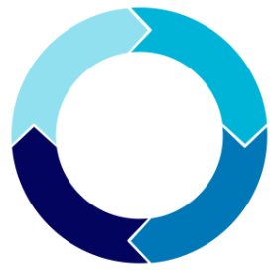
System Development Life Cycle (SDLC)
System development life cycle (SDLC) is a process used to design, develop, and maintain software systems.
It includes a series of phases or stages that follow a sequential order, each with its own set of objectives, deliverables, and activities.
  Planning
  Analysis
  Design
  Implementation (development)
  Testing
  Deployment
  Maintenance
Two strategies to manage SDLC:
  Traditional Method
  Agile
For more, visit:
www.farhatlectures.com

Slide 2
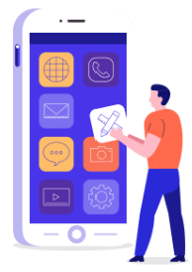
Planning
Let's say a company wants to develop a mobile application that allows users to order food from local restaurants. The company would typically follow the following steps in the SDLC process:
Planning: The company would identify the project's goals, objectives, scope, and requirements, including the features that the mobile app should have.
  The company would also assess the project's feasibility in terms of budget, time, and resources.
For more, visit:
www.farhatlectures.com

Slide 3
Analysis
Analysis: The company would perform a detailed analysis of the project requirements, involving consultation with stakeholders, such as users, restaurant owners, and delivery drivers.
The company would create a list of requirements for the mobile app, such as user registration, restaurant search, menu browsing, order placement, payment processing, and delivery tracking.
Clear understanding of the big picture
For more, visit:
www.farhatlectures.com

Slide 4
Design
The company would design the mobile app's architecture and user interface, which would include wireframes, user stories, and flowcharts.
The company would also create a database schema and define the app's integration points with other systems, such as payment gateways and delivery platforms.
Three step at this stage
  Conceptual design
  Logical design
  Physical design
For more, visit:
www.farhatlectures.com

Slide 5
Implementation (or Development)
The company would start developing the mobile app, following the design specifications.
The company would use programming languages, frameworks, and libraries to develop the app's frontend and backend components.
The company would also create a web-based dashboard for restaurant owners and delivery drivers to manage their orders and deliveries.
For more, visit:
www.farhatlectures.com

Slide 6
Testing
The company would test the mobile app to ensure that it meets the requirements and performs as expected.
The company would use testing tools and techniques, such as manual testing, automated testing, and user acceptance testing (TBD).
The company would also test the app's compatibility with different mobile devices and operating systems.
For more, visit:
www.farhatlectures.com

Slide 7
Deployment (1 of 2)
Once the mobile app has passed the testing phase, the company would deploy the app to the app stores (e.g., Apple App Store, Google Play Store).
This would involve submitting the app for review, complying with the app store guidelines, and making it available to users.
Plunge or Big Bang: In this deployment strategy, the new software or updates are released all at once, replacing the existing software entirely.
  This approach can be risky because any issues or bugs can affect the entire system, and there is no fallback option.
For more, visit:
www.farhatlectures.com

Slide 8
Deployment (2 of 2)
Ramped Conversion: Gradually rolling out the new software or updates to a subset of users or systems, testing them for issues, and then rolling them out to more users or systems over time.
  This approach allows for early detection of issues and provides a fallback option if issues arise.
A/B Testing: Involves releasing two different versions of the software or updates to different user groups and comparing their performance and user satisfaction.
  This approach allows organizations to collect data on user preferences and make informed decisions about which version to release more widely.
Blue/Green or Shadow Deployment: The new software or updates are released to a separate environment (blue), while the existing system remains in production (green).
  The traffic is gradually redirected from the green environment to the blue environment once the new software or updates are tested and deemed stable.
  This approach provides a fallback option and reduces downtime during deployment.
For more, visit:
www.farhatlectures.com

Slide 9
Maintenance
The company would maintain the mobile app by providing ongoing support, including bug fixes, updates, and upgrades.
The company would also monitor the app's performance and user feedback, and make improvements based on user feedback and market trends.
For more, visit:
www.farhatlectures.com

