Slide 1
Schedule M-3 Form 1120
Prior session M-1 and M-2
What is the big idea if schedule M-3?
Schedule M-1 with details (on syteroid)
Large corporation with total ssets of $10 million or above
Enhancing Transparency: schedule M-3 facilitates a higher level of transparency by aligning corporate financial statements with tax return.
  1. This increased disclosure enables stockholders to gain a more accurate understanding of a corporation's financial position and tax obligations.
Identifying Aggressive Tax Practices: By mandating schedule M-3, the Internal Revenue Service (IRS) can effectively identify corporations that employ aggressive tax practices.
  1.The detailed information provided in the schedule aids the IRS and detecting any potentially questionable or non compliant tax strategies adopted by these corporations.

Slide 2
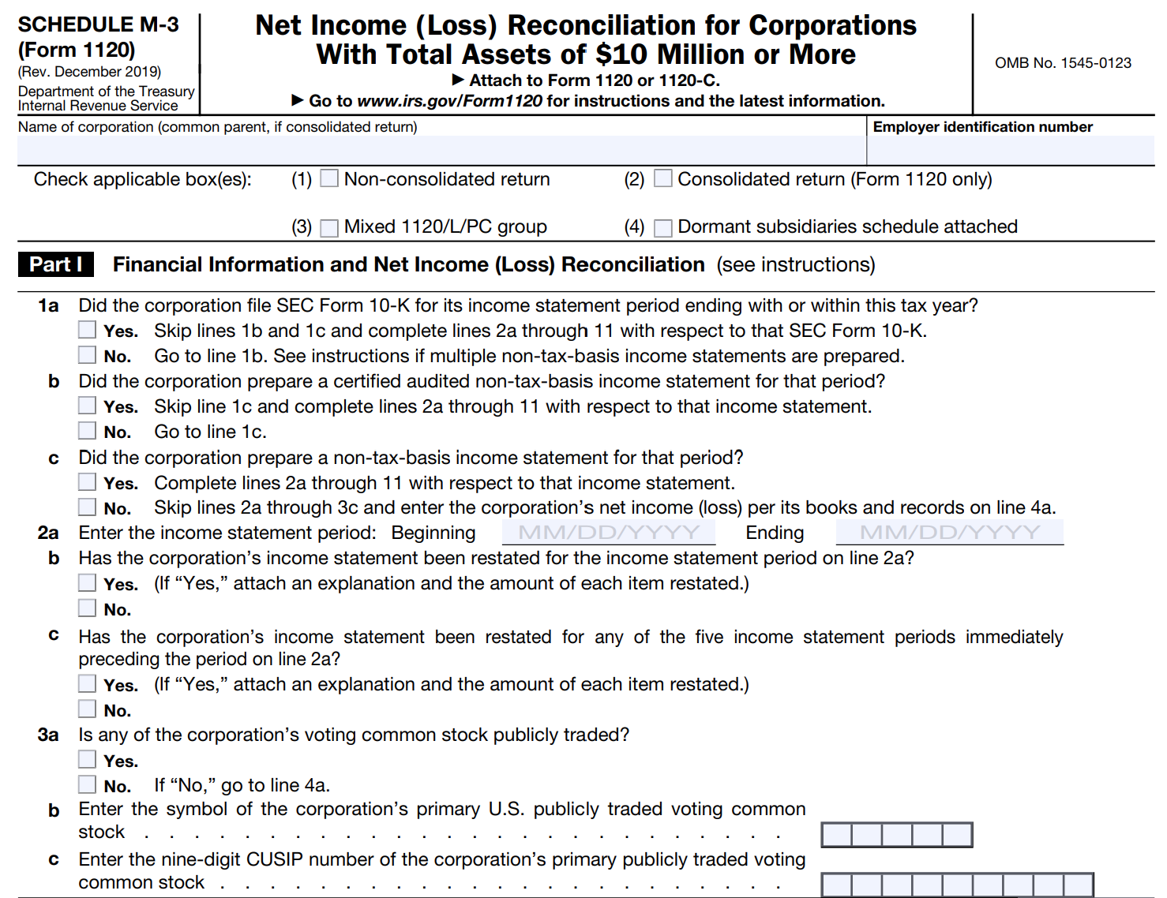
Part 1: source of financial net income (loss:
The corporation must disclose the origin of financial net income (lost) amount used in the reconciliation. This could be derived from various sources, including SEC Form 10-K, audited financial statements, prepared financial statements, or the corporation's own books and records.
Restatements of income statement:

Slide 3
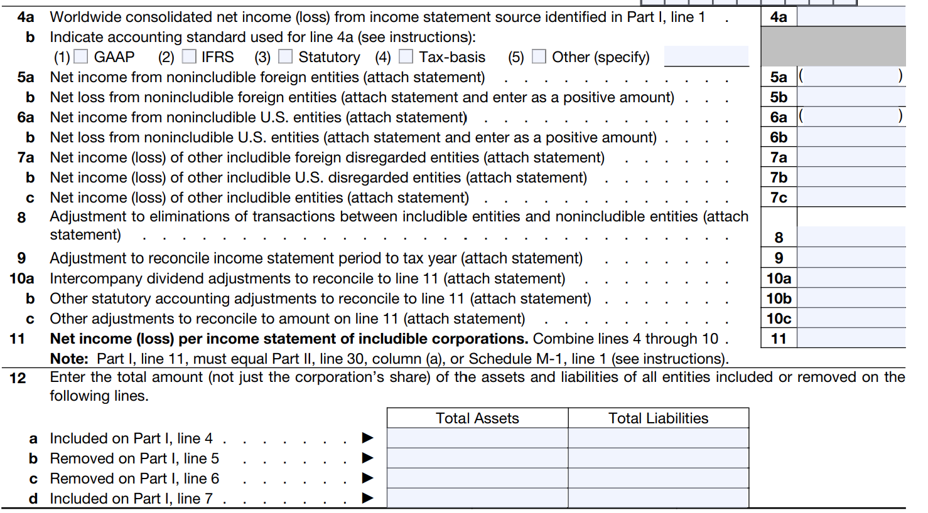
Any required adjustment to the net income (loss) amount referred to the previously (part I, lines 5 through 10 ).

Slide 4
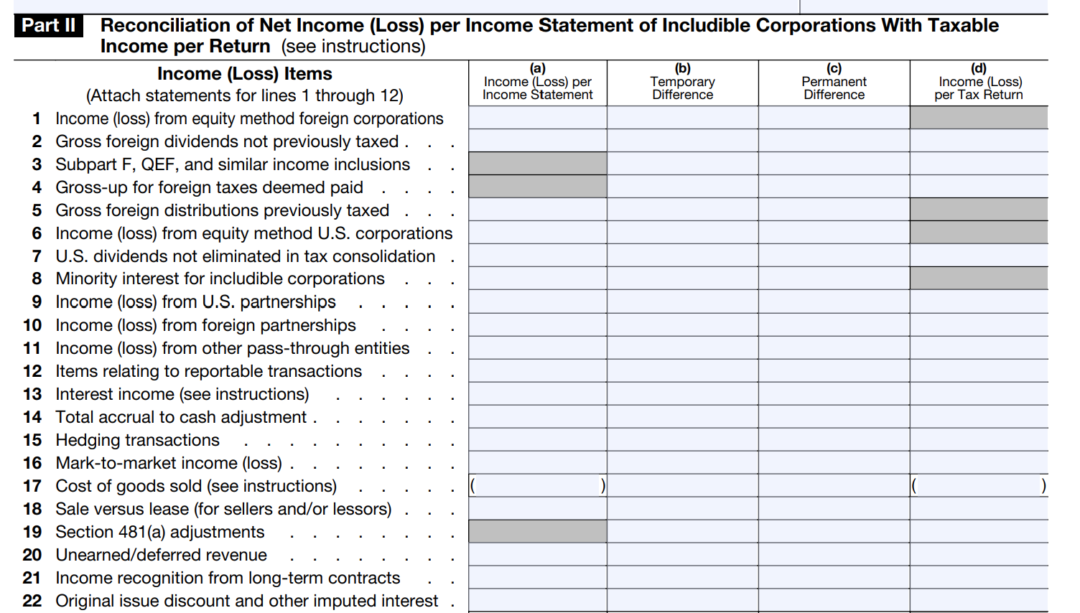
Reconciles income and loss items of includable corporation

Slide 5
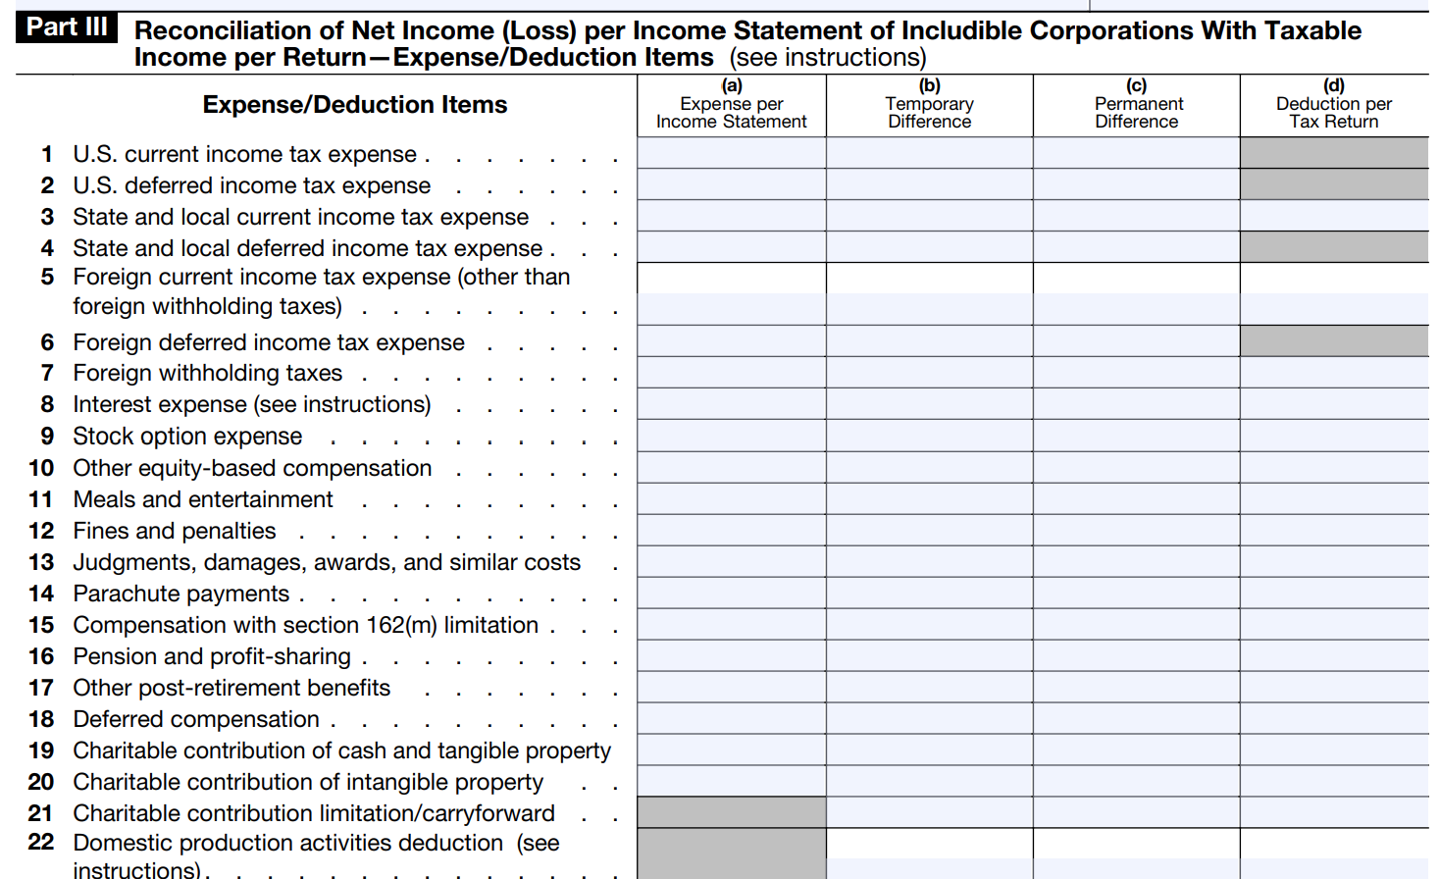
Reconciling items relating to expenses and deductions.
For these items, taxpayers must reconcile differences between income statement amounts (column a ) and tax return amounts (column d ), and then classify these differences as temporary (column B) or permanent (column c ) differences.

Slide 6
Noah Outdoors Corporation specializes in the sale of hunting and fishing equipment.
Noah operates multiple stores in Colorado, Utah, and Nevada.
Additionally, it has a subsidiary in Canada, which is structured as a Canadian corporation.
Noah, being exempt from filing a Form 10-K with the SEC, includes the income generated by its Canadian subsidiary in its audited financial statements.
The financial statements indicate a net income of $35,000,000 for the current year.
The Canadian corporation, not consolidated by Noah for tax purposes and thus not considered an includible corporation, reported a net income of $5,000,000.
On Part I, line 5a of Schedule M-3, Noah will record $5,000,000, which will lead to a "net income per income statement of includible corporations" of $30,000,000 (Part I, line 11).

Slide 7
Any required adjustment to the net income (loss) amount referred to the previously (part I, lines 5 through 10 ).

