Slide 1

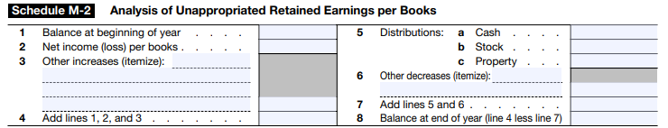
Schedule M-2 Form 1120
Prior session: Schedule M-1 Form 1120
What is the big idea? R/E
Beginning retained earnings
+ net income (- net loss)
- Dividend (withdrawal)
= ending retained earnings
Adjustment to retained earing due to error (mathematical or misapplication or fact, accounting rules)
Changed the taxes?
Corporations (exceptions exist) are required to reconcile their retained earnings at the beginning of the year with the retained earnings at the end of the year using Schedule M-2 (Form 1120).
Visit: farhatlectures.com for complete course: Lectures, MCQs, TF, & Notes

Slide 2

Exemption from Schedule M-2
For corporations that have gross receipts and assets totaling less than $250,000, certain reporting requirements are eased.
Specifically, Schedule L (balance sheet) and Schedules M-1 and M-2 of Form 1120 are not mandatory for these corporations.
  This streamlined approach aims to simplify compliance for smaller businesses, reducing administrative burden while maintaining the accuracy of financial information.
Visit: farhatlectures.com for complete course: Lectures, MCQs, TF, & Notes

Slide 3
Example Schedule M-2 Form 1120
Farhat Corporation (C Corp) had the following information:
Net income per books (after tax) 400,000
Taxable Income 150,000
Federal income tax per books 82,000
Cash dividend distribution 140,000
Unappropriated retained earning as of beginning of the year 510,000
Prepare schedule M-2
Visit: farhatlectures.com for complete course: Lectures, MCQs, TF, & Notes

