Slide 1

Schedule M-1
What is the big idea?
  Accounting for income taxes (Intermediate Accounting).
Corporations must reconcile financial accounting income with taxable income on Schedule M-1 (Form 1120)
Start with net income per books (GAAP)
  Common reconciling items include:
    Federal income tax per books (- for GAAP ➔ + for tax)
    Net capital losses fully deduction for GAAP (Revenue – all capital losses ➔ + excess capital losses
    Income reported for tax but not book income (e.g., prepaid income of 10,000) and vice versa
    Expenses deducted for book income but not tax (e.g., excess charitable contributions) and vice versa
Visit: farhatlectures.com for complete course: Lectures, MCQs, TF, & Notes

Slide 2
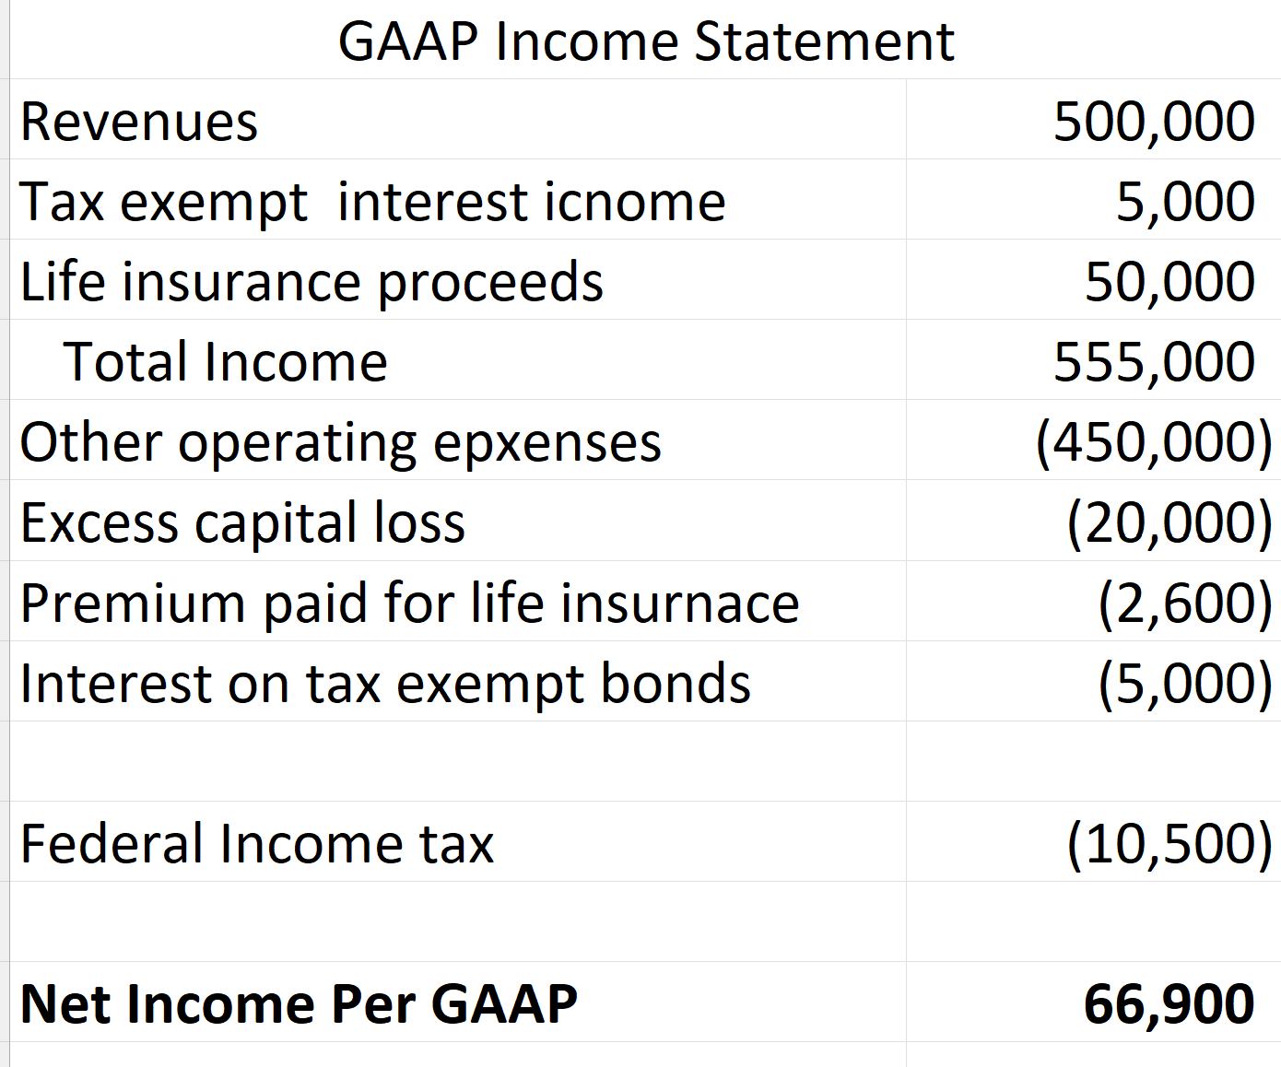
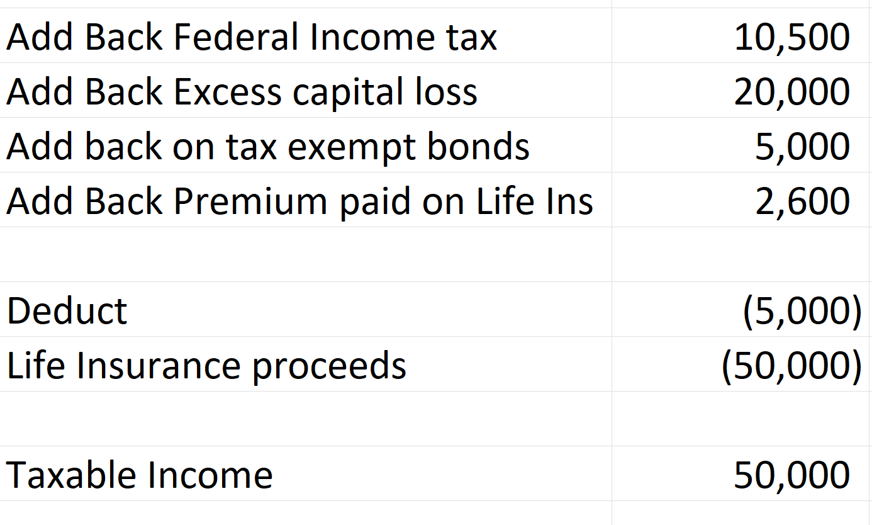
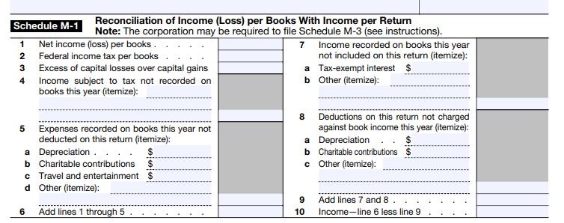
Visit: farhatlectures.com for complete course: Lectures, MCQs, TF, & Notes

Slide 3
Partial List of Schedule M-1 Items
Depreciation
Prepaid Income and Expenses
Capital Gains and Losses.
Accruals and Reserves
Timing of Deductions
Unearned Revenue
Installment Sales
Valuation Allowances
Bad Debt Reserves
LIFO Reserves
Examples
Visit: farhatlectures.com for complete course: Lectures, MCQs, TF, & Notes

