Slide 1
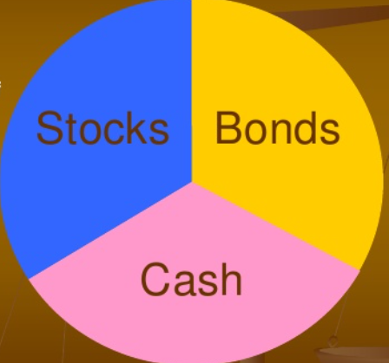
Portfolio (eggs in one basket!) is simply his collection of investment assets
Asset Allocation
Security Selection
Asset allocation: choose among Broad asset classes
Stock 33.33%
Bonds 33.33%
Cash 33.33%
Security selection: Selection of individual securities
Stocks : 33.33%
  Software
  Social media
  Retailers
  Large Tech. Etc.
(rebalanced as needed)

Slide 2
Top Down Approach
Bottom Up Approach
Asset allocation followed by security analysis
Research needed
Might be more diversified
Select securities based mainly on Price attractiveness
NO class asset proportions
Might not be well diversified (statistical Perspective) as the stock are mores sensitive to issuing forms conditions

Slide 3

Risk and Return
Risk you take in delay consumption (Cash flow uncertainty).
  Invest in government bonds (safe)
  Invest in stocks or startup (Risky)
Higher risk asset require a higher return.
Positive (correlation) Relationship

Slide 4
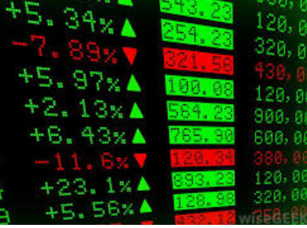
Concept of Efficient market
Stock price reflect all available information (will discuss later)
Cannot beat the market!
Prices quickly adjust
How comfortable are you that this is a fair price?
  If you believe in market efficiency then the stock is not over priced or under priced.
  If you not believe in market efficiency, then you have the opportunity to find an advantage over other investors by finding undervalued investments (conducting research)
How do we invest?

Slide 5
Passive Management
Active Management
Purchased Highly diversified portfolio (easy these days)
No attempt to time the market.
Not time consuming.
No attempt to find undervalued securities.
Assume efficient market.
  Don’t worry about it.
Buy and hold: Warren Buffet
Find mispriced securities.
Best time to enter the market.
Assume inefficiency in the market and prices of securities.
Active management is costly and difficult

