Slide 1
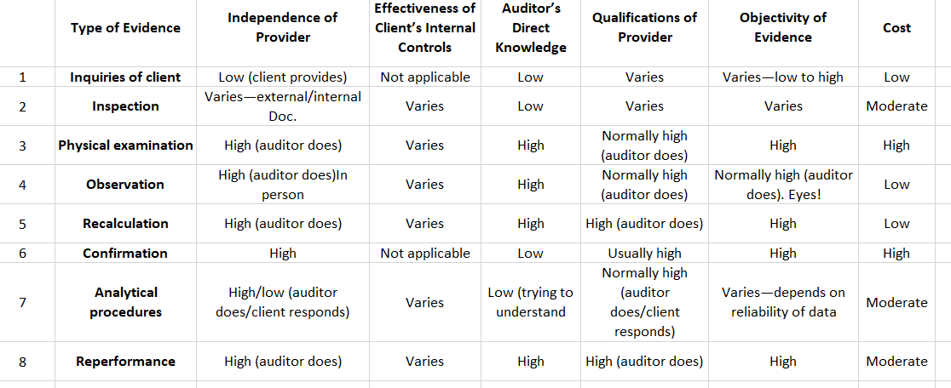
Reliability & Cost of Evidence
Visit: farhatlectures.com for complete course: Lectures, MCQs, TF, & Notes

Slide 2

Most Expensive Types of Evidence
Physical examination ("inspection of tangible assets"): Costly due to auditor's presence during asset counting, requiring travel and coordination.
-Confirmation: Costly due to careful preparation, transmission, receipt, and follow-up procedures.
Visit: farhatlectures.com for complete course: Lectures, MCQs, TF, & Notes

Slide 3

Moderately Costly Types of Evidence
Inspection: Cost varies based on document availability and complexity; client-organized documents are less expensive.
Analytical procedures: Less expensive than physical examination and confirmation; auditors prefer them when possible to reduce costs.
Reperformance: Cost depends on the procedure's complexity; simple tests are quicker, complex tests like bank reconciliations take more time.
Visit: farhatlectures.com for complete course: Lectures, MCQs, TF, & Notes

Slide 4

Least Expensive Types of Evidence
Observation: Usually conducted alongside other procedures; concurrent inventory counting and procedure observation.
Inquiries of the client: Extensively used with generally low cost; written statements for detailed discussions might be costly.
Recalculation: Involves simple calculations and tracing, often done using computer software for convenience.
Visit: farhatlectures.com for complete course: Lectures, MCQs, TF, & Notes

Slide 5

Summary
Client's internal controls greatly impact evidence reliability; effective controls enhance reliability of internal documentation.
Analytical procedures reliability depends on accurate information from controls; unreliable controls affect evidence.
Effective internal controls make physical examination and recalculation highly reliable.
Sole reliance on inquiry often falls short in providing adequate evidence for audit objectives.
Visit: farhatlectures.com for complete course: Lectures, MCQs, TF, & Notes

Slide 6
MCQ from Farhat Lectures
The auditor measures audit evidence by its reliability and relevance. Which of the following is considered the most reliable evidence?
  A- Account balances of general ledger
  B- Customer accounts receivable confirmation
  C- An internal memo that explains the issuance of a credit memo.
  D- Receiving reports issued by the receiving department.
Visit: farhatlectures.com for complete course: Lectures, MCQs, TF, & Notes

