Slide 1
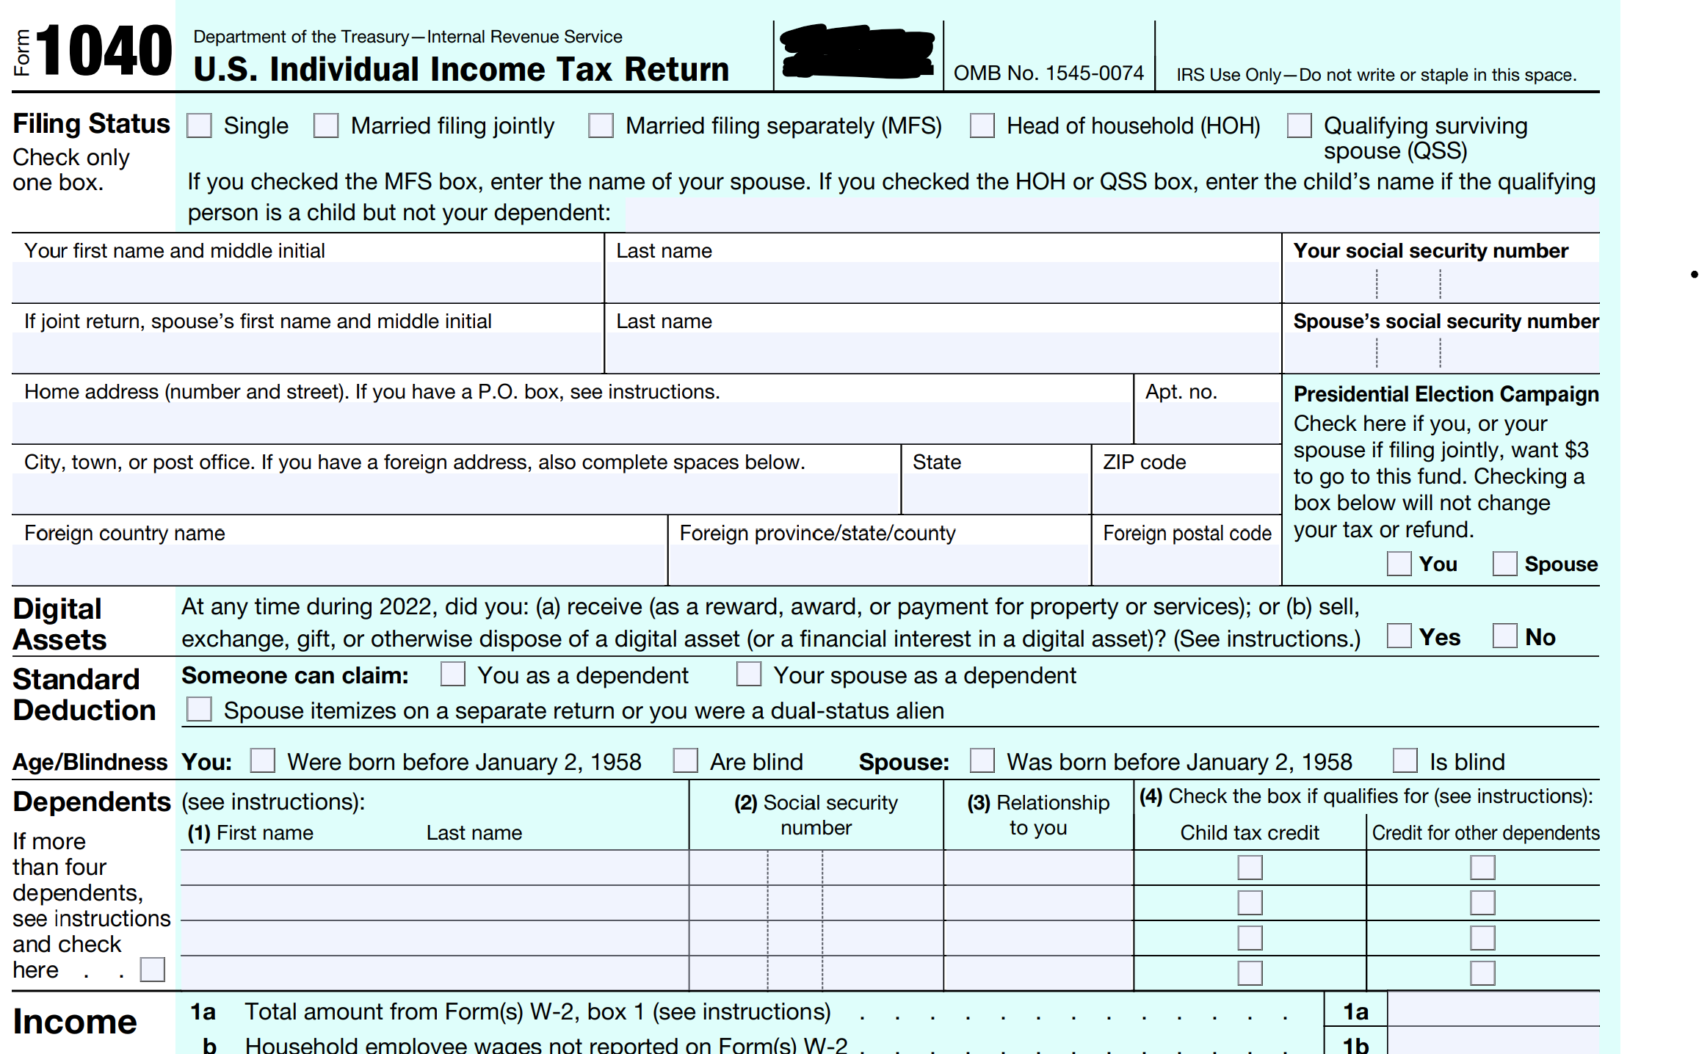
Tax Form
Student or CPA/EA Candidate?
www.farhatlectures.com

Slide 2
Dependents
There are two types of dependents (according to IRC)—a
A qualifying child (QC) or
a qualifying relative (QR)
  Unique tests apply to each type of dependent
Definition of qualifying child for purposes of:
  Head-of-household filing status
  Earned income tax credit (TBD)
  Child and dependent tax credit (TBD)
  Credit for child and dependent care expenses (TBD)
Student or CPA/EA Candidate?
www.farhatlectures.com

Slide 3
Qualifying Child
A qualifying child (QC) must meet the following tests:
    Relationship
    Residence
    Age
    Support
    Joint Return
Student or CPA/EA Candidate?
www.farhatlectures.com

Slide 4
Relationship Test
The child must be the taxpayer’s:
  Son or daughter
  Stepson or stepdaughter
  Brother or sister
  Stepbrother or stepsister
  Half brother or half sister, or
  A descendant of such individual (e.g., grandchildren, nephews, nieces)
A child who has been adopted, or whose adoption is pending, qualifies
A foster child may also qualify
Student or CPA/EA Candidate?
www.farhatlectures.com

Slide 5
Residence Test
A qualifying child must live with the taxpayer for more than half of the year
  Temporary absences from the household due to special circumstances (e.g., illness, education) are not considered
  Must be a U.S. citizen or resident of U.S., Canada or Mexico
  Sale test applies to QR
For more lectures, visit:
www.farhatlectures.com

Slide 6
Age Test
The child must be under age 19 or under age 24 in the case of a student
  during any part of five months of the year, is enrolled full time at a school
  Younger than taxpayer
Individuals who are disabled are not subject to the age test
Student or CPA/EA Candidate?
www.farhatlectures.com

Slide 7
Support Test
To be a qualifying child, the individual must not be self-supporting (does not have to the taxpayer supporting them)
  Cannot provide more than one-half of his or her own support
The child can be a millionaire!
No gross income test!
Student or CPA/EA Candidate?
www.farhatlectures.com

Slide 8
Joint Return Test
Dependent cannot file a joint return with spouse unless:
  Filing solely for refund of tax withheld
  No tax liability exists for either spouse
  The same test will apply to QR
Student or CPA/EA Candidate?
www.farhatlectures.com

Slide 9
Qualifying Relative (QR)
A qualifying relative can be a dependent if the following tests are met:
  Relationship or member of household test
  Gross income (totally different)
  Support
  Residence (same as QC)
  Joint return (same as QC)
Student or CPA/EA Candidate?
www.farhatlectures.com

Slide 10
Relationship Test (or household member)
The relationship test for a qualifying relative is more expansive than for a qualifying child. Also included are the following relatives:
  Lineal ascendants (e.g., parents, grandparents)
  Collateral ascendants (e.g., uncles, aunts)
  Certain in-laws (e.g., son-, daughter-, father-, mother-, brother-, and sister-in-law)
The relationship test also includes unrelated parties (boyfriend, girlfriend, cousins) who live with the taxpayer the whole year.
  Member of household
Student or CPA/EA Candidate?
www.farhatlectures.com

Slide 11
Gross Income Test
Gross income of the dependent must be less than the exemption amount (5,300 for 2026 subject to inflation) Personal exemption!
Remember this does not apply to QC.
The income does not count if it is tax exempt income:
  Muni bond interest
  Social security
Student or CPA/EA Candidate?
www.farhatlectures.com

Slide 12
Joint Return Test
Same as QC
Dependent cannot file a joint return with spouse unless:
  Filing solely for refund of tax withheld
  No tax liability exists for either spouse
Student or CPA/EA Candidate?
www.farhatlectures.com

Slide 13
Citizenship or Residency Test
Same as QC
Dependent must be a U.S. citizen or a resident of U.S., Canada, or Mexico for some part of the calendar year in which the taxpayer’s tax year begins
  An exception provides that an adopted child need not be a citizen or resident of the U.S. as long as his or her principal abode is with a U.S. citizen
Student or CPA/EA Candidate?
www.farhatlectures.com

Slide 14
Support Test
Taxpayer must provide more than 50% of the qualifying relative’s support
  Actual expended amounts are considered in the support test
  Scholarships don’t count
Two exceptions to the support test:
  Multiple support agreements
  Children of divorced parents
Student or CPA/EA Candidate?
www.farhatlectures.com

Slide 15
Multiple Support Agreements
Several individuals together contribute the 50% + support
Allows one member of a group providing more than 50% of support to claim individual even though no one person provides more than 50% support
  Eligible parties must provide more than 10% of support
  Each eligible party must meet all other dependency requirements
Example - Allows children of elderly parent to claim exemption for parent when none individually meets the 50% support test
Student or CPA/EA Candidate?
www.farhatlectures.com

Slide 16
Children of Divorced Parents
General rule: the parent having custody (custodial parent) of the child for the greater part of year >50%
  Time test
  Support test is ignored here as well as divorce decree
If Custody is 50%/50% ➔ Higher AGI
General rule does not apply if
    A multiple support agreement is in effect
    Custodial parent issues a waiver in favor of the noncustodial parent
If both parties are not the parents ➔ higher AGI
Student or CPA/EA Candidate?
www.farhatlectures.com

