Slide 1
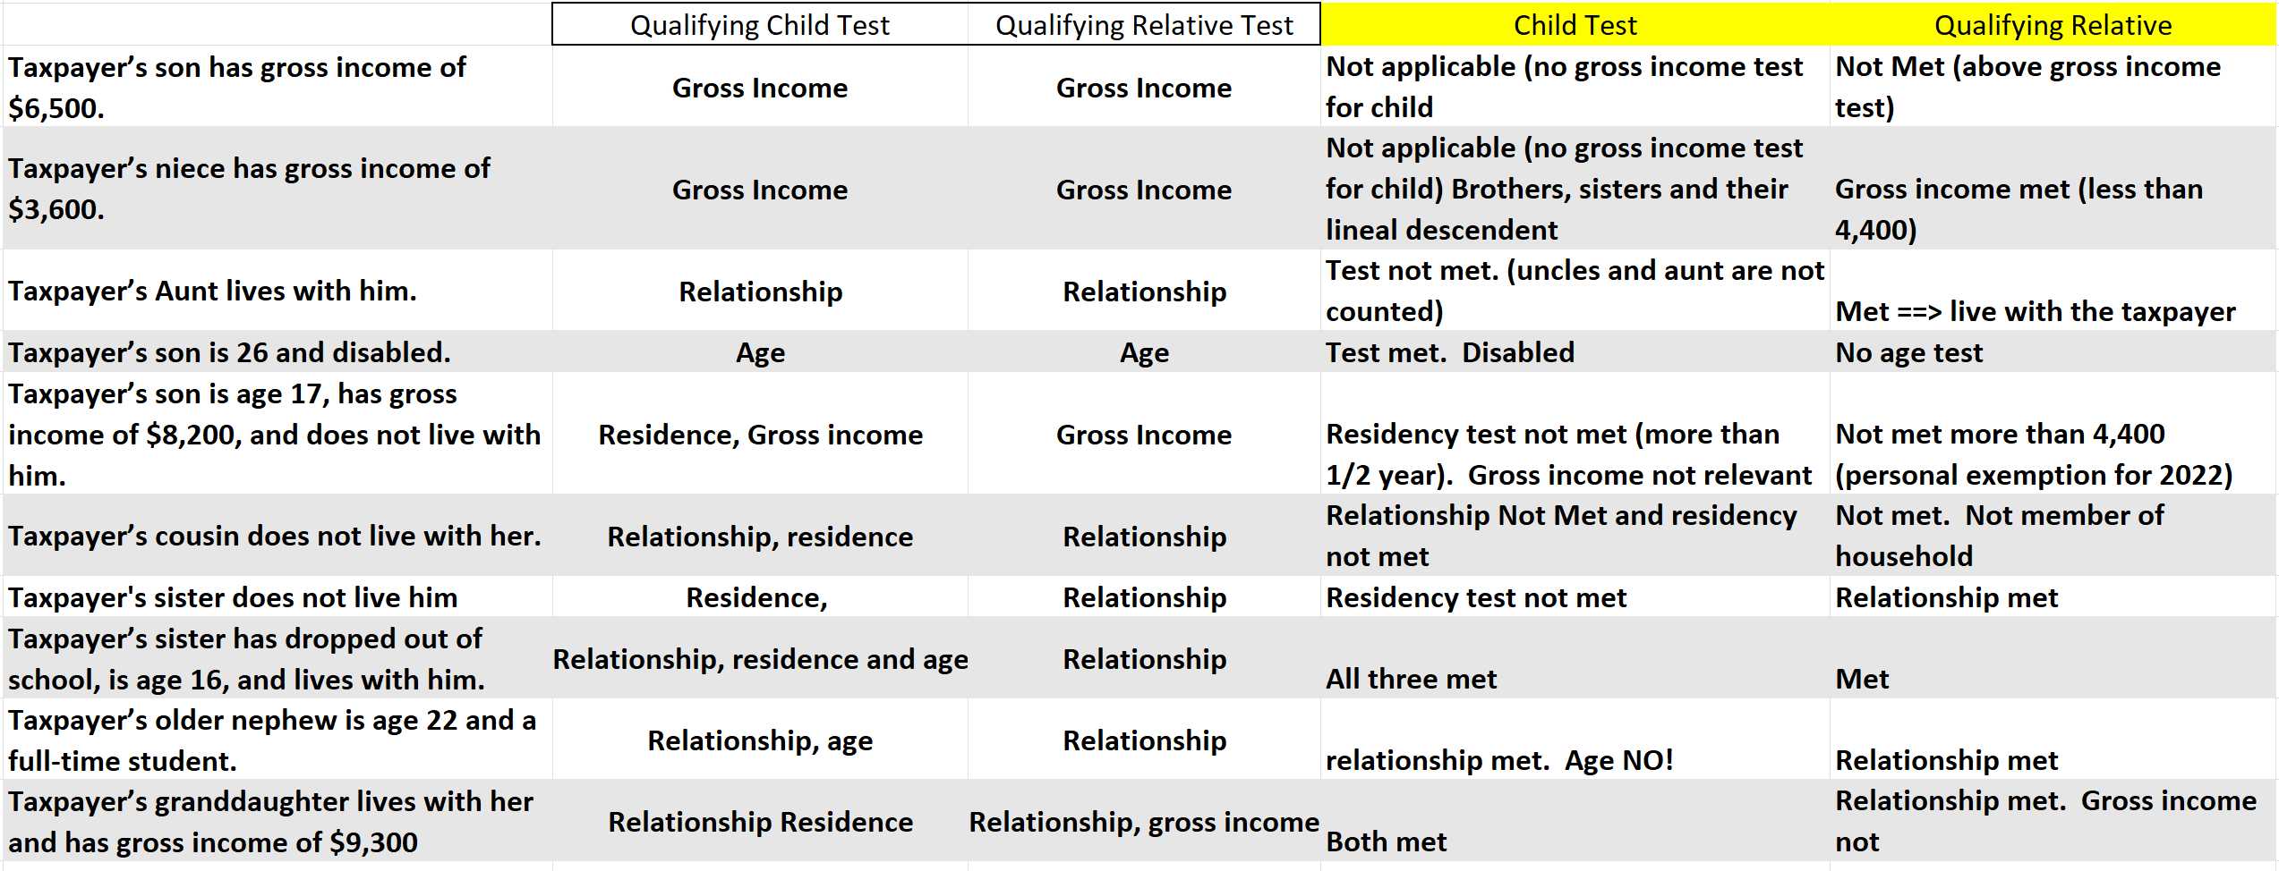
Qualifying Child Vs. Qualifying Relative Test
Visit: farhatlectures.com for complete course: Lectures, MCQs, TF, & Notes

