Slide 1
Failure to Pay Estimated Taxes
Employee: Paycheck!
  Other income such as interest, dividend royalty etc….side business
Self-Employed?
A penalty is imposed for a failure to pay estimated income taxes.
The penalty applies to individuals, trusts, certain estates and corporations and is based on the rate of interest in effect for deficiency assessments.
No Penalty: if tax due is less than 500 for Corporations and 1,000 for all others (individuals)
Corporations must make the last quarterly payment by the twelfth month of the same year.
Generally, the payment is one-fourth of the tax expected to be due.

Slide 2
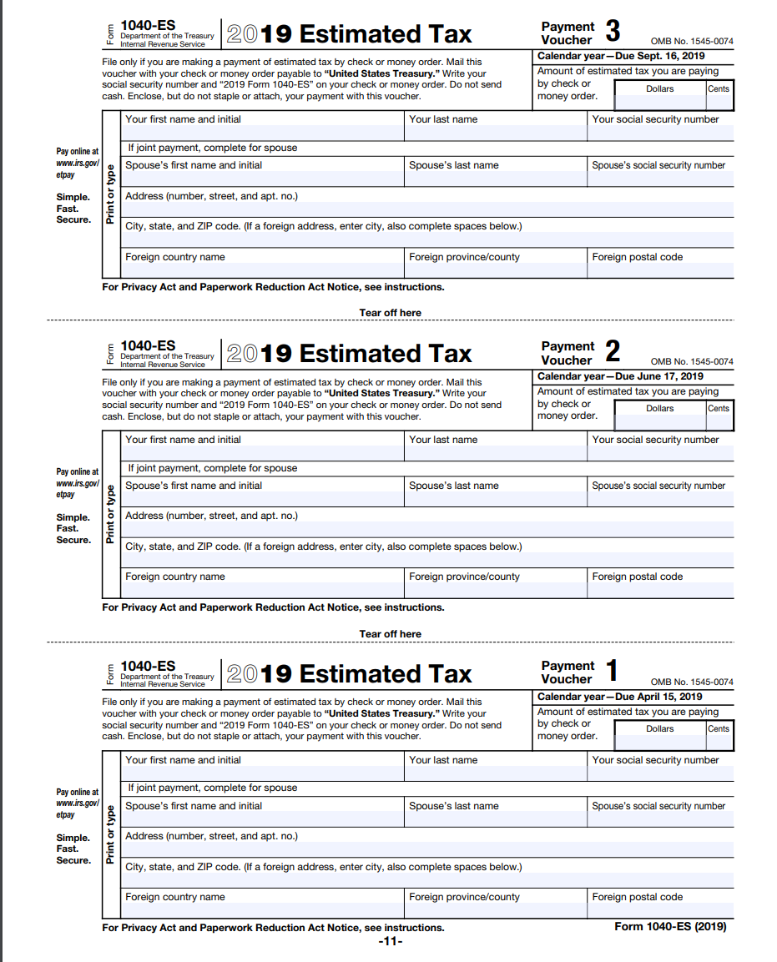
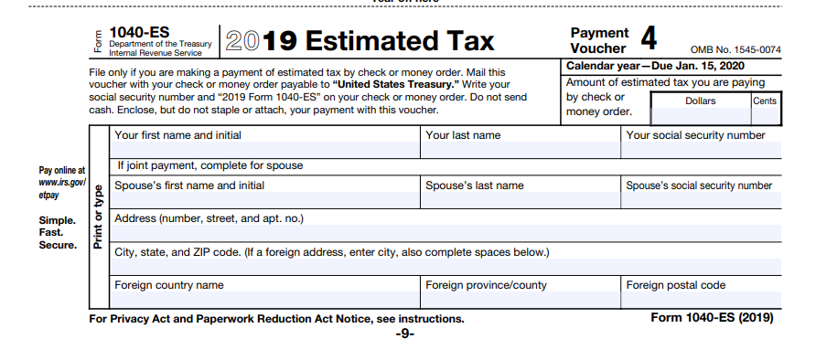

Slide 3
Individual (CPA Tested)
An individual’s underpayment of estimated tax is the difference between the estimates (and withholdings) that were paid and the lower of:
90 percent of the current-year tax,
100 percent of the prior-year tax
If the taxpayer’s prior-year AGI exceeds $150,000, the 100 percent requirement becomes 110 percent

Slide 4
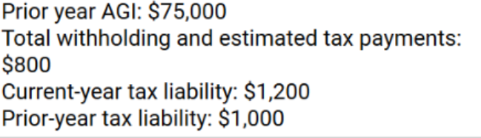
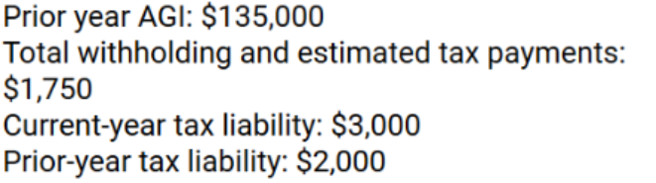
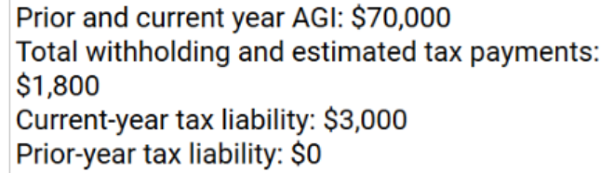

Slide 5
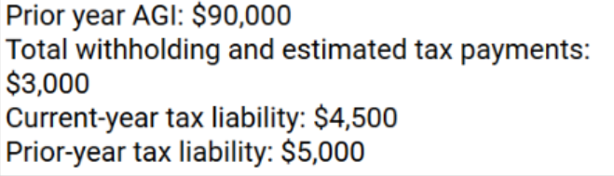
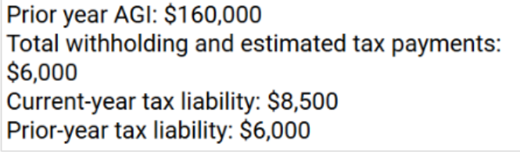

Slide 6
Corporation
A corporation’s underpayment of estimated tax is the difference between the estimates that were paid and the lower of:
The current-year tax,
The prior-year tax, and
For the prior-year alternative,
  the prior tax year must have been a full 12 months,
  a nonzero tax amount must have been generated for that year, and
  large corporations (taxable income of $1 million or more in any of the three immediately preceding tax years) can use the alternative only for the first installment of a year.

Slide 7
