Slide 1
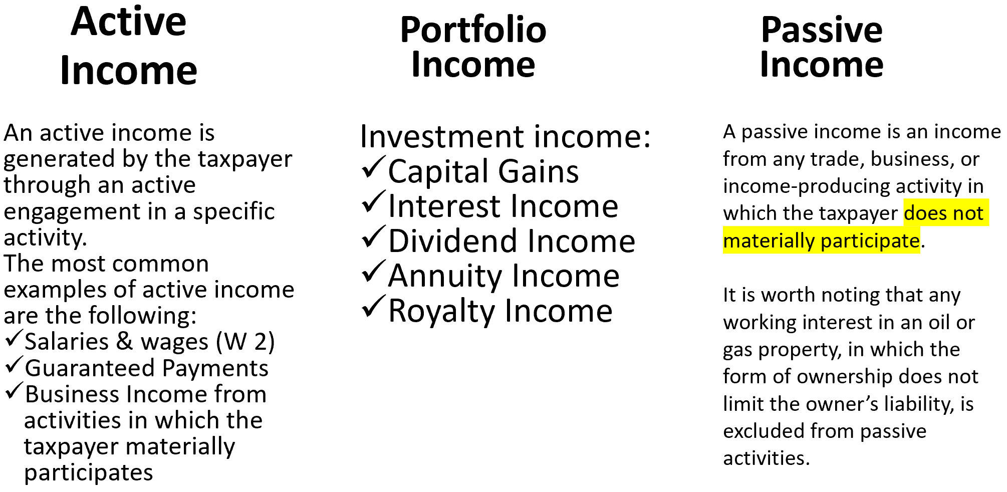
Passive Activity Loss Limits
Prior session: At Risk Limits for investors (money at risk).
First we have to determine if the investor is “at risk”
  Learned how to compute “at risk amount”
Real estate Rental business (assume passive) 2 Exceptions.
Schedule C (P or A)
S Corporation (P or A)
Partner (P or A)
If the taxpayer does not work on a:
regular
continuous and
substantial basis
in the business the losses are considered to be passive ➔ they are generally not deductible in the absence of passive income
What is a passive activity?
Student or CPA Candidate?
www.farhatlectures.com

Slide 2
Is it a Passive Activity?
To determine whether an activity is a passive activity, the following three questions must be addressed:
What constitutes an activity?
What is the taxpayer’s material participation?
When is an activity a rental activity?
Student or CPA Candidate?
www.farhatlectures.com

Slide 3
Identification of an Activity (1 of 3)
Under the treasury regulation:
  An activity is defined as any one or more trade or business activities or rental activities that form an appropriate economic unit for the purpose of measuring the taxpayer’s gain or loss.
When identifying an activity, or grouping various activities together, all of the relevant factors and circumstances must be considered.
Once activities are grouped, a regrouping is not allowed unless the original grouping was clearly inappropriate or the facts and circumstances have materially changed.
Student or CPA Candidate?
www.farhatlectures.com

Slide 4
Example:
Maggie owns a business with two separate units: X and Y.
Maggie materially participates in managing X but does not get involved in the activity of unit Y.
For the current year, unit X generated a net income of $100,000, while unit Y reported a net loss of $37,000.
If Maggie treats X and Y units as components of the same activity, she can use the loss reported in unit Y to offset the income generated in unit X. As a result, he would report a net income of $63,000.
However, if Maggie is not allowed to treat the two units as one single activity, she would have an active income of $100,000 from unit X, and a passive loss of $37,000 from unit Y.
In this case, the passive loss may not be used to offset her active income
Student or CPA Candidate?
www.farhatlectures.com

Slide 5
Example :
Maria owns a vape store and a restaurant in Maryland. She also owns a vape store and a restaurant in Boston. In deciding how to group her activities, any of the following alternatives seems to be reasonable:
She can group all the four activities together as she is their sole owner. Grouping based on the owner's identity.
She can group the activities in Maryland together, and the activities in Boston together. Grouping based on geographical areas.
She can group the vape stores together and the restaurants together. Grouping based on the type of activities.
She can also treat each activity as a separate stand alone activity.
Student or CPA Candidate?
www.farhatlectures.com

Slide 6
Material Participation (2 out of 3)
A taxpayer is considered to be actively participating in an activity if he meets one of the following 7 material participation tests:
  The taxpayer participates in the activity for more than 500 hours during the year.
  The taxpayer’s participation in the activity is substantially all of the participation in the activity of all individuals for the year.
  The taxpayer participates in the activity for more than 100 hours during the year and not less than the participation of any other individual in the activity.
  The taxpayer’s participation in the activity is significant and the taxpayer’s aggregate participation in all significant participation activities during the year exceeds 500 hours. The significant participation is more than 100 hours.
  The taxpayer materially participated in the activity for any 5 years during the last 10-year period.
  The activity is a personal service activity in which the taxpayer materially participated for any 3 preceding years.
  Based on the facts and circumstances, the taxpayer participated in the activity on a regular, continuous, and substantial basis. However, regular, continuous, and substantial are not specifically defined in the Regulations.
*Investor type work does not count: Obtaining a loan, raising money, meeting with potential investors and creditors, reviewing financial reports, financial statements etc.
Student or CPA Candidate?
www.farhatlectures.com

Slide 7
Example :
During the current year, John, a CPA, earned a net income of $450,000 from his CPA practice.
Additionally, John owned an interest in activities B and D, in which he does not materially participate. He incurred a loss of $20,000 from activity B, and a net income of $15,000 from activity D. John needs an additional 50 hours of participation in activity D to be treated as materially participating in this activity.
To determine if John should attempt to meet the material participation standard for D, it is important to understand the associated tax consequences. Without a material participation in D, both activities, B and D, are treated as passive activities. The loss from B may be used to offset the income from D.
However, if John materially participates in D, the D activity becomes an active activity.
John’s income from D becomes an active income and may no longer be used to offset the loss from activity B.
Student or CPA Candidate?
www.farhatlectures.com

Slide 8
Example
Jane, an attorney, owns a restaurant that reported a net loss in the current year. During the year, Jane worked 450 hours in managing the restaurant activity and 20 hours doing janitorial activities. Her husband, Julien, participated 80 hours in activities related to marketing and sales.
Assuming that the activities were not performed to avoid any disallowance of passive activity losses, Jane qualifies as materially participating in the restaurant activity, as the total number of hours equals 450 + 80, or 530 hours.
It is important to note that the Janitorial activities are not included in the determination of Jane’s participation in the activity (adding up hours not allowed).
Student or CPA Candidate?
www.farhatlectures.com

Slide 9
Rental Activity (3 of 3)
Subject to 2 exceptions, all rental activities are automatically considered passive activities:
Mom and pop exception
Real Estate Professional
Student or CPA Candidate?
www.farhatlectures.com

Slide 10
Mom and pop exception
Under the mom-and-pop exception, the taxpayer is allowed to deduct up to $25,000 of net losses from rental real estate activities. Any excess loss is carried forward as a suspended passive activity loss.
The deduction amount is reduced by 50 percent of the taxpayer’s AGI in excess of $100,000, and the deduction is completely eliminated if the taxpayer’s AGI is in excess of $150,000.
A taxpayer who is actively engaged in a rental real estate activity and owns at-least 10% of that activity is eligible for the mom-and-pop exception.
The active engagement requires an active (no material) participation in making management decisions in a significant and bona fide sense.
Examples of bona fide sense decisions are:
Approving tenants
Deciding on rental terms
Approving capital or
Repair expenditures
Student or CPA Candidate?
www.farhatlectures.com

Slide 11
Real Estate Professionals
An individual who:
Provide more than 50% of his/her personal services in real estate businesses and
at least 750 hours of services in the real property business
is considered a real estate professional, and his income is treated as an active income.
The spouse’s participation hours are not taken into account when evaluating whether a taxpayer has worked for more than 750 hours in real property trades or businesses during a year.
Personal services performed as an employee are not treated as performed in real property trade or business unless the employee owns at least 5% of the business.
Student or CPA Candidate?
www.farhatlectures.com

Slide 12
Example: Mario has an AGI before any consideration of rental activities of $120,000. He has a loss from a rental activity, in which he actively participates, of $75,000. In addition, he has passive income of $15,000 from another rental activity.
What is the amount of the rental activity loss that Mario is allowed to deduct in the current year.
Solution: First, Mario can offset $15,000 of his rental loss against his passive income. As a result, Mario will have a remaining passive loss of $60,000.
Mario is actively engaged in the rental activity. Therefore, he is eligible for the mom-and-pop exception which allows up to $25,000 deduction of the passive losses from rental activities against other sources of income.
The allowance of $25,000 is reduced by half the excess of AGI over $100,000. Given that Mario’s AGI equals $120,000, his allowance is reduced by $20,000/2, or $10,000. As such, Mario may deduct $15,000 of rental losses against his active or portfolio income.
40%
As a result, the total amount of rental losses that Mario can deduct in the current year equals: $15,000 (against passive income) + $15,000 (against other sources of income) = $30,000.
Student or CPA Candidate?
www.farhatlectures.com

Slide 13
From Passive to Active
When a passive activity changes to an active activity, suspended losses “from the years in which the activity was passive” may be deducted against the income from the newly becoming an active activity. Any remaining suspended loss is carried forward to offset future income from the formerly passive activity or income from other passive activities.
Example:
Over the previous three years, Lisa has owned interest in a single passive activity. At the beginning of the current year, when Lisa’s total suspended passive losses amounted to $50,000, she increased her hours of participation and became a material participant in the activity.
Lisa’s share of the current year’s income from the activity is $30,000. As a result, Lisa may use her suspended losses of $50,000 to offset her current income.
The remaining $20,000 loss may be carried forward to offset future income from this activity or income from other passive activities.
MCQ and TF
Student or CPA Candidate?
www.farhatlectures.com

