Slide 1

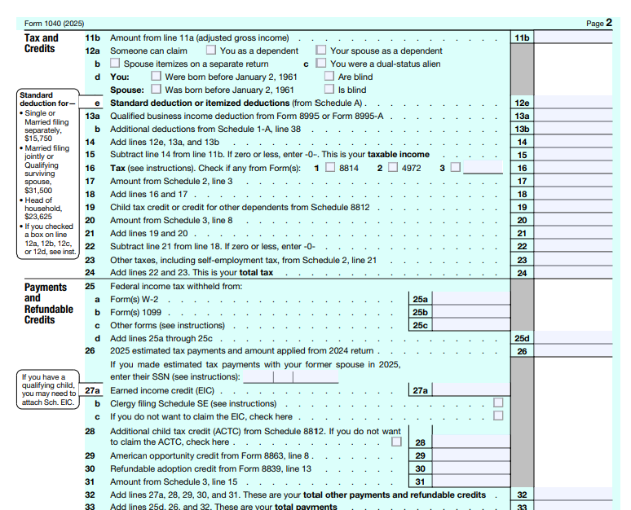
📹 Videos AICPA MCQs & Sims 🤖 Farhat AI Assistant🎙 Podcast Lessons 📊 CPA, CMA, EA Exam 💼Accounting & Finance Courses 🙌 Support by Farhat Team
🌐 farhatlectures.com | ⭐ Start Your Free Trial

Slide 2
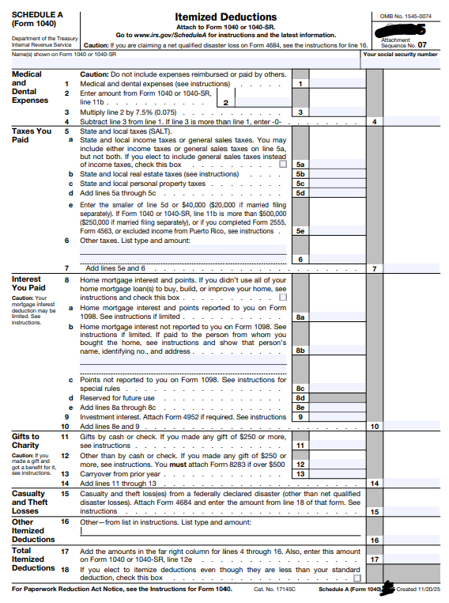
📹 Videos AICPA MCQs & Sims 🤖 Farhat AI Assistant🎙 Podcast Lessons 📊 CPA, CMA, EA Exam 💼Accounting & Finance Courses 🙌 Support by Farhat Team
🌐 farhatlectures.com | ⭐ Start Your Free Trial

Slide 3

Other Itemized Deductions
Schedule A
Other itemized deductions represent a narrow category of deductions that do not fall under medical expenses, taxes, interest, or charitable contributions.
Over time, this category has been significantly reduced by legislative changes, and only a limited number of items remain deductible under current law.
📹 Videos AICPA MCQs & Sims 🤖 Farhat AI Assistant🎙 Podcast Lessons 📊 CPA, CMA, EA Exam 💼Accounting & Finance Courses 🙌 Support by Farhat Team
🌐 farhatlectures.com | ⭐ Start Your Free Trial

Slide 4

Historical Context (Pre-2017)
Before 2017, taxpayers were permitted to deduct several expenses classified as miscellaneous itemized deductions, provided the total exceeded 2% of adjusted gross income (AGI). These expenses included:
  Unreimbursed employee business expenses
  Tax preparation fees
  Investment expenses other than investment interest
  Hobby expenses, limited to hobby income
These deductions were subject to the 2% AGI floor and were commonly tested on tax and CPA exams under prior law.
📹 Videos AICPA MCQs & Sims 🤖 Farhat AI Assistant🎙 Podcast Lessons 📊 CPA, CMA, EA Exam 💼Accounting & Finance Courses 🙌 Support by Farhat Team
🌐 farhatlectures.com | ⭐ Start Your Free Trial

Slide 5

Tax Cuts and Jobs Acts
After 2017, miscellaneous itemized deductions subject to the 2% AGI floor were suspended till 2025. As a result:
  Employee business expenses are no longer deductible
  Tax preparation fees are no longer deductible
  Most investment expenses are no longer deductible
  Hobby expenses are no longer deductible
Importantly, income from hobbies and investments remains taxable, even though related expenses generally cannot be deducted.
This created a mismatch between income inclusion and expense deductibility.
📹 Videos AICPA MCQs & Sims 🤖 Farhat AI Assistant🎙 Podcast Lessons 📊 CPA, CMA, EA Exam 💼Accounting & Finance Courses 🙌 Support by Farhat Team
🌐 farhatlectures.com | ⭐ Start Your Free Trial

Slide 6
One Big Beautiful Bill Act (OBBBA)
OBBBA makes the TCJA suspension of miscellaneous itemized deductions subject to the 2% AGI floor permanent.
  unreimbursed employee expenses, tax prep fees, and most investment and hobby expenses are no longer deductible.
Still allowed Under OBBBA:
  gambling losses
  casualty/theft losses for income‑producing property
  unrecovered annuity investment
  Plus: new educator expenses itemized deduction
📹 Videos AICPA MCQs & Sims 🤖 Farhat AI Assistant🎙 Podcast Lessons 📊 CPA, CMA, EA Exam 💼Accounting & Finance Courses 🙌 Support by Farhat Team
🌐 farhatlectures.com | ⭐ Start Your Free Trial

Slide 7

Amount of loss: Income producing
Applies to income‑producing property:
Completely destroyed or stolen:
  Deductible loss = adjusted basis − insurance or other reimbursement.​
Partially destroyed:
  Deductible loss = lesser of (adjusted basis, or FMV before − FMV after), reduced by insurance or other reimbursement.​
Insurance proceeds reduce the deductible loss.​
📹 Videos AICPA MCQs & Sims 🤖 Farhat AI Assistant🎙 Podcast Lessons 📊 CPA, CMA, EA Exam 💼Accounting & Finance Courses 🙌 Support by Farhat Team
🌐 farhatlectures.com | ⭐ Start Your Free Trial

Slide 8

Example: Total destruction
A high‑income professional buys an investment painting and keeps it in a safe‑deposit box purely for appreciation, not as part of an art‑dealer business.
The painting is totally destroyed in a flood at the storage facility.
Immediately before the flood, the painting’s FMV was 8,000 dollars; its adjusted basis was 12,000 dollars.
Deductible casualty loss = 8,000 dollars (lower of adjusted basis 12,000 dollars or FMV 8,000 dollars, fully unreimbursed).
Because the painting is held for production of income but is not part of a trade or business, the 8,000‑dollar loss is claimed as an “other itemized deduction” on Schedule A (income‑producing property casualty/theft loss), not as a Schedule C business deduction
📹 Videos AICPA MCQs & Sims 🤖 Farhat AI Assistant🎙 Podcast Lessons 📊 CPA, CMA, EA Exam 💼Accounting & Finance Courses 🙌 Support by Farhat Team
🌐 farhatlectures.com | ⭐ Start Your Free Trial

Slide 9
Example
A high‑income professional buys an investment painting and keeps it in a safe‑deposit box purely for appreciation, not as part of an art‑dealer business.
A flood damages, but does not destroy, the painting. It is later appraised.
Pre‑flood FMV = 13,000 dollars; adjusted basis = 11,000 dollars; post‑flood FMV = 7,000 dollars.
Decline in FMV = 6,000 dollars (13,000 − 7,000).
Deductible casualty loss = 6,000 dollars, the lesser of adjusted basis (11,000 dollars) or decline in FMV (6,000 dollars), assuming no insurance reimbursement.​
Because the painting is income‑producing but not part of a trade or business, the 6,000‑dollar loss is claimed as an “other itemized deduction” on Schedule A, not on Schedule C.
📹 Videos AICPA MCQs & Sims 🤖 Farhat AI Assistant🎙 Podcast Lessons 📊 CPA, CMA, EA Exam 💼Accounting & Finance Courses 🙌 Support by Farhat Team
🌐 farhatlectures.com | ⭐ Start Your Free Trial

Slide 10

Gambling losses limitation
Gambling losses are deductible as an itemized deduction only up to gambling winnings and, beginning in 2026 (OBBBA), only up to 90% of those qualified losses, leaving at least 10% of gambling winnings taxable.
Break‑even player now has taxable income
Winnings: 10,000, Losses: 10,000
Step 1 – Apply “up to winnings” rule: you could deduct up to 10,000 of losses.
Step 2 – Apply 90% cap: you may deduct only 90% × 10,000 = 9,000.
Tax result:
Gambling income reported: 10,000
Gambling loss deduction: 9,000
Net taxable gambling income: 1,000
Even though you broke even in cash, 10% of your winnings (1,000) is taxable.
📹 Videos AICPA MCQs & Sims 🤖 Farhat AI Assistant🎙 Podcast Lessons 📊 CPA, CMA, EA Exam 💼Accounting & Finance Courses 🙌 Support by Farhat Team
🌐 farhatlectures.com | ⭐ Start Your Free Trial

Slide 11
Gambling losses limitation
Example 2 – Losses smaller than winnings
Winnings: 10,000, Losses: 5,000
Step 1 – “Up to winnings”: you can deduct up to 5,000 (your actual losses).
Step 2 – 90% cap: 90% × 5,000 = 4,500 deductible.
Tax result:
Income: 10,000
Deduction: 4,500
Net taxable: 5,500
Here, more than 10% of your winnings are taxable because your losses were already smaller than your winnings; the 90% rule just makes it a bit worse.
Example 3 – Big loser
Winnings: 5,000, Losses: 20,000
Step 1 – “Up to winnings”: you can deduct at most 5,000 (even though you lost 20,000).
Step 2 – 90% cap: 90% × 5,000 = 4,500 deductible.
Tax result:
Income: 5,000
Deduction: 4,500
Net taxable: 500
You lost a lot overall, but you still end up with at least 10% of your winnings (here 500) taxable because the law won’t let you deduct the full amount of losses.
📹 Videos AICPA MCQs & Sims 🤖 Farhat AI Assistant🎙 Podcast Lessons 📊 CPA, CMA, EA Exam 💼Accounting & Finance Courses 🙌 Support by Farhat Team
🌐 farhatlectures.com | ⭐ Start Your Free Trial

Slide 12

Educator expenses
Educator expenses as an itemized deduction
  OBBBA adds a new educator expense itemized deduction that is not subject to the 2% floor for eligible educators (separate from the above‑the‑line adjustment we covered).
  Spent 1,000 on qualified educator expense
  Deducted 350 for AGI on schedule 1
  The remaining 650 deductible as itemized deductions not subjevt to AGI limitation
📹 Videos AICPA MCQs & Sims 🤖 Farhat AI Assistant🎙 Podcast Lessons 📊 CPA, CMA, EA Exam 💼Accounting & Finance Courses 🙌 Support by Farhat Team
🌐 farhatlectures.com | ⭐ Start Your Free Trial

Slide 13

MCQ from farhatlectures.com
Under the One Big Beautiful Bill Act (OBBBA), which of the following statements about itemized deductions beginning in 2026 is correct?
A. Gambling losses are fully deductible against gambling winnings as an itemized deduction, with no further limitation.
B. Miscellaneous itemized deductions subject to the 2% of AGI floor (such as unreimbursed employee business expenses and investment advisory fees) are restored in 2026, but educator expenses are allowed only as an above‑the‑line deduction.
C. Gambling losses are limited to 90% of gambling losses, and then further limited to the amount of gambling winnings; unreimbursed educator expenses above the statutory above‑the‑line cap may be claimed as itemized deductions not subject to the 2% floor.
D. Gambling losses are no longer deductible at all, but all unreimbursed employee business expenses (including those of educators) become fully deductible as itemized deductions without any AGI‑based limitation.
📹 Videos AICPA MCQs & Sims 🤖 Farhat AI Assistant🎙 Podcast Lessons 📊 CPA, CMA, EA Exam 💼Accounting & Finance Courses 🙌 Support by Farhat Team
🌐 farhatlectures.com | ⭐ Start Your Free Trial

