Slide 2
Net Operating Loss (NOL)
Taxpayer annual business deductions > annual business income (negative income). Trade or business and casualty losses may create NOL.
Adam and Avi, single taxpayers, started their businesses in year 1.
Over the first 5-year period, Adam has reported the following:
Year 1: Taxable income of $20,000
Year 2: Loss of ($160,000)
Year 3: Taxable income of $170,000
Year 4: Loss of ($120,000)
Year 5: Taxable income of $150,000
On the other hand, Avi reported a taxable income of $12,000 in each year.
 | Adam’s tax liability | Avi’s tax liability
Year 1 | $2,195 | $1,235
Year 2 | $0 | $1,235
Year 3 | $34,636 | $1,235
Year 4 | $0 | $1,235
Year 5 | $29,836 | $1,235
Total Tax liability | $66,667 | $6,175
Student or CPA Candidate?
www.farhatlectures.com

Slide 3
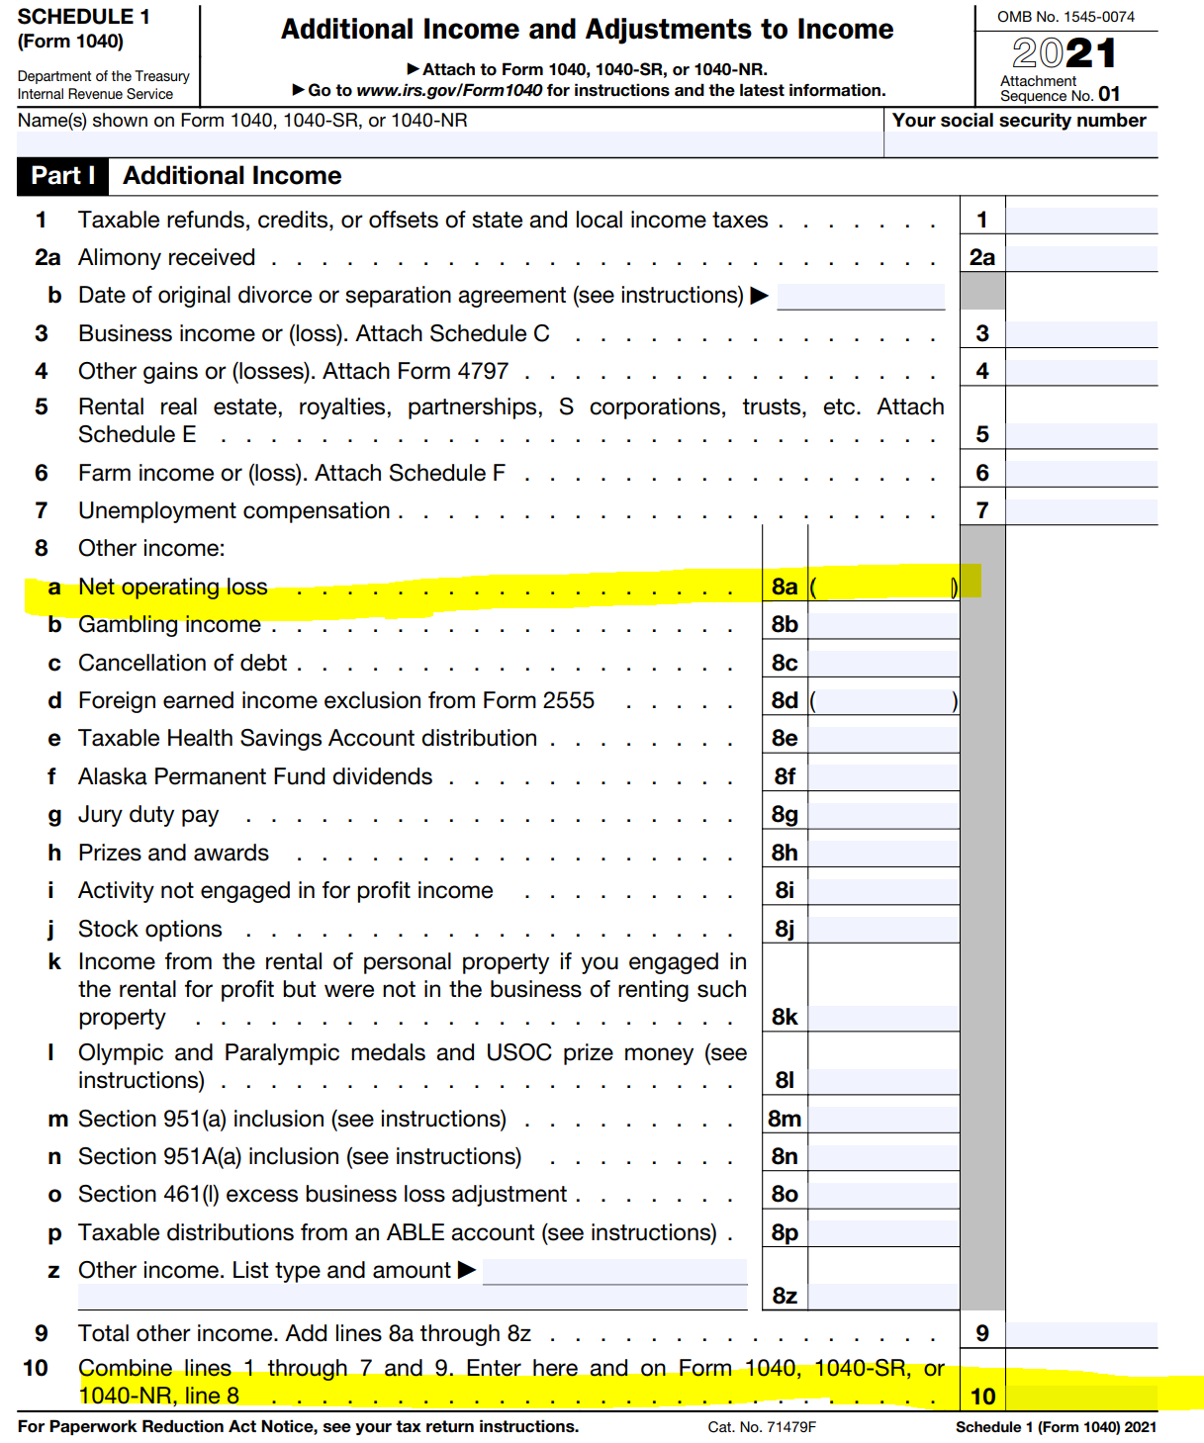
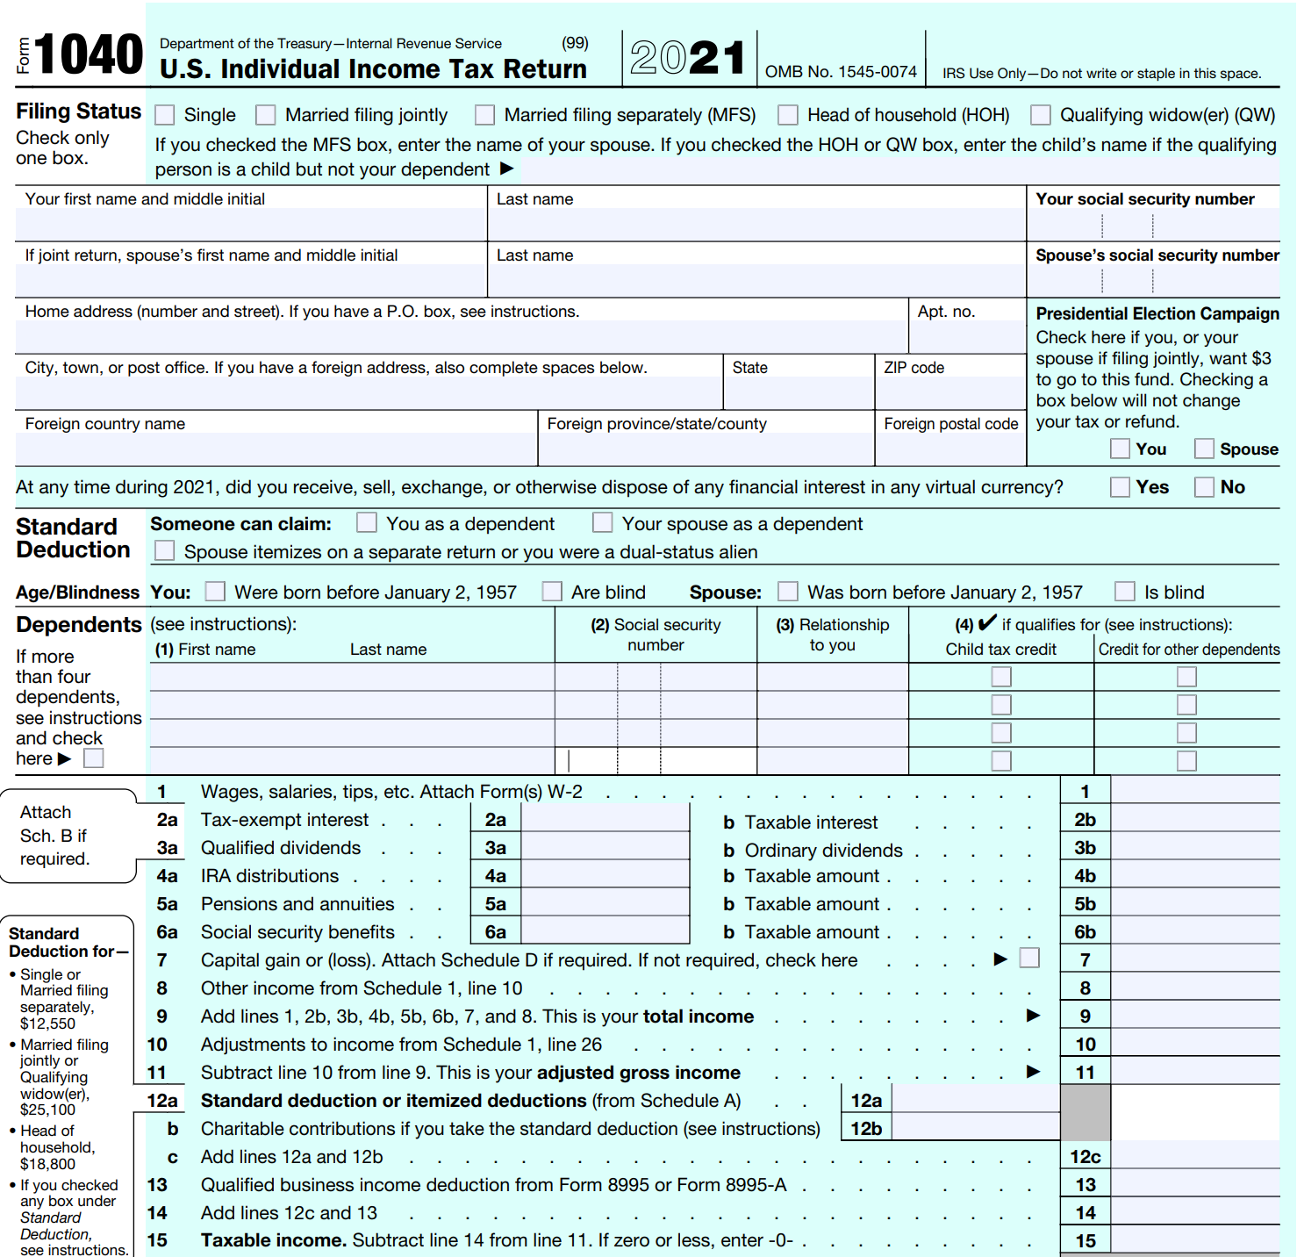


Slide 4
NOL rules Changed Over the years
NOLs arising on or prior to December 31, 2017 (TCJA) can be carried back 2 years and carried forward 20 years (“old rules”).
  Deducted against up to 100 percent of taxable income before NOL deduction, regardless of the year to which they are carried forward.
NOLs arising after December 31, 2017 but on or before December 31, 2020 can be carried back 5 years and carried forward indefinitely.
  NOLs arising after December 31, 2017 and carried forward to 2018, 2019, and 2020 may be deducted against up to 100 percent of these years’ taxable income before NOL deduction.
  NOLs arising after December 31, 2017 and carried forward to 2021 onward, may be deducted against up to 80 percent of taxable income before NOL deduction.
NOLs arising after December 31, 2020 can not be carried back. They can be carried forward indefinitely (“new rules”).
  If the amount of the net operating loss carried forward is less than the computed limitation (80%), the entire loss is allowed as a deduction.
Anytime the carry back option is available, the taxpayer may elect not to carry back the net operating loss and just carry it forward.
  However, if the loss is carried back, it should be carried back to the oldest year in the carryback period first.
Student or CPA Candidate?
www.farhatlectures.com

Slide 5
Example:
John, a single taxpayer, started his business in 2017. Over the period 2017-2021, John has reported the following:
2017: Taxable income of $70,000
2018: Loss of ($90,000)
2019: Taxable income of $6,000
2020: Taxable income of $2,000
2021: Taxable income of $10,000
What is the amount of NOL carried forward to 2022?
Solution:
The net operating loss of 2018 is carried back to offset the taxable income reported in 2017, of $70,000.
The remaining loss of $20,000 offsets the total taxable income of 2019, 2020, and 80% of the 2021 taxable income.
As a result, the NOL carried forward to 2022 equals: $90,000 - $70,000 - $6,000 - $2,000 - ($10,000 x 80%) = $4,000.
Student or CPA Candidate?
www.farhatlectures.com

Slide 6
Net Operating Loss and AGI
A net operating loss carried forward is accounted for as a deduction to arrive at AGI.
Any deduction that depends on the AGI level, such as medical expenses, charitable contributions, or casualty losses should be determined on the basis of the AGI after the NOL has been applied.
Student or CPA Candidate?
www.farhatlectures.com

Slide 7
What is not included in computing NOL?
The items listed below are not allowed when determining an individual’s NOL:
  Excess nonbusiness deductions over nonbusiness income.
    Examples of nonbusiness income items are interest income, dividends Income, etc..
    Examples of nonbusiness deductions include, among others, contributions to Individual Retirement Accounts, alimony payments, standard or itemized deductions other than casualty losses, etc..
  NOLs carried over from previous years (double counting)
  Capital losses in excess of capital gains
  Section 1202 exclusion of gain from the sale of qualified small business stock
  Qualified business income duction QBI cannot create or increase NOL
  *Rental losses are business losses
  The net operating loss may not be used to reduce the self-employment tax due on the taxpayer.
    As such, a NOL may not be deducted against the taxpayer’s self-employment income.
Student or CPA Candidate?
www.farhatlectures.com

Slide 8
Example: For the tax year 2022, Adam, a sole proprietor, reported operating income and expenses of $250,000 and $290,000, respectively. In addition, he earned $2,200 of interest income on his personal savings, and $5,000 of capital gains from the sale of a business property. Adam claimed the standard deduction of $12,950 on his income tax return.
Determine Adam’s NOL for 2022.
Operating Income $250,000
+ Interest Income $2,200
+ Capital Gains $5,000
- Operating Expenses ($290,000)
- Standard Deduction ($12,950)
Excess Deductions ( $45,750)
However, to compute Adam’s NOL, we should add back the standard deduction of $12,950 and deduct the interest income of $2,200.
Adam’s NOL for the current tax year is:
Excess Deductions ($45,750) + standard deduction $12,950 - interest income ($2,200) = ($35,000)
Student or CPA Candidate?
www.farhatlectures.com

