Slide 1
Net Operation Loss NOL (Corporation)
A NOL arises in a tax year in which the corporation has deductions in excess of its gross income.
Adam and Avi Corp started their businesses in year 1.
Over the first 5-year period, Adam Corp has reported the following:
Year 1: Taxable income of $20,000
Year 2: Loss of ($160,000)
Year 3: Taxable income of $170,000
Year 4: Loss of ($120,000)
Year 5: Taxable income of $150,000
On the other hand, Avi Corp. reported a taxable income of $12,000 in each year.
 | Adam’s Corp. 21% Corp rate | Avi’s Corp 21% Corp rate
Year 1 | $4,200 | $2,520
Year 2 | $0 | $2,520
Year 3 | $35,700 | $2,520
Year 4 | $0 | $2,520
Year 5 | $31,500 | $2,520
Total Tax liability | $71,400 | $12,600
Student or CPA Candidate?
www.farhatlectures.com

Slide 2
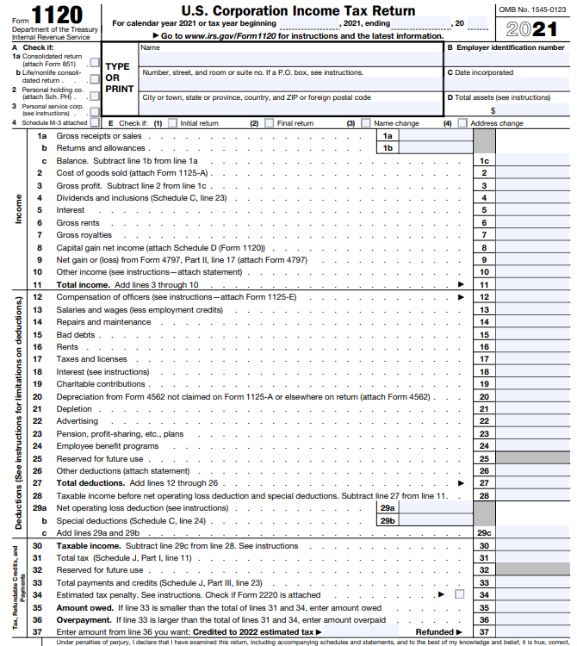

Slide 3
The following points must be given a great attention when determining the NOL of a corporation:
  A NOL carried forward from a previous tax year should not be deducted when computing the current NOL.
  Dividends-received deductions (DRD) limitations that apply when determining the corporation’s taxable income are disregarded when determining the NOL, if the deduction of the total DRD creates or increases the corporation’s NOL.
  The computation of NOLs should be made before any deduction for charitable contributions.
  A capital loss carried over from a previous year may be deducted against current year capital gains, when determining the current NOL.
  Example
Student or CPA Candidate?
www.farhatlectures.com

Slide 4
Example: For the current tax year, Mike Co. reported gross income of $250,000, which included capital gains of $45,000. In addition, Mike Co received dividend income, from XYZ Co., a 50 percent owned corporation, of $60,000. It also had operating losses of $270,000.
Determine Mike Co.’s NOL for the current year given that it had capital losses carried forward of $20,000.
Solution: In determining the current NOL, Mike Co may deduct the capital losses carried forward against the current capital gains.
In addition, Mike Co owns 50 percent of the stock of XYZ Co. Therefore, a deduction of 65% of the total dividend received from this corporation is allowed. It amounts to $60,000 x 0.65 = $39,000. The taxable income limitation does not apply as the corporation has a negative NOL after deducting the total DRD.
As a result, Mike’s NOL for the year equals:
Gross Income $250,000
- Capital Losses carried fwd ($20,000)
- Operating expenses ($270,000)
+ Dividend Income $60,000
- DRD ($39,000)
Current NOL ($19,000)
Student or CPA Candidate?
www.farhatlectures.com

Slide 5
NOL rules Changed Over the years
NOLs arising on or prior to December 31, 2017 (TCJA) can be carried back 2 years and carried forward 20 years (“old rules”).
  Deducted against up to 100 percent of taxable income before NOL deduction, regardless of the year to which they are carried forward.
NOLs arising after December 31, 2017 but on or before December 31, 2020 can be carried back 5 years and carried forward indefinitely.
  NOLs arising after December 31, 2017 and carried forward to 2018, 2019, and 2020 may be deducted against up to 100 percent of these years’ taxable income before NOL deduction.
  NOLs arising after December 31, 2017 and carried forward to 2021 onward, may be deducted against up to 80 percent of taxable income before NOL deduction.
NOLs arising after December 31, 2020 can not be carried back. They can be carried forward indefinitely (“new rules”).
  If the amount of the net operating loss carried forward is less than the computed limitation (80%), the entire loss is allowed as a deduction.
Anytime the carry back option is available, the taxpayer may elect not to carry back the net operating loss and just carry it forward.
  However, if the loss is carried back, it should be carried back to the oldest year in the carryback period first.
Student or CPA Candidate?
www.farhatlectures.com

Slide 6
Example: At the beginning of 2022, Adam Inc., a calendar year C corporation, asked for your support in preparing its schedule for net operating losses carryback and carryforward.
The corporation started its business in 2016, and the results of its operations for the period 2016-2021 were as follows:
2016: Income of $30,000
2017: Loss of ($60,000)
2018: Loss of ($32,000)
2019: Income of $42,000
2020: Income of $5,000
2021: Income of $10,000
Prepare the NOL schedule for Adam Inc.
Solution: The corporation reported NOLs in the years 2017 and 2018.
Losses from 2017 may be carried back 2 years and forward 20 years. However, losses from 2018 may be carried back 5 years and forward indefinitely.
Adam Inc. may carry back half of its 2017 NOL, to 2016. The other half is carried forward to 2019. On the other hand, the NOL loss of 2018 is carried forward to 2019, 2020, and 2021. However, the deduction against 2021 income is subject to the 80% limitation.
Next slide: Table presents the NOLs carryback and carryforward schedule:
Student or CPA Candidate?
www.farhatlectures.com

Slide 7
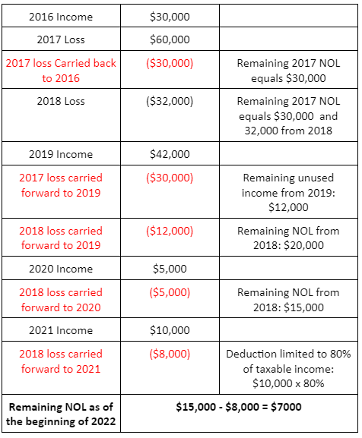
2016: Income of $30,000
2017: Loss of ($60,000)
2018: Loss of $(32,000)
2019: Income of $42,000
2020: Income of $5,000
2021: Income of $10,000
NOL effect in the carryforward year:
A net operating loss carried forward is accounted for as a regular business deduction.
Student or CPA Candidate?
www.farhatlectures.com

