Slide 1
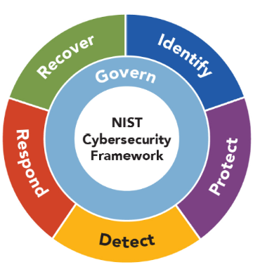

NIST Cybersecurity Framework
The NIST Cybersecurity Framework, developed by the National Institute of Standards and Technology (NIST), is a voluntary set of guidelines that helps organizations manage and reduce cybersecurity risk.
The framework is designed to be flexible and adaptable, allowing organizations to tailor it to their unique needs and risk profiles.
The framework consists of:
  six core functions
  profile and
  4 tiers
which together form a comprehensive approach to cybersecurity.
Lectures + MCQs @ farhatlectures.com ➔ Free Trial

Slide 2
NIST Big Picture
Core Functions:
Govern
  Categories (6)
    Subcategories
Identify
  Categories (3)
    Subcategories
Protect
  Categories (5)
    1. Subcategories
Detect
  Categories (2)
    Subcategories
Respond
  Categories (4)
    Subcategories
Recover
Profile
Target Profile
Current Profile
Gap Analysis
4 Tiers
Partial
Risk Informed
Repeatable
Adaptive
Lectures + MCQs @ farhatlectures.com ➔ Free Trial

Slide 3
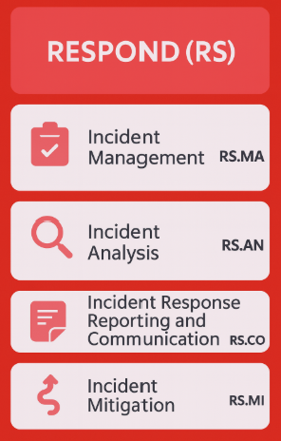
Respond (RS) Function
The Respond function encompasses activities designed to effectively manage and limit the impact of cybersecurity incidents once they occur.
  After the detect function
Organizations must have clear processes to detect, analyze, contain, and communicate incidents promptly and transparently.
  Minimize the impact
  Learn from the attack
Lectures + MCQs @ farhatlectures.com ➔ Free Trial

Slide 4
Incident Management (RS.MA)
Incident Management involves having defined and tested processes to handle cybersecurity incidents promptly and effectively.
  What to do after detecting?
  Do you have policies and procedures to respond?
This includes clear roles, responsibilities, and procedures for escalating incidents.
Example:
A financial services firm detects unauthorized access attempts on their internal database.
The Incident Management plan specifies immediate isolation of the compromised server, assigns IT staff responsibilities, activates an incident response team, and notifies the CIO to oversee the response.
Lectures + MCQs @ farhatlectures.com ➔ Free Trial

Slide 5
Incident Analysis (RS.AN)
Incident Analysis involves thorough investigation and evaluation of cybersecurity events to understand their scope, impact, root causes, and potential future risks.
  What happened? Why? And how we responded?
  Mitigation strategies and consequences?
  Did the detect function worked properly? Yes or no.
Example:
A retail company experiences a ransomware attack.
The cybersecurity team analyzes server logs, antivirus alerts, and firewall data to determine the malware's entry point, attack vector, affected assets, and scope. They document their findings to inform future protective measures.
Lectures + MCQs @ farhatlectures.com ➔ Free Trial

Slide 6
Incident Response Reporting and Communication (RS.CO)
Incident Response Reporting and Communication involves timely sharing of information about cybersecurity incidents to internal and external stakeholders, including regulatory authorities, affected customers, or partners.
  Role of people: Who should make the communication.
  Who needs to be informed and under what circumstances
  Are stackholders aware of what is happening?
Example:
An online retailer experiences a data breach compromising customer payment information.
The response team immediately informs senior management, legal counsel, regulatory authorities, and communicates transparently with customers, explaining the issue, the actions being taken, and measures to protect affected customers.
Lectures + MCQs @ farhatlectures.com ➔ Free Trial

Slide 7
Incident Mitigation (RS.MI)
Incident Mitigation involves actions taken to contain and reduce damage caused by cybersecurity incidents, minimizing negative effects on operations, assets, or stakeholders.
  Limit the incident from expending
  New identifies vulnerabilities are mitigated and documented
  Lesson learned
Example:
A healthcare provider experiences a phishing attack that leads to credential theft.
Mitigation actions include immediately disabling compromised accounts, resetting passwords for all users, applying security patches, and reinforcing staff training to prevent similar future incidents.
Lectures + MCQs @ farhatlectures.com ➔ Free Trial

Slide 8
Example Scenario Illustrating Entire RESPOND Function
A large accounting firm suffers a ransomware attack affecting its critical systems, locking users out of client data.
Incident Management: The incident response team is activated immediately, isolating affected servers.
Incident Analysis: Logs and alerts are reviewed to pinpoint initial access points, identifying a compromised employee workstation as the infection source.
Incident Response Reporting and Communication: Clients, regulatory bodies, and company executives are informed promptly, with clear, frequent updates provided.
Incident Mitigation: The firm restores services from secure backups, implements immediate cybersecurity measures such as software updates, increased endpoint protection, and stronger authentication controls.
Lectures + MCQs @ farhatlectures.com ➔ Free Trial

Slide 9
MCQ from farhatlectures.com
Following a cybersecurity attack involving customer data, a healthcare provider's incident response team promptly communicates the incident details to regulatory authorities, affected patients, and management. Which of the RESPOND function categories is illustrated by this action?
Incident Management
Incident Analysis
Incident Mitigation
Incident Response Reporting and Communication
(d) is correct because timely notification to stakeholders, regulators, and customers specifically falls under incident response reporting and communication.
Choice (a) is incorrect because incident management involves procedural and organizational management rather than external communication.
Choice (b) is incorrect because incident analysis focuses on technical evaluation, not communication.
Choice (c) is incorrect because incident mitigation involves actions to contain the event, not stakeholder communication.
Lectures + MCQs @ farhatlectures.com ➔ Free Trial

