Slide 1
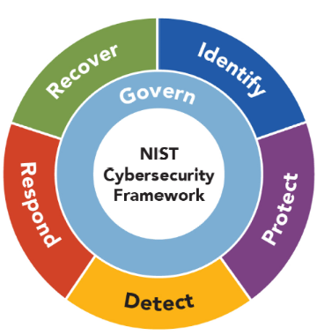

NIST Cybersecurity Framework
The NIST Cybersecurity Framework, developed by the National Institute of Standards and Technology (NIST), is a voluntary set of guidelines that helps organizations manage and reduce cybersecurity risk.
The framework is designed to be flexible and adaptable, allowing organizations to tailor it to their unique needs and risk profiles.
The framework consists of:
  six core functions
  profile and
  4 tiers
which together form a comprehensive approach to cybersecurity.
Lectures + MCQs @ farhatlectures.com ➔ Free Trial

Slide 2
NIST Big Picture
Core Functions:
Govern
  Categories (6)
    Subcategories
Identify
  Categories (3)
    Subcategories
Protect
  Categories (5)
    1. Subcategories
Detect
Respond
Recover
Profile
Target Profile
Current Profile
Gap Analysis
4 Tiers
Partial
Risk Informed
Repeatable
Adaptive
Lectures + MCQs @ farhatlectures.com ➔ Free Trial

Slide 3
PROTECT (PR) Function
The PROTECT (PR) function within the NIST Cybersecurity Framework focuses on the proactive steps an organization takes to safeguard its assets and reduce or mitigate the potential impacts of cybersecurity incidents.
The core idea behind this function is to create multiple layers of defense to effectively manage risks and ensure that critical systems and data remain secure.
Lectures + MCQs @ farhatlectures.com ➔ Free Trial

Slide 4
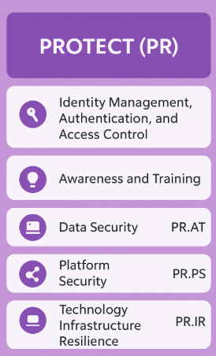
1. Identity Management, Authentication, and Access Control (PR.AA)
This category involves controlling who can access specific systems and data within an organization.
Proper management ensures users only have access to information necessary for their role, thus minimizing unauthorized access and internal threats.
  Logical, physical or remote (TBD)…Least privilege access
Example:
A company implements multi-factor authentication (MFA), requiring employees to use both passwords and biometric verification (such as fingerprints or facial recognition) to log into sensitive systems.
Lectures + MCQs @ farhatlectures.com ➔ Free Trial

Slide 5
2. Awareness and Training (PR.AT)
Critical!
Awareness and training programs educate employees and stakeholders about cybersecurity threats, policies, and their responsibilities.
Regular training helps prevent security incidents by preparing individuals to recognize and respond appropriately to potential threats. Are you privilege user? Senior executive
3rd party: Suppliers, partners even customers
Example:
A financial institution regularly conducts phishing email simulations and cybersecurity workshops to teach employees how to identify and avoid common cyber threats like phishing attacks and social engineering.
Lectures + MCQs @ farhatlectures.com ➔ Free Trial

Slide 6
3. Data Security (PR.DS)
This area includes methods and techniques to protect the confidentiality, integrity, and availability of information.
It encompasses data encryption, data classification, secure backups, and data retention policies.
Data at rest, data in transit. TBD.
Enough capacity and protection against leaks.
Example:
A healthcare provider encrypts patient records both at rest (stored) and in transit (when transmitted between systems), ensuring confidentiality even if unauthorized access occurs.
Lectures + MCQs @ farhatlectures.com ➔ Free Trial

Slide 7
4. Platform Security (PR.PS)
Platform security covers the protection of the hardware and software platforms that host information systems.
This includes configuration management, vulnerability scanning, and applying security patches promptly.
Example:
An online retailer regularly updates its server operating systems and applies security patches to mitigate vulnerabilities that could be exploited by cybercriminals.
Lectures + MCQs @ farhatlectures.com ➔ Free Trial

Slide 8
5. Technology Infrastructure Resilience (PR.IR)
This focuses on maintaining and securing the infrastructure necessary to ensure systems remain operational and resilient against disruptions, failures, or cyber-attacks.
This involves redundancy, disaster recovery planning, and system reliability improvements.
Example:
A large cloud service provider deploys geographically dispersed data centers with backup systems to ensure continuous availability of critical customer applications, even if one facility experiences a disruption or attack.
Lectures + MCQs @ farhatlectures.com ➔ Free Trial

Slide 9
MCQ from farhatlectures.com
Capstone Bank has implemented several cybersecurity measures. Recently, an unauthorized access incident occurred due to compromised employee login credentials. Management wants to strengthen their security framework to prevent similar incidents. Which measure would provide the strongest improvement?
(a) Implementing multi-factor authentication (MFA)
(b) Increasing frequency of data backups
(c) Enhancing disaster recovery plans
(d) Conducting annual employee training sessions
Lectures + MCQs @ farhatlectures.com ➔ Free Trial

