Slide 1
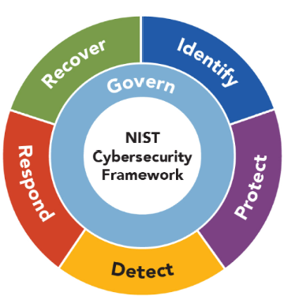

NIST Cybersecurity Framework
The NIST Cybersecurity Framework, developed by the National Institute of Standards and Technology (NIST), is a voluntary set of guidelines that helps organizations manage and reduce cybersecurity risk.
The framework is designed to be flexible and adaptable, allowing organizations to tailor it to their unique needs and risk profiles.
The framework consists of:
  six core functions
  profile and
  4 tiers
which together form a comprehensive approach to cybersecurity.
Lectures + MCQs @ farhatlectures.com ➔ Free Trial

Slide 2
NIST Big Picture
Core Functions:
Govern
  Categories (6)
    Subcategories
Identify
  Categories (3)
    Subcategories
Protect
Detect
Respond
Recover
Profile
Target Profile
Current Profile
Gap Analysis
4 Tiers
Partial
Risk Informed
Repeatable
Adaptive
Lectures + MCQs @ farhatlectures.com ➔ Free Trial

Slide 3
Identify (ID) Function: Overview
The Identify (ID) function provides the foundational understanding necessary to manage cybersecurity risk effectively.
  It involves a comprehensive assessment of the organization's cybersecurity posture by clearly defining assets, evaluating risks, and identifying improvement opportunities to protect these assets.
Purpose of the Identify (ID) Function:
Clarify Understanding: Establishes clarity around the organization's critical assets, including hardware, software, data, personnel, and external suppliers. $$
Risk Insight: Identifies potential cybersecurity threats and vulnerabilities that could impact those critical assets.
Foundation for Strategy: Serves as the initial step to effectively manage cybersecurity risks through informed policies, processes, and improvement practices.
Lectures + MCQs @ farhatlectures.com ➔ Free Trial

Slide 4
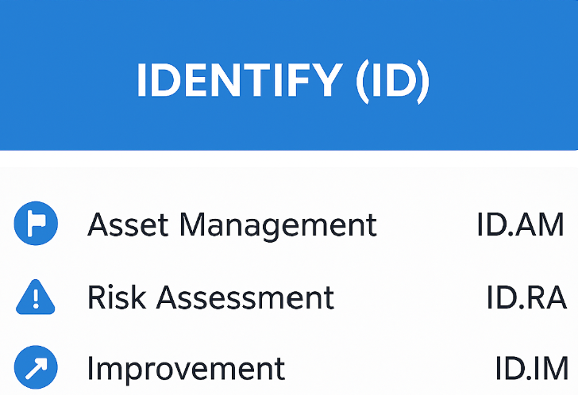
Asset Management (ID.AM)
  Definition: Identifying and managing the organization's key assets to protect them from cybersecurity risks.
  Includes:
    Inventorying hardware and software assets.
    Understanding how data flows within the organization and between external entities.
    Classifying data based on criticality and sensitivity.
  Example:
    A hospital maintains a detailed inventory of all medical devices connected to its network, including model numbers, firmware versions, and data transmission routes to ensure security measures effectively address all assets.
Lectures + MCQs @ farhatlectures.com ➔ Free Trial

Slide 5
Risk Assessment (ID.RA)
Definition: Analyzing the cybersecurity threats, vulnerabilities, and potential impacts to the organization’s operations and assets. Predicting.
Includes:
  Regular assessment of threats (e.g., malware, insider threats, external attacks).
  Evaluation of vulnerabilities within organizational processes, infrastructure, or third-party interactions.
  Understanding the potential impact on business continuity and organizational reputation if a threat materializes.
Example:
  A financial services firm conducts regular penetration tests and vulnerability scans on its web-based applications to identify weaknesses that could expose sensitive customer data to hackers.
Lectures + MCQs @ farhatlectures.com ➔ Free Trial

Slide 6
Improvement (ID.IM)
Definition: Continuously identifying, prioritizing, and implementing improvements in cybersecurity risk management processes and practices.
Includes:
  Regularly reviewing and refining cybersecurity policies.
  Addressing gaps identified during risk assessments and audits.
  Implementing corrective actions based on lessons learned from incidents and emerging threats.
Example:
  After experiencing a phishing attack, a technology company implements additional email filtering software, conducts employee cybersecurity awareness training, and updates its incident response plan based on the insights gained from the attack.
Lectures + MCQs @ farhatlectures.com ➔ Free Trial

Slide 7
MCQ from farhatlectures.com
A healthcare provider recently identified unauthorized devices connected to its network. As part of enhancing cybersecurity, the management team decides to formalize their asset management processes. Which of the following actions aligns BEST with the Asset Management (ID.AM) category?
(a) Conduct periodic penetration testing
(b) Maintain an up-to-date inventory of all network-connected hardware and software
(c) Implement a policy restricting USB drives
(d) Provide employee cybersecurity awareness training
Choice (b) is correct because maintaining a current and comprehensive inventory of hardware and software assets is essential for asset management (ID.AM) to track and manage cybersecurity effectively.
Choice (a) is incorrect because penetration testing relates to Risk Assessment (ID.RA), not Asset Management directly.
Choice (c) is incorrect because it involves preventative policy measures rather than asset identification and management.
Choice (d) is incorrect because employee training falls under Improvement and general cybersecurity awareness rather than specifically identifying assets.
Lectures + MCQs @ farhatlectures.com ➔ Free Trial

