Slide 1
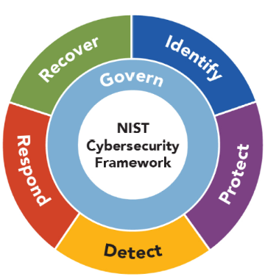

NIST Cybersecurity Framework
The NIST Cybersecurity Framework, developed by the National Institute of Standards and Technology (NIST), is a voluntary set of guidelines that helps organizations manage and reduce cybersecurity risk.
The framework is designed to be flexible and adaptable, allowing organizations to tailor it to their unique needs and risk profiles.
The framework consists of:
  six core functions
  profile and
  4 tiers
which together form a comprehensive approach to cybersecurity.
Lectures + MCQs @ farhatlectures.com ➔ Free Trial

Slide 2
NIST Big Picture
Core Functions:
Govern
  Categories (6)
    Subcategories
Identify
  Categories (3)
    Subcategories
Protect
  Categories (5)
    1. Subcategories
Detect
  Categories (2)
    Subcategories
Respond
Recover
Profile
Target Profile
Current Profile
Gap Analysis
4 Tiers
Partial
Risk Informed
Repeatable
Adaptive
Lectures + MCQs @ farhatlectures.com ➔ Free Trial

Slide 3
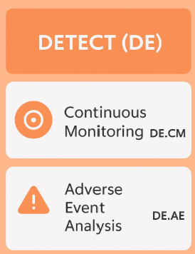
Detect (DE) Function
The Detect (DE) function is a core component of the NIST Cybersecurity Framework (CSF), emphasizing the timely identification and understanding of cybersecurity events or incidents through comprehensive observation, detection, and analysis practices.
The primary objective of the Detect function is early identification of potential cybersecurity incidents, allowing organizations to respond swiftly to mitigate or prevent further damage.
Early detection reduces overall risk exposure, minimizes financial and reputational harm, and ensures continuity of operations.
Lectures + MCQs @ farhatlectures.com ➔ Free Trial

Slide 4
Continuous Monitoring (DE.CM)
Continuous monitoring involves the systematic tracking and logging of cybersecurity activities and events, using automated tools and processes.
This real-time monitoring ensures timely detection of anomalies and unusual behavior.
Examples of Continuous Monitoring:
  Network traffic analysis:
  Using tools like intrusion detection systems (IDS) or intrusion prevention systems (IPS) to continuously monitor network traffic for malicious or abnormal activities, such as unauthorized access or data exfiltration attempts.
  Endpoint detection and response (EDR):
  Real-time monitoring of endpoints (computers, servers, mobile devices) to identify suspicious behaviors, malware, or compromised systems.
  User behavior analytics (UBA):
  Analyzing patterns of user activities to detect deviations from established norms, such as unusual login times or data access attempts.
Lectures + MCQs @ farhatlectures.com ➔ Free Trial

Slide 5
Adverse Event Analysis (DE.AE)
Adverse event analysis involves the examination of cybersecurity events to identify the root causes, assess their significance, and understand their implications.
This analysis provides insight into potential compromises or malicious activity within an organization's network.
Examples of Adverse Event Analysis:
  Malware analysis:
  Performing in-depth examinations of detected malware to determine its origin, intent, and capabilities, enabling appropriate defensive responses.
  Forensic investigation:
  Conducting digital forensics to analyze the timeline, methods, and impact of an incident, providing a clear understanding for future prevention and remediation.
  Incident correlation:
  Combining different data points and logs (firewall logs, antivirus alerts, authentication logs) to correlate seemingly isolated events and uncover a coordinated cybersecurity incident.
Lectures + MCQs @ farhatlectures.com ➔ Free Trial

Slide 6
Importance of the Detect Function
Proactive security: Allows businesses to identify and neutralize threats before significant damage occurs.
Compliance: Helps organizations meet regulatory obligations by maintaining audit trails and documenting detection efforts.
Improved response: Early detection translates to quicker and more efficient incident response and recovery actions.
Informed decision-making: Provides valuable insights through the continuous analysis of security data, improving future cybersecurity strategy.
Lectures + MCQs @ farhatlectures.com ➔ Free Trial

Slide 7
MCQ from farhatlectures.com
An online retail company observes repeated transactions being declined due to incorrect CVV codes across numerous customer accounts simultaneously. The cybersecurity team suspects fraudulent activity.
Which action represents the best adverse event analysis procedure to perform initially?
(a) Notify your local law enforcement cybersecurity body.
(b) Conduct forensic analysis to identify patterns and correlations in transaction attempts.
(c) Immediately suspend all online transactions indefinitely.
(d) Reset customer passwords and inform them to update their payment methods.
Lectures + MCQs @ farhatlectures.com ➔ Free Trial

