Slide 1

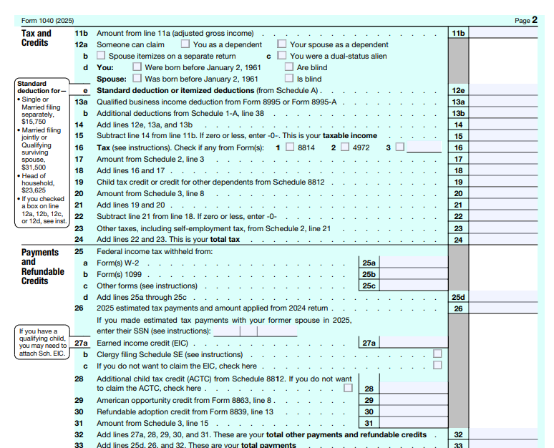
📹 Videos AICPA MCQs & Sims 🤖 Farhat AI Assistant🎙 Podcast Lessons 📊 CPA, CMA, EA Exam 💼Accounting & Finance Courses 🙌 Support by Farhat Team
🌐 farhatlectures.com | ⭐ Start Your Free Trial

Slide 2
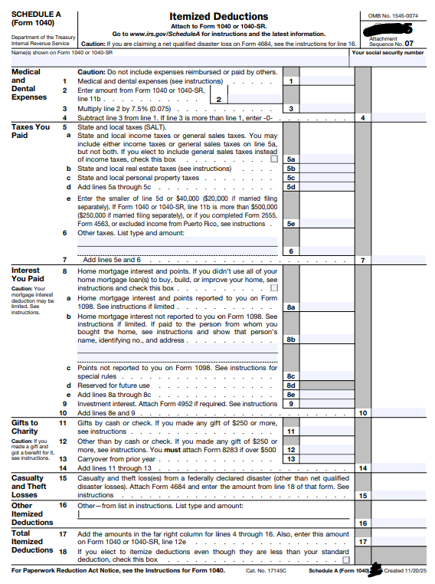
📹 Videos AICPA MCQs & Sims 🤖 Farhat AI Assistant🎙 Podcast Lessons 📊 CPA, CMA, EA Exam 💼Accounting & Finance Courses 🙌 Support by Farhat Team
🌐 farhatlectures.com | ⭐ Start Your Free Trial

Slide 3

Itemized Deductions Schedule A
Itemized Deductions (from AGI) included a range of expenses, including non-trade business expenses (such as employee and investment expenses), as well as certain personal expenses that can be deducted.
These deductions are subject to individual limits and must collectively exceed the standard deduction before any tax benefit can be obtained.
  Medical and dental expenses
  Specific state and local Income Taxes (SALT)
  Interest paid on mortgages and investments
  Charitable contributions
  Miscellaneous expenses (employee and investment expenses)
  Casualty and Theft Loss
📹 Videos AICPA MCQs & Sims 🤖 Farhat AI Assistant🎙 Podcast Lessons 📊 CPA, CMA, EA Exam 💼Accounting & Finance Courses 🙌 Support by Farhat Team
🌐 farhatlectures.com | ⭐ Start Your Free Trial

Slide 4

Deductible Interest
Interest is the cost paid for borrowing money.
  The tax law encourages homeownership by allowing a deduction for certain mortgage interest.
Most taxpayers do not itemize deductions until they purchase a primary residence.
The primary component of deductible interest for individuals is qualified home mortgage interest on a personal residence.
The main types of interest that deductible for individuals on schedule A are:
  Mortgage interest on a personal residence, and
  Investment interest (subject to specific limitations).
Interest related to a trade, business, or income-producing activity remains deductible, but these deductions are for AGI and are reported on the appropriate schedules (Schedule C, Schedule E, or Schedule F), not on Schedule A.
📹 Videos AICPA MCQs & Sims 🤖 Farhat AI Assistant🎙 Podcast Lessons 📊 CPA, CMA, EA Exam 💼Accounting & Finance Courses 🙌 Support by Farhat Team
🌐 farhatlectures.com | ⭐ Start Your Free Trial

Slide 5

Mortgage Interest and Home Equity Loans
Qualified residence interest generally includes interest paid on debt secured by a qualified residence (a principal residence and, in limited cases, a second residence).
  To be deductible, the loan must be secured by the residence.
Acquisition indebtedness refers to debt used to buy, build, or substantially improve a qualified residence.
If a loan is not secured by the residence, the related interest does not qualify as deductible mortgage interest, even if the funds are used for home improvements.
📹 Videos AICPA MCQs & Sims 🤖 Farhat AI Assistant🎙 Podcast Lessons 📊 CPA, CMA, EA Exam 💼Accounting & Finance Courses 🙌 Support by Farhat Team
🌐 farhatlectures.com | ⭐ Start Your Free Trial

Slide 6

Limits and Key Rules for
Deductible Mortgage Interest
Taxpayers may deduct qualified residence interest on a principal residence and one additional residence.
The Tax Cuts and Jobs Act temporarily reduced the acquisition indebtedness limit to 750,000; the One Big Beautiful Bill Act (OBBBA) now makes this 750,000 (375,000 MFS) cap permanent for post‑2017 acquisition debt.
The Tax Cuts and Jobs Act introduced limits on the amount of acquisition indebtedness that qualifies for the interest deduction.
Refinanced debt continues to qualify as acquisition indebtedness only to the extent it does not exceed the original loan balance.
Interest on debt exceeding the allowable acquisition indebtedness limit is not deductible.
📹 Videos AICPA MCQs & Sims 🤖 Farhat AI Assistant🎙 Podcast Lessons 📊 CPA, CMA, EA Exam 💼Accounting & Finance Courses 🙌 Support by Farhat Team
🌐 farhatlectures.com | ⭐ Start Your Free Trial

Slide 7

Example
Limits and Key Rules
A married couple incurs $600,000 of acquisition debt to purchase and substantially improve their principal residence.
In a later year, they purchase a second home and borrow an additional $200,000 to improve that property.
Their total acquisition indebtedness is therefore $800,000.
Because the mortgage interest deduction is limited to interest on $750,000 of acquisition indebtedness for married taxpayers filing jointly, interest is deductible only on the first $750,000 of the combined debt. The interest attributable to the excess $50,000 of acquisition indebtedness is not deductible.
📹 Videos AICPA MCQs & Sims 🤖 Farhat AI Assistant🎙 Podcast Lessons 📊 CPA, CMA, EA Exam 💼Accounting & Finance Courses 🙌 Support by Farhat Team
🌐 farhatlectures.com | ⭐ Start Your Free Trial

Slide 8

Home Equity Loans and HELOCs
Interest on home equity loans, second mortgages, or lines of credit may be deductible based on how the loan proceeds are used, not how the loan is labeled.
To qualify, the debt must be secured by a qualified residence and used for acquisition or substantial improvement of that residence.
Interest is not deductible if home equity proceeds are used for personal expenses such as education, living costs, or credit card payments.
The combined balance of acquisition debt and qualifying home equity debt cannot exceed the statutory acquisition debt limit.
Home equity loans and HELOCs are subject to the same interest deduction rules, even though their interest rates may be structured differently.
📹 Videos AICPA MCQs & Sims 🤖 Farhat AI Assistant🎙 Podcast Lessons 📊 CPA, CMA, EA Exam 💼Accounting & Finance Courses 🙌 Support by Farhat Team
🌐 farhatlectures.com | ⭐ Start Your Free Trial

Slide 9
Limits and Key Rules
Home Equity Loan
Alex purchased a home several years ago for $600,000.
The outstanding acquisition debt on the residence is $520,000, and the home currently has a fair market value of $620,000. As a result, Alex’s equity in the home is $100,000 ($620,000 FMV − $520,000 debt).
Alex may borrow against this equity using a home equity loan.
As long as the combined debt on the residence does not exceed the $750,000 acquisition debt limit, and the loan proceeds are used to substantially improve the residence, the related interest may be deductible.
However, lenders typically restrict borrowing to a percentage of the available equity rather than the full equity amount.
📹 Videos AICPA MCQs & Sims 🤖 Farhat AI Assistant🎙 Podcast Lessons 📊 CPA, CMA, EA Exam 💼Accounting & Finance Courses 🙌 Support by Farhat Team
🌐 farhatlectures.com | ⭐ Start Your Free Trial

Slide 10

Mortgage Points
Mortgage points are upfront charges paid to obtain a mortgage, commonly referred to as loan origination fees, discount points, or loan processing fees.
Points are typically stated as a percentage of the loan principal.
Points paid in connection with the purchase of a principal residence or home improvement to be deducted in full in the year paid, provided specific requirements are met.
📹 Videos AICPA MCQs & Sims 🤖 Farhat AI Assistant🎙 Podcast Lessons 📊 CPA, CMA, EA Exam 💼Accounting & Finance Courses 🙌 Support by Farhat Team
🌐 farhatlectures.com | ⭐ Start Your Free Trial

Slide 11

Deductibility Requirements and Special Situations
To deduct points currently, all of the following conditions must be satisfied:
  The loan must be secured by the taxpayer’s principal residence.
  The points must be computed as a percentage of the loan amount.
  Charging points must be a common business practice in the geographic area.
  The points must be paid directly by the taxpayer and shown clearly on the settlement statement.
Points paid in connection with refinancing are generally deducted over the loan term, not immediately.
If a loan is repaid early, any remaining unamortized points become deductible in the year the debt is paid off.
📹 Videos AICPA MCQs & Sims 🤖 Farhat AI Assistant🎙 Podcast Lessons 📊 CPA, CMA, EA Exam 💼Accounting & Finance Courses 🙌 Support by Farhat Team
🌐 farhatlectures.com | ⭐ Start Your Free Trial

Slide 12
Points Paid for Home
Improvement Loan
Sophia and Daniel purchased their principal residence several years ago. In the current year, they borrow $90,000 from a local bank to substantially improve the home.
As part of the loan agreement, they pay 1% in loan origination points, totaling $900.
Because the loan proceeds are used to substantially improve their principal residence, the points are treated as qualified residence interest.
The $900 in points is deductible in the year paid, assuming all other deductibility requirements are met.
Points Paid on a Refinancing
Assume the same facts except that instead of borrowing additional funds, Sophia and Daniel refinance their existing mortgage, which has an outstanding balance of $260,000.
They obtain a new 30-year loan at a lower interest rate and pay 1.5% in points, or $3,900.
Because the points are paid in connection with a refinancing, the points are not deductible in full in the year paid.
Instead, the $3,900 must be deducted ratably over the 30-year loan term, unless the loan is later paid off early.
📹 Videos AICPA MCQs & Sims 🤖 Farhat AI Assistant🎙 Podcast Lessons 📊 CPA, CMA, EA Exam 💼Accounting & Finance Courses 🙌 Support by Farhat Team
🌐 farhatlectures.com | ⭐ Start Your Free Trial

Slide 13

Mortgage Insurance Premium
A mortgage insurance premium is the extra amount you pay for insurance that protects the lender (not you) if you default on your mortgage
Mortgage insurance is required when the lender is taking more risk, typically because you made a small down payment or are using an FHA/VA/USDA‑type loan program.
Under OBBBA, qualified mortgage insurance premiums (PMI) related to home acquisition debt are treated as qualified residence interest and may be deducted on Schedule A.
The deduction phases out by 10% for each 1,000 (500 MFS) of AGI above 100,000 (50,000 MFS) and is fully phased out once AGI exceeds 109,000 (54,500 MFS).
📹 Videos AICPA MCQs & Sims 🤖 Farhat AI Assistant🎙 Podcast Lessons 📊 CPA, CMA, EA Exam 💼Accounting & Finance Courses 🙌 Support by Farhat Team
🌐 farhatlectures.com | ⭐ Start Your Free Trial

Slide 14

Investment Interest
Investment interest is interest paid on debt used to purchase or carry property held for investment, such as stocks, bonds, or investment land.
Investment interest expense is deductible only to the extent of net investment income.
This deduction is an itemized deduction and is reported on Schedule A.
If investment interest expense exceeds net investment income for the year, the excess cannot be deducted currently.
📹 Videos AICPA MCQs & Sims 🤖 Farhat AI Assistant🎙 Podcast Lessons 📊 CPA, CMA, EA Exam 💼Accounting & Finance Courses 🙌 Support by Farhat Team
🌐 farhatlectures.com | ⭐ Start Your Free Trial

Slide 15

Net Investment Income and Carryforward?
Net investment income generally includes taxable interest, nonqualified dividends, and certain other investment income.
Capital gains are normally excluded from net investment income unless the taxpayer elects to treat them as such.
Any investment interest expense disallowed in the current year is carried forward indefinitely until sufficient investment income is available.
The allowable investment interest deduction is calculated and reported using Form 4952.
📹 Videos AICPA MCQs & Sims 🤖 Farhat AI Assistant🎙 Podcast Lessons 📊 CPA, CMA, EA Exam 💼Accounting & Finance Courses 🙌 Support by Farhat Team
🌐 farhatlectures.com | ⭐ Start Your Free Trial

Slide 16
Example
Olivia borrows $30,000 to purchase shares of stock held solely for investment purposes. During the year, she pays $1,800 of interest on the loan.
Olivia’s net investment income for the year consists of $1,200 of taxable interest and nonqualified dividends.
Because investment interest expense is deductible only up to net investment income, Olivia may deduct $1,200 of the investment interest in the current year.
The remaining $600 of investment interest expense is carried forward and may be deducted in a future year when additional net investment income is available.
📹 Videos AICPA MCQs & Sims 🤖 Farhat AI Assistant🎙 Podcast Lessons 📊 CPA, CMA, EA Exam 💼Accounting & Finance Courses 🙌 Support by Farhat Team
🌐 farhatlectures.com | ⭐ Start Your Free Trial

Slide 17

MCQ from farhatlectures.com
A married couple filing jointly incurs acquisition debt of $650,000 to purchase their principal residence. In a later year, they borrow an additional $150,000 to improve a second home. Both loans qualify as acquisition indebtedness.
How much of the combined acquisition debt may be used to calculate deductible mortgage interest?
A. $650,000
B. $750,000
C. $800,000
D. $900,000
The mortgage interest deduction for married taxpayers filing jointly is limited to interest on $750,000 of acquisition indebtedness.
Even though both loans qualify as acquisition debt, the combined balance exceeds the statutory limit.
Interest is deductible only on the first $750,000 of qualifying debt.
📹 Videos AICPA MCQs & Sims 🤖 Farhat AI Assistant🎙 Podcast Lessons 📊 CPA, CMA, EA Exam 💼Accounting & Finance Courses 🙌 Support by Farhat Team
🌐 farhatlectures.com | ⭐ Start Your Free Trial

